Slide 1

EO – ElasticObjects
A
Bean Call Approach
FOR
Computer Services

Slide 2

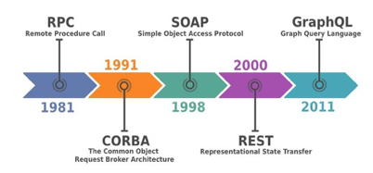
Service Oriented Architecture
When preparing these slides I‘ve found this nice diagram in a discussion REST/SOAP vs. GraphQL.
Not part of this diagram are the unnumerous solutions for „JSON-APIs“ defining it‘s own rule set.
https://www.quora.com/Is-GraphQL-a-REST-killer?q=GraphQl%20
https://en.wikipedia.org/wiki/API
https://en.wikipedia.org/wiki/Remote_procedure_call
https://www.infoq.com/presentations/history-api/

Slide 3
SOAP and REST
Don‘t want to get to deep into some comparision. Basically SOAP and REST define some binding of an URL to a server method with a strong typed input and output.
When it comes to build up a client side solution one quickly find oneself in a situation, where one has to combine several request.
One is stuck into a 50 year old concept creating microservices today.

Slide 4
GraphQL
When it comes to database service, GraphQL offers a graph format for generic input messages. The graph format fits better to create individual query messages by one endpoint.
This flexibility is within the rules of the input message. The input of the method is GraphQL and the output is in JSON.

Slide 5
The Shopping Bag Concept
The concept I would like to introduce is a JSON message triggering the instantiation of call objects.
It uses also a generic endpoint. It has a JSON input. The output is same JSON modified by the calls.
Type annotations could be set in every node of the input. These call types use a node as input. And the store a result in another node.
It‘s like a shopping bag, where the calls are the shopping list.

Slide 6

Typed JSON
EO is a Java implemention of some simple rules for JSON:
type information is embedded in front of a field name „(AnObject)name“:{...}
field names starting with „_“ are not mapped to the parent object.
EO gather special call types in a list. These „Call“ types has a sourcePath for the input and a targetPath for the result. The list can be executed.

Slide 7
Pseudo Request
An pseudo JSON message, where „ACall“ uses the source „Anobject“ as input:
{
„(AnObject)source“:{
“key1“:value1,
„key2“:value2, ... ,
“keyN“: valueN
}
„(ACall)target“:{
„sourcePath“:“source“,
“callKey1“, callValue1, ...,
“callKeyM“, callValueM
}
}

Slide 8
Pseudo Response
The pseudo JSON response message is basically the same as the request, beside the call is replaced by the call result.
{
„(AnObject)source“:{
“key1“: value1,
„key2“: value2,
...
“keyN“: valueN
}
„(AnOtherObject)target“:{
“otherKey1“: otherValue1,
„otherKey2“: otherValue2,
...
“otherKeyO“: otherValueO
}
}

Slide 9
Functionality is provided not by a method with input and output parameters.
Functionality is provided by instanciation an object with a generic execute method.

Slide 10
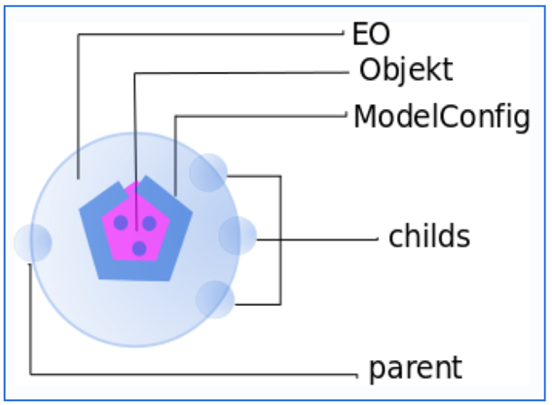
What is Elastic Objects
EO is a tiny generic „skin“ for (Java) objects
EO is an object wrapper like Optional.
EO knows its parent wrapper and so its root.
EO knows its child wrapper
It accesses the object via a model configuration
It offers path pattern methods

Slide 11
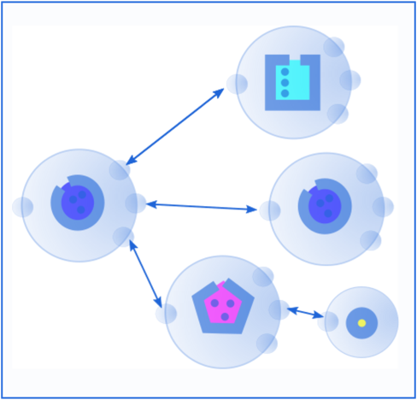
The Object “Skeleton“
EO wraps each member of the object tree skeleton.

Slide 12
Usages in Java
Model configuration and cache.
Creating EO root with configuration cache
Accessing objects in java via path
Accessing EO in java via path
Typed JSON serialization
Adding Calls in java
Other Calls

Slide 13

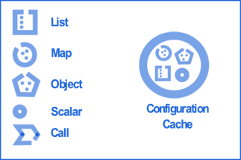
Configuration Cache
The EOConfigsCache is just a class with an empty constructor. It could be initialized in a java context.
This command loads available configuration files from the class path.
It could be loaded static or as a singelton in a dependency injection environment.
EOConfigCache cache = new EOConfigsCache();

Slide 14

Configuration Files
EO core configuration:
ModelConfig.json
FieldConfig.json
Models.json (list of classes with classpath)
Call configurations
HostConfig.json
FileConfig.json
DbSqlConfig.json

Slide 15
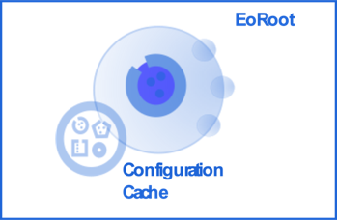
EORoot
Each EO object starts with a root object.
A new root EO must be created with the configuration cache.
Without object parameter an empty LinkedHashMap is created within.
EO eoRoot = new EoRoot(configCache);

Slide 16
EORoot with Object
If one create a new root EO with an object as parameter, all subsequent values will be wrapped.
The object determines, which ModelConfig will be added to access the object.
In this case it would the ModelConfig with class „AnObject“.
EO eoRoot = new EoRoot(configCache, anObject);

Slide 17
EORoot with Object
If one create a new EO root with an object as parameter, all subsequent values will be wrapped.
The object determines, which ModelConfig will be added to access the object.
In this case it would the ModelConfig with class „AnObject“.
EO eoRoot = new EoRoot(configCache, anObject);

Slide 18
Add an Object via path
This creates an object with three LinkedHashMaps
This is equivalent to some native java code:
EO child = eoRoot.set(anObject, "a/b/c“);
EO child = eoRoot.set(anObject, "a", "b", "c");
map.put("a", new LinkedHashMap());
map.get("a").put("b", new LinkedHashMap());
map.get("a").get("b").put(new LinkedHashMap());
map.get("a").get("b").get("c").put(anObject);

Slide 19
So Far?
So far there is nothing exciting. Accessing, creating or modifying an object via path is a nice feature when one work with java. It‘s simply a tool to manipule objects. These methods could simplify conversion or comparision of objects.

Slide 20
Navigation through EO object
On any level the objects hierarchy is wrapped with an eo-object. one can get the EO object also via a path.
But from any point we can get to the root when starting with a slash
And we can go back from the child with two points.
EO child = eoRoot.getEO("a/b/c");
EO same = eoRoot.getEo("a","b","c");
EO childA = child.getEo("/a");
EO childB = child.getEo("..");

Slide 21
Typesafe Serializing
For the serialization there is a special class:
This creates something like this:
String typedJson = new EOToJSON.toJSON(eoRoot)
{
"a": {
"b": {
"(AnObject)c":{...}
}
}
}

Slide 22
Typesafe Deserialization
We can create a new EO object from this JSON String:
And it's value is typed again:
EO newEoRoot = new EORoot(configCache, typedJson)
AnObject anObject = eoRoot.get("a/b/c“);

Slide 23
Type Safety
So far we have a generic object with path to navigate through to embed typed object. These objects can be serialized and deserialized without loosing embedded type information.

Slide 24
Calls
Since the objects are generic with each sub element, one can define generic methods to offer some funcionalities.
In Elastic objects there is the class "Calls" with an execute method:
public SomeCall extends CallImpl implements Call {
....
public Object execute(EO eo) {
....
}
}

Slide 25
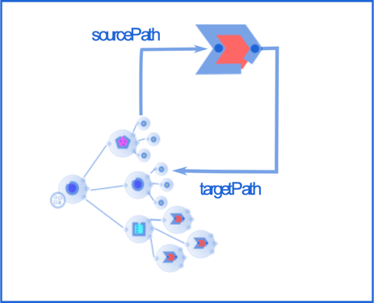
Calls
A call has as equivalent to an input value a sourcePath.
And as a equivalent to an output value a targetPath.

Slide 26
Simple Calls
There are really simple calls like SinusValueCall. In a java context one can just use the calls straight forward:
Obviously a direct call of Math.sinus is shorter.
EO eoRoot = new EoRoot(configsCache);
eoRoot.set(1.0, "abc");
Call call = new ValueSinusCall()
.setSourcePath("abc")
.setTargetPath("xyz");
Double result = (Double)call.execute(eoRoot);
Assertions.assertThat(eoRoot.get("xyz").isEqualTo(result);

Slide 27
Combination of Calls
The advantage comes from adding several calls to EO, which could also be done by some remote client
Or it could come from a remote client:
EO = new new EoRoot(configsCache);
eoRoot.addCall(call1);
eoRoot.addCall(call2);
....
eoRoot.addCall(callN);
eoRoot.execute();
{
...
„target1“:{(CALL1)source1“:{...}},
„target2“:{(CALL2)source2“:{...}},
....
„targetn“:{(CALLn)sourceN“:{...}},
}

Slide 28
Configured Calls
When it comes to calls, where a server resource like a file or a database is involved, there is a configuration involved similar to the model configuration.
These resource configuration offers methods to provide the information to the call object and some role access permissions
A file configuration for example contains information where the file is located.

Slide 29
File Calls
The file calls using different configurations depending on the content.
The FileConfig for example offers a read method to return a String, where as the ScsConfig read method returns a list.
Other call/configurations in separate modules are
CsvReadCall/CsvConfig
XlsxReadCall/XlsxConfig

Slide 30

Template Calls
A special call is the TemplateCall. It parses an arbitrary text file for calls within.
With this call one can build a hierarchical calling structure whereas in JSON it‘s just a list.

Slide 31
Db Calls and Configuration
The DB calls are in a very early stage just to make the example on www.elasticobject.org work.
They are in a separate module.

Slide 32
Sources and Documentation
In the sources are available https://github.com/fluentcodes/elasticobjects.
You can find more information on http://www.elasticobjects.org/ with a lot of interactive examples.
The deployed artifacts you find on https://mvnrepository.com/artifact/org.fluentcodes.projects.elasticobjects

Slide 33
Questions
....

