Slide 1
DECORATORS DECODED
the meaning of @fun
A gentle introduction to
Python metaprogramming

Slide 2
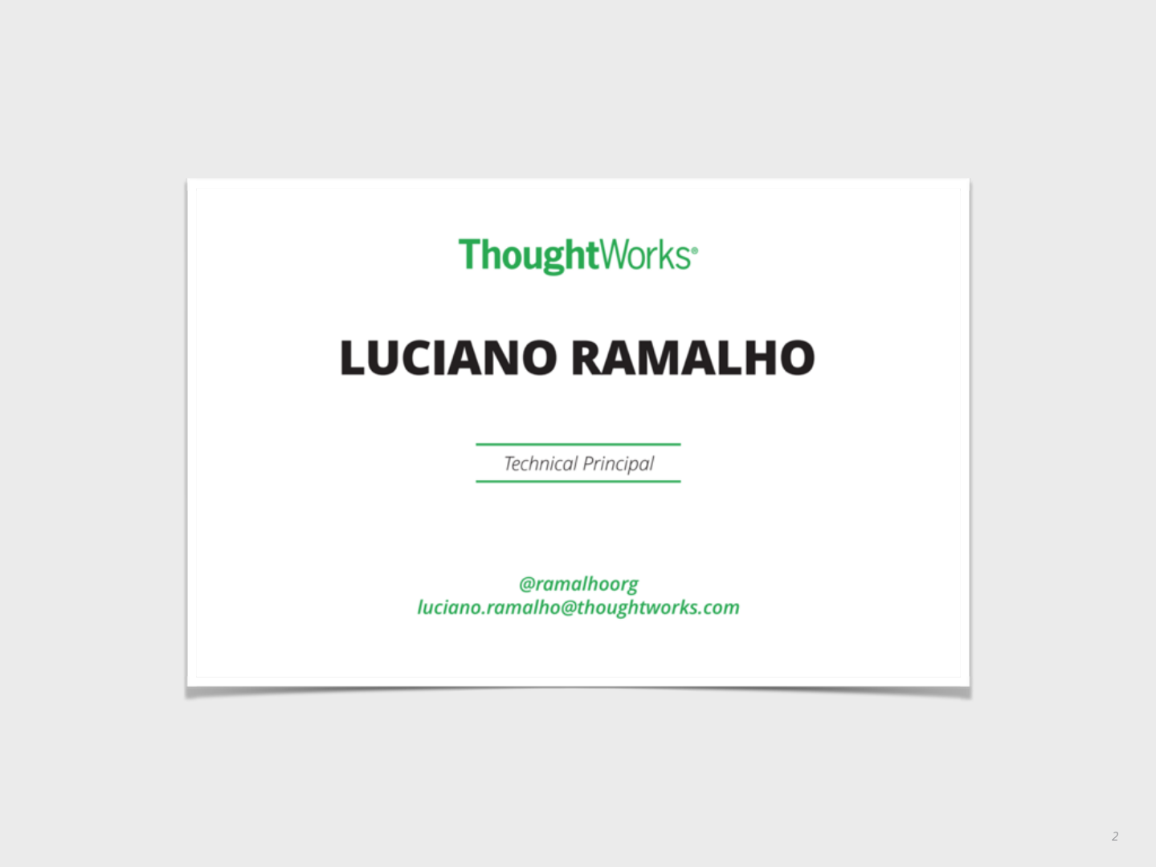
Sometimes you need a blank template.

Slide 3
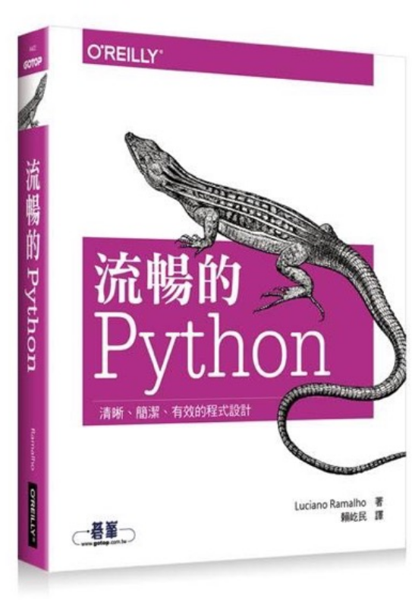
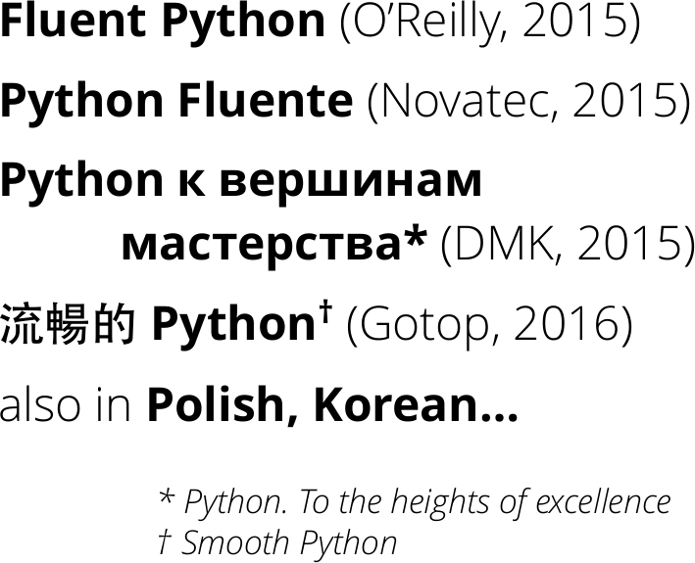
FLUENT PYTHON, MY FIRST BOOK

Slide 4
OVERVIEW
What we’ll cover

Slide 5
TOPICS
Review: functions as objects
Introducing decorators
Registration decorators
Closures
Decorators that affect behavior
Parametrized decorators
Class-based decorators

Slide 6
FUNCTIONS
AS OBJECTS
Naturally

Slide 7
I have never considered Python to be heavily influenced by functional languages, no matter what people say or think.
I was much more familiar with imperative languages such as C and Algol 68 and although
I had made functions first-class objects, I didn’t view Python as a functional programming language.
—Guido van Rossum, Python BDFL

Slide 8
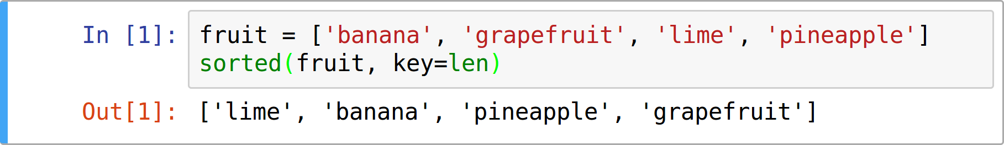
FUNCTIONS AS FIRST-CLASS OBJECTS
Python functions can be:
Created at runtime
Assigned to a variable or element in a data structure
Passed as an argument to a function
Returned as the result of a function

Slide 9
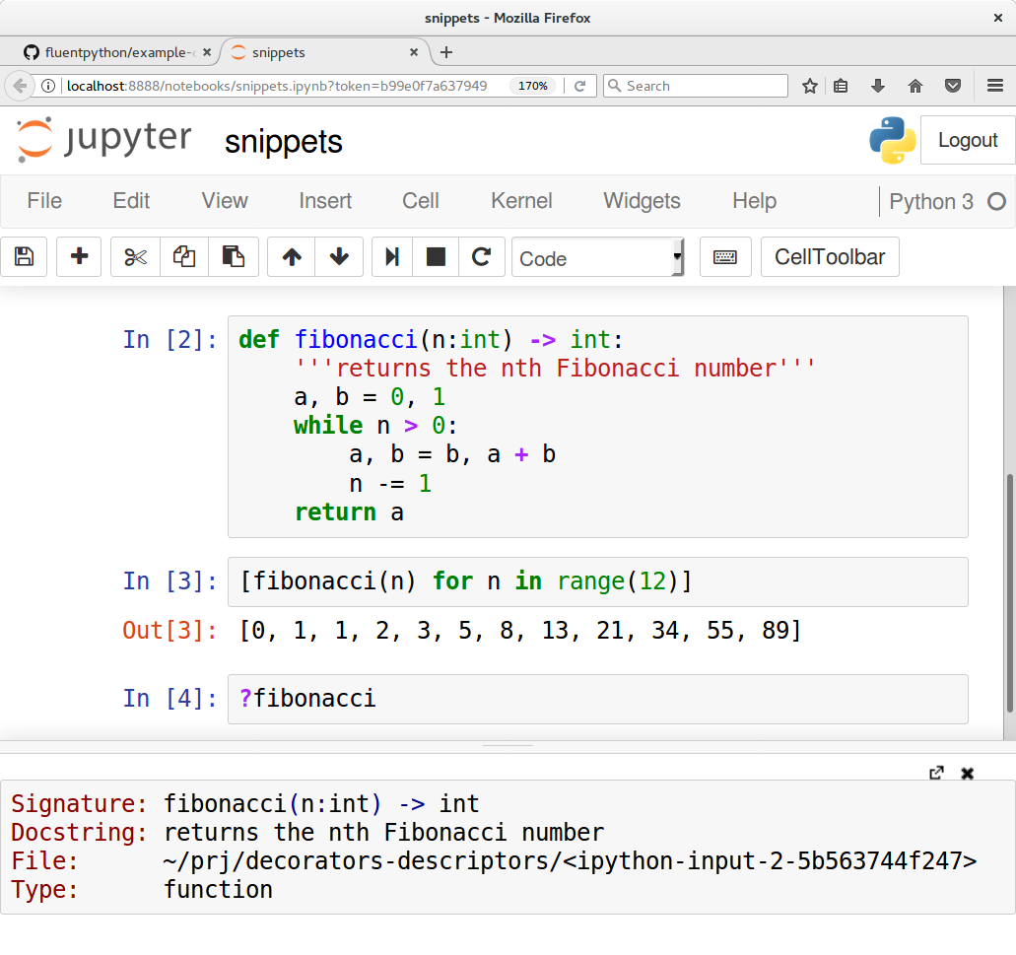
FUNCTIONS HAVE ATTRIBUTES

Slide 10
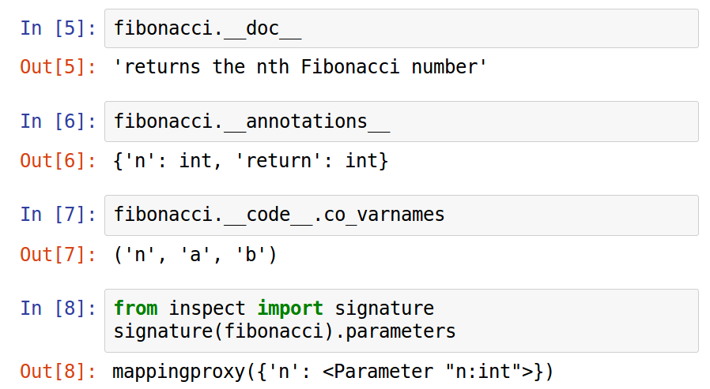
FUNCTIONS HAVE ATTRIBUTES (2)

Slide 11
DECORATORS 101
The basics

Slide 12
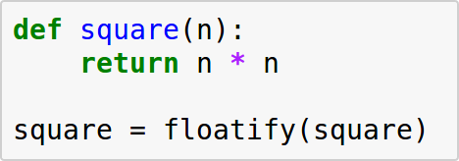
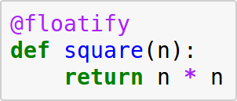
DECORATORS ARE SYNTACTIC SUGAR
These snippets have the same effect:

Slide 13
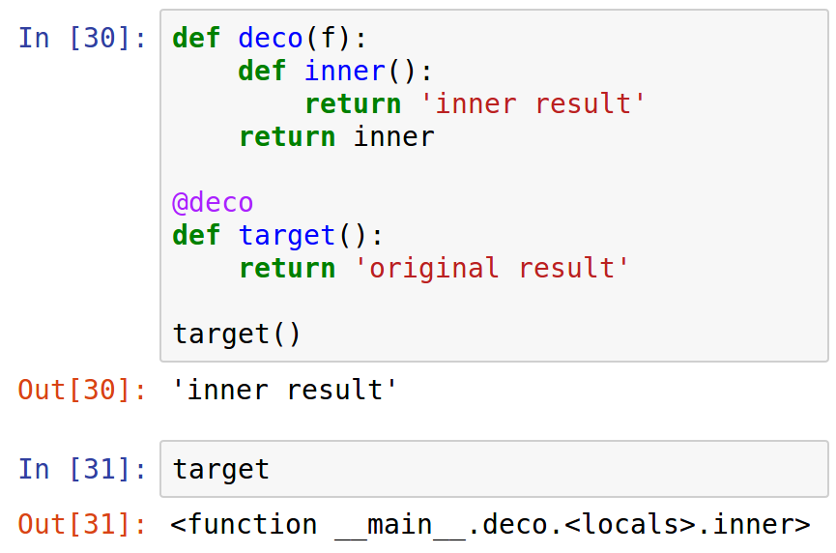
FUNCTION REPLACEMENT
Decorators may replace the decorated function with another function:

Slide 14
DECORATORS RUN AT IMPORT TIME
Import time == when a module is loaded
>>> import registration
running register(<function f1 at 0x…f28>)
>>>

Slide 15
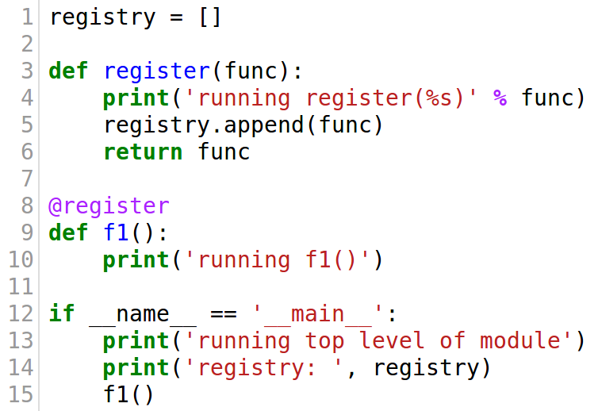
DECORATORS RUN AT IMPORT TIME (2)
>>> import registration
running register(<function f1 at 0x…f28>)
>>>

Slide 16
DECORATORS RUN AT IMPORT TIME (3)
$ python3 registration.py
running register(<function f1 at 0x…7b8>)
running top level of module
registry: [<function f1 at 0x…7b8>]
running f1()

Slide 17
EXERCISE 1:
EXECUTION TIME
What happens when

Slide 18
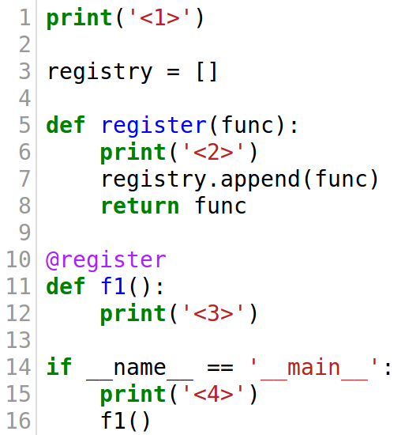
SAMPLE EXERCISE
sample.py
Running this...
...will output this
$ python3 sample.py
<1>
<2>
<4>
<3>

Slide 19
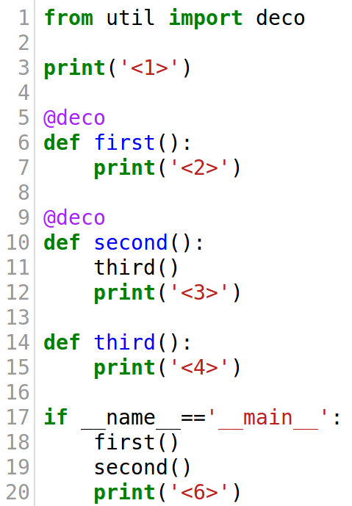
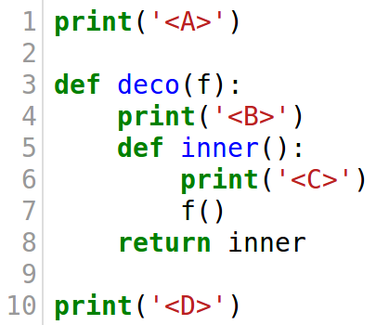
EXERCISE 1: WRITE DOWN THE OUTPUT
main.py
util.py
$ python3 main.py
<?>
...
Write the expected output on paper. Don’t use the computer.

Slide 20
REGISTRATION
DECORATORS
The simplest kind

Slide 21
REGISTRATION DECORATORS
Goal:
Register decorated functions in a global application registry
Typical use case:
Register view functions in Web framework

Slide 22
SIMPLE EXAMPLE
A command-line utility that can be extended by adding decorated functions.
Example inspired by Armin Ronacher’s click library for CLI:
http://click.pocoo.org/
$ ./kron.py
Usage: ./kron.py d|m|t
$ ./kron.py t
20:24:02
$ ./kron.py d
Monday, May 01, 2017
$ ./kron.py m
May 2017
Mo Tu We Th Fr Sa Su
1 2 3 4 5 6 7
8 9 10 11 12 13 14
15 16 17 18 19 20 21
22 23 24 25 26 27 28
29 30 31

Slide 23
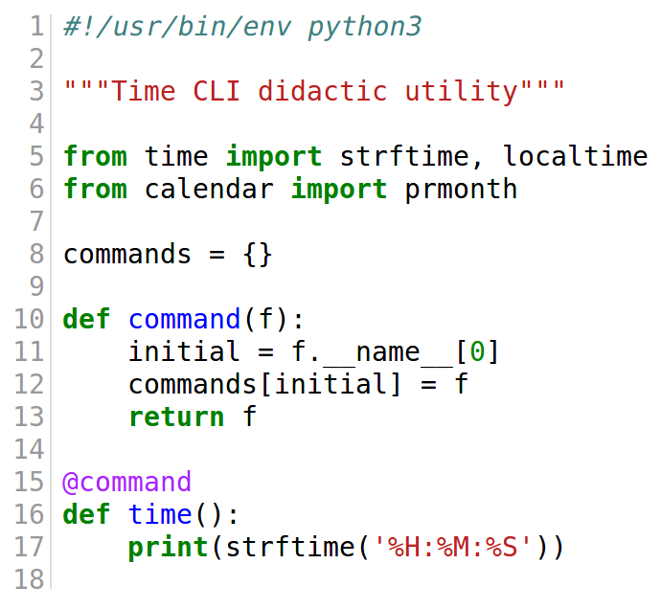
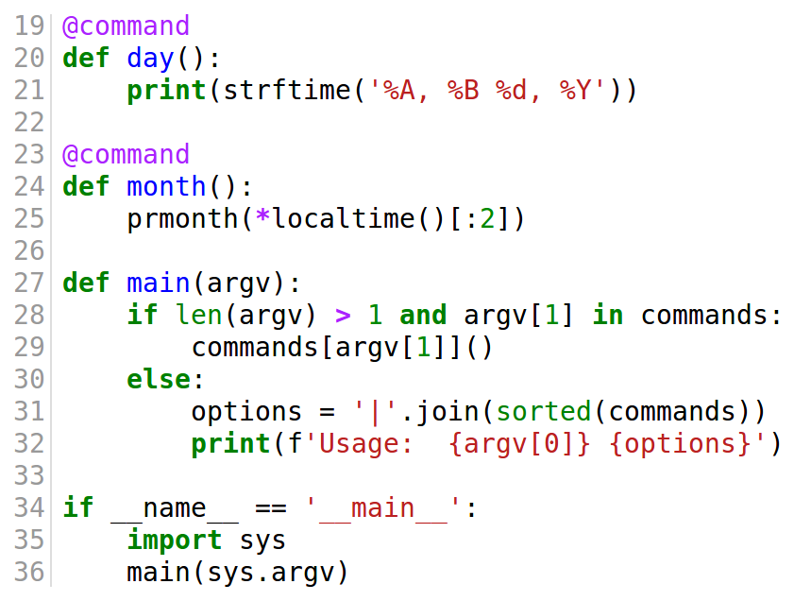
SIMPLE EXAMPLE (2)
The utility that can be extended by adding functions decorated with @command

Slide 24
SIMPLE EXAMPLE (3)
The @command decorator puts the function in the commands dict, with its initial letter as key.

Slide 25
SIMPLE EXAMPLE (4)
main gets the function using the command-line argument as key, and calls it (line 29)

Slide 26
SIMPLE EXERCISE
Add an y (year) command line option.
Hint: look for the calendar.prcal function
$ ./kron.py y
2017
January February March
Mo Tu We Th Fr Sa Su Mo Tu We Th Fr Sa Su Mo Tu We Th Fr Sa Su
1 1 2 3 4 5 1 2 3 4 5
2 3 4 5 6 7 8 6 7 8 9 10 11 12 6 7 8 9 10 11 12
9 10 11 12 13 14 15 13 14 15 16 17 18 19 13 14 15 16 17 18 19
16 17 18 19 20 21 22 20 21 22 23 24 25 26 20 21 22 23 24 25 26
23 24 25 26 27 28 29 27 28 27 28 29 30 31
30 31
April May June
Mo Tu We Th Fr Sa Su Mo Tu We Th Fr Sa Su Mo Tu We Th Fr Sa Su
1 2 1 2 3 4 5 6 7 1 2 3 4
3 4 5 6 7 8 9 8 9 10 11 12 13 14 5 6 7 8 9 10 11
10 11 12 13 14 15 16 15 16 17 18 19 20 21 12 13 14 15 16 17 18
17 18 19 20 21 22 23 22 23 24 25 26 27 28 19 20 21 22 23 24 25
24 25 26 27 28 29 30 29 30 31 26 27 28 29 30

Slide 27
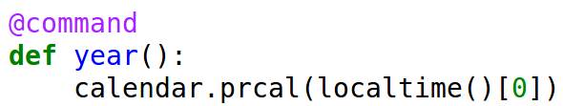
SIMPLE EXERCISE SOLUTION
Code to add
a y (year) option
$ ./kron.py y
2017
January February March
Mo Tu We Th Fr Sa Su Mo Tu We Th Fr Sa Su Mo Tu We Th Fr Sa Su
1 1 2 3 4 5 1 2 3 4 5
2 3 4 5 6 7 8 6 7 8 9 10 11 12 6 7 8 9 10 11 12
9 10 11 12 13 14 15 13 14 15 16 17 18 19 13 14 15 16 17 18 19
16 17 18 19 20 21 22 20 21 22 23 24 25 26 20 21 22 23 24 25 26
23 24 25 26 27 28 29 27 28 27 28 29 30 31
30 31
April May June
Mo Tu We Th Fr Sa Su Mo Tu We Th Fr Sa Su Mo Tu We Th Fr Sa Su
1 2 1 2 3 4 5 6 7 1 2 3 4
3 4 5 6 7 8 9 8 9 10 11 12 13 14 5 6 7 8 9 10 11
10 11 12 13 14 15 16 15 16 17 18 19 20 21 12 13 14 15 16 17 18
17 18 19 20 21 22 23 22 23 24 25 26 27 28 19 20 21 22 23 24 25
24 25 26 27 28 29 30 29 30 31 26 27 28 29 30

Slide 28
VARIABLE SCOPE
Implicit vs. explicit variable declarations

Slide 29
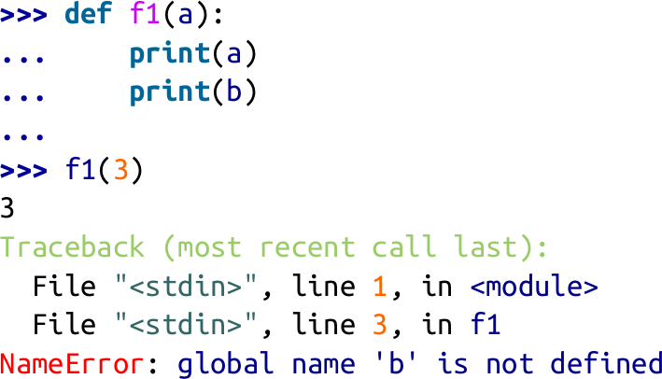
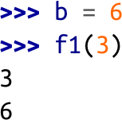
LOCAL VS. GLOBAL VARIABLES
In a clean environment, define and call f1:
To fix, create a global b, and call f1 again:

Slide 30
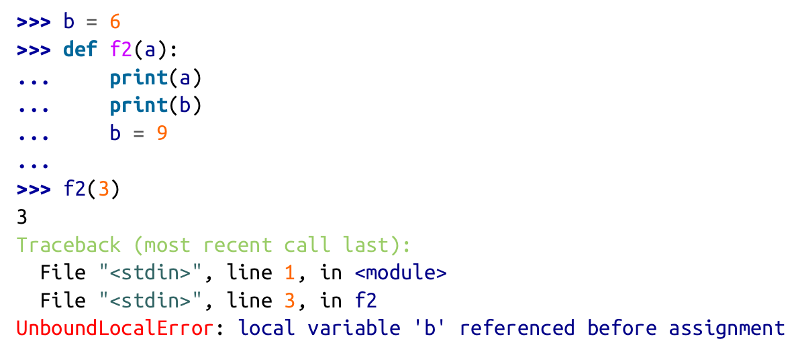
LOCAL VS. GLOBAL VARIABLES (2)
Function f2 always fails, regardless of the environment:
This assignment makes b a
local variable.

Slide 31
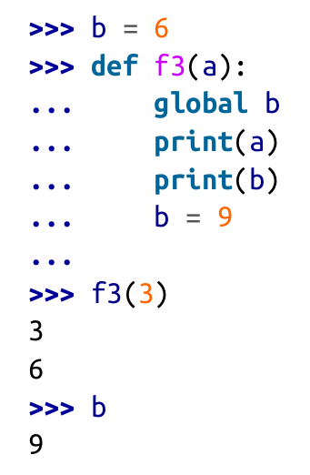
THE global STATEMENT
With the global instruction, the compiler knows that b is global despite the assignment in the body of the function.

Slide 32
CLOSURES
Not the same as “anonymous functions”

Slide 33
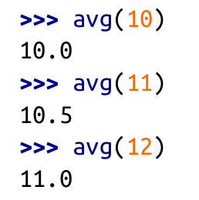
THE RUNNING AVERAGE EXAMPLE
Imagine an avg function that computes the running average of a series of values.
Each call to avg adds a term and returns the updated average.

Slide 34
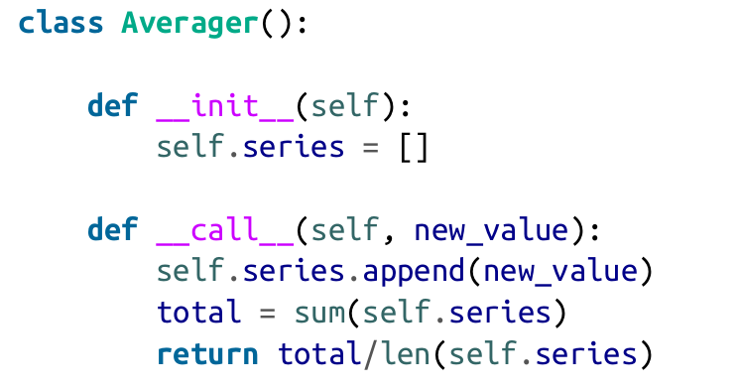
CLASS-BASED RUNNING AVERAGE
One way to do it, using a class:

Slide 35
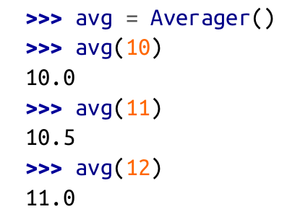
CLASS-BASED RUNNING AVERAGE (2)
One way to do it, using a class:
Demo:

Slide 36
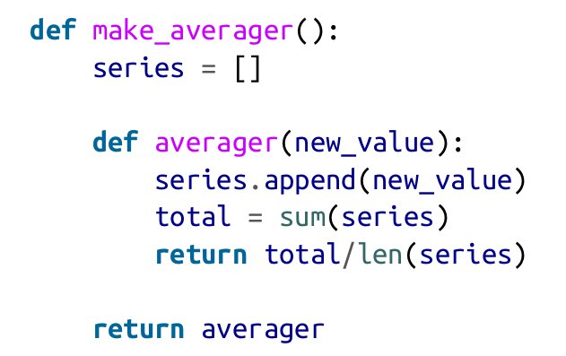
FUNCTION-BASED RUNNING AVERAGE
The functional way, using a higher-order function make_averager:

Slide 37
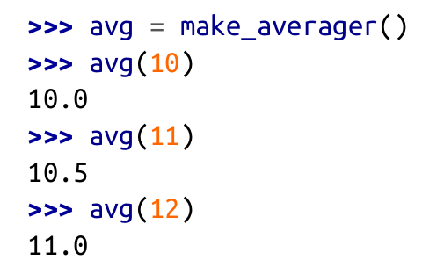
FUNCTION-BASED RUNNING AVERAGE
The functional way, using a higher-order function make_averager:
Demo:

Slide 38
FUNCTION-BASED RUNNING AVERAGE
The functional way, using a higher-order function make_averager:
Demo:

Slide 39
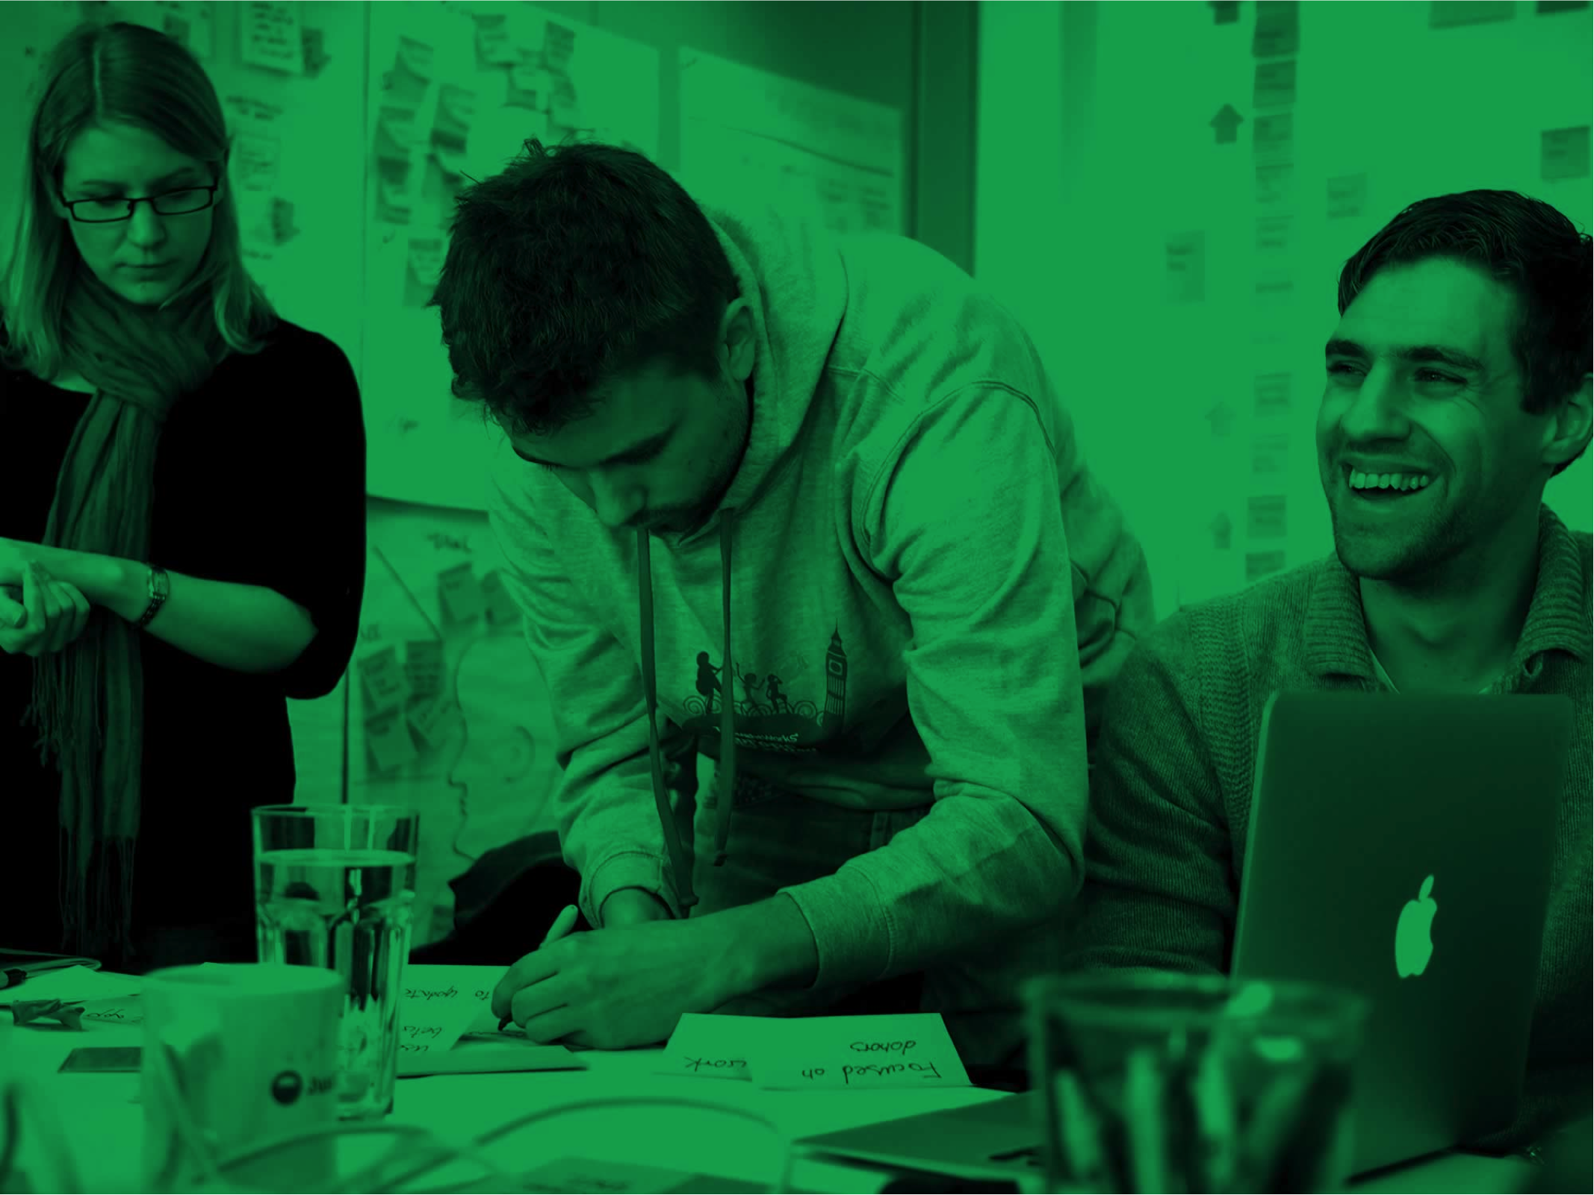
HOW DOES
THIS WORK?
Closures FTW!

Slide 40
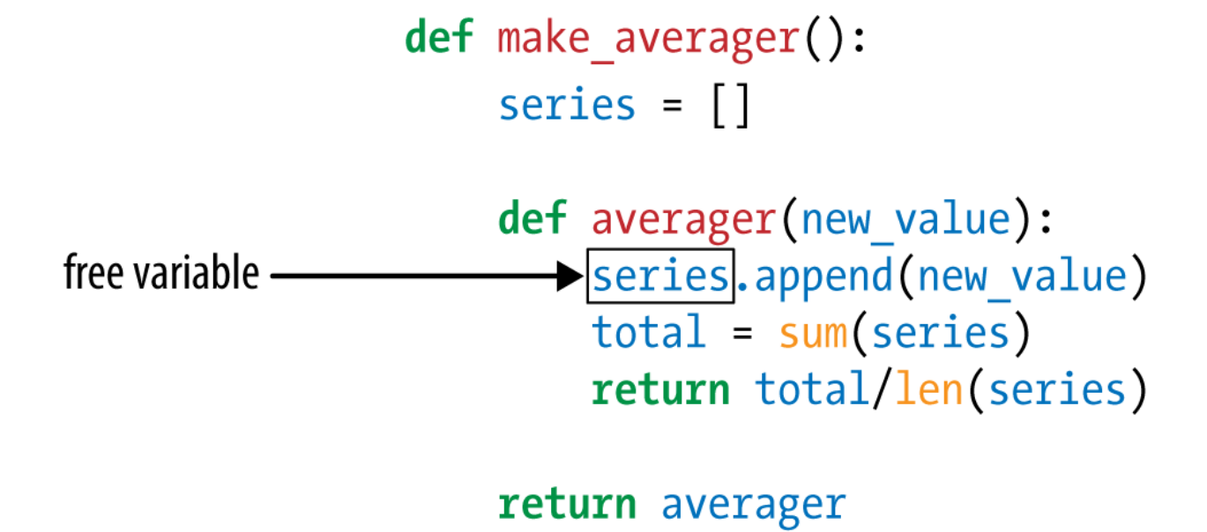
KEY CONCEPT: FREE VARIABLE
A free variable is a non-local variable referenced in a function body.

Slide 41
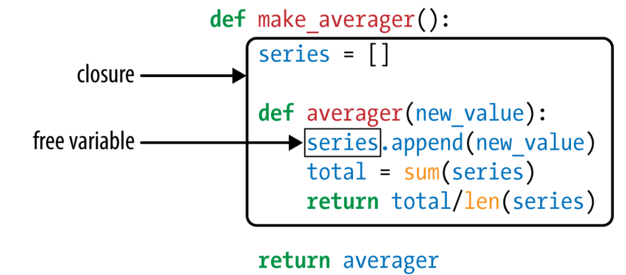
CLOSURES “ENCLOSE” FREE VARIABLES
The closure for averager encompasses the series free variable it needs to run.

Slide 42
FUNCTION-BASED RUNNING AVERAGE
The functional way, using a higher-order function make_averager:
Demo:

Slide 43
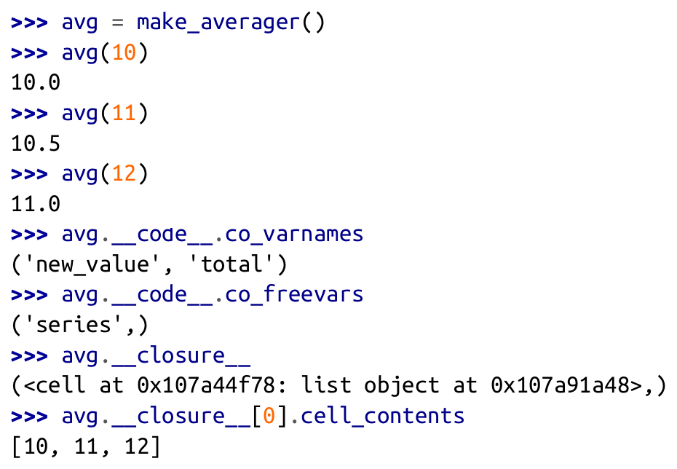
A REAL CLOSURE UNDER THE MICROSCOPE

Slide 44
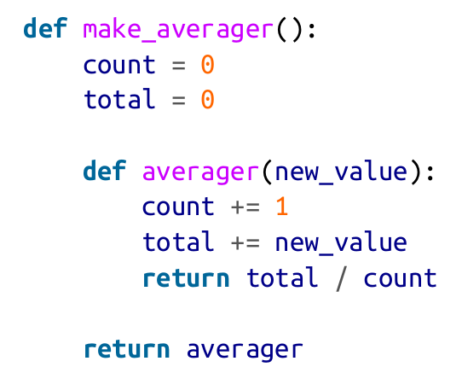
BETTER RUNNING AVERAGE (BROKEN)
Keeping track of count and total, instead of the whole series.
However, this code fails.
Can you explain why?

Slide 45
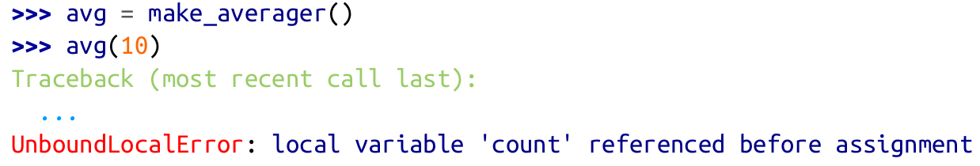
BETTER RUNNING AVERAGE (BROKEN)
This is why:

Slide 46
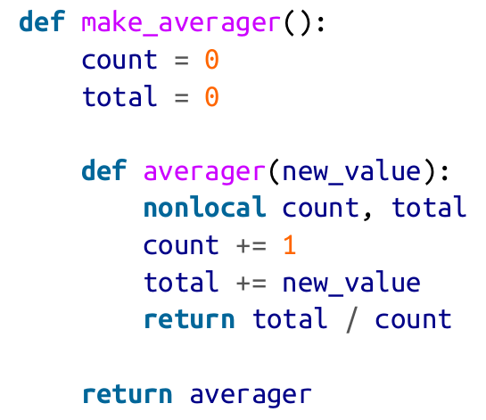
BETTER RUNNING AVERAGE (FIXED)
Use the nonlocal statement to declare variables that will be assigned in the function but are not local.

Slide 47
BETTER RUNNING AVERAGE (FIXED)
Fixed:

Slide 48
FUNCTIONAL
DECORATORS
Altering behavior by function wrapping

Slide 49
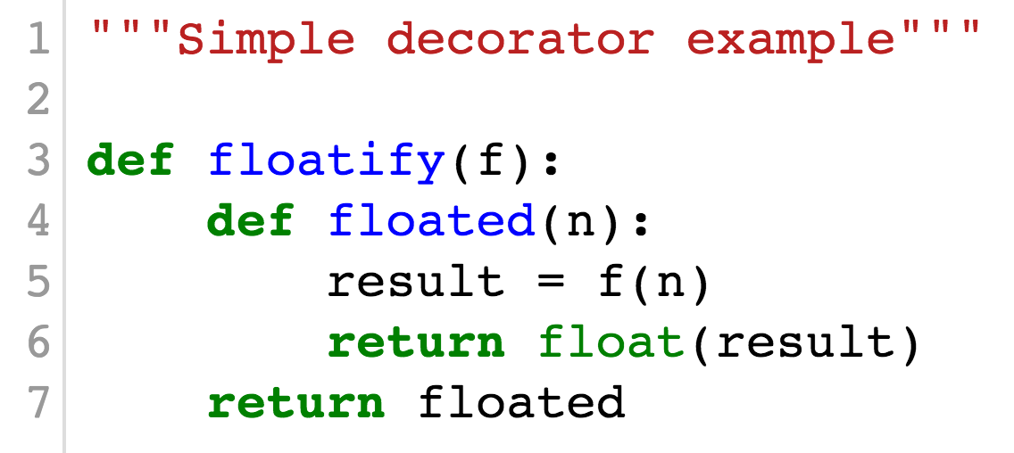
VERY SIMPLE DECORATOR
Replace decorated function f with floated, which:
Calls f(n)
Applies float to result and returns it

Slide 50
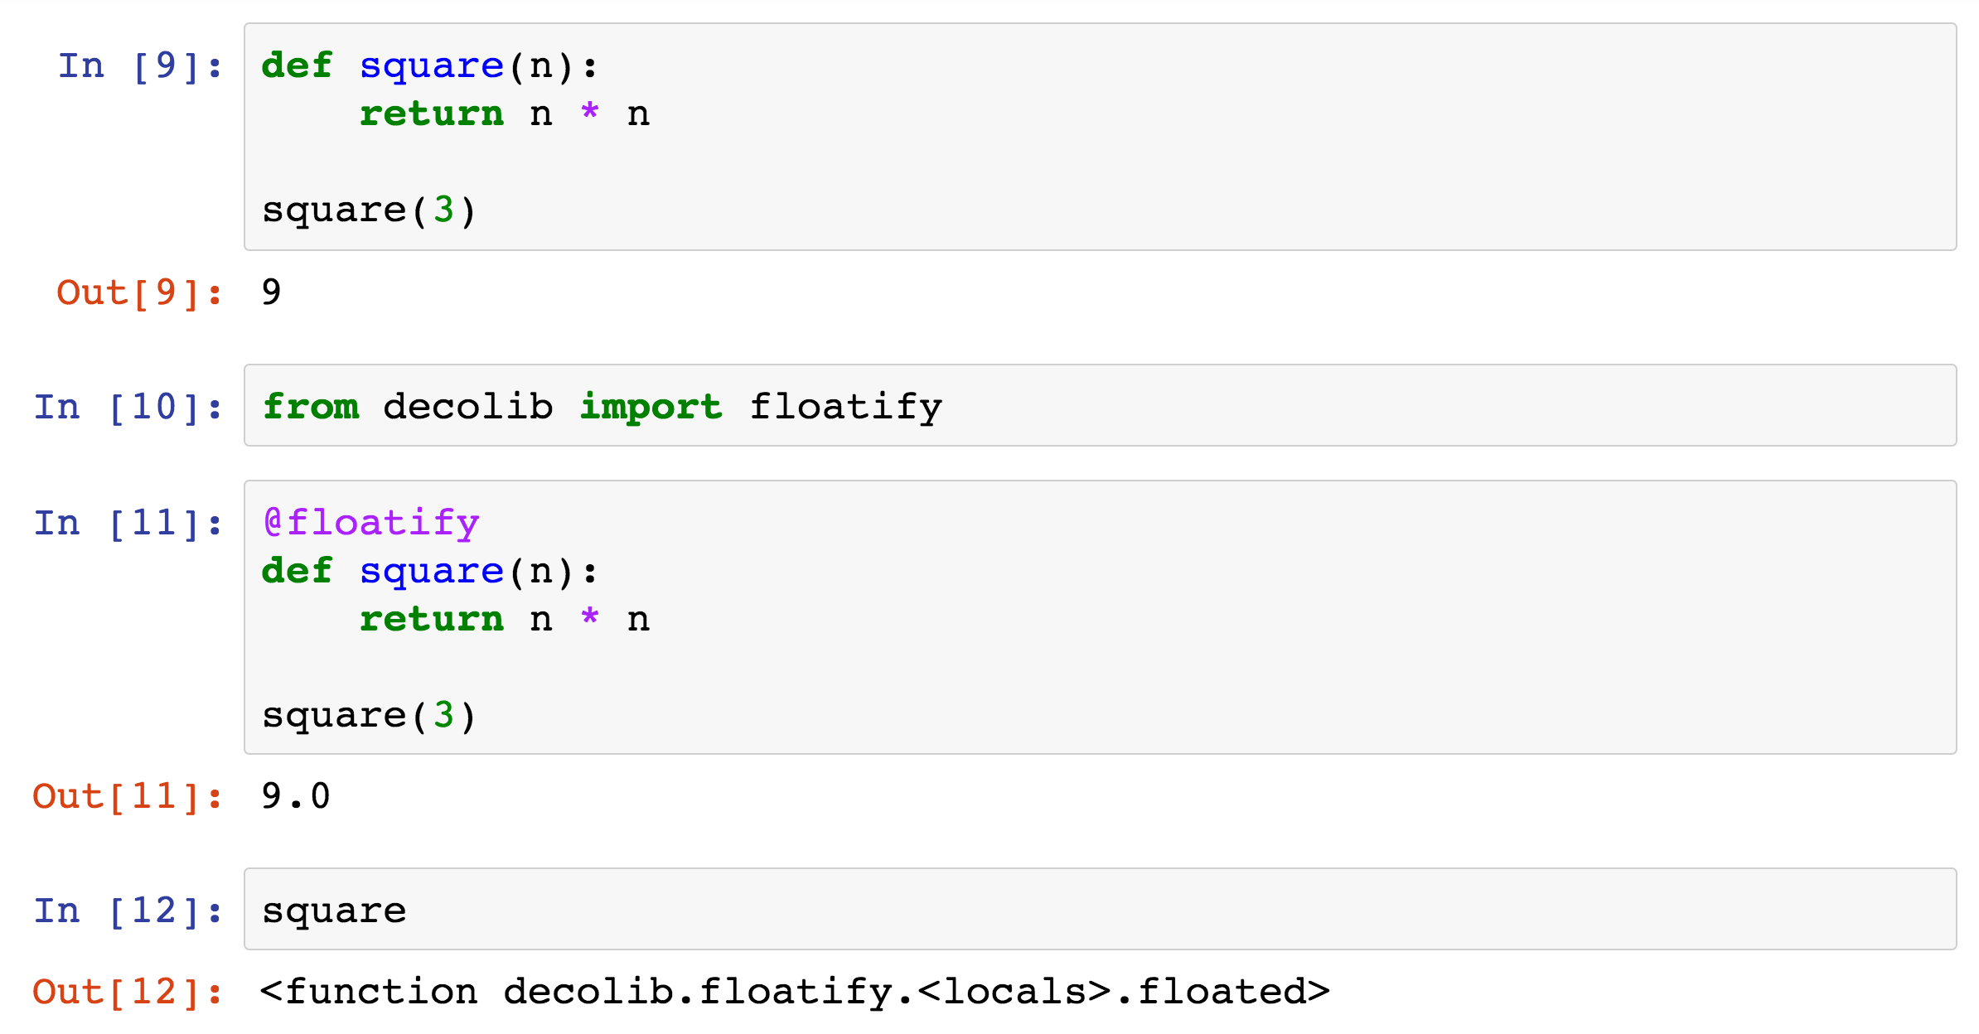
VERY SIMPLE DECORATOR DEMO

Slide 51
ISSUES TO BE ADDRESSED
The replacement function usually honors the contract of the decorated function:
  Accept same number/kinds of args
  Return result of compatible type
The replacement function should preserve metadata from the decorated function
  Important for debugging and other metaprogramming purposes

Slide 52
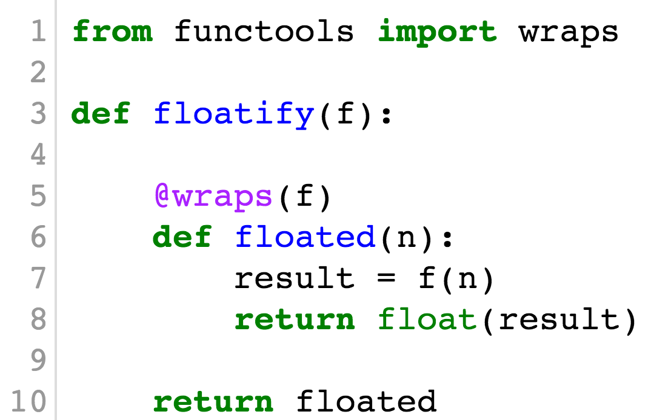
PROPERLY WRAPPED DECORATOR
Use of @functools.wraps():

Slide 53
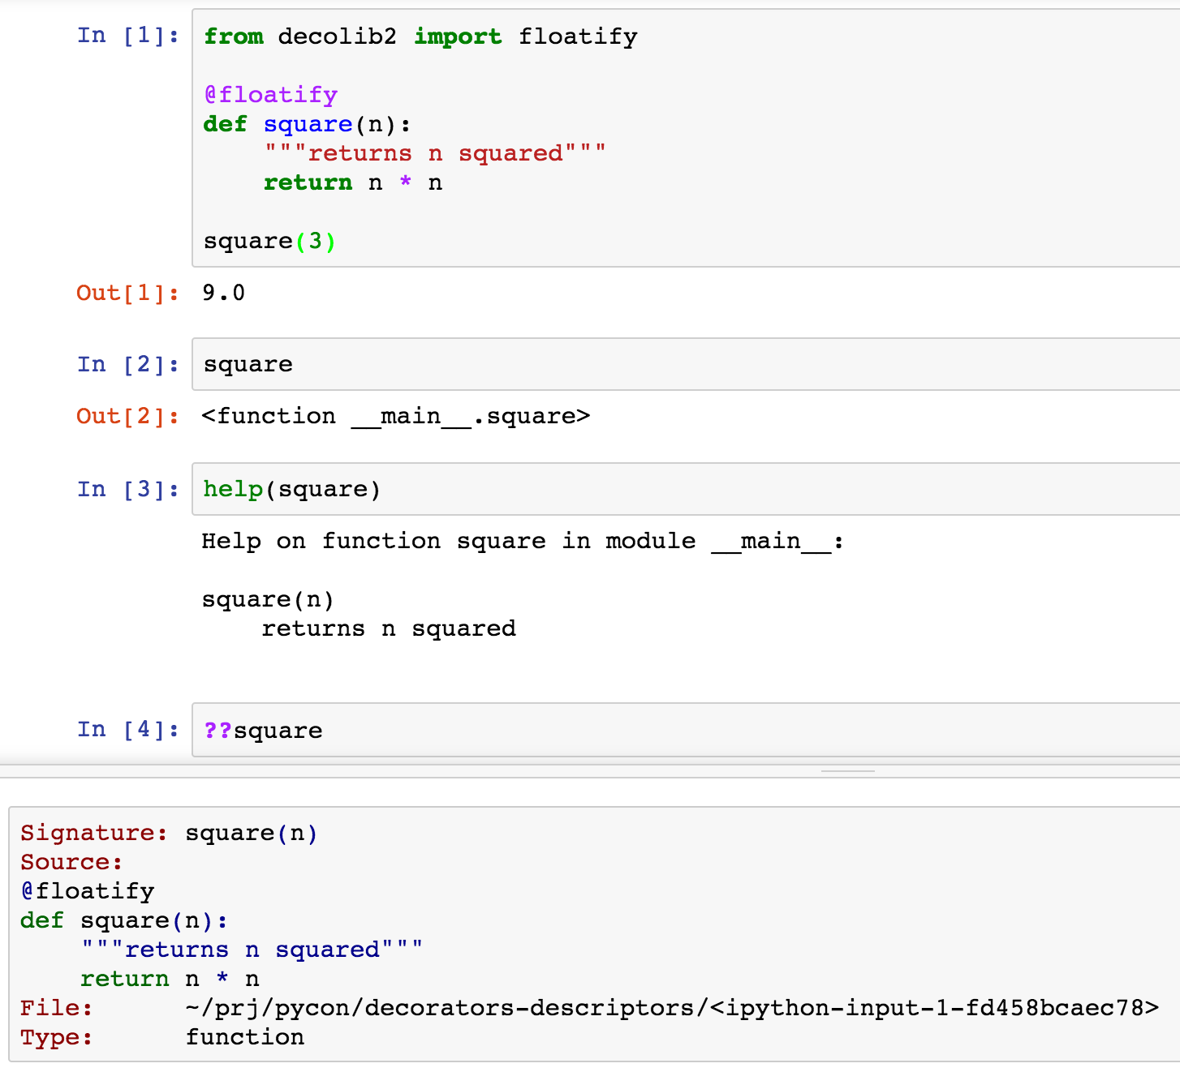

Slide 54
CLOCKING DECORATOR DEMO
@clock decorator displays:
Elapsed time
Arguments passed and results returned
$ python3 clockdeco_demo.py
**************************************** Calling snooze(.123)
[0.12818575s] snooze(0.123) -> None
**************************************** Calling factorial(6)
[0.00000191s] factorial(1) -> 1
[0.00002408s] factorial(2) -> 2
[0.00003886s] factorial(3) -> 6
[0.00005102s] factorial(4) -> 24
[0.00006604s] factorial(5) -> 120
[0.00008702s] factorial(6) -> 720

Slide 55
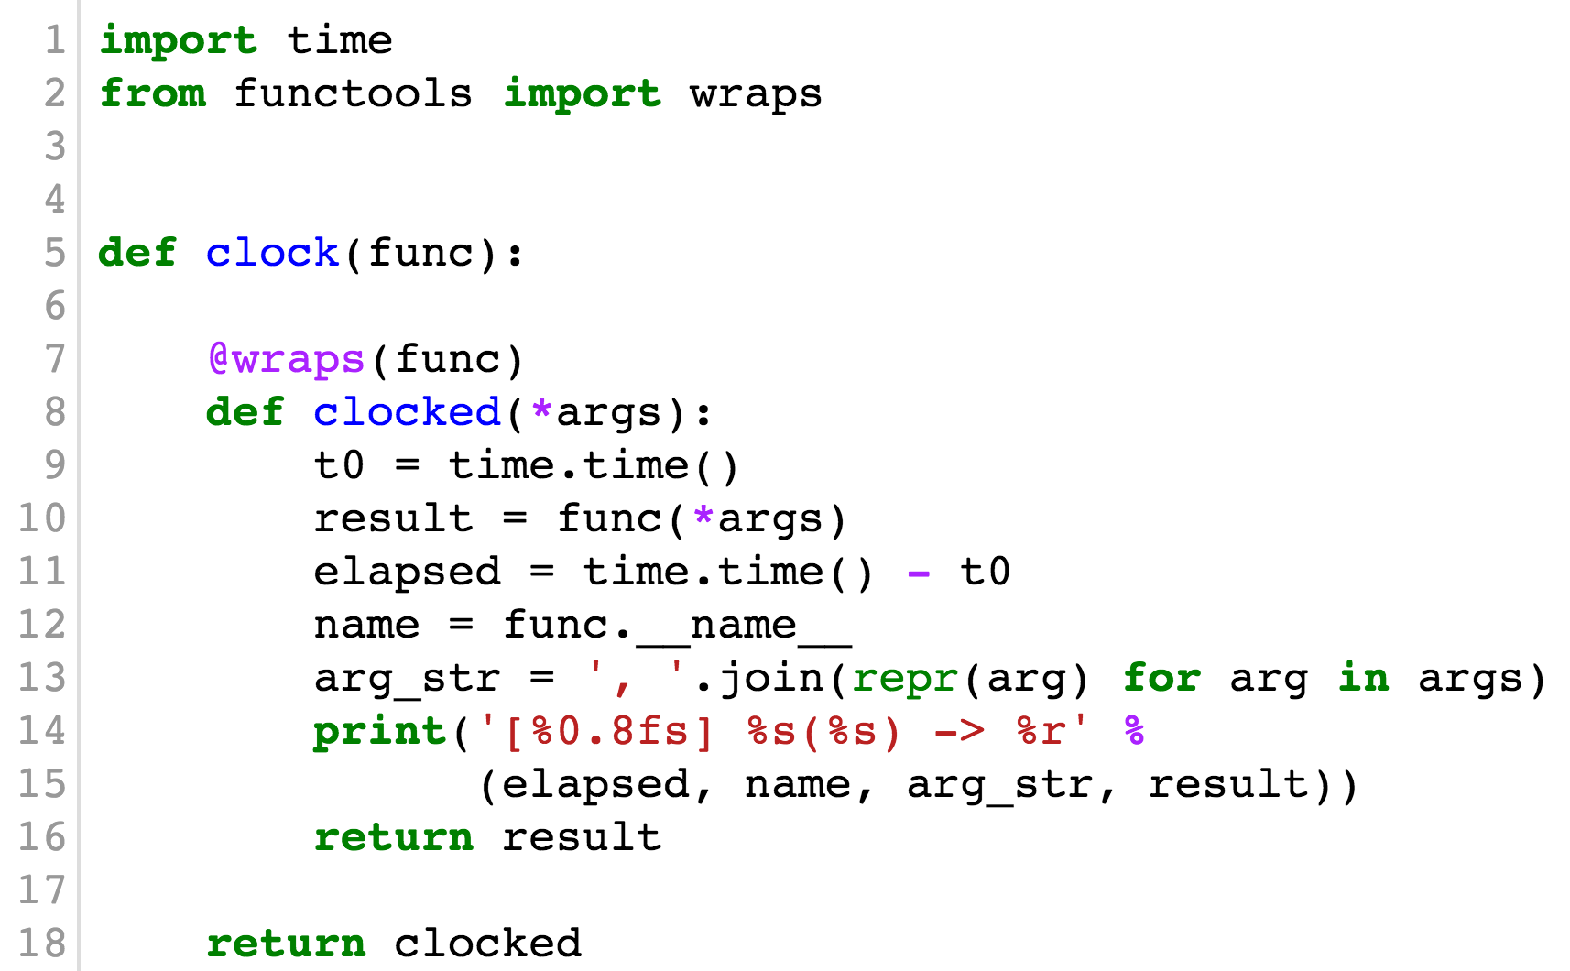
CLOCKING DECORATOR CODE

Slide 56
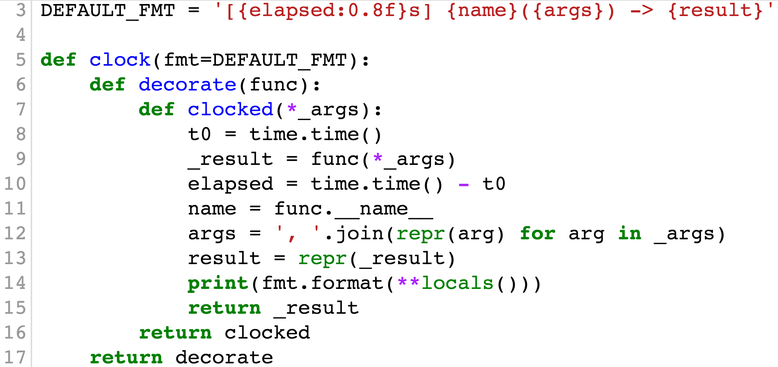
PARAMETRIZED CLOCKING DECORATOR

Slide 57
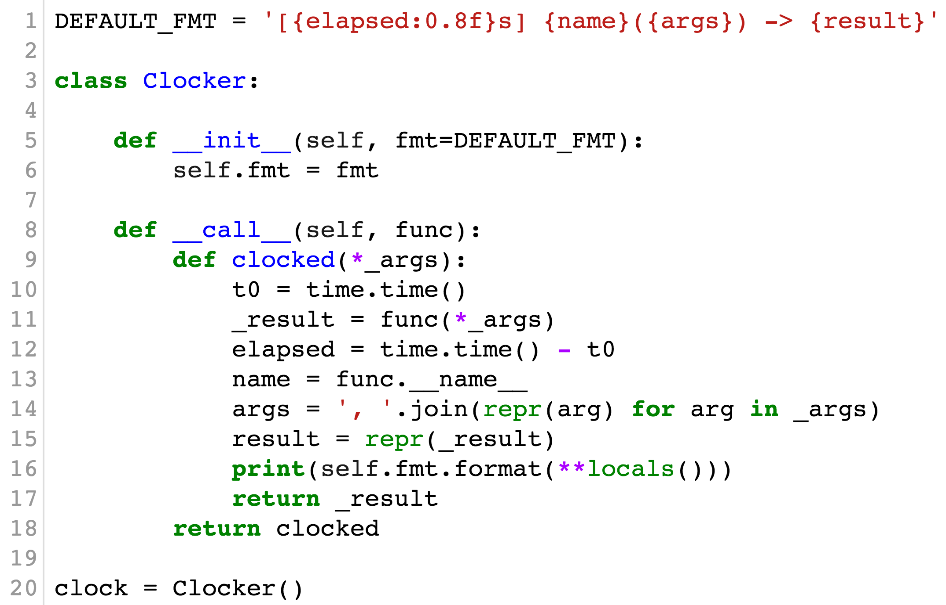
CLASS-BASED CLOCKING DECORATOR

Slide 58
DECORATE LIKE A PRO
At a minimum, use @functools.wraps
Use Graham Dumpleton’s wrapt
or
Michele Simionato’s decorator package

Slide 59
A NICE BIG TITLE
the black theme
And then a subhead that can run long to add some background flavor or prosaic flourish.

Slide 60
ANOTHER WAY TO DO A BIG TITLE OR SECTION DIVIDER
Add a subhead if you want.

Slide 61
FULL BLEED PHOTO WITH TYPE OVERLAY
This is useful when you have a ncie photo or color-black as a background. On this slide only, you can put your elements behind a master element.

Slide 62
FULL BLEED PHOTO WITH TYPE OVERLAY
This is useful when you have a ncie photo or color-black as a background. On this slide only, you can put your elements behind a master element.

Slide 63

FULL BLEED PHOTO WITH TYPE OVERLAY
This is useful when you have a nice photo or color-black as a background. On this slide only, you can put your elements behind a master element.

Slide 64
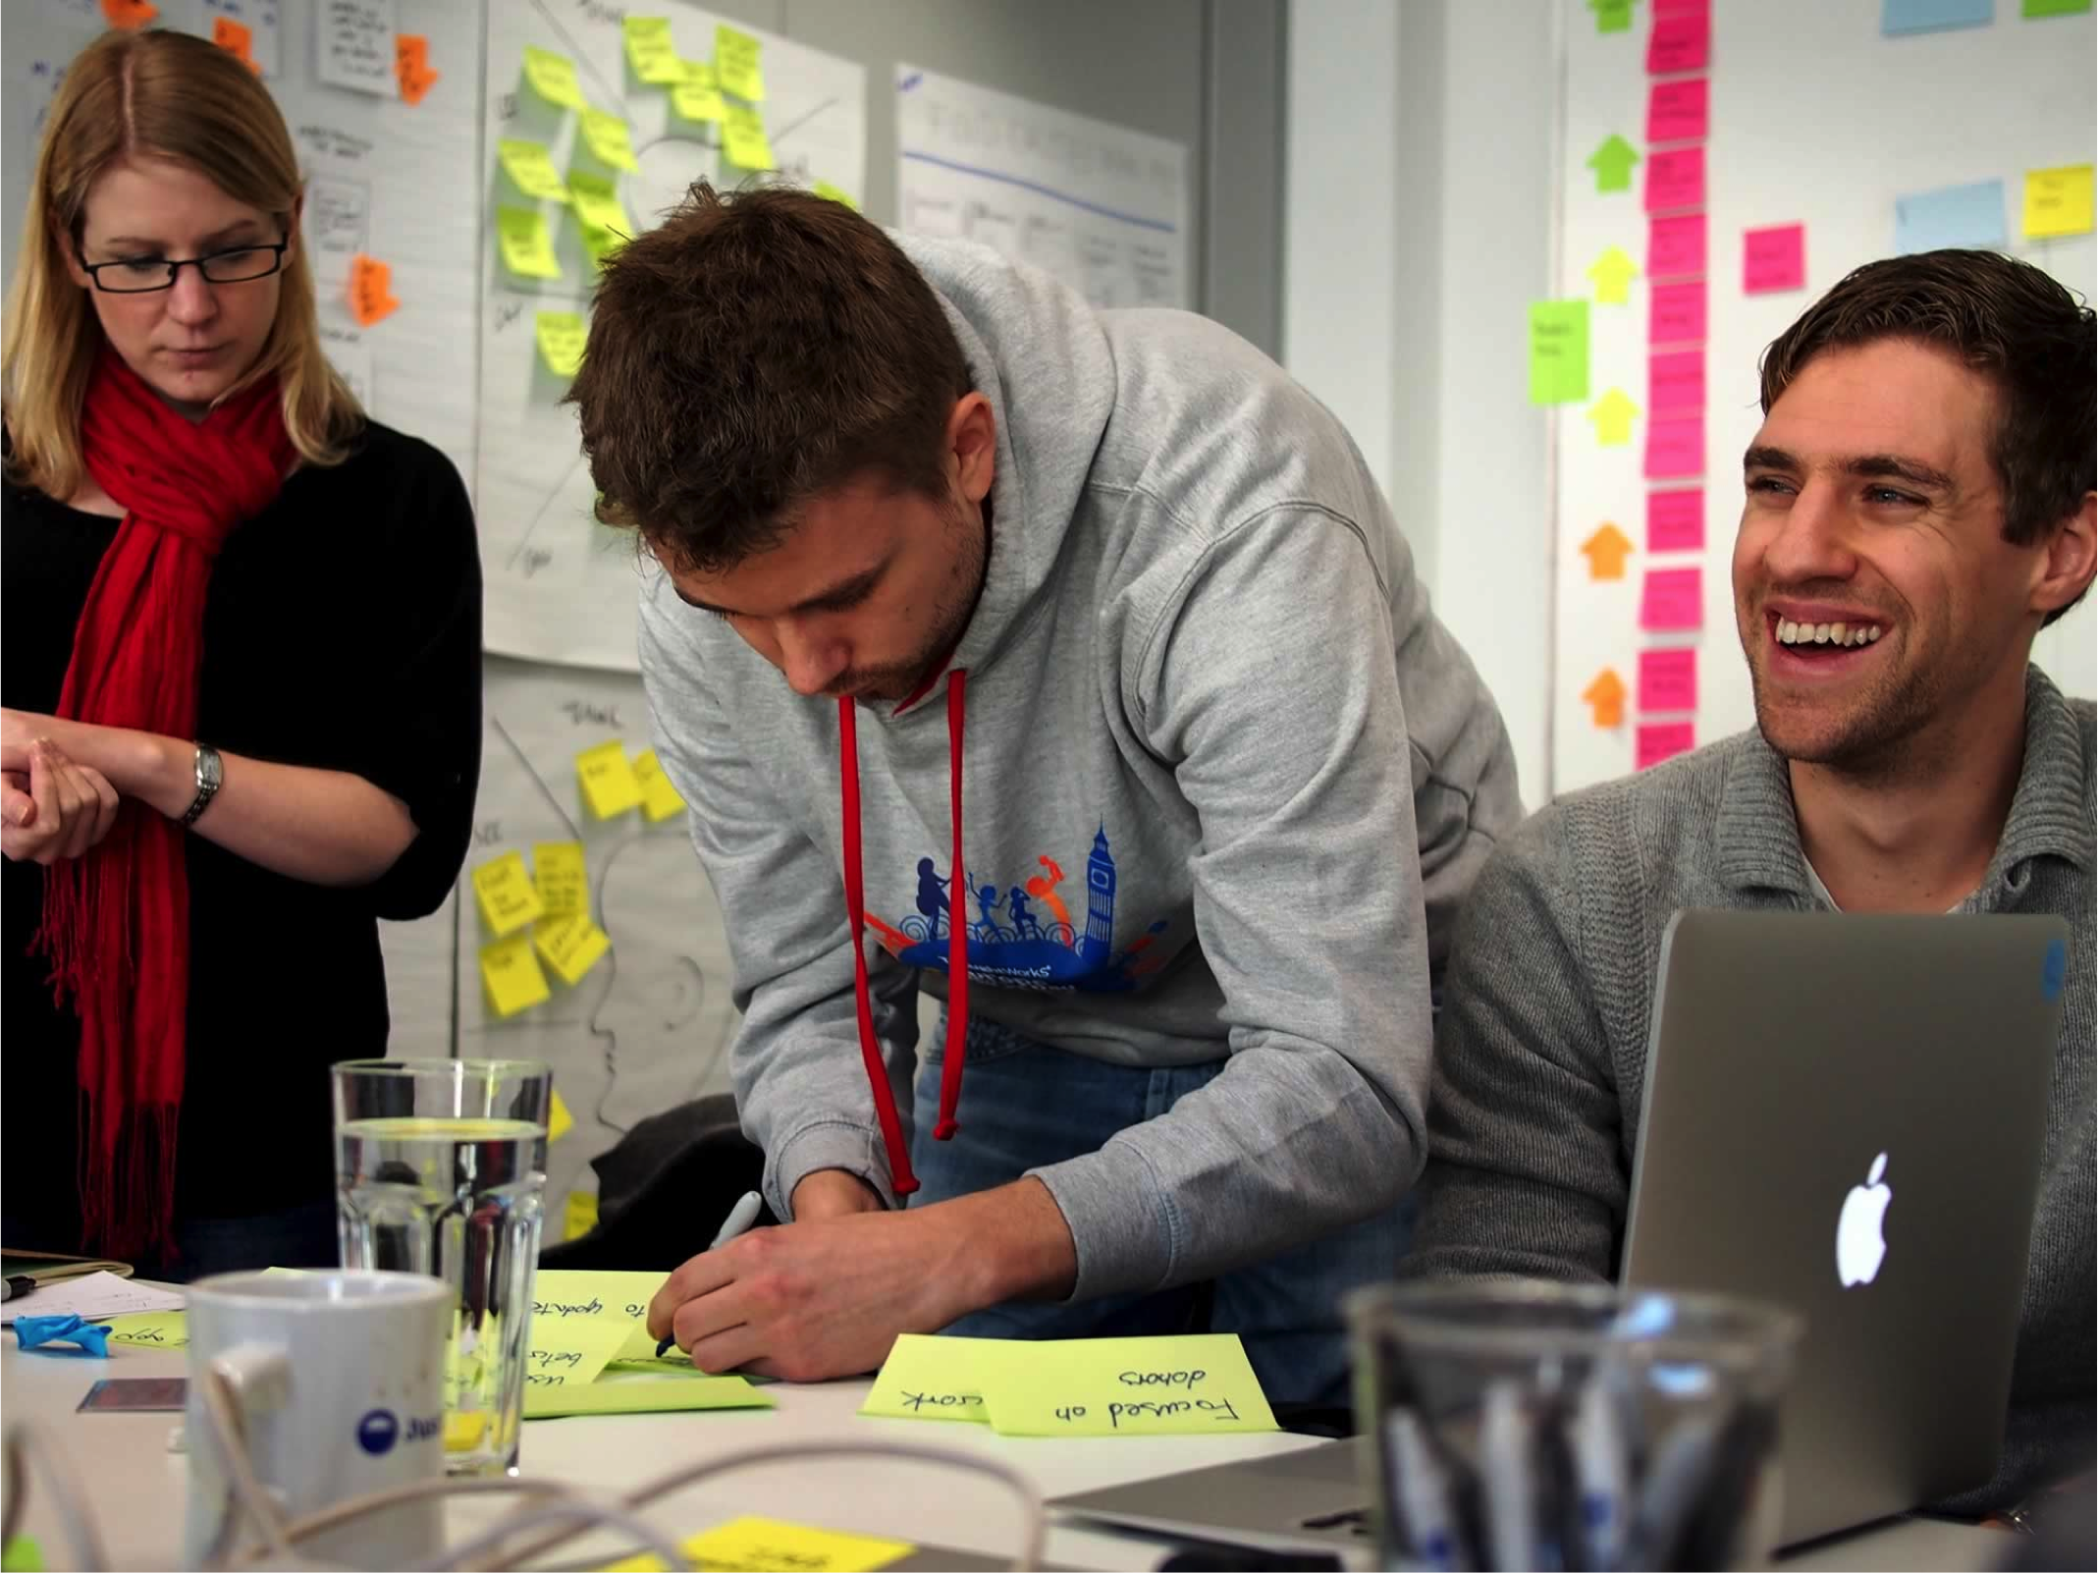
UNTINTED PHOTO
Use with care.

Slide 65
YOUR BASIC, HARD-WORKING SLIDE
Make subheads 24
Body defaults to 18pt by default.
Bullet One
Bullet Two
Bullet Three
Bullet Four
Bullet Five
Bullet 6

Slide 66
YOUR BASIC, HARD-WORKING SLIDE
Make subheads 24
Body defaults to 18pt by default.
Bullet One
Bullet Two
Bullet Three
Bullet Four
Bullet Five
Bullet 6

Slide 67
50/50 CONTENT SPLIT
Make subheads 24
Body defaults to 18pt by default.
Bullet One
Bullet Two
Bullet Three
Bullet Four
Bullet Five
Bullet 6

Slide 68
LONG FORM CONTENT
Sometimes we use PowerPoint for page layout.
And in that case we need room for body copy. That’s what this slide is for.
Cras mattis consectetur purus sit amet fermentum. Duis mollis, est non commodo luctus, nisi erat porttitor ligula, eget lacinia odio sem nec elit. Morbi leo risus, porta ac consectetur ac, vestibulum at eros. Donec sed odio dui. Cum sociis natoque penatibus et magnis dis parturient montes, nascetur ridiculus mus. Praesent commodo cursus magna, vel scelerisque nisl consectetur et. Aenean lacinia bibendum nulla sed consectetur.
“Sometimes you need a quote and you’ll have to copy this block since there’s no way to predefine a quote style.”

Slide 69
Sometimes you need a blank template.

Slide 70
Sometimes you want to say something simply and boldly on a dedicated slide. This template is called the "quote".

Slide 71
BLANK PAGE WITH A TITLE

Slide 72
COLOR PALETTE
Safe on Projectors
#0078bf
0,120,191
#00bccd
0,188,205
#7dced5
125,206,213
#00aa5b
0,170,91
#85b880
133,184,128
#bdbd32
189,189,50
#fff350
255,243,80
#fbe0ce
251,224,206
#f2ba97
242,186,151
#a17861
161,120,97
#808184
128,129,132
#eeeeee
238,238,238
Risky on Projectors
#ee5ba0
238,91,160
#702269
112,34,105
#b51b58
181,27,88
#ed312f
237,49,47
#f58a33
245,138,51
#5f3c25
95,60,37

Slide 73
BOXES, SHAPES AND TABLES
Works for any shape.
Shapes are tinted gray with lots of padding.
Buy default, a floating text box looks like this.
PowerPoint doesn’t … | offer much … | in the way …
of custom … | table … | styles.
It prefers to use predefined | colors from … | The built in theme.

Slide 74
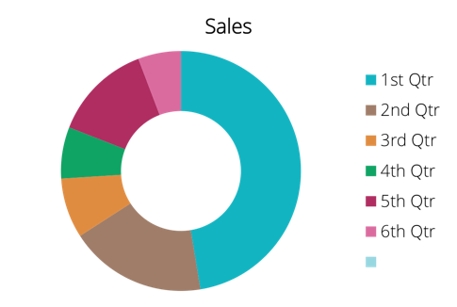
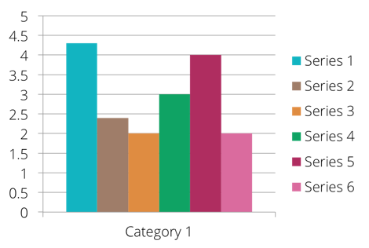
CHART SUGGESTIONS

Slide 75
CHECKLIST TEMPLATE
First, get the proper font: http://opensans.com/
Start with a clean template.
When in doubt, copy and paste from something that already works.
Be brave:
  Learn to use master pages properly.
  Edit! Brevity, not design, makes presentations great.

Slide 76
THANK YOU
For questions or suggestions:
Chad Currie
Smith & Robot
chad@smithandrobot.com

