Slide 1
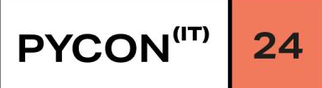

Pythonic type hints with
typing.Protocol
Luciano Ramalho
https://fosstodon.org/@ramgarlic

Slide 2
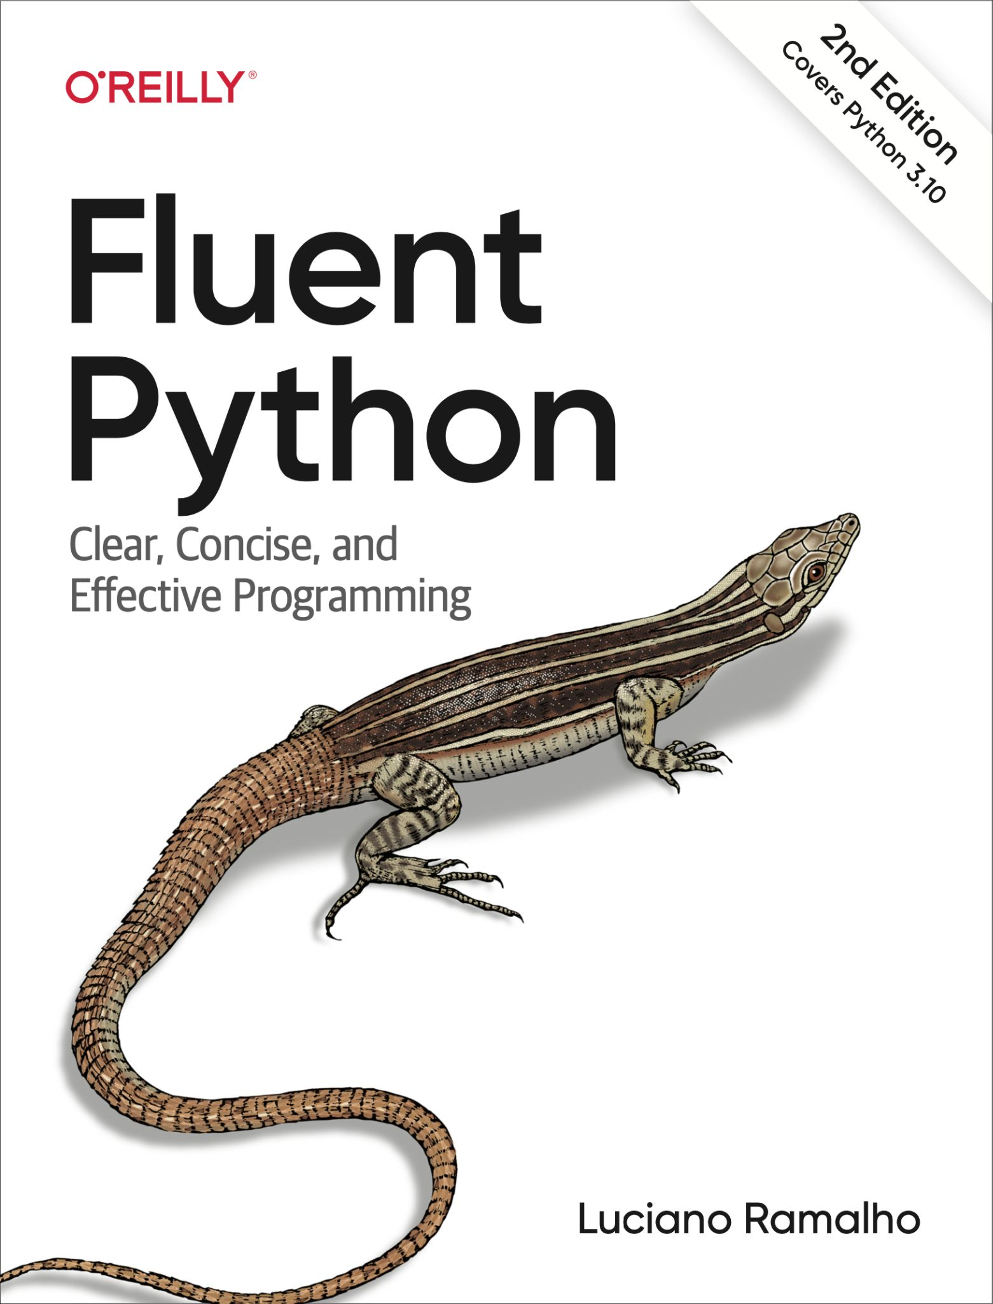


Fluent Python,
Second Edition
●
Covers 3.10, including pattern
matching
●
100+ pages about type hints,
with many examples
●
New coverage of async/await,
with examples in asyncio, FastAPI
and Curio
●
OReilly.com:
https://bit.ly/FluPy2e
3

Slide 3
Motivating
Example
39

Slide 4

The first parameter is the
file-like object to be sent…
To be considered “file-like”,
the object supplied by the
application must have a
read() method that takes an
optional size argument.
PEP 3333 – Python Web Server Gateway Interface
6
6

Slide 5
The words "file-like" appear with similar implied meaning in the Python 3.12 distribution:
148 times in the documentation;
92 times in code comments in
.py or .c source files;
30 times across 21 PEPs:
100, 214, 258, 282, 305, 310, 333, 368, 400, 441, 444, 578, 680, 691, 3116, 3119, 3143, 3145, 3154, 3156, 3333.

Slide 6
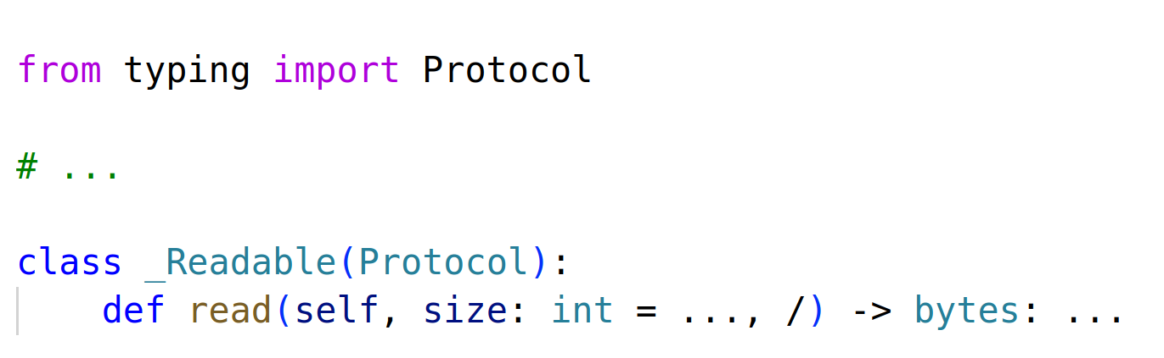
Protocol definition for “a file-like object”
code from Lib/wsgiref/types.py
44
44

Slide 7
Agenda
1.
2.
3.
4.
What is a type?
The four modes
typing.Protocol
Conclusion
of typing
examples
4
4

Slide 8
What is a type?
5

Slide 9
There are many
definitions of the
concept of type in the
literature. Here we
assume that type is
a set of values and a
set of functions that
one can apply to these
values.
Guido van Rossum, Ivan Levkivskyi in
PEP 483—The Theory of Type Hints
6
6

Slide 10
>>> i = 10**23
>>> i
100000000000000000000000
>>> f = float(i)
>>> f
1e+23
>>> i == f
False
>>> from decimal import Decimal
>>> Decimal(i)
Decimal('100000000000000000000000')
>>> Decimal(f)
Decimal('99999999999999991611392')
>>> i | 2
100000000000000000000002
>>> f | 2
Traceback (most recent call last):
File "<stdin>", line 1, in <module>
TypeError: unsupported operand type(s) for |: 'float' and 'int'
12

Slide 11
>>> i = 10**23
>>> i
100000000000000000000000
>>> f = float(i)
>>> f
1e+23
>>> i == f
False
>>> from decimal import Decimal
>>> Decimal(i)
Decimal('100000000000000000000000')
>>> Decimal(f)
Decimal('99999999999999991611392')
>>> i | 2
100000000000000000000002
>>> f | 2
Traceback (most recent call last):
File "<stdin>", line 1, in <module>
TypeError: unsupported operand type(s) for |: 'float' and 'int'
12

Slide 12
>>> i = 10**23
>>> i
100000000000000000000000
>>> f = float(i)
>>> f
1e+23
>>> i == f
False
>>> from decimal import Decimal
>>> Decimal(i)
Decimal('100000000000000000000000')
>>> Decimal(f)
Decimal('99999999999999991611392')
>>> i | 2
100000000000000000000002
>>> f | 2
Traceback (most recent call last):
File "<stdin>", line 1, in <module>
TypeError: unsupported operand type(s) for |: 'float' and 'int'
12

Slide 13
The “set of values” definition is not
useful: Python does not provide
ways to specify types as sets of
values, except for Enum.
We have very small sets (None, bool)
or very large ones (int, str…).
9

Slide 14
Python type hints cannot define a
Quantity type as the set of integers
0 < n ≤ 1000
or…
AirportCode as the set of all 17576
three-letter ASCII strings like “FLR”,
”LAX”, “BER” etc.
10

Slide 15
In practice, it’s more useful to think
that int is a subtype of ﬂoat because
it implements the same interface,
and adds extra methods
—not because int is a subset of ﬂoat*
* which it definitely isn’t
11

Slide 16
>>> i = 10**23
>>> i
100000000000000000000000
>>> f = float(i)
>>> f
1e+23
>>> i == f
False
>>> from decimal import Decimal
>>> Decimal(i)
Decimal('100000000000000000000000')
>>> Decimal(f)
Decimal('99999999999999991611392')
>>> i | 2
100000000000000000000002
>>> f | 2
Traceback (most recent call last):
File "<stdin>", line 1, in <module>
TypeError: unsupported operand type(s) for |: 'float' and 'int'
12

Slide 17
There are many
definitions of the
concept of type in the
literature. Here we
assume that type is
a set of values and a
set of functions that
one can apply to these
values.
Guido van Rossum, Ivan Levkivskyi in
PEP 483—The Theory of Type Hints
14
14

Slide 18
Every object in
Smalltalk, even a lowly
integer, has a set of
messages, a protocol,
that defines the explicit
communication to
which that object can
respond.
Dan Ingalls (Xerox PARC) in
Design Principles Behind Smalltalk
—BYTE Magazine, August 1981
15
15

Slide 19
To summarize:
●
Types are defined by interfaces
●
Protocol is a synonym of interface
16

Slide 20
Duck typing
17

Slide 21

Don’t check whether it
is-a duck:
check whether it
quacks-like-a duck,
walks-like-a duck, etc,
depending on exactly
what subset of
duck-like behavior you
need...
Alex Martelli in comp-lang-python:
”polymorphism (was Re: Type
checking in python?)” 2000-07-26
18
18

Slide 22
>>> def double(x):
... return x * 2
...
>>> double(3)
6
>>> double(3.5)
7.0
>>> double(3j+4)
(8+6j)
>>> from fractions import Fraction
>>> double(Fraction(1, 3))
Fraction(2, 3)
>>> double('Spam')
'SpamSpam'
>>> double([1, 2, 3])
[1, 2, 3, 1, 2, 3]
>>>
12

Slide 23
>>> class Train:
... def __init__(self, cars):
... self.cars = cars
... def __iter__(self):
... for i in range(self.cars):
... yield f'car #{i+1}'
...
>>> t = Train(4)
>>> for car in t:
... print(car)
...
car #1
car #2
car #3
car #4
12

Slide 24
>>> class Train:
... def __init__(self, cars):
... self.cars = cars
... def __getitem__(self, i):
... if i < self.cars:
... return f'car #{i+1}'
... raise IndexError
... def __len__(self):
... return self.cars
...
>>> t = Train(4)
>>> len(t)
4
>>> t[0]
'car #1'
>>> for car in t:
... print(car)
...
car #1
car #2
car #3
car #4
12

Slide 25
Example 1
A TextReader protocol
22

Slide 26

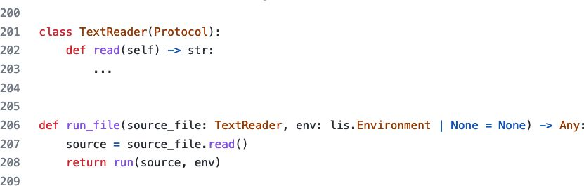
typing.Protocol allows (static) duck typing
25
25

Slide 27
typing.Protocol allows (static) duck typing
Protocol used in library code,
not in application code
23
23

Slide 28
typing.Protocol allows (static) duck typing
Protocol often defined
near API that requires it
24
24

Slide 29
Benefits of using
Preserve the flexibility of duck typing
typing.Protocol
Let your clients know what is the
minimal interface expected, regardless
of class hierarchies
Support static analysis
IDEs and linters can verify that an
actual argument satisfies the protocol
in the formal parameter
Reduce coupling
Client classes don’t need to subclass
anything; just implement the protocol.
26

Slide 30
Benefits of using
Preserve the flexibility of duck typing
typing.Protocol
Let your clients know what is the
minimal interface expected, regardless
of class hierarchies
Support static analysis
IDEs and linters can verify that an
actual argument satisfies the protocol
in the formal parameter
Reduce coupling
Client classes don’t need to subclass
anything; just implement the protocol.
27

Slide 31
Benefits of using
Preserve the flexibility of duck typing
typing.Protocol
Let your clients know what is the
minimal interface expected, regardless
of class hierarchies
Support static analysis
IDEs and linters can verify that an
actual argument satisfies the protocol
in the formal parameter
Reduce coupling
Client classes don’t need to subclass
anything; just implement the protocol.
This also makes testing easier.
28

Slide 32
The four
modes of typing
29

Slide 33
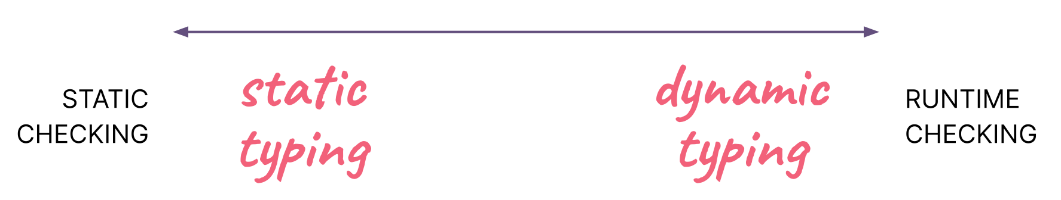
Static v. Dynamic Typing
30
30

Slide 34
Static v. Dynamic Typing
a matter of when
30
30

Slide 35
Python will remain a
dynamically typed
language, and the
authors have no desire
to ever make type
hints mandatory,
even by convention.
Guido van Rossum, Jukka Lehtosalo,
Łukasz Langa in PEP 484—Type Hints
32
32

Slide 36
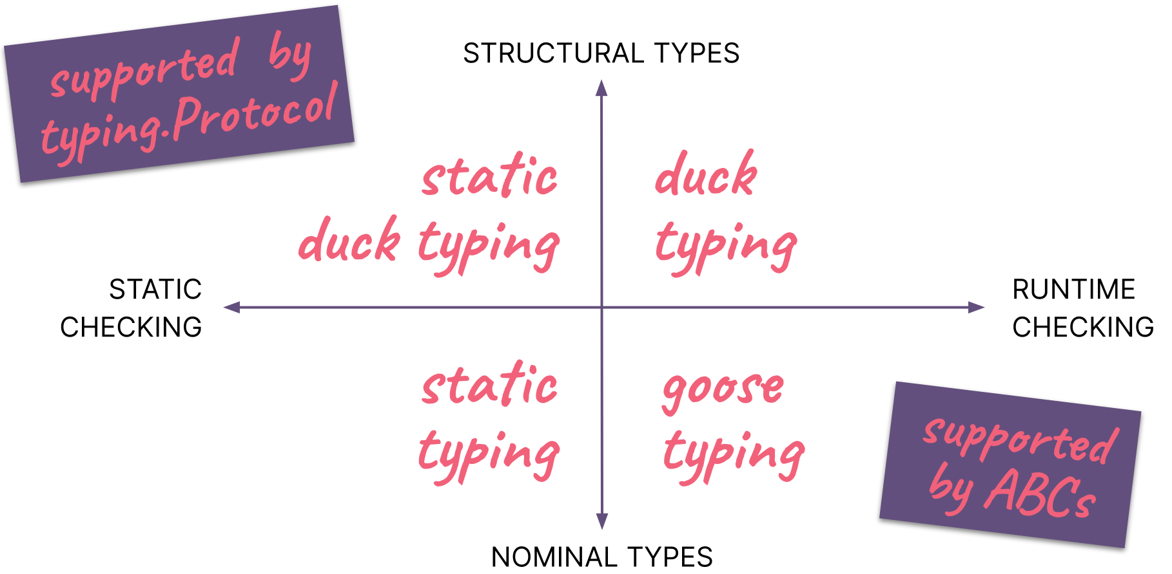
Typing Map
33
33

Slide 37
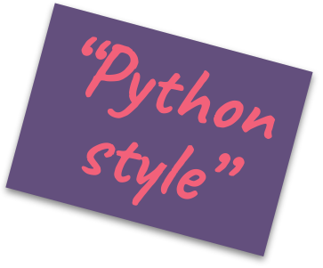
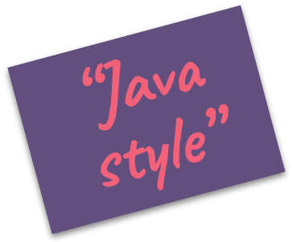
Typing Map
33
33

Slide 38
Typing Map
33
33

Slide 39
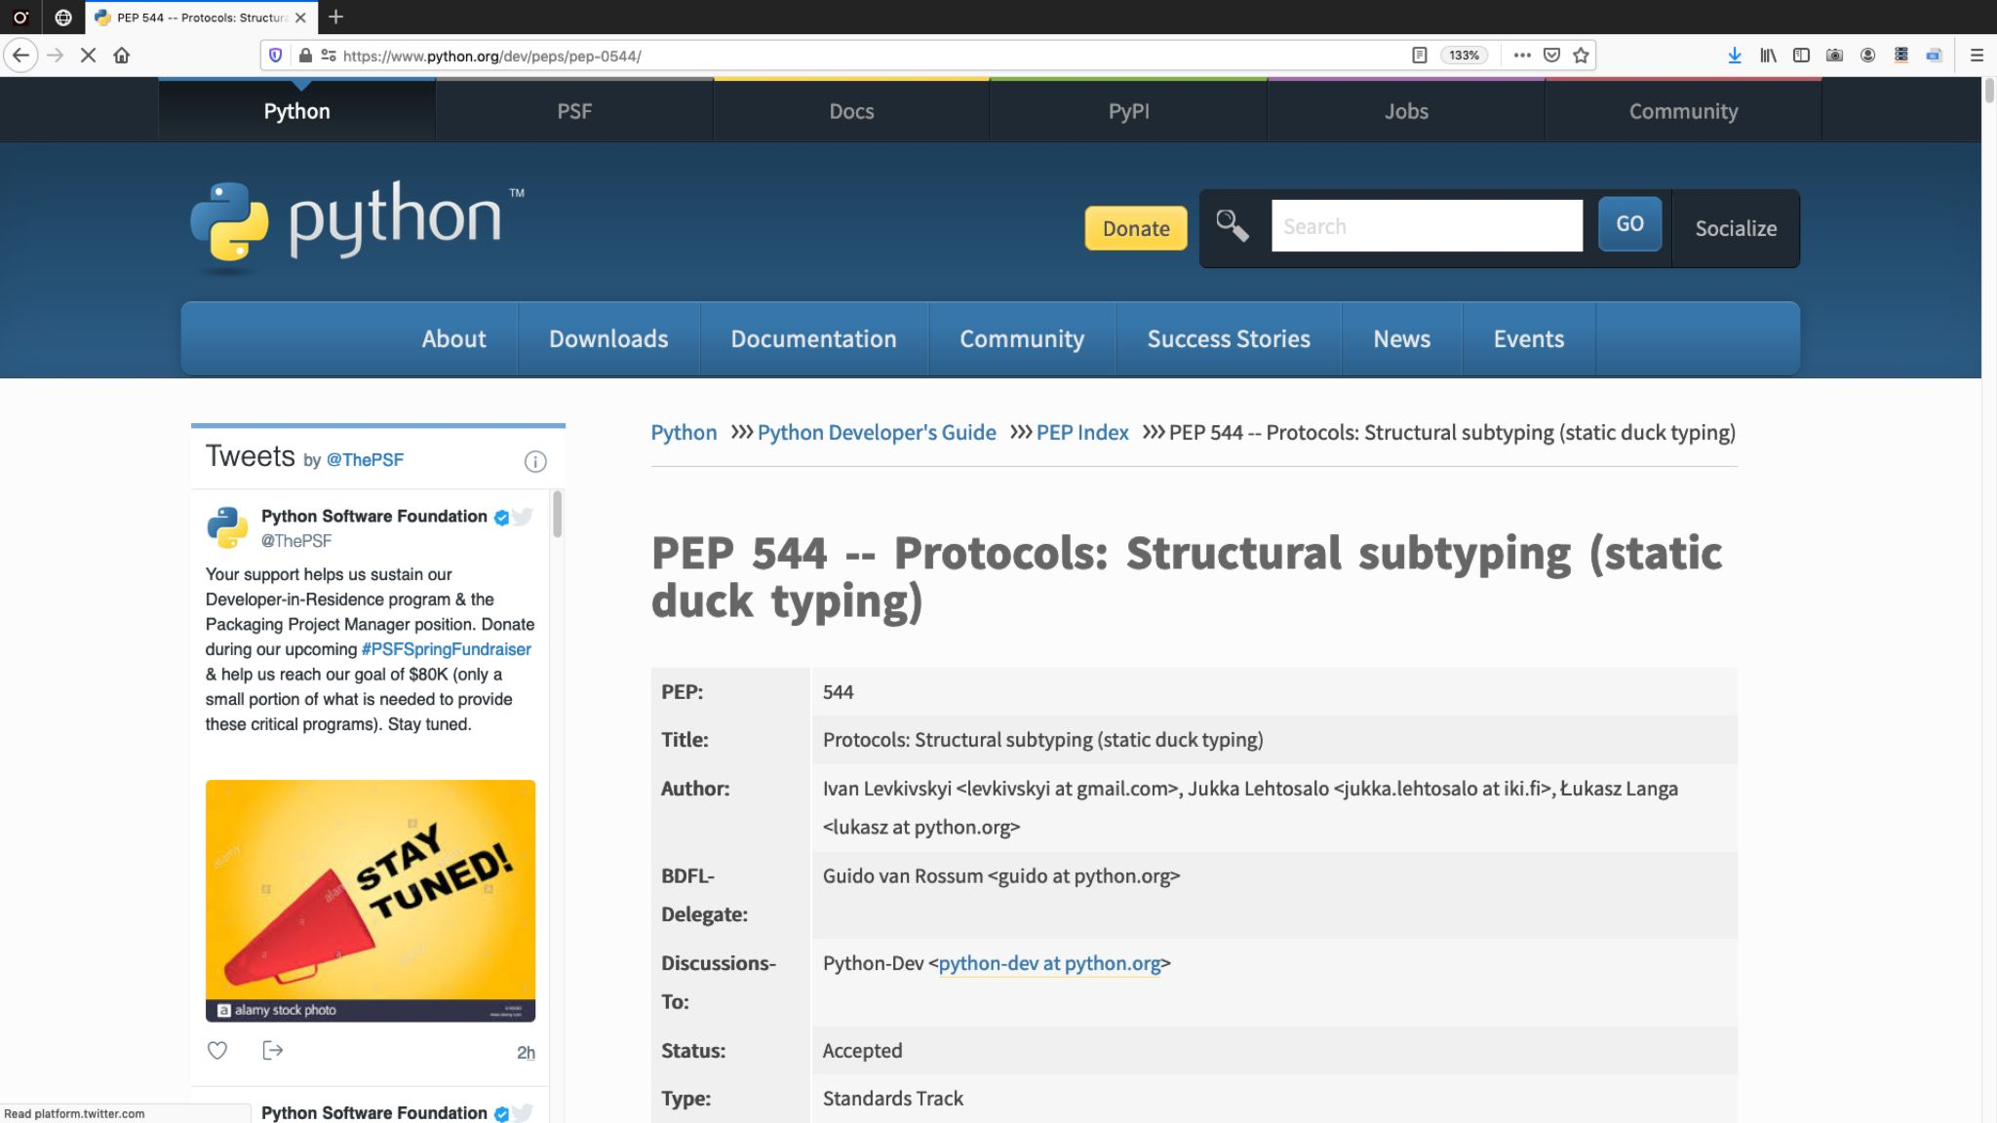
36

Slide 40
Typing Map
33
33

Slide 41
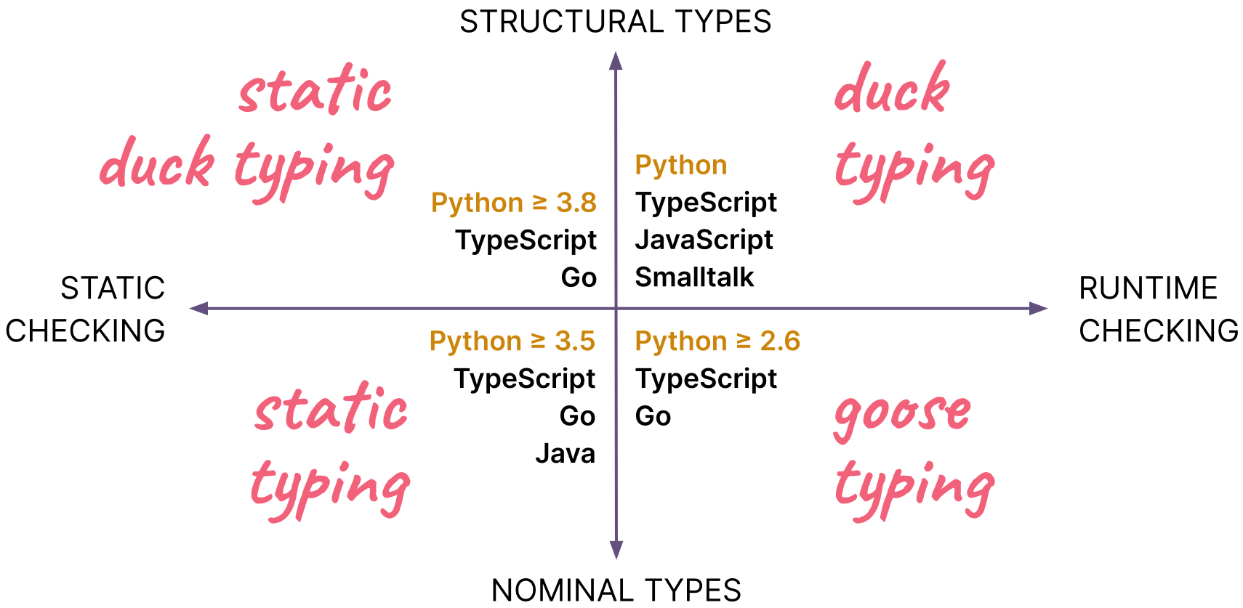
Typing Map: languages
33
33

Slide 42
More
Examples
39

Slide 43
2.
double
40

Slide 44
>>> def double(x):
... return x * 2
...
>>> double(3)
6
>>> double(3.5)
7.0
>>> double(3j+4)
(8+6j)
>>> from fractions import Fraction
>>> double(Fraction(1, 3))
Fraction(2, 3)
>>> double('Spam')
'SpamSpam'
>>> double([1, 2, 3])
[1, 2, 3, 1, 2, 3]
>>>
12

Slide 45
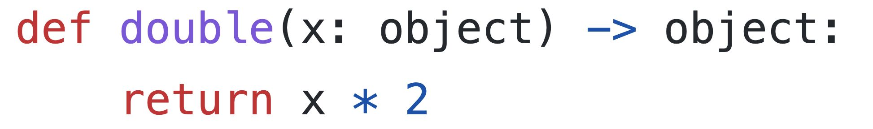
First take: object
Error: object
does not
implement
__mul__
42
42

Slide 46
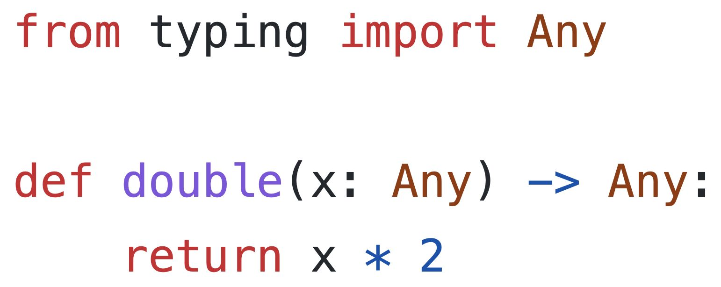
Second take: Any
Useless: Any
defeats type
checking
43
43

Slide 47
Every Python value is of type object.
Every Python value is of type Any.
The object type implements a narrow
interface, but Any is assumed to
implement the widest possible
interface: all possible methods!
13

Slide 48
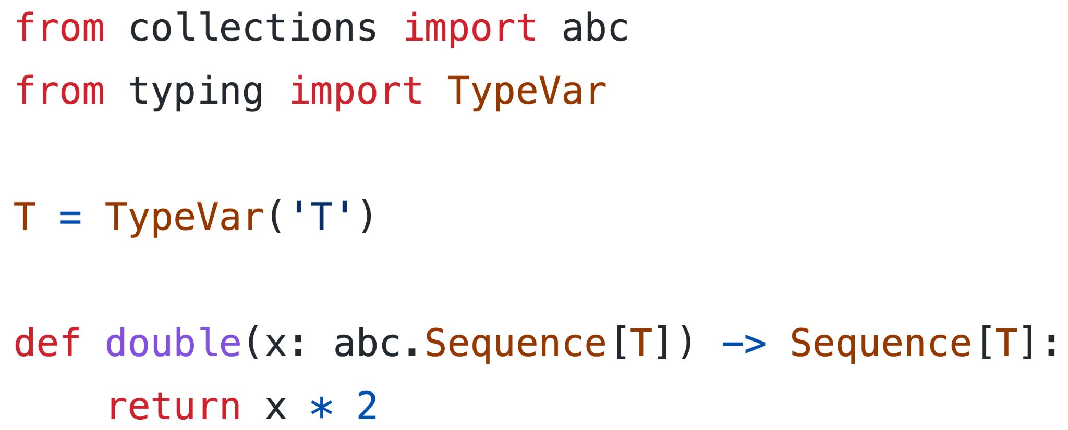
Third take: Sequence[T]
Only works with
sequences, not
numbers
44
44

Slide 49
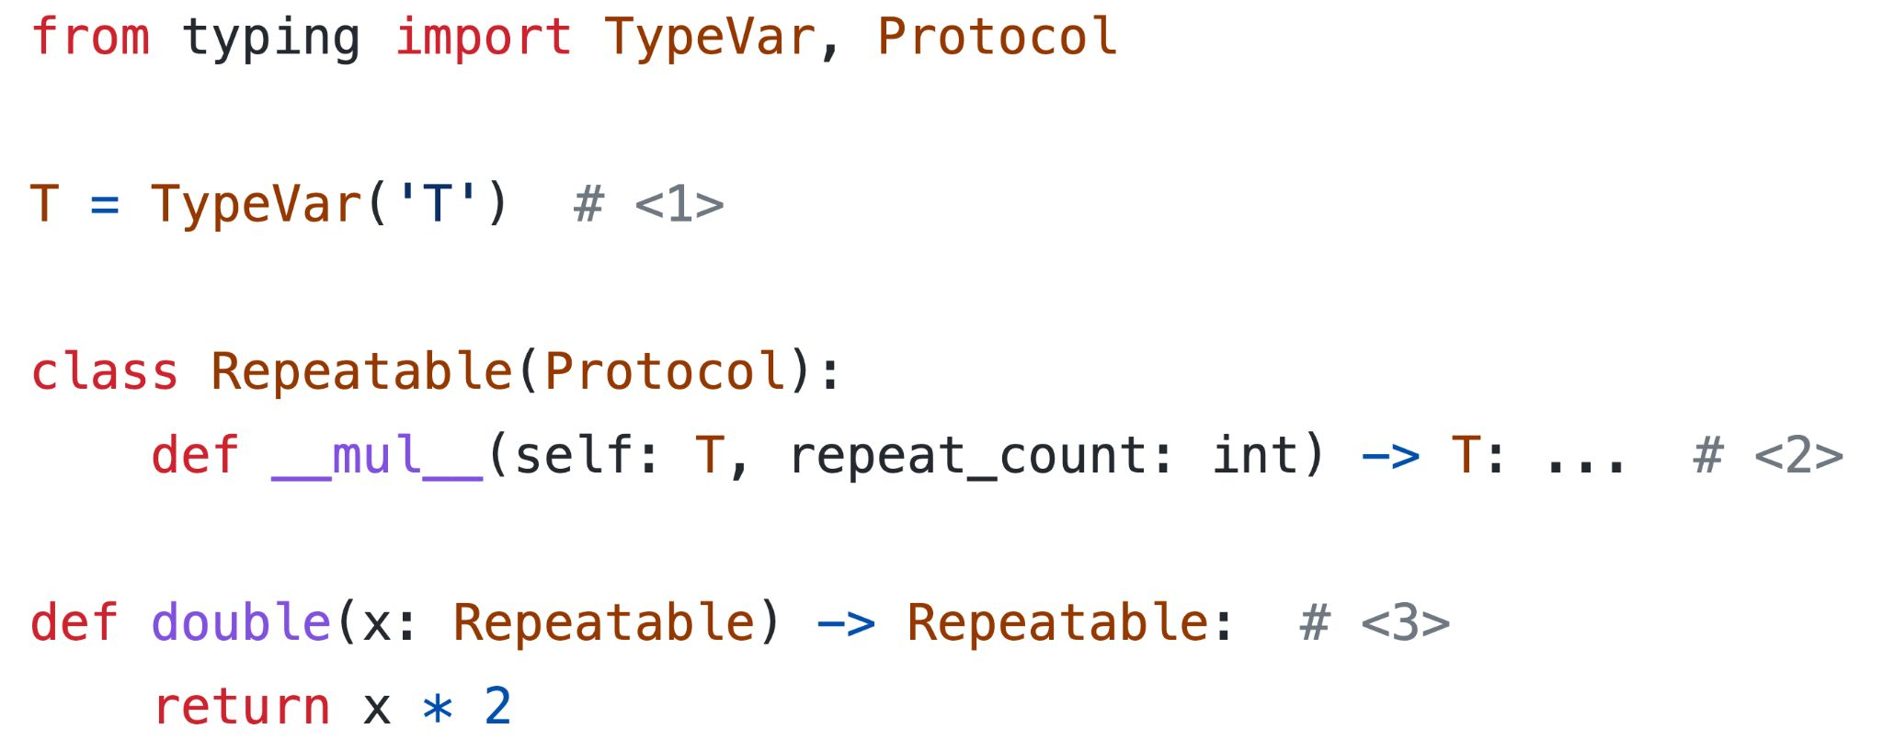
Fourth take: protocol misuse
Not OK: Type checker assumes
that result supports only
__mul__, and no other method.
45
45

Slide 50
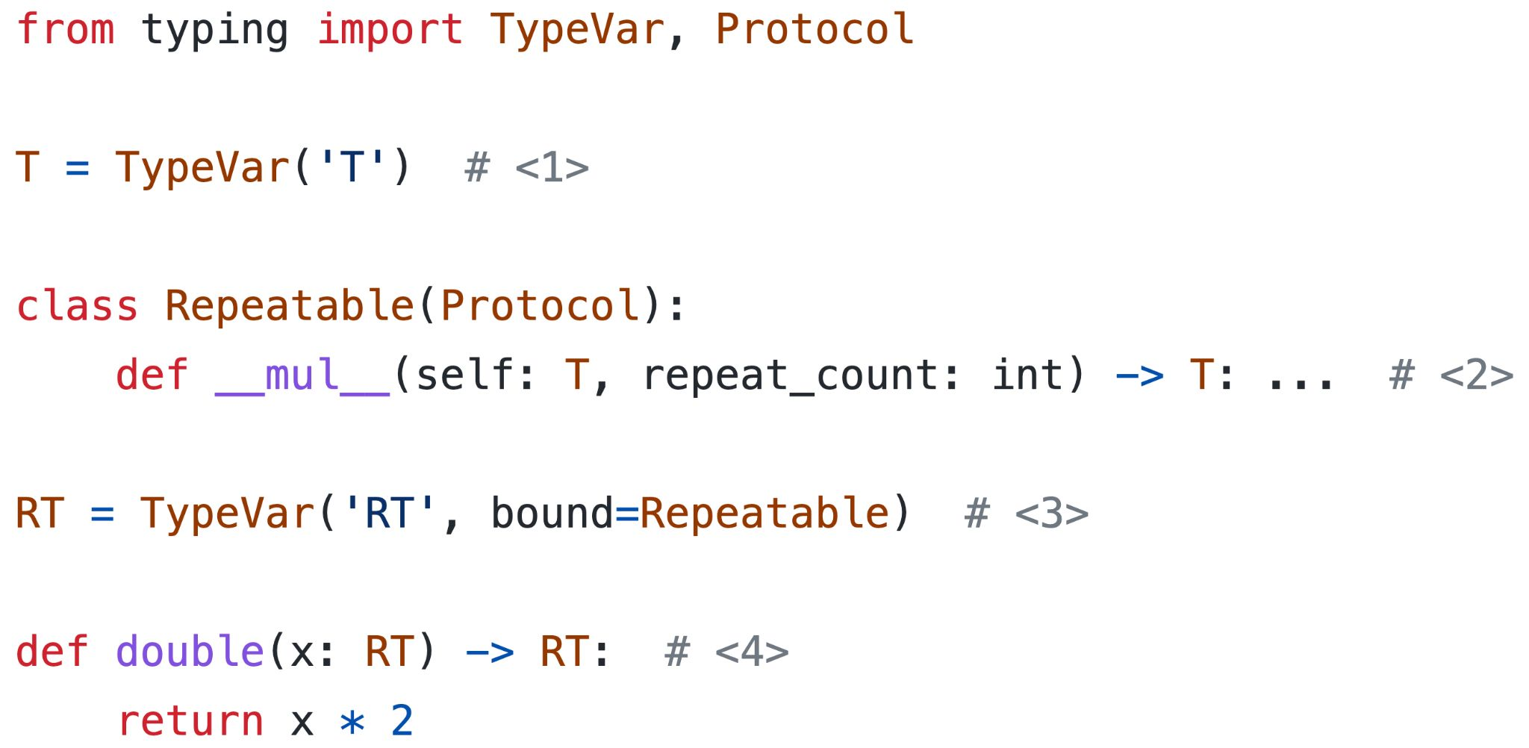

Solution: type variable bounded by protocol
46
46

Slide 51
3.
statistics.median_low
47

Slide 52
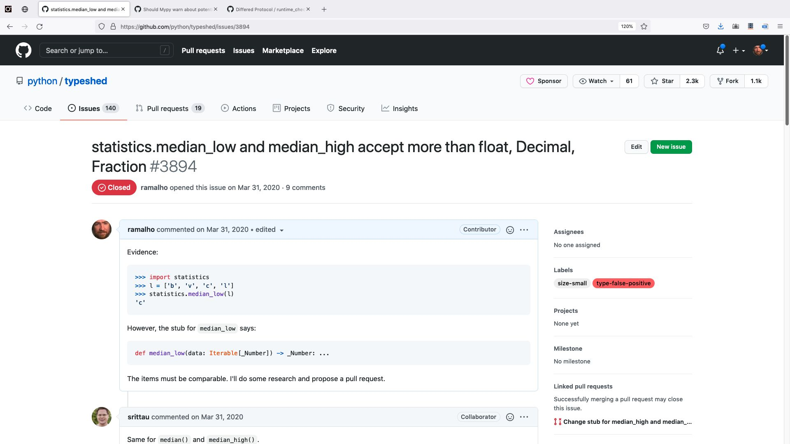
48

Slide 53
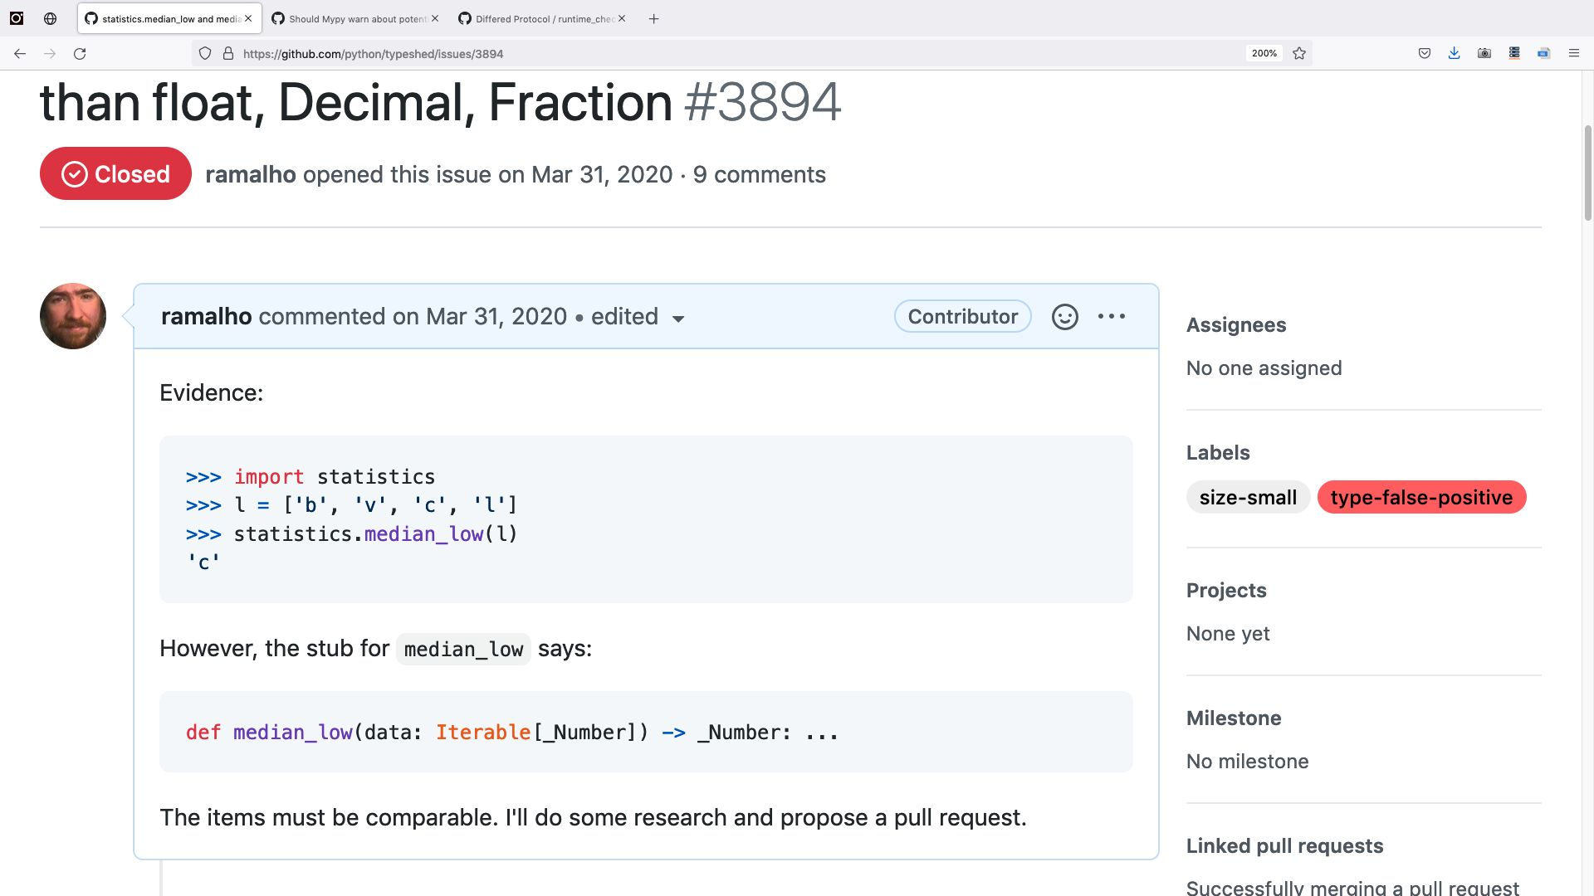
49

Slide 54
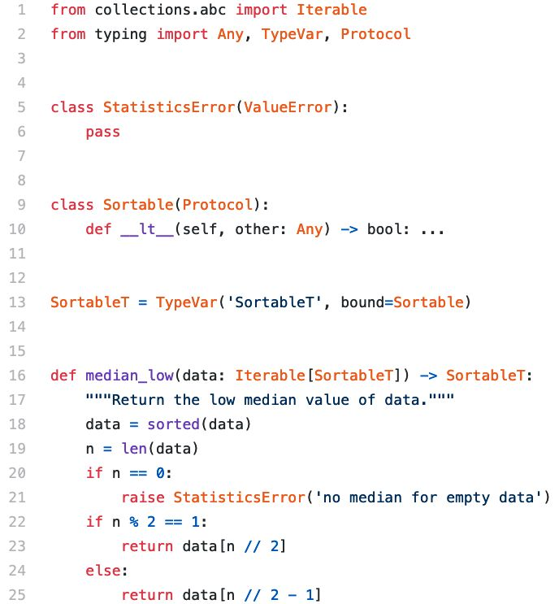
median_low: fixed code
etc.
50
50

Slide 55
First uses of the SupportsLessThan Protocol
Stub files for Python 3.9 standard library on typeshed in 2020
builtins: list.sort
bisect: bisect_left
max
bisect_right
min
insort_left
sorted
insort_right
statistics: median_low
heapq: nlargest
median_high
nsmallest
functools: cmp_to_key
os.path: commonprefix
51
51

Slide 56
Today* there are 120** Protocol
definitions on typeshed/stdlib
and nearly 100** on /stubs***
* 2024-05-24
** not counting network protocols
*** for external packages like Pillow, psycopg2, tensorflow, etc.

Slide 57
4.
max overload
52

Slide 58
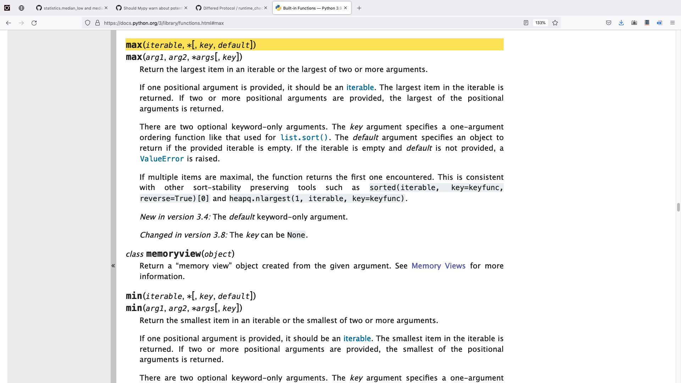
The max() built-in function
Flexible and easy to use, but very hard to annotate
53

Slide 59
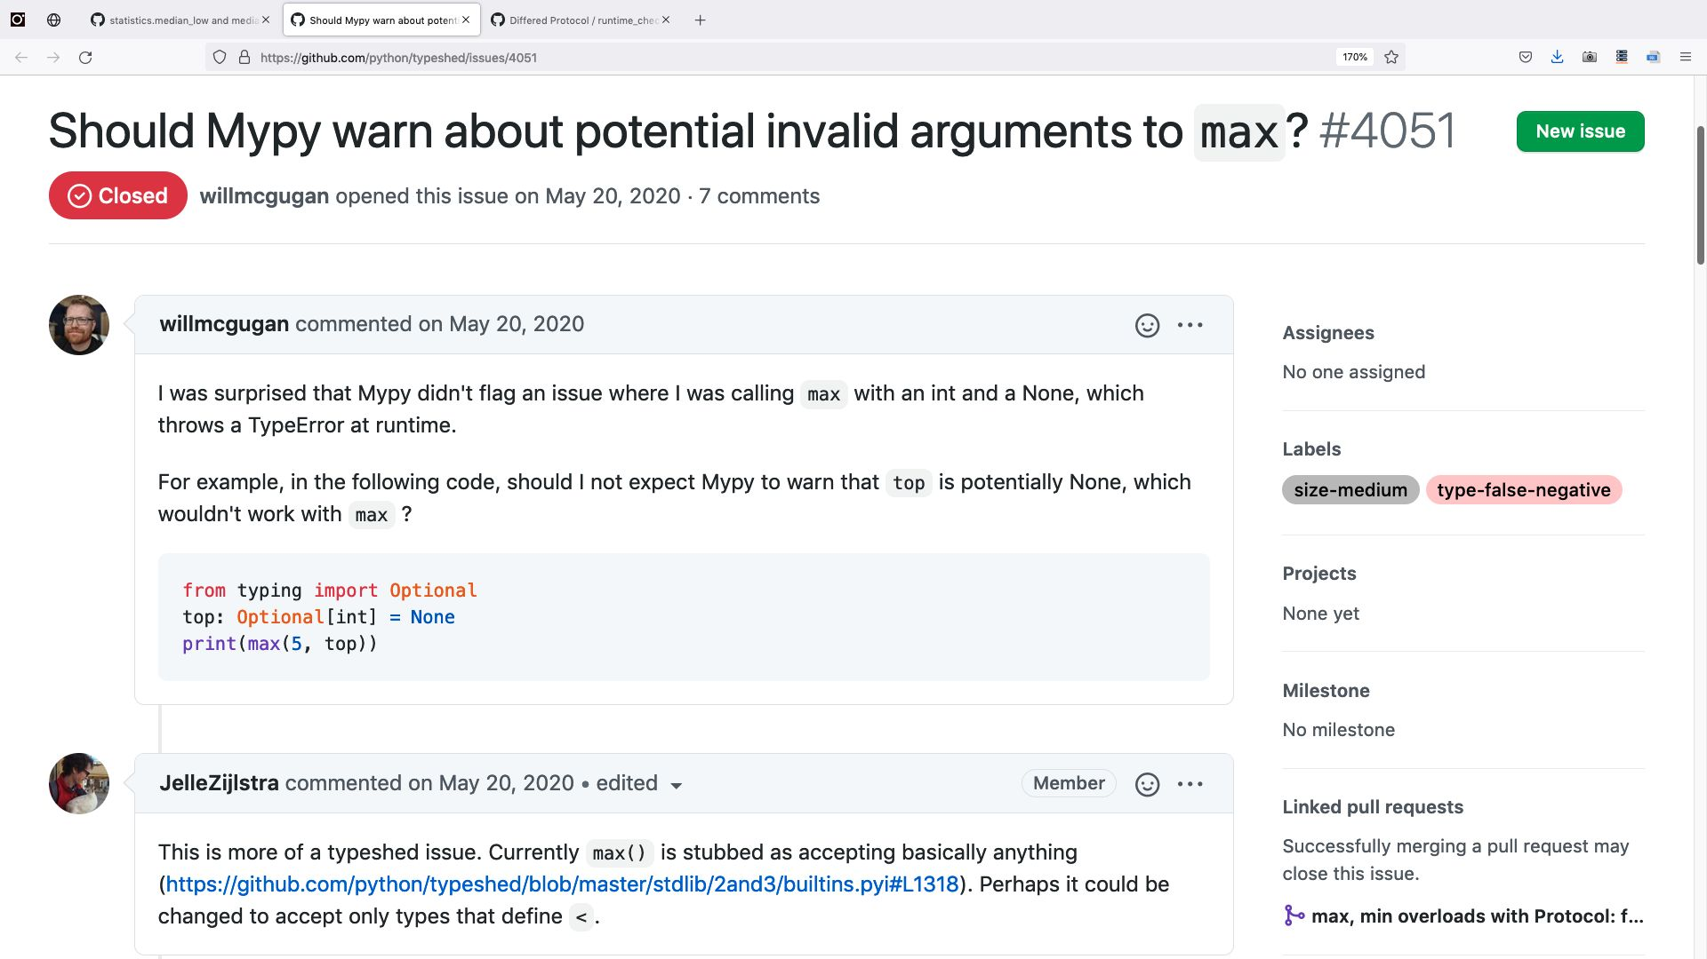
54

Slide 60

False
negative!
55

Slide 61
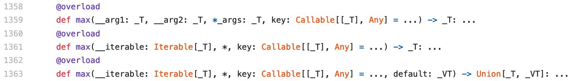
max: old type hints
56
56

Slide 62
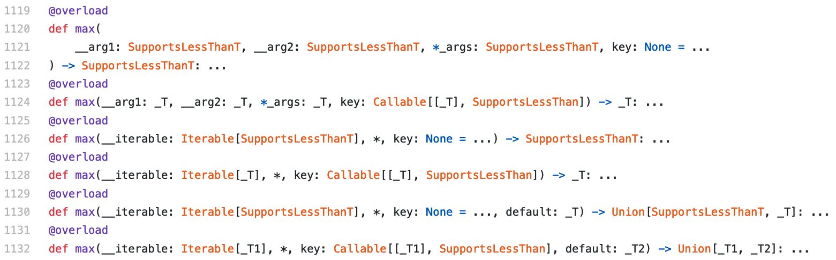
max: fixed type hints
57
57

Slide 63
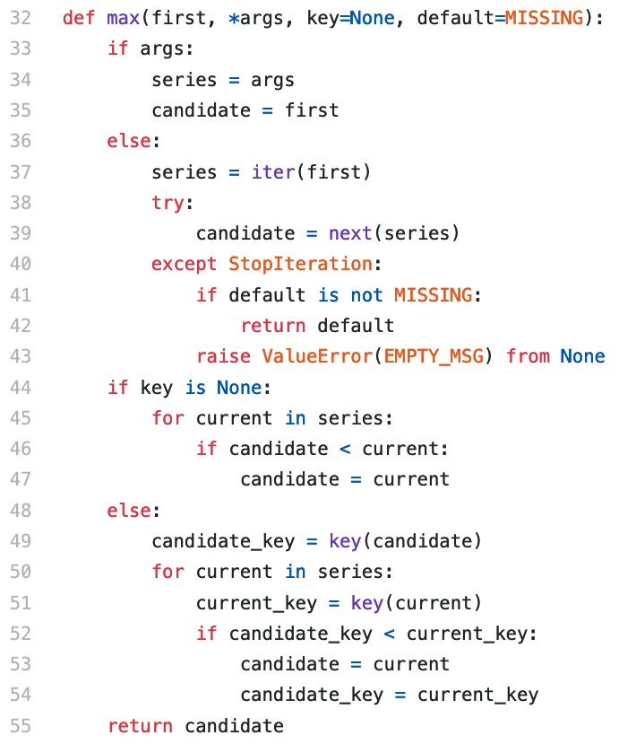
max
implemented in
Python, for testing
58
58

Slide 64
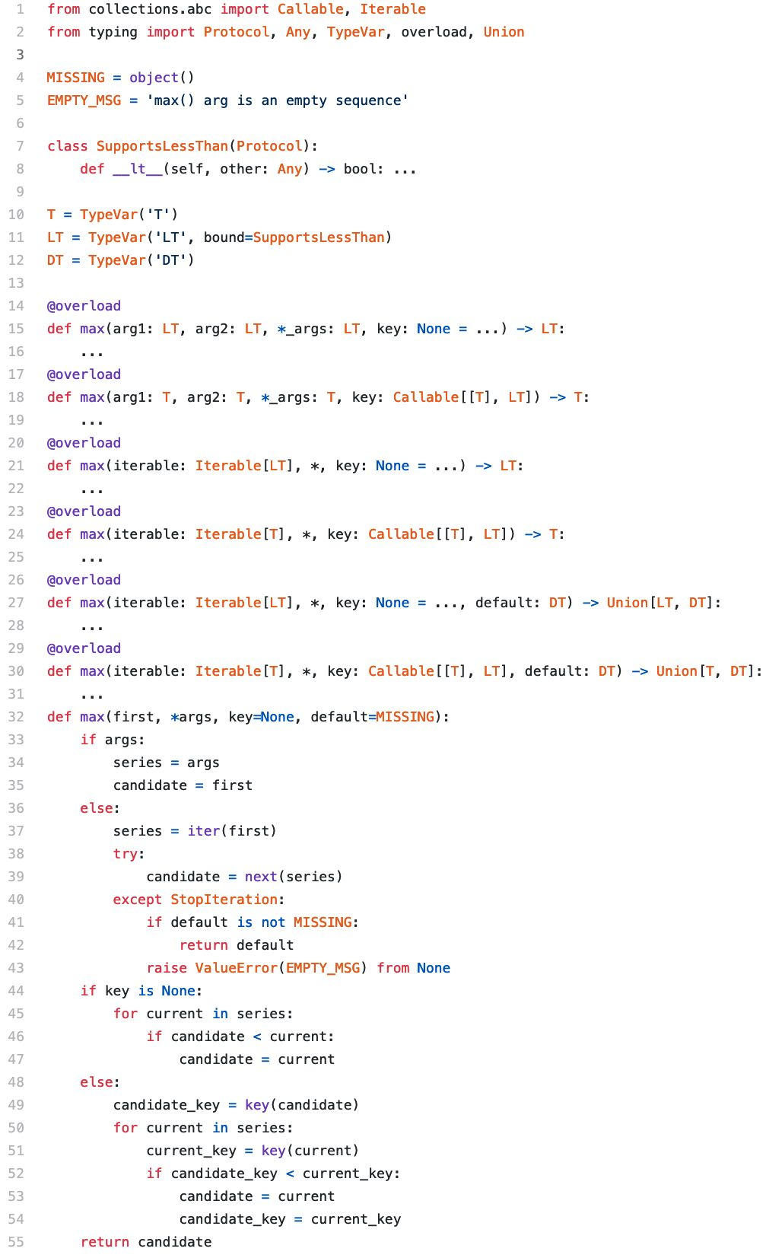
29
Lines of code for type hints:
7 imports, 4 definitions, and
6 overloaded signatures
26
Lines of code to implement all
the documented functionality,
with 2 constants, no imports
59
59

Slide 65
max overload: postscript
After I contributed SupportsLessThan to typeshed, a few things happened:
●
Edge cases were discovered where SupportsGreaterThan was needed
●
SupportsLessThan was replaced with SupportsGreaterThan, but this exposed
symmetric bugs in cases that previously worked
●
Both were superseded by SupportsDunderLT and SupportsDunderGT
●
Almost all of their uses were replaced with a new type—the union of both of
them—named SupportsRichComparison
○
This means most functions that involve comparisons in the standard library now have type hints that
accept objects implementing either < or >. No need to implement both.
●
For details, see:
https://github.com/python/typeshed/blob/master/stdlib/_typeshed/__init__.pyi
60

Slide 66
5.
Some protocols in the
standard library
61

Slide 67
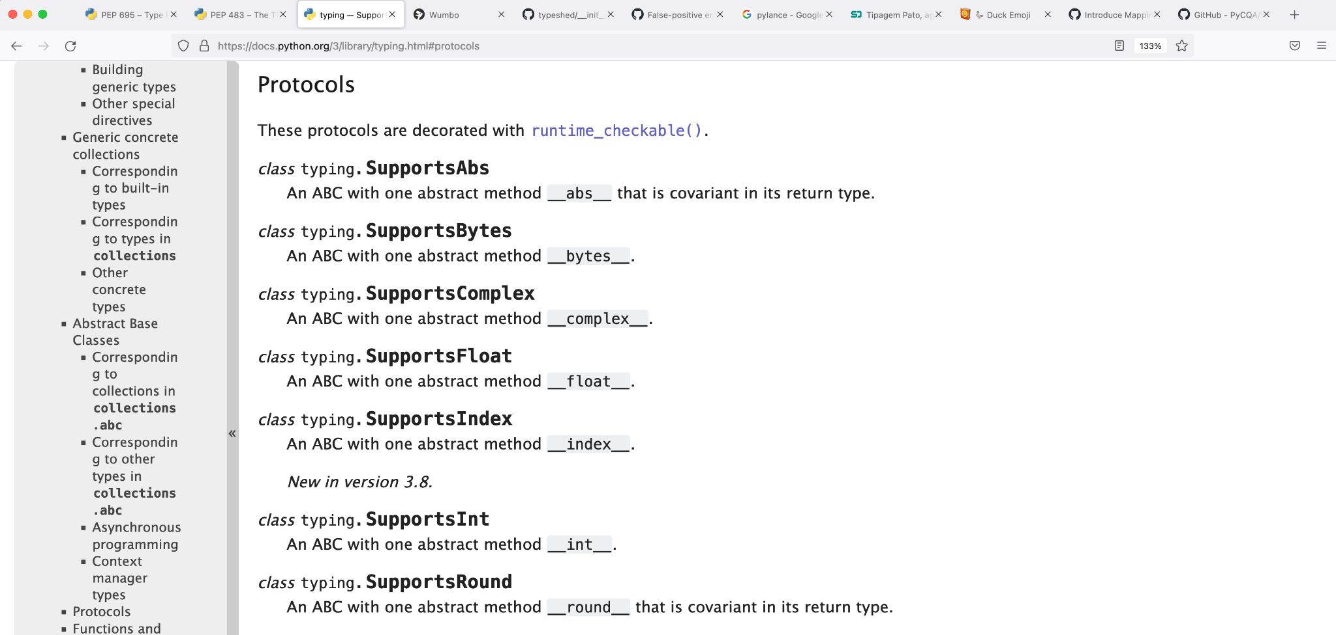
Protocols defined in the typing module
62

Slide 68
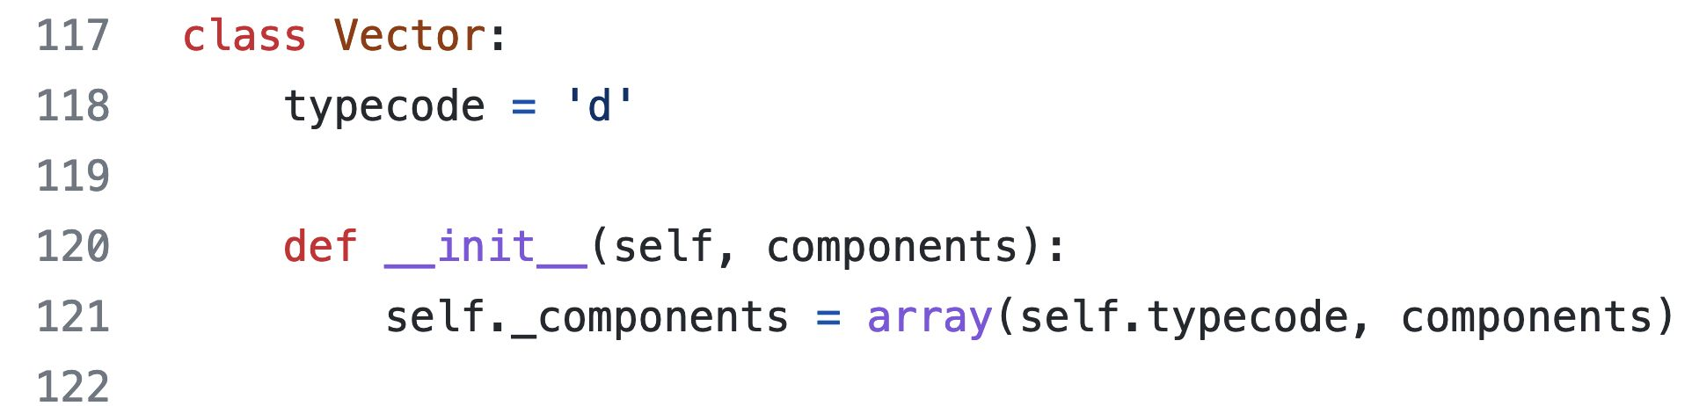
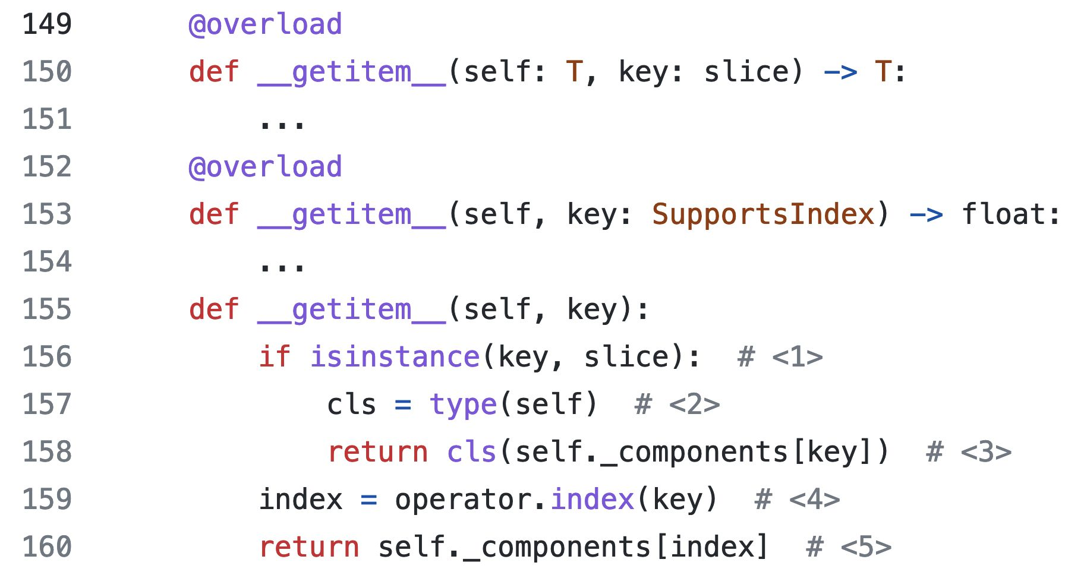
Example using SupportsIndex
63
63

Slide 69
Summary
64

Slide 70
Protocol definition for “a file-like object”
44
44

Slide 71
Use typing.Protocol
Support duck typing with type hints
to build Pythonic APIs
The essence of Python’s
Data Model and standard library
Follow the
Interface Segregation Principle
Client code should not be forced to
depend on methods it does not use
Prefer narrow protocols
Single method protocols should be the
most common. Sometimes, two
65

Slide 72
Use typing.Protocol
Support duck typing with type hints
to build Pythonic APIs
The essence of Python’s
Data Model and standard library
Follow the
Interface Segregation Principle
Client code should not be forced to
depend on methods it does not use
Prefer narrow protocols
Single method protocols should be the
most common. Sometimes, two
66

Slide 73
Use typing.Protocol
Support duck typing with type hints
to build Pythonic APIs
The essence of Python’s
Data Model and standard library
Follow the
Interface Segregation Principle
Client code should not be forced to
depend on methods it does not use
Prefer narrow protocols
Single method protocols should be the
most common. Sometimes, two
methods. Rarely more.
67

Slide 74
Bonus slides:
position statement
on type hints
68

Slide 75
Being optional is not a bug
of Python type hints.
69
69

Slide 76
Being optional is not a bug
of Python type hints.
It’s a feature that gives us the
power to cope with the inherent
complexities, annoyances, flaws,
and limitations of static types.
69
69

Slide 77
I don’t hesitate to use
# type: ignore to
avoid the limitations of
static type checkers
when submission to the
tool would make the
code worse or needlessly
complicated.
70
70

Slide 78
I don’t hesitate to use
# type: ignore to
avoid the limitations of
static type checkers
when submission to the
tool would make the
code worse or needlessly
complicated.
Me, in Fluent Python Second Edition
70
70

Slide 79
I don’t hesitate to use
# type: ignore to
avoid the limitations of
static type checkers
when submission to the
tool would make the
code worse or needlessly
complicated.
Me, in Fluent Python Second Edition
@ramgarlic@fosstodon.org
70
70

