Slide 1
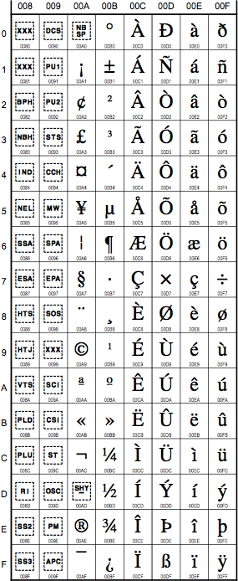
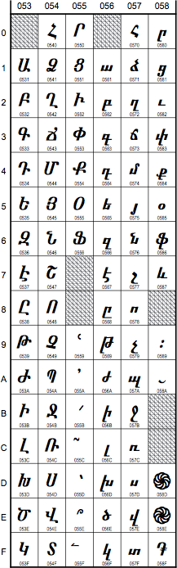
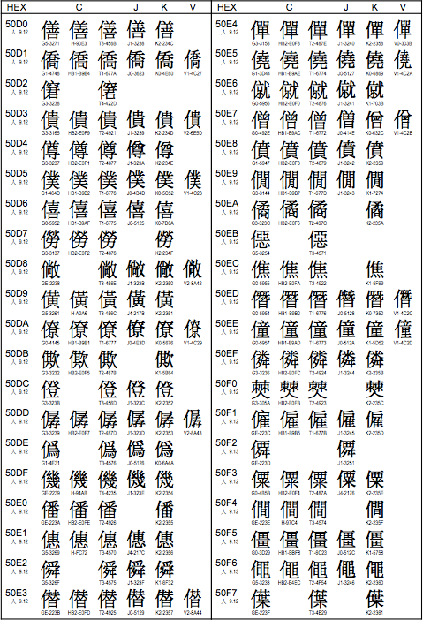
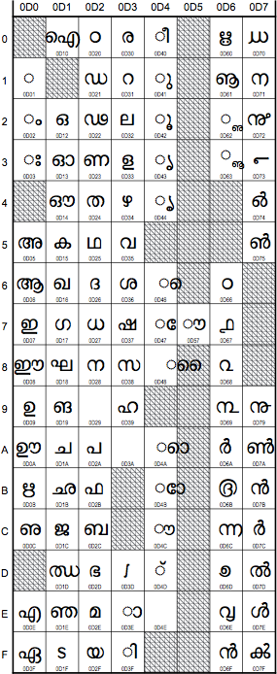
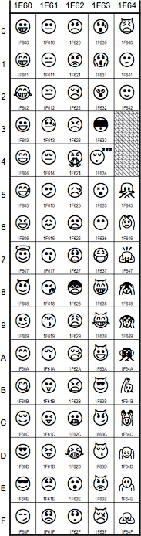
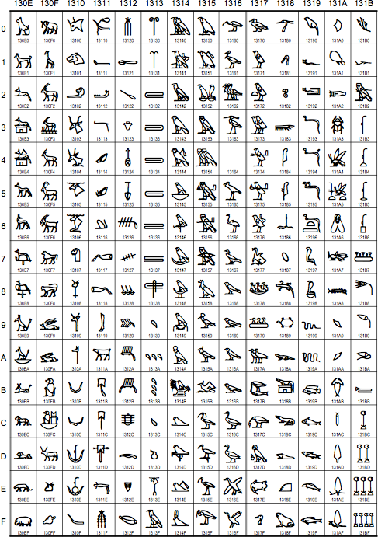
Unicode solutions in Python 2 and 3

Slide 2
Unicode solutions in Python 2 and 3
Latin-1
Armenian
Malayalam
CJK
Unified
Ideographs
Egyptian
Hieroglyphs
emoticons

Slide 3
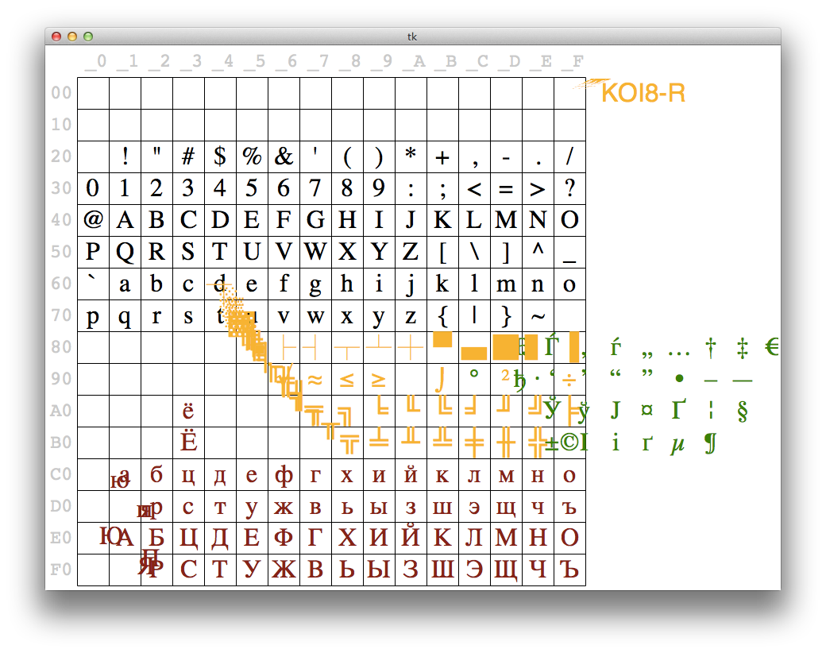
Dance of the codepages
Video: https://www.youtube.com/watch?v=J4qioAacrYo
Source code: http://bit.ly/1Oqt0MZ

Slide 4

Why Unicode
Too many incompatible single-byte encodings
Enough incompatible multi-byte encodings
Separate concepts:
  character identity: one code point for each abstract character
    U+0041 → LATIN CAPITAL LETTER A
    U+096C → DEVANAGARI DIGIT SIX
  binary representation: multiple encodings
    U+0041 → 0x41 | 0x41 0x00
    U+096C → 0xE0 0xA5 0xAC | 0x6C 0x09
UTF-8
UTF-16LE

Slide 5
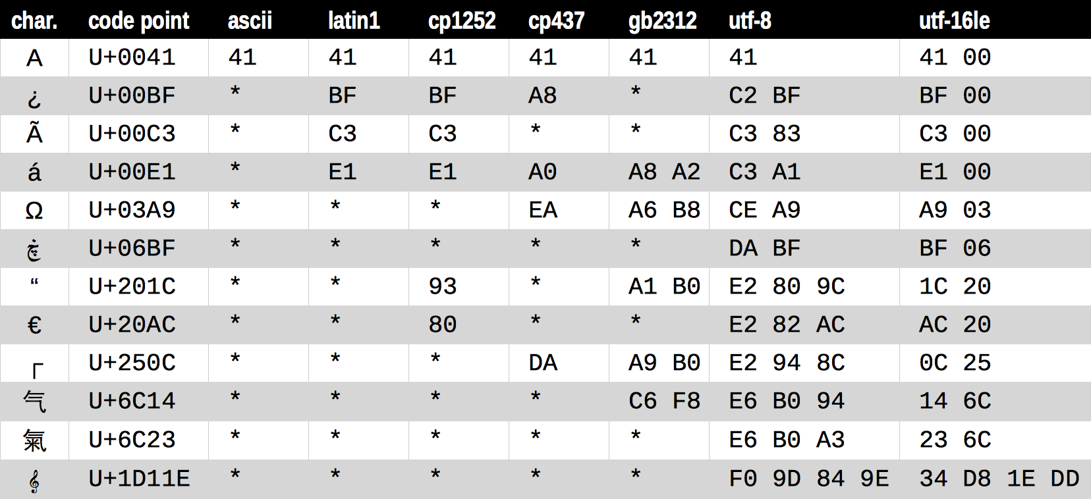
A sample of encodings
Figure 4-1 of Fluent Python

Slide 6
.encode() vs .decode()
“Humans use text. Computers speak bytes.”
  Esther Nam and Travis Fischer in
  Character encoding and Unicode in Python
  (Pycon US 2014)
Use .encode() to convert human text to bytes
Use .decode() to convert bytes to human text
2.7 gotcha:
the methods
.encode() and .decode()
exist in str and unicode

Slide 7
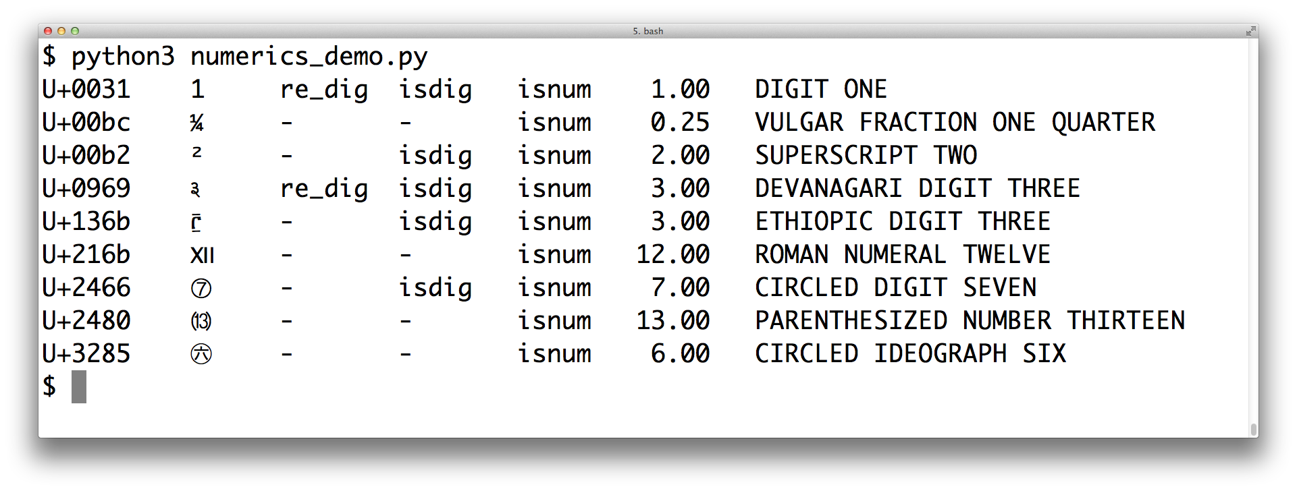
Unicode database

Slide 8
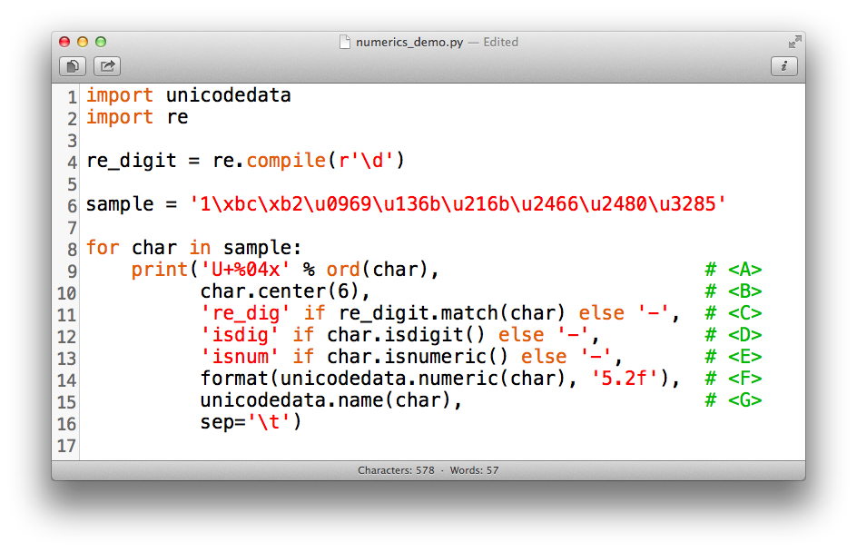
Unicode database

Slide 9
Coping with Unicode Errors
SyntaxError
  A .py file is loaded with contents in an unexpected encoding
UnicodeDecodeError
  A binary sequence is contains bytes that are not valid in the expected encoding
UnicodeEncodeError
  A Unicode string contains codepoints that have no representation in the desired encoding

Slide 10
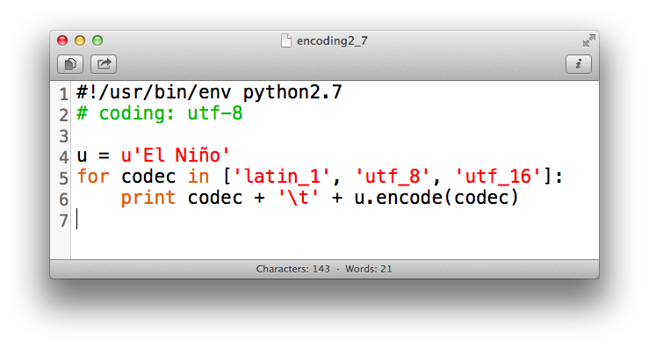
Coping with SyntaxError
A .py file is loaded with contents in an unexpected encoding
  The source file encoding is not the default, and no
  # encoding comment was found.
  The source file encoding is not the one declared in the # encoding comment
Defaults:
    Python 2.7 == ASCII
    Python 3.x == UTF-8
2.7 gotcha:
default source
encoding is ASCII

Slide 11
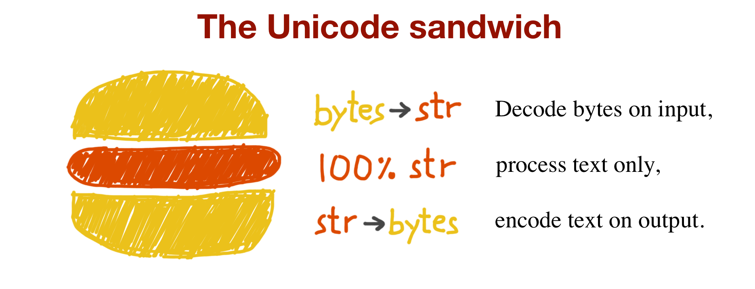
Best practice
Figure 4-2 of Fluent Python

