Slide 1

Introduction to OpenCL
Concurrent Programming

Slide 2
Inhalt
Types of parallelism
OpenCL platform
Programming model
  Extensions

Slide 3
Types of parallelism
Task parallelism
  Client connection handler
  Web crawler
  ...
Data paralellism
  Image manipulation
  Vector arithmetics
  ....

Slide 4
Types of parallelism – Task parallel hardware
Modern CPUs
  Multiple, full-blown CPU cores
  Branch-prediciting
  Caching
  Independent from each-other (but share infrastructure)

Slide 5
Types of parallelism – Data parallel hardware
Modern GPUs
  SIMD – Single instruction multiple data
  „stupid“ processors
  One GPU processor can execute several threads at once

Slide 6
Overview of work splitting
Time
Serial Execution
Multi-Threading (CPU)
Massivly parallel (GPU)
T0
0
1
2
3
4
5
6
7
8
9
10
15
T0
0
1
2
3
T1
4
5
6
7
T2
8
9
10
11
T3
12
13
14
15
T0
0
T1
1
T2
2
T3
3
T15
15

Slide 7
OpenCL Platform
Platform for data parallel applications
  No support for task based parallelism
Data paralellism
  SPMD – Single program multiple data
Programs are written as Kernels
  One kernel executed on one Work Item

Slide 8

OpenCL Platform - Overview

Slide 9
OpenCL Platform
Program consitst of Kernels
A Kernel is executed on a Work Item
Wok Items are grouped to Work Groups

Slide 10

OpenCL Platform - Overview

Slide 11
OpenCL Platform - Memory
Host memory
Memory is separated to reflect the possibilty of GPUs
Global memory (biggest, slowest) / Constan memory
  All work items have access
  On GPU: Streaming memory
Local memory
  All work items in same group share it
Private memory (smallest, fastest)
  Private to a work item

Slide 12
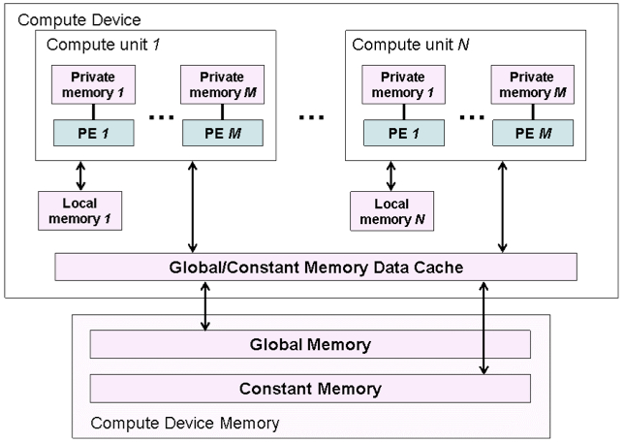
OpenCL Platform - Memory

Slide 13
OpenCL Platform - Memory
Explicit memory management
  You have to decide what to put to which memory location
Be careful with optimizations
  On CPUs no such thing as „local“ memory exists, only RAM

Slide 14
OpenCL Programming Model
Programs are writen in OpenCL C
  Compiled at runtime by a specialized, device dependent compiler
  Generates highly optimized code
  Some overhead
No fancy memory management units on GPU
  No SIGSEGV
  Display server can crash

