Slide 1
Making NATs work for
Online Gaming and VoIP
Dr. Cullen Jennings
fluffy@cisco.com

Slide 2
Topics
Requirements that Gaming & VoIP place on NATs
Solutions with NATs
Types of NATs
Protocols to work with NATs
NAT Market
How to Build Good NATs
IETF Work

Slide 3




Gaming, VoIP, and Collaboration
Real time response is needed to serve these applications
  Need low latency
  Applications use significant bandwidth
Data flows between 2 or more end points
  Client to Client not Client to Server
UDP is usually used for Real Time data
  TCP Retransmission increases latency too much
Voice and Video
Data Collaboration

Slide 4
What NATs Do
Allow many computers with private IP addresses to sit behind a single public IP address
Send packets that arrive at the public IP address to the correct computer behind the NAT
Reduce number of public IP addresses needed
Allow partitioning of who manages the IP address space

Slide 5
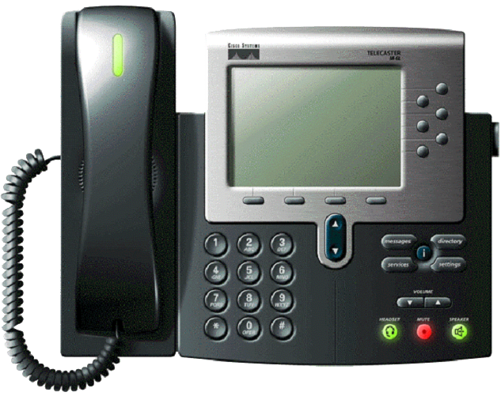


The NAT Problem
Alice wants to call Bob, whose phone is behind a NAT
Bob needs to tell Alice where to send her IP packets
to let them traverse his NAT
STUN (RFC 3489) solves this for most NATs
Alice needs to send
packets to Bob
The NAT doesn’t
permit Alice’s packets
to reach Bob
Bob must tell Alice
how to traverse his
NAT
Alice
Internet
NAT
Bob

Slide 6
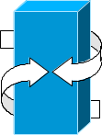
Relay Solution
(Not appropriate for Real Time data)
A communicates with B through a relay
Server hosting must have bandwidth for all traffic from A → B
Resulting latency is higher
Relay needs bandwidth for all the data among all clients
SERVER
Client A
Client B

Slide 7
The Latency Problem
Taipei
Taipei
RELAY
RELAY
45 ms
45 ms
140 ms
280 ms
A
B
A
B
Tokyo
20 ms
Tokyo
San Jose
150 ms
Amsterdam
Communication is often between parties in same geography
When parties are separated, relay is often off path
Human communications work best at < 150ms latency
  Arcade games require even less latency

Slide 8
Echo Server Solutions
STUN (RFC 3489) is an example of this class of solution
Used for online gaming & VoIP for many years
Servers
What’s my public IP address?
It is a.b.c.d
Tell server when client can receive data
Server tells client where to send data
Client sends data directly to other client
1
2
5
1
2
5

Slide 9
How STUN (RFC 3489) works
Bob pings the STUN server to discover the NAT’s public IP address and create a forwarding in the NAT.
Bob then tells this address to Alice.
STUN Servers
Bob sends packet to stun server
NAT maps packet to be from
1.2.3.4:5555
STUN replies and says address
packet came from is 1.2.3.4:5555
NAT forwards to Bob
Bob tells Alice to send
to 1.2.3.4:5555 and sends a packet to where Alice will send from
Alice sends to 1.2.3.4:5555
NAT forwards to Bob
2
3
6
1
4
7
Alice
5
Bob

Slide 10
When does STUN work?
Stun
Server
Stun
Server
Client B
Client B
1234
1234
1234
4568
NAT
NAT
Client A
Client A
Echo server works when NAT binding is endpoint independent
Echo server does NOT work when ports change
This is bad

Slide 11

Types of NATs: Full Cone
Mapping: Forward 2 to 1
4.4.4.4:444
1.1.1.1:111
2.2.2.2:222
1 sends to 4.
The NAT creates a mapping and forward from 2 to 4 and sends
the packet to 4 from 2
Now any packets that arrive at 2 are forwarded to 1
Both 5 and 4 can send a packet to 2 and have it forwarded to 1
Works with STUN
5.5.5.5:555

Slide 12
Types of NATs: Address Restricted
Mapping:
Forward 2 to 1 if from 4.4.4.4:*
Forward 2 to 1 if from 5.5.5.5:*
4.4.4.4:444
1.1.1.1:111
2.2.2.2:222
5.5.5.5:555
1 sends to 4
The NAT creates a mapping and forward from 2 to 4 and sends the packet to 4 from 2
1 sends to 5 and NAT creates similar binding
Now any packets that arrive at 2 from 4 or 5 are forwarded to 1.
Packets from 6 get dropped because 1 never sends to 6
Most Restricted NATs are port restricted, not address restricted
Works with STUN - can send RTP from any port
6.6.6.6:666

Slide 13
Types of NATs: Port Restricted
Mapping:
Forward 2 to 1 if from 4.4.4.4:444
Forward 2 to 1 if from 5.5.5.5:555
4.4.4.4:444
1.1.1.1:111
2.2.2.2:222
5.5.5.5:555
1 sends to 4
The NAT creates a mapping and forward from 2 to 4 and
sends the packet to 4 from 2
1 sends to 5 and NAT creates similar binding
Now any packets that arrive at 2 from 4 or 5.5.5.5:555 are
forwarded to 1
Packets from 5.5.5.5:666 get dropped because 1 never sends to 5.5.5.5:666
Works with STUN - must send & receive RTP from same port
5.5.5.5:666

Slide 14
Types of NATs: Symmetric
Mapping:
Forward 2 to 1 if from 4.4.4.4:444
Forward 3 to 1 if from 5.5.5.5:555
4.4.4.4:444
1.1.1.1:111
2.2.2.2:222
5.5.5.5:555
2.2.2.2:333
1 sends to 4
The NAT creates a mapping and forward from 2 to 4 and sends the packet to 4 from 2
1 sends to 5 and NAT creates mapping from new port 3 to 5
Now any packets that arrive at 2 from 4 or at 3 from 5 are forwarded
Packets from 6 get dropped because 1 never sends to 6
Does NOT work with STUN - needs TURN or other media relay
6.6.6.6:666

Slide 15
Security Implications
Endpoint independent bindings do not change the security properties of NATs
NATs can accept packets from anyone, or they can decide to only accept packets only from computers to which they have sent a packet to (reciprocal)
Either way, NATs should have endpoint independent binding

Slide 16
Hairpin Media
Alice
Internet
Bob
NAT
Happens when both clients are behind the same NAT
NAT must send data from client A to the NAT’s public IP where it loops back to client B

Slide 17
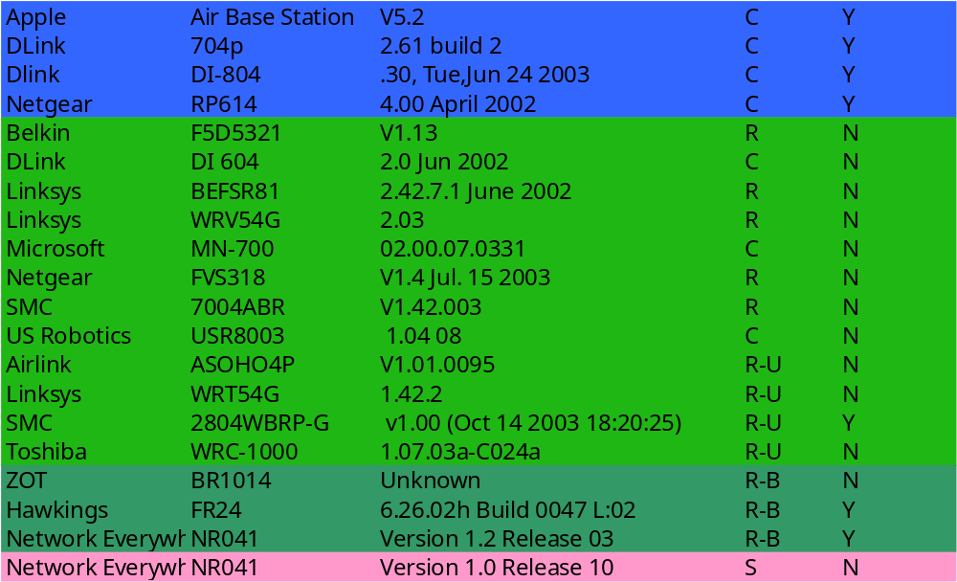
Survey of NATs (2004 Q1)
Hairpin
Type
OK
OK but no hairpin without
ICE
OK one phone
NO

Slide 18
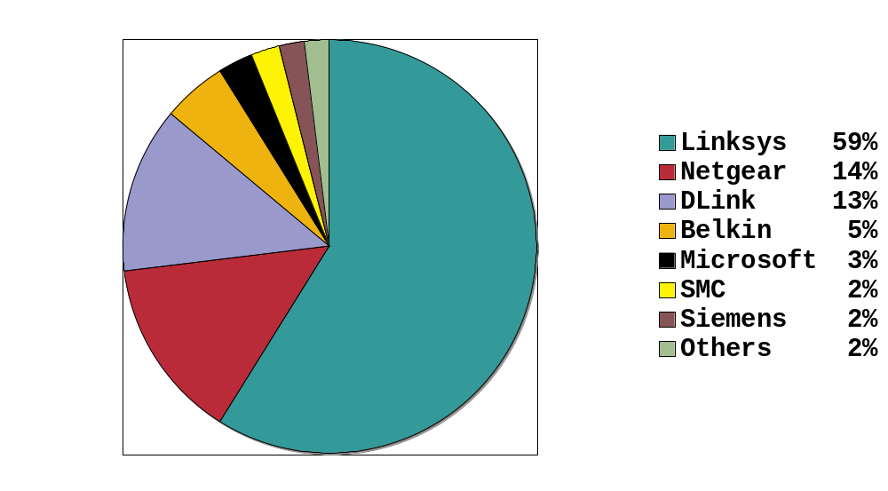
Percentage Deployment of NAT in US
Data from AOL study
  Most data is this space is not public.
Consistent with other reports
Fairly US Centric - not accurate for Asia
(source http://www1.ietf.org/mail-archive/web/midcom/current/msg03507.html)

Slide 19
IETF Update
IETF has not encouraged NATs
  IPv6 is a better solution
  It will be many years before IPv6 is fully deployed
At last IETF, a BOF on NAT Behavior was held
  Plan to form working group to create formal RFC addressing best current practices around NAT behavior
Read draft-audet-nat-behave-00.txt

Slide 20
Key BEHAVE Draft Recommendations
Bindings are endpoint independent
UDP binding expiry time > 2 minutes
Have SIP ALGs off by default
Support Hairpin media
Read draft-audet-nat-behave-00.txt

Slide 21
Recommendations & Predictions
Online Gaming & VoIP will drive the NATs that service providers recommend and support
Most vendors will build NATs that work this way
Ensure that your NAT:
  provides endpoint independent port translation
  behaves consistently
  can hairpin media
This is no more work that doing the wrong thing
Follow the advice of IETF drafts
  Applications will follow the advice of the drafts

