Slide 1

“Classroom Attendance Tracker ”
Sanjivani Rural Education Society’s
Sanjivani College of Engineering, Kopargaon 423 603
(Affiliated to Savitribai Phule Pune University, Pune )
Department of Computer Engineering
Prepared By,
MS. VAISHNAVI BORSE [UCS23F1019]
MS. TANISHKA BHAKRE [UCS23F1011]
Guided By,
Prof. S. S. Gawali

Slide 2
Contents
Sanjivani Rural Education Society’s
Sanjivani College of Engineering, Kopargaon 423 603
(Affiliated to Savitribai Phule Pune University, Pune )
Department of Computer Engineering Research Center
Introduction of project
Functionality of project
Details about Data types used in project
Details about predefine module/libraries used in project
Details about predefined function.
Output of Code.

Slide 3
Introduction
Sanjivani Rural Education Society’s
Sanjivani College of Engineering, Kopargaon 423 603
(Affiliated to Savitribai Phule Pune University, Pune )
In educational institutions, monitoring and managing student attendance is a critical aspect of ensuring academic success and accountability. Traditional methods of attendance tracking, such as manual roll calls, are often time-consuming, prone to errors, and lack real-time visibility. To address these challenges, modern technology offers innovative solutions, such as classroom attendance trackers.
Objectives:
The objective of the classroom attendance tracker is to automate and streamline the process of recording student attendance, providing educators with real-time visibility into student presence.
By ensuring accuracy and accountability in attendance management, the system aims to facilitate data analysis for identifying trends and informing interventions.
With a focus on integration, scalability, user experience, compliance, and security, the tracker aims to enhance efficiency and effectiveness in attendance tracking while prioritizing data privacy and user satisfaction.

Slide 4
Functionality of Project
Sanjivani Rural Education Society’s
Sanjivani College of Engineering, Kopargaon 423 603
(Affiliated to Savitribai Phule Pune University, Pune )
Attendance recording for multiple subjects.
Viewing attendance for a specific subject and date.
Entering attendance for a subject and date.
Adding new students to the database.
Calculating overall attendance and identifying detained students.

Slide 5
Data types
Sanjivani Rural Education Society’s
Sanjivani College of Engineering, Kopargaon 423 603
(Affiliated to Savitribai Phule Pune University, Pune )
Integer: Used for roll numbers.
String: Used for student names and subject names.
Date: Used for recording attendance dates.
Dictionary: Represents a collection of key-value pairs, allowing efficient storage and retrieval of information based on unique keys.
Example: In the Attendance Tracker Application, a dictionary is used to store student data, with roll numbers as keys and corresponding student names as values.
total_students = { 1: ‘Vaishnavi', 2: ‘Tanishka', 3: ‘Shruti'}

Slide 6
Predefine Module/Libraries
Sanjivani Rural Education Society’s
Sanjivani College of Engineering, Kopargaon 423 603
(Affiliated to Savitribai Phule Pune University, Pune )
Tkinter: Provides tools for building graphical user interfaces (GUIs) in Python, allowing the creation of interactive elements such as buttons and entry fields.
Pandas: Offers data structures and functions for manipulating and analyzing structured data, essential for handling attendance data stored in Excel files.
tkcalendar: Provides a date entry widget for Tkinter GUIs, enhancing the user experience when selecting dates for attendance recording.

Slide 7
Predefined Function
Sanjivani Rural Education Society’s
Sanjivani College of Engineering, Kopargaon 423 603
(Affiliated to Savitribai Phule Pune University, Pune )
tt.Tk(): This function creates the main window or root window of the Tkinter application.
ttk.Frame(): Creates a container frame widget that can hold other widgets.
ttk.Button(): Creates a button widget used for user interaction.
ttk.Label(): Creates a label widget to display text or images.
ttk.Combobox():Creates a combobox widget, which is a drop-down menu combined with an entry widget
ttk.Treeview(): Creates a treeview widget to display tabular data in a hierarchical structure. -messagebox.showinfo(): Displays an information message box with a specified message. -
mainloop(): Starts the Tkinter event loop to handle user inputs and events.

Slide 8
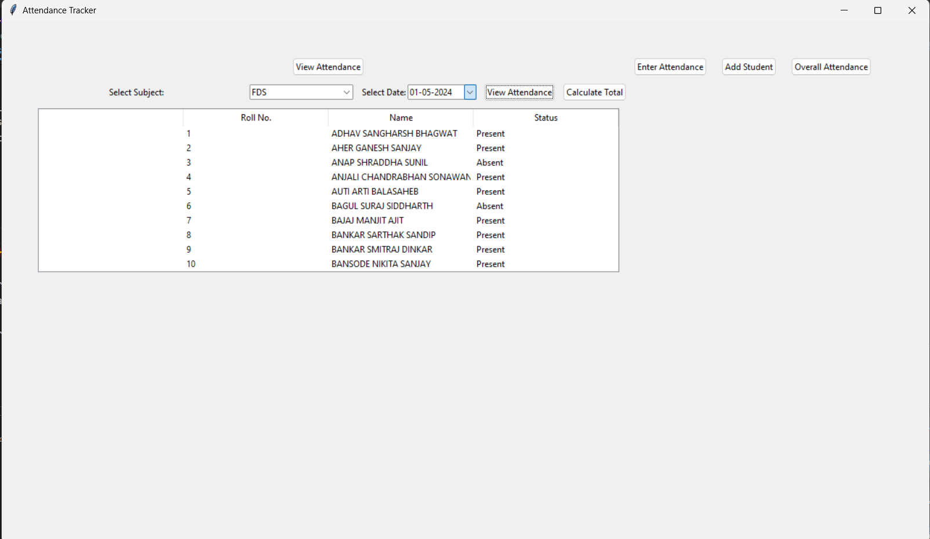
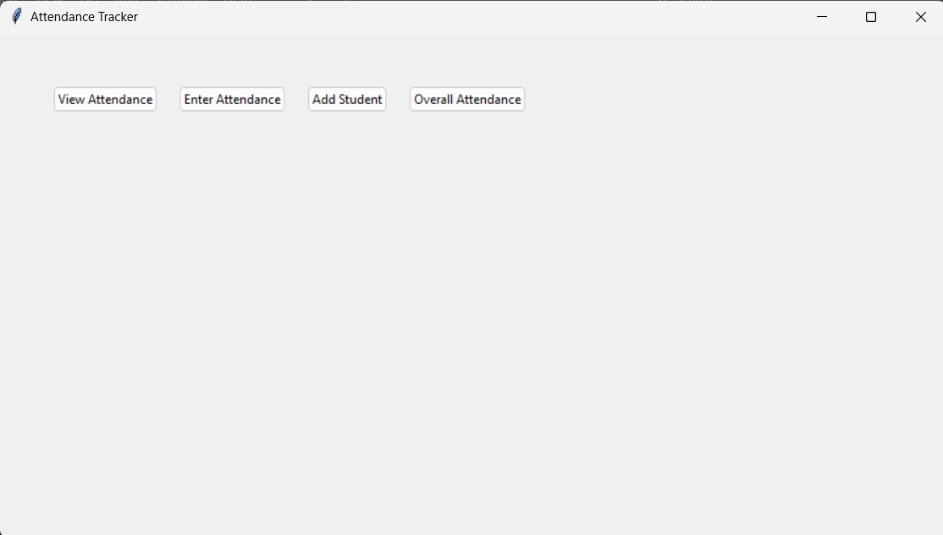
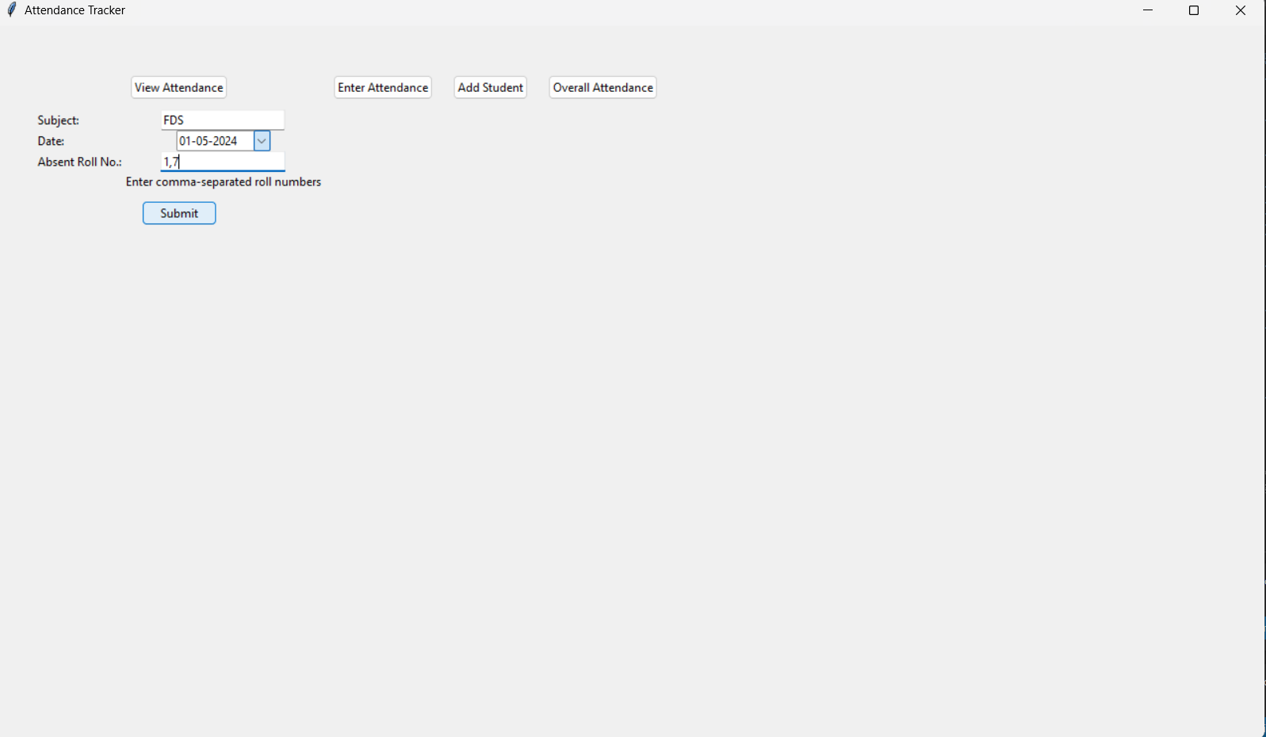
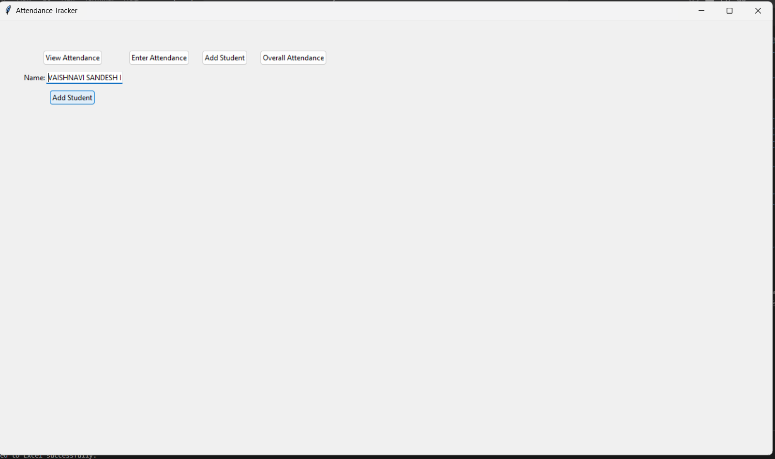
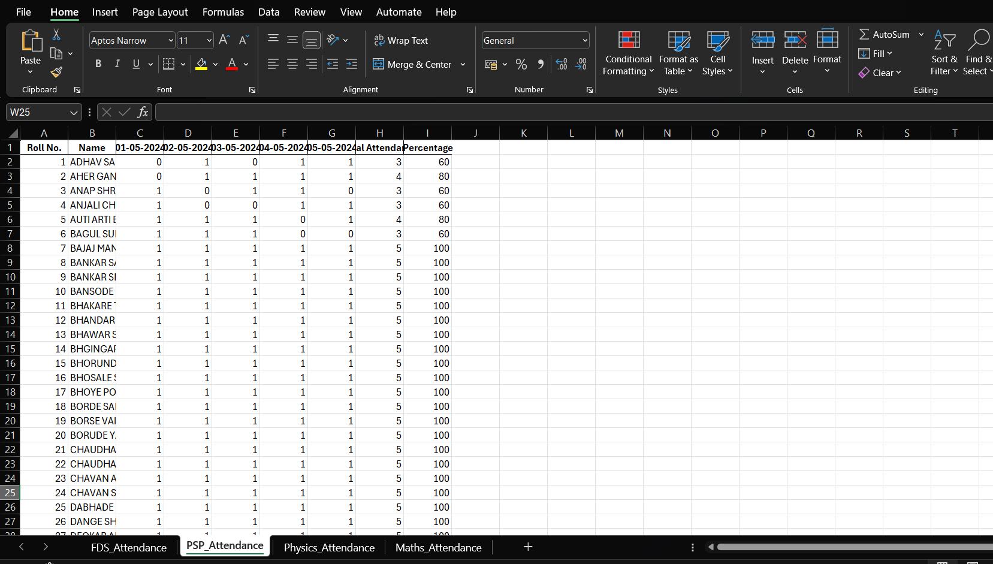
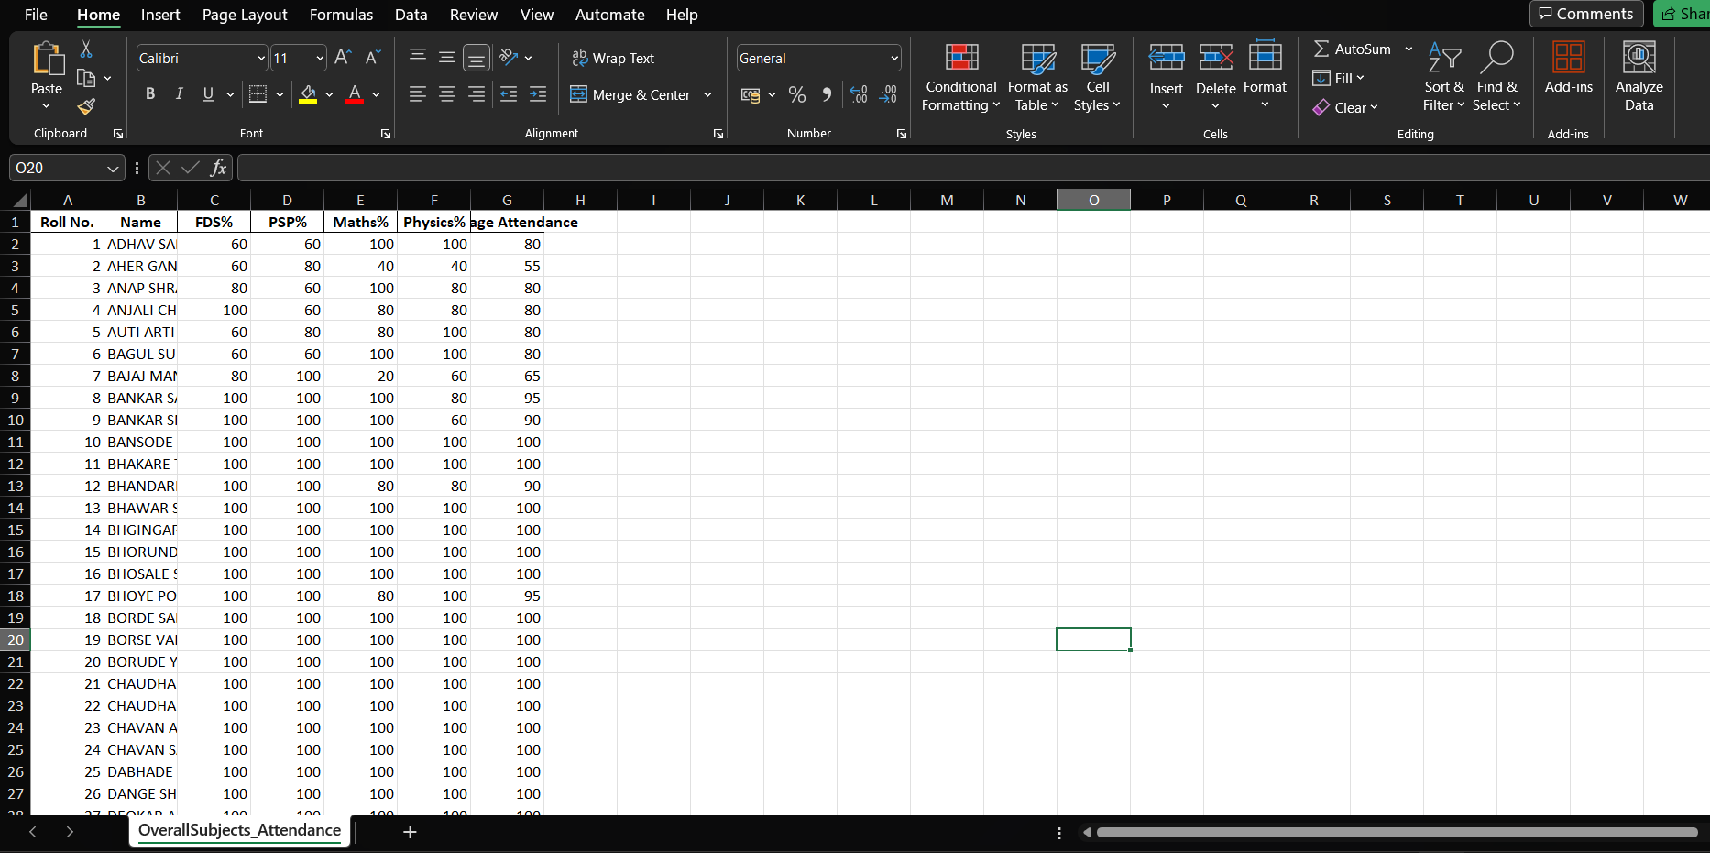
Output
Sanjivani Rural Education Society’s
Sanjivani College of Engineering, Kopargaon 423 603
(Affiliated to Savitribai Phule Pune University, Pune )

Slide 9
Thank You
Sanjivani Rural Education Society’s
Sanjivani College of Engineering, Kopargaon 423 603
(Affiliated to Savitribai Phule Pune University, Pune )

