Slide 1
Intro to GoLang

Slide 2
What is Go?
Go, or Golang, is an open source programming language. It’s statically typed and produces compiled machine code binaries. Developers say that Google's Go language is the C for the twenty-first century when it comes to syntax. However, this new programming language includes tooling that allows you to safely use memory, manage objects, collect garbage, and provide static (or strict) typing along with concurrency.
The world was first introduced to Go in 2009 thanks to Google’s Rob Pike, Robert Griesemer, and Ken Thompson. The main goal of creating Go was to combine the best features of other programming languages:
Ease of use together with state-of-the-art productivity
High-level efficiency along with static typing
Advanced performance for networking and the full use of multi-core power

Slide 3
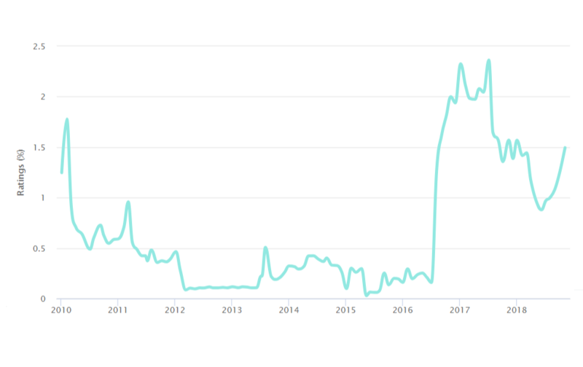
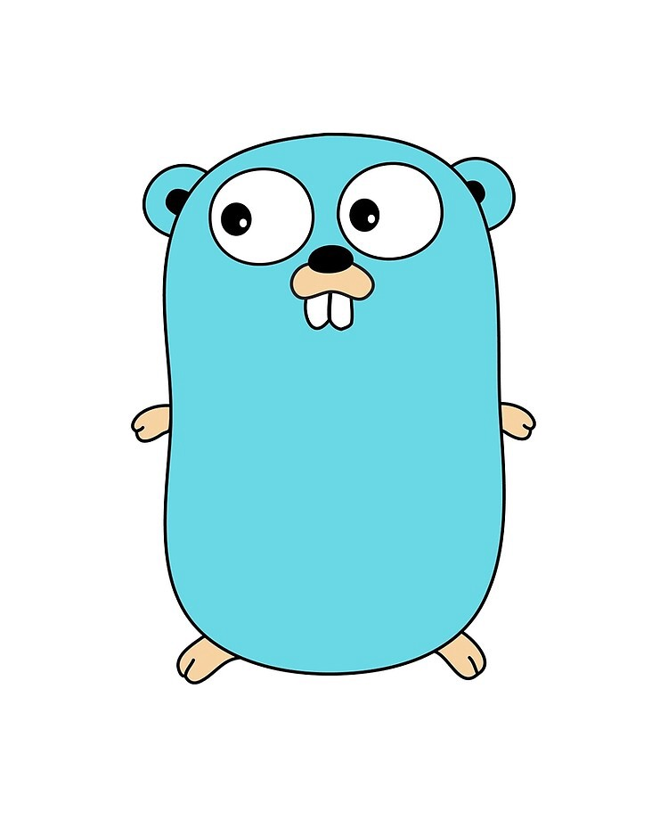
Advantages
Why Go language is popular? Besides the cute mascot, Go brings a whole set of advantages. The language began rising almost as soon as it was released back in 2009. It quickly started drifting from the #65 language toward the top positions around the world. Then Business Insider called Go the hottest programming language of 2016. According to the TIOBE index, Go’s rating went way up and a bit down in 2017, but in 2018 it has continuously gone up as shown in the graph below.

Slide 4
Advantages
You might want to know why Go is rising. The reason is that Go has the same performance as C and is much easier to maintain than Java, as we need no virtual machine, no warming up period, no JAR hell, and so on. Let’s have a look at the other Golang advantages.

Slide 5
Pros
Great standard library
Build with concurrency in mind
Cross Platform
Avoids a lot of unnecessarily complicated of traditional object oriented language
Functions are first class citizens
Generally one way to do just about everything
Backed by Google
Has Garbage Collection
Simple and Fast

Slide 6
Cons (subjective)
Go ignored advances in modern language design
Lack of Function Overloading and Default Values for Arguments
Lack of Generics
Error Handling
Interface methods don't support default implementations
No enumerations

Slide 7
Experience
From OVPM before, we were newbies in GoLang. With a limited time to study and a high demand of tasks, I think GoLang did its best from its core with simplicity in mind.
Simplicity – I mean less solution options on a problem, less study and more standardized approach.
GoLang doesn’t have a lot of 3rd party frameworks available but this is because the standard library itself can suffice most of the needed features.

Slide 8
Training Ground
[sites]
https://golang.org/doc/
https://tour.golang.org/moretypes/1
https://www.tutorialspoint.com/go/go_function_call_by_reference.htm
[youtube]
https://www.youtube.com/watch?v=G3PvTWRIhZA&list=PLQVvvaa0QuDeF3hP0wQoSxpkqgRcgxMqX
https://www.youtube.com/watch?v=YS4e4q9oBaU
[IDE]
VScode - Free
https://code.visualstudio.com/
GoLand - Paid
https://www.jetbrains.com/go/promo/?gclid=CjwKCAjwjqT5BRAPEiwAJlBuBZQFzUzKco8D1qd-IgsmrhSIfpEQCOWf8DfkIGaMDw964OQH0FNbGRoCwYYQAvD_BwE

