Slide 1
Functional Verification of FPGA Designs
Jakob Stadler
Vector Informatik GmbH
jakob.stadler@vector.com
4. Juni 2024

Slide 2
Functional Verification of FPGA Designs
Download:
https://github.com/flufpuf/functional_verification_of_fpga_designs_presentation

Slide 3
What is testing?
&
Why should we test?
https://github.com/flufpuf/functional_verification_of_fpga_designs_presentation

Slide 4
How do you test your designs?
https://github.com/flufpuf/functional_verification_of_fpga_designs_presentation

Slide 5
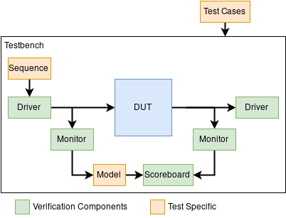
Functional Verification of FPGA Designs
Universal Verification Methodology (UVM)

Slide 6
Functional Verification of FPGA Designs
Universal Verification Methodology (UVM)
Universal testbench architecture
Collection of reusable VCs
Transaction Level Modelling (TLM)
as abstracted VC API
Requirement:
Design for Testability (DFT)
(makes live easier)
UVM Standard (Accellera): https://www.accellera.org/downloads/standards/uvm

Slide 7
Functional Verification of FPGA Designs
Some free and open source tools
OSVVM VUnit Cocotb
Simulation interface
Test case management
Test configuration
Verification Components
Transfer Level Modelling (TLM)
Randomization
Assertion checking
Logging
Report generation

Slide 8
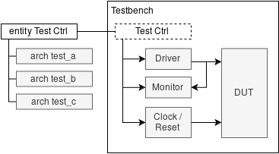
Functional Verification of FPGA Designs
OSVVM
Jim Lewis
(IEEE VHDL WG Chair)
Classic VHDL
Test cases are defined by VHDL configurations
TCL framework for test management

Slide 9
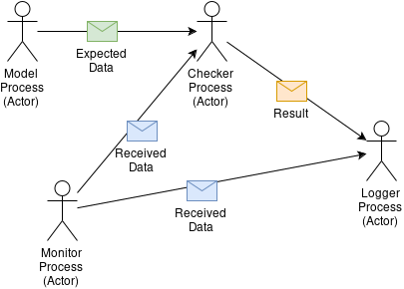
Functional Verification of FPGA Designs
VUnit
Python
Simple and powerful
Test management and configuration
Actor Model
Hacked “strong typing” of VHDL

Slide 10
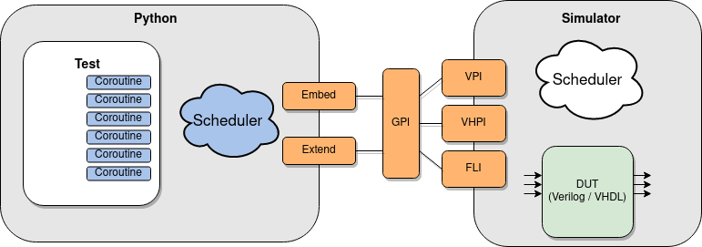
Functional Verification of FPGA Designs
CocoTB
Source: docs.cocotb.org
Verilog Procedural Interface (VPI)
VHDL Programming Language Interface (VHPI)
Foreign Language Interface (FLI)

Slide 11
Functional Verification of FPGA Designs
CocoTB
DUT runs in Simulator
Testbench runs in python
Based on python coroutines (asyncio)
All python features can be used
Source: docs.cocotb.org
Verilog Procedural Interface (VPI)
VHDL Programming Language Interface (VHPI)
Foreign Language Interface (FLI)

Slide 12
Appendix
Links
UVM Standard (Accellera): https://www.accellera.org/downloads/standards/uvm
OSVVM:
https://osvvm.org/ and https://github.com/OSVVM
Vunit:
https://vunit.github.io/ and https://github.com/VUnit/vunit
Cocotb:
https://www.cocotb.org/ and https://github.com/cocotb/cocotb
GHDL:
https://github.com/ghdl/ghdl
gtkwave:
https://github.com/gtkwave/gtkwave
NVC:
https://github.com/nickg/nvc

