Slide 1

Final Project Group 2 · IEOR 4723 · Fall 2026
FOMC Tone Lab
Measuring Fed Communication and Testing Duration Signals
01 / READ
02 / MEASURE
03 / TEST
04 / SIZE
Fed language
Policy tone
Treasury yields
Portfolio duration
LIVE DEMO
CODE
fedtone.web.app
github.com/flukier1016/fomc-tone-lab
Genie Zhang
Hong-syuan Lin
Myron Pang
Weijun Situ
Notes:
We are Group 2. Our topic is the central bank communication index: read everything the Fed publishes, score its tone with Claude, see whether Treasuries react, and ask whether a duration trade can use it. Everything on these slides is computed live from our system.

Slide 2
ROADMAP
2 / 46
Contents
Five sections, from the question to the conclusions
01
Question and data
The task, course lessons, the data and release times
3–8
02
Readers and validation
How each reader scores tone and how accurate it is
9–21
03
Index, yields and duration
Tone over time, Treasury reactions and the duration trade
22–31
04
Forward checks and system
Tests on new data, the system and the dashboard
32–41
05
Conclusions and limits
What we found and what remains open
42–46
Notes:
First define the investment question and the information available at each release. Then explain the readers, including the model fine-tuned locally, before judging their accuracy and recognition risk. Only then move to Treasury responses and the delayed duration trade. Forward evaluation and implementation follow the research results, and the close separates delivered functionality from evidence of profitability.

Slide 3
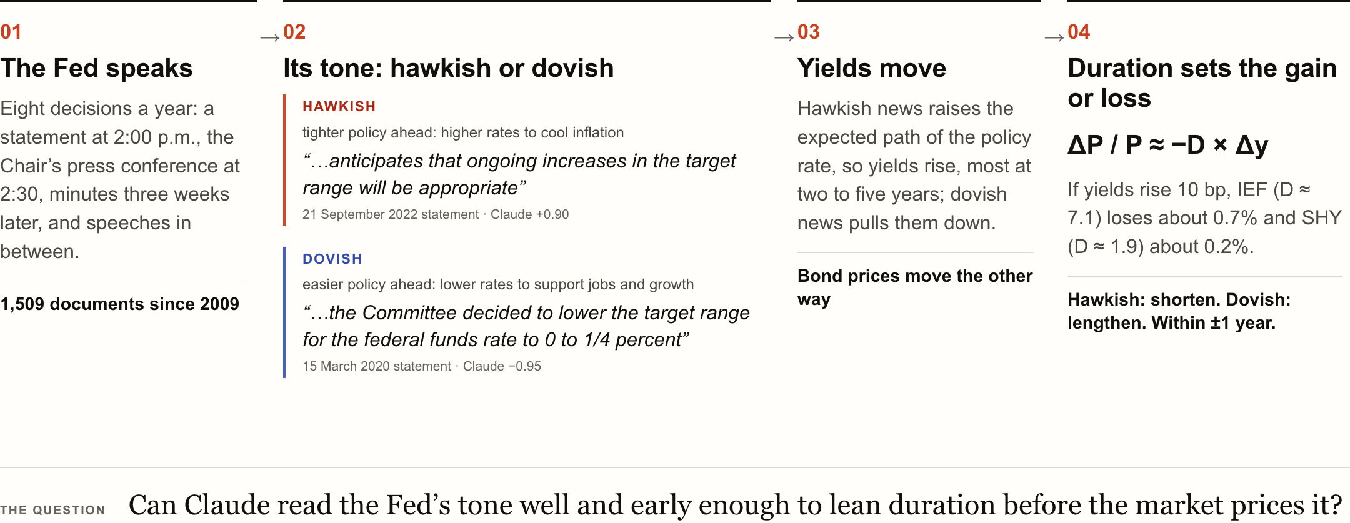
01
QUESTION AND DATA
3 / 46
The Fed moves Treasuries with words
So its tone might tell a bond portfolio how much duration to hold
Source: FOMC statements of 21 Sep 2022 (+0.90) and 15 Mar 2020 (−0.95), scored by Claude; IEF and SHY durations from the backtest.
Notes:
Before the results, the idea. The Fed sets short-term interest rates, and it signals where they are going through what it says: statements, minutes, press conferences and speeches. When it sounds hawkish, ready to raise rates to cool inflation, yields rise and bond prices fall; when it sounds dovish, they move the other way. How much a bond portfolio gains or loses depends on its duration: seven years of duration loses about seven percent if yields rise one point. So the topic asks: can we read the tone of the Fed’s words, turn it into an index, and use it to decide how much duration to hold?
Source: FOMC statements of 21 Sep 2022 (+0.90) and 15 Mar 2020 (−0.95), scored by Claude; IEF and SHY durations from the backtest.

Slide 4
01
QUESTION AND DATA
4 / 46
What the brief asks, and what we built
Topic 4: a central bank communication index and duration positioning
THE BRIEF ASKS FOR
WHAT WE BUILT
01
A hawkish-dovish index from statements, minutes, press-conference transcripts and governor speeches
1,509 documents from the Fed’s website since 2009, each stamped with its release minute
02
Claude scores each document on a defined rubric with evidence spans
Rubric v1: six policy dimensions and a stance from −1 to +1; mean document evidence-match share 99.96%
03
Compared with simpler baselines: dictionary methods and sentence-level embeddings
Dictionary, TF-IDF classifier and MiniLM sentence embeddings, judged on the same human labels
04
Tested against subsequent Treasury yield changes from FRED across the curve
3-month to 30-year yields and the 2s10s slope over each release window; FRED first, the Treasury par curve it republishes as fallback (used this run)
05
A duration tilt in a Treasury or aggregate-bond portfolio, respecting that statements are priced within minutes
IEF against SHY, applied to AGG and IEI; entry the day after release; minutes, speeches and statement-to-statement shifts
Source: IEOR 4723 final project brief, Topic 4.
Notes:
Our topic is number four: build a hawkish-dovish index from everything the Fed publishes, score it with Claude against a defined rubric with evidence, compare it with simpler baselines, test it on Treasury yields across the curve, and use it to tilt duration in a bond portfolio. The left column is what the brief asks for; the right column is what we built for each line. Why it matters: The brief’s key insight shapes every test: the market reprices a statement within minutes, so any tradable edge has to sit in slower documents or in the change of tone.
Source: IEOR 4723 final project brief, Topic 4.

Slide 5
01
QUESTION AND DATA
5 / 46
What we learned in the course, and how we used it
Six lessons from the lectures, each put to work in this project
What we learned | How we applied it
A prompt has a ceiling; training on labeled data can go further | Fine-tuned RoBERTa on the expert labels as a reference reader, and report that it beats Claude
Treat the prompt as a specification: version it and check the output | One rubric enforced as a JSON schema; every quote is checked against the Fed's text
A model may remember history; test for it before trusting a score | Masked dates and names, asked Claude to date statements, re-scored to check stability
Use only what was public at the time | Timestamped every release; trades enter at the first close after publication
Count every variant you try, and charge for costs | Reported 116 strategy variants with costs and placebos, including the negative result
Ground answers in sources | Every score links to the Fed's own words; the full archive is searchable
Source: IEOR 4723 Sessions 1 to 4 and the Topic 4 brief; page references in docs/COURSE_ALIGNMENT.md.
Notes:
Six things from the lectures shaped how we built this. From Session One: prompting a general model has a ceiling, and training on labeled data can go past it, so we fine-tuned RoBERTa on the expert labels and report that it beats Claude. From Session Two: treat the prompt as a specification you version and check, and test whether a model is simply remembering history; hence the JSON rubric, the quote checks, the masked dates and the re-scoring. From Session Three: use only information that was public at the time, and count every variant you try; hence the release clocks, the next-close entry, and every strategy reported with costs and a placebo, including the one that failed. From Session Four: ground answers in sources; every score links back to the Fed's own words, and the archive is searchable by full text.
Source: IEOR 4723 Sessions 1 to 4 and the Topic 4 brief; page references in docs/COURSE_ALIGNMENT.md.

Slide 6
01
QUESTION AND DATA
6 / 46
Four hypotheses, four answers
Public-label accuracy and release-window associations; no delayed trading edge detected
H1 · MEASUREMENT
H2 · INFORMATION
H3 · TRADABILITY
H4 · CONTAMINATION
Claude matches public expert labels better than the baselines
Tone is associated with release-window Treasury moves
A pre-registered next-day duration tilt beats chance
Masked scores are stable; recognition risk remains
Supported on public expert labels
Supported
Not supported
Mixed
Macro-F1 0.66 against 0.58 (p = 0.004)
26 of 198 tests survive false-discovery control
Sharpe −0.18, placebo p = 0.28
Dates 99% of masked statements, yet masked scores track raw ones (r = 0.99)
Source: Project results, frozen 21 October 2026; design and pre-registration in docs/DESIGN.md.
Notes:
Here are the answers before the evidence, one card per hypothesis. H1: supported. H2: supported. H3: not supported. H4: mixed. For the desk: Use Claude to read the Fed faster and with evidence; do not expect a daily duration tilt on tone alone to pay.
Source: Project results, frozen 21 October 2026; design and pre-registration in docs/DESIGN.md.

Slide 7
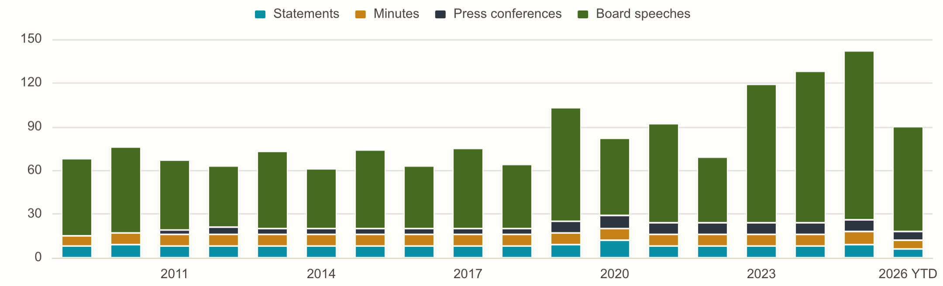
01
QUESTION AND DATA
7 / 46
Every Fed document since 2009
Fed source text, recorded release times, and consistent cleaning
1,509
statements, minutes, press conferences and Board speeches; 4.5M words
149 statements; time from text or recorded convention
142 minutes; attendance removed
95 press conferences; Chair's words only
1,123 speeches; time from the Fed's feed
Source: Federal Reserve Board website: FOMC calendar, statements, minutes, press conferences and speeches.
Notes:
The corpus is collected from the Federal Reserve Board's own calendar, statements, minutes, transcripts and speech feed. Each release minute retains its source: text, the speech feed or a recorded convention. Press conferences keep the Chair's words, minutes omit attendance lists, and speeches under 300 words are excluded. The counts and annual bars use documents without an exclusion note. For the desk: One searchable store keeps source text, time provenance and every score, so a reading can be checked against its source.
Source: Federal Reserve Board website: FOMC calendar, statements, minutes, press conferences and speeches.

Slide 8
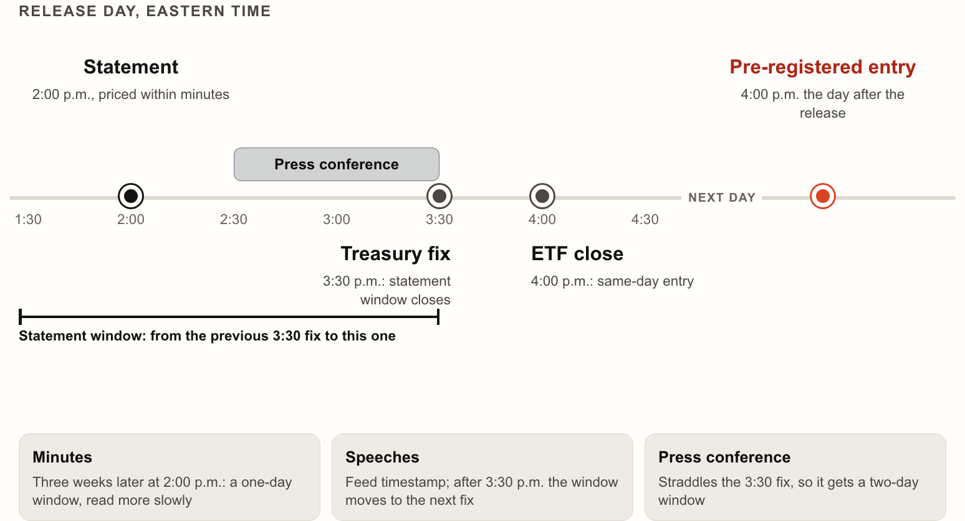
01
QUESTION AND DATA
8 / 46
Release windows and trade entry
Event windows measure repricing; returns begin only after entry
+1 day
primary entry lag after the first eligible ETF close
Event window: last pre-release Treasury fix to the first eligible later fix
Speech-feed buffer: 60 minutes before either market close counts as after it
Entry clock: first eligible ETF close, then one more trading day for the primary
Return clock: first return after entry, never the return ending at that close
Source: Fed release times; Treasury par yields (about 3:30 p.m.) and ETF closes (4:00 p.m.); align.py.
Notes:
A document's event window begins at the last Treasury fix before the first information is public, and ends at the first eligible fix after the full text is available. A statement has one fix-to-fix window; a press conference that straddles the Treasury fix spans two. A feed-timestamped speech's availability is delayed by 60 minutes for both the Treasury-window end and ETF-entry calculation. The exploratory entry is the first eligible ETF close; the primary waits one more trading day. A position earns only close-to-close returns after its entry. Weekends and holidays follow the observed trading calendar. For the desk: The event study asks when yields adjust; the backtest asks whether a later executable position can use the signal.
Source: Fed release times; Treasury par yields (about 3:30 p.m.) and ETF closes (4:00 p.m.); align.py.

Slide 9
02
READERS AND VALIDATION
9 / 46
One rubric, enforced as a JSON schema
Positive is hawkish; negative is dovish; stance_score is the index
6
{
"policy_relevance": "high | medium | low",
"policy_action":
-2 … +2 | null,
policy dimensions, each from −2 to +2, then an overall stance and a continuous score
"forward_guidance":
-2 … +2 | null,
"inflation_assessment":
-2 … +2 | null,
"activity_labor_assessment":
-2 … +2 | null,
Structured outputs: the schema is the contract, no free text to parse
"risk_balance":
-2 … +2 | null,
"balance_sheet":
-2 … +2 | null,
"overall_stance":
-2 … +2,
# holistic, not an average
The scorer sees the document type and the text, never the date
"stance_score":
-1.0 … +1.0,
# the index
"confidence":
0 … 1,
"evidence": [{"dimension": …, "quote": "verbatim"}]
Any change to the prompt or schema bumps v1 and starts new records
}
Source: llm/rubric.py and llm/scorer.py.
Notes:
Each level reading returns this object. Six dimensions on an integer scale from minus two to plus two, null when a document does not address one; an overall stance that weighs forward guidance and the balance of risks most; a continuous score for finer ranking between documents with the same stance; a confidence; and evidence quotes tied to a dimension. The schema is enforced by structured outputs, so nothing is parsed from prose. For the desk: The stance_score is the index; dimensions explain it and quotes locate supporting language.
Source: llm/rubric.py and llm/scorer.py.

Slide 10
02
READERS AND VALIDATION
10 / 46
Every score comes with its evidence
Claude supplies quoted spans; we verify each quote against the source
01
Document
02
Rubric v1
99.96%
Cleaned text, the Fed’s words only; no date or title shown
Six policy dimensions, stance and confidence; cached system prompt
mean document evidence-match share (1,509 documents)
03
Claude Opus 5.5
04
Verify
Adaptive thinking, structured JSON output, Message Batches
Checks every quote; stores matched spans and unmatched exceptions
Rubric v1: structured JSON and character-span evidence
1,506 of 1,509 documents: every quote matched
05
Record
06
Store
3 documents contain an unmatched quote
JSON keyed by a hash of prompt, schema and text, with IDs and tokens
Scores, evidence and costs in SQLite; the dashboard reads them
Lowest document match share: 67%
Source: Claude Opus 5.5 readings in the project store; quote checks in llm/scorer.py.
Notes:
Each document is scored against six policy dimensions with a holistic stance, a continuous score, confidence and quoted evidence. Every returned quote is checked against the cleaned source with typography normalized; matched spans are located as character offsets. The mean document evidence-match share is 99.96% over 1,509 level records. Unmatched quotes are disclosed, not treated as verified evidence. Finding the quoted language proves its location, not the correctness of the model's economic judgment. Request provenance and spending are detailed on the next page. For the desk: Matched spans make scores inspectable; quote matching alone does not establish that an economic interpretation is correct.
Source: Claude Opus 5.5 readings in the project store; quote checks in llm/scorer.py.

Slide 11
02
READERS AND VALIDATION
11 / 46
Cached requests and auditable spending
Operational snapshot through 2026-10-22, including monthly re-reads
$32.75
Piece | Setting
Model | claude-opus-5-5, adaptive thinking, effort medium
Output | structured JSON against the rubric's schema; quotes located in the source
Batching | 7 Message Batches at half price; 21 direct calls
Prompt cache | 3.7M input tokens read from the cache
Tokens | 10.6M in, 0.96M out
Records | 2,057, each keyed by a hash of prompt, schema and text
Failures | 0 failed requests
Caps | at most 40 new jobs a run; 5 USD a month of scheduled scoring
for 2,057 stored Claude records; operations continue after the research freeze
A record's key changes with the prompt, schema or text, never otherwise
Records live in git: a rebuilt store costs nothing
Refusals, truncation and schema misses are recorded, not retried silently
Source: Anthropic Message Batches records in data/llm/; llm/scorer.py.
Notes:
All Claude traffic goes through one module. The full corpus ran as 7 Message Batches at half price, with the system prompt cached. Each record is keyed by a hash of prompt, schema and text, so a rerun never pays twice, and the 2,057 records are committed. 21 direct calls are the scheduled scoring of new documents and the monthly re-read. For the desk: Every reading is reproducible from its record: request and message IDs, tokens, cost and raw text.
Source: Anthropic Message Batches records in data/llm/; llm/scorer.py.

Slide 12
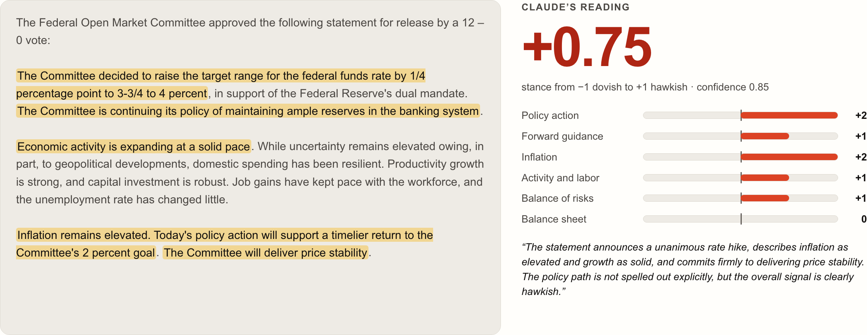
02
READERS AND VALIDATION
12 / 46
Claude reads the 16 September statement as hawkish
And shows, word for word, where the statement says so
Source: FOMC statement of 16 September 2026; Claude Opus 5.5, rubric v1.
Notes:
Here is one real reading: the statement of 16 September. Claude scores it +0.75, hawkish, with confidence 0.85. The highlights are its evidence: the rate decision, the inflation language, the commitment to price stability. Each quote was found in the source text. For the desk: An analyst can check any score in seconds: the highlighted words are the evidence, located in the source.
Source: FOMC statement of 16 September 2026; Claude Opus 5.5, rubric v1.

Slide 13
02
READERS AND VALIDATION
13 / 46
Same 1,984 sentences, same five folds
H1 uses the same test sentences; corpus scoring uses full documents
Reader | Representation | Classifier | Tuned | CV macro-F1 | Test macro-F1
Dictionary | policy nouns near direction words | signed rules | none | – | 0.511
TF-IDF | unigrams and bigrams, min_df 2, sublinear tf | logistic regression, balanced | C = 2 of 0.5 to 8 | 0.575 | 0.578
Sentence embeddings | all-MiniLM-L6-v2, 384 dimensions, ONNX | logistic regression, balanced | C = 4 of 0.25 to 16 | 0.592 | 0.576
Fine-tuned RoBERTa | RoBERTa-large, 355M parameters | fine-tuned end to end | 9 settings × 5 folds | 0.724 | 0.737
Claude Opus 5.5 | sentences (H1); documents (index) | zero-shot rubric | none | – | 0.661
Trained sentence-reader index: mean[P(hawkish) − P(dovish)]; Claude uses a holistic document rubric.
Source: Trillion Dollar Words (Shah, Paturi and Chava, 2023): 1,984 training and 496 test sentences.
Notes:
Five readers. The dictionary needs no training. TF-IDF and sentence embeddings each fit a balanced logistic regression, with the penalty chosen by five-fold cross-validated macro-F1 on the train split. The RoBERTa reference uses the same folds and score. Claude reads the same test sentences for H1, and whole documents for the index, without task-specific training. A document's score for the sentence readers is the mean of P(hawkish) minus P(dovish) over its sentences. Why it matters: Same data, same folds, same score: the readers differ only in how they represent a sentence.
Source: Trillion Dollar Words (Shah, Paturi and Chava, 2023): 1,984 training and 496 test sentences.

Slide 14
02
READERS AND VALIDATION
14 / 46
How we fine-tuned RoBERTa locally
A supervised reference added after the original study, using public expert labels
01
02
Keep the split fixed
Select on validation folds
1,984 public expert training sentences; 496 held out. Three classes: dovish, neutral and hawkish.
9 settings across 5 stratified folds. Mean validation macro-F1 selects the setting and epoch.
03
04
Fit the chosen model locally
Evaluate the fixed ensemble
Full-parameter RoBERTa fine-tuning on Apple MPS; 5 seeds. Chosen learning rate 2e-5, stopping at epoch 9.
Average the seeds' class probabilities. Test once; then average P(hawkish) minus P(dovish) over each document's sentences.
Source: RoBERTa (Liu et al., 2019); Trillion Dollar Words training labels; finetune.py.
Notes:
The model is a pretrained RoBERTa encoder with a three-class classification head. We update all its parameters locally on an Apple GPU through PyTorch MPS. The saved record identifies the backbone revision, train/test sentence hashes, device, software versions, every search run and the final seeds. The 1,984 training sentences and the 496-sentence held-out test are the same split used by the supervised baselines. Five-fold stratified validation selects architecture, learning rate and stopping epoch without consulting test performance. Training uses class-balanced cross-entropy, AdamW, 10% warmup, linear decay and gradient clipping. The final chosen configuration is fit on all training sentences with five seeds; their class probabilities are averaged before the fixed ensemble is evaluated. Document tone is the mean of P(hawkish) minus P(dovish) across sentences. This reference was added after the original results and does not replace the frozen Claude H1 comparison, event study or duration strategy. The next slide shows the complete parameter search; the following slides compare held-out performance.
Source: RoBERTa (Liu et al., 2019); Trillion Dollar Words training labels; finetune.py.

Slide 15
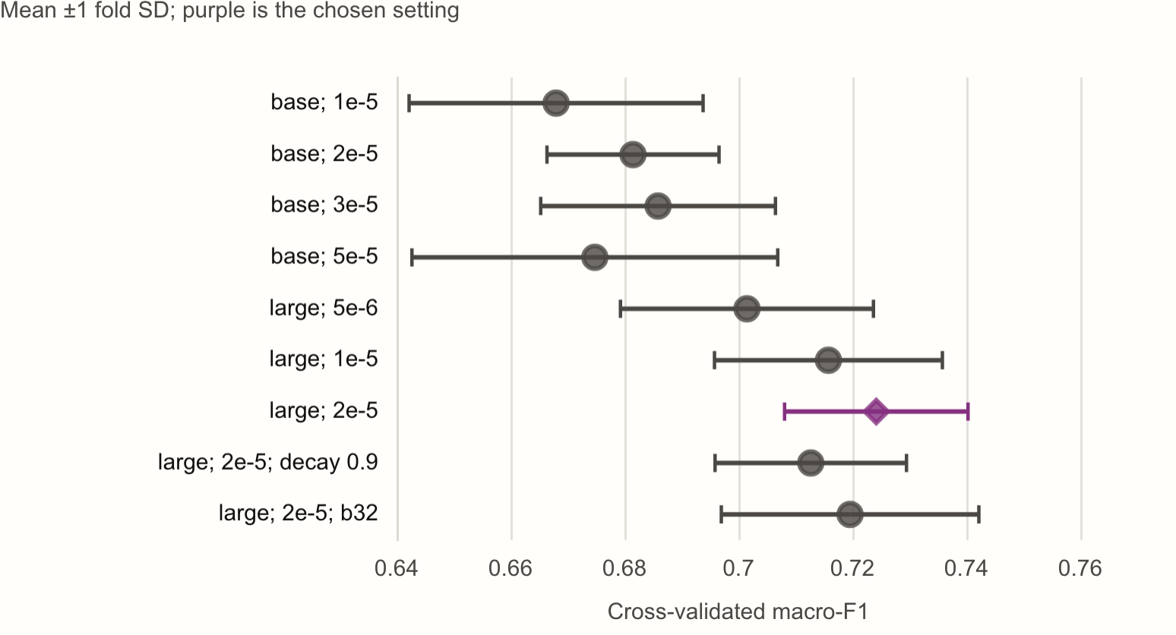
02
READERS AND VALIDATION
15 / 46
Nine settings, five folds, five seeds
The best setting is refit on all 1,984 sentences with five seeds, then averaged
0.724
cross-validated macro-F1 of RoBERTa-large at 2e-5, epoch 9 of ten
AdamW, betas 0.9 and 0.98, eps 1e-6, weight decay 0.01
10% warmup, linear decay; class-balanced loss; gradients clipped at 1
Validation macro-F1 after every epoch: the epoch is chosen too
Source: finetune.py; data/baselines/roberta-tuned.json.
Notes:
The search ran RoBERTa-base at four learning rates and RoBERTa-large at three, then two refinements of the best: layer-wise learning-rate decay and batches of 32. Each setting ran on the TF-IDF baseline's five folds for ten epochs, scored after each, so the epoch with the best average was chosen with the rest. The winner was refit on all 1,984 sentences with five seeds, stopped at that epoch, and their probabilities averaged. For the desk: The test split was read once, by the chosen setting; every setting tried is in the record.
Source: finetune.py; data/baselines/roberta-tuned.json.

Slide 16
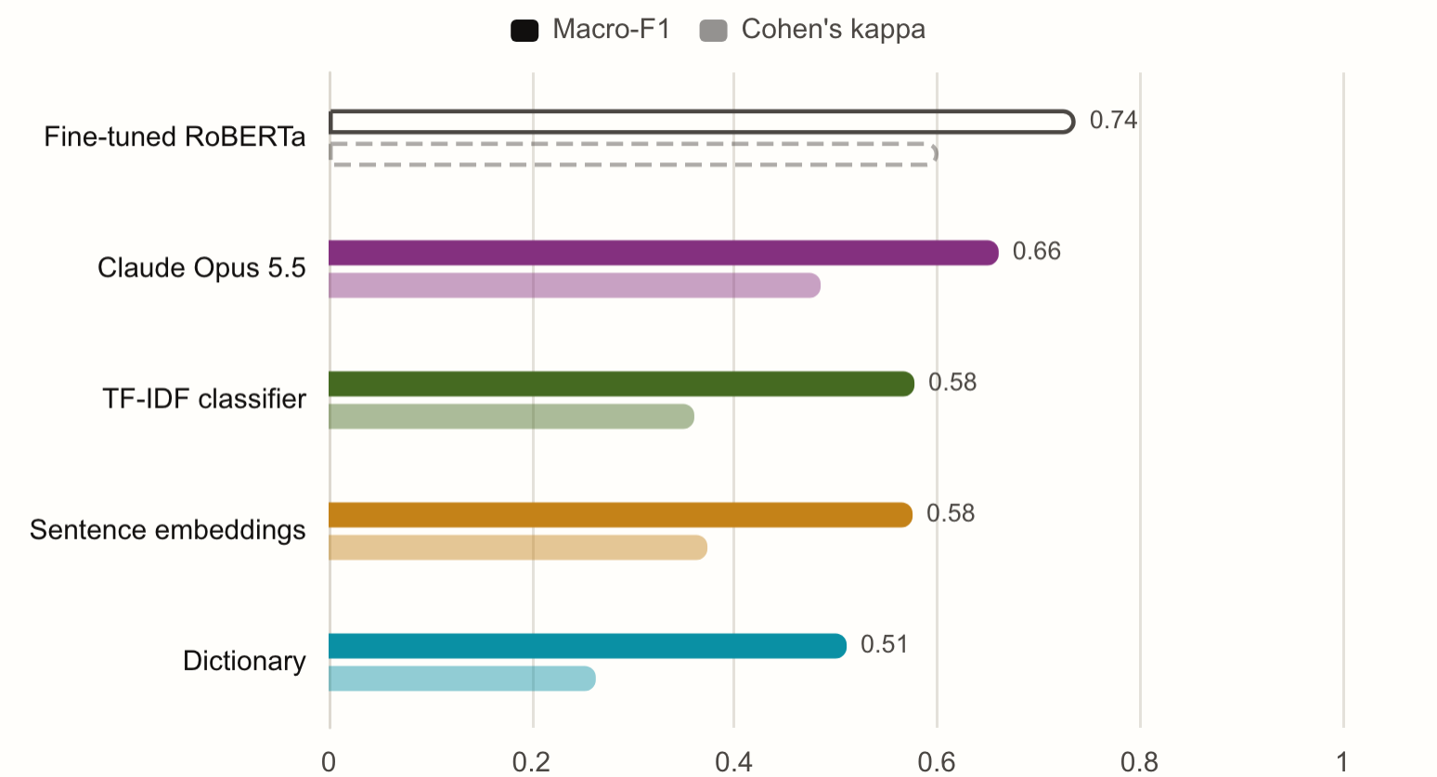
02
READERS AND VALIDATION
16 / 46
Higher agreement on public expert labels
Public expert labels support H1; the post-cutoff human test was not run
0.66
Claude’s macro-F1 on 496 expert-labeled sentences
AGAINST
0.58
the best of the three simpler readers
Kappa 0.49; best baseline 0.37 (Sentence embeddings)
Source: Trillion Dollar Words test split, 496 expert-labeled sentences (Shah, Paturi and Chava, 2023).
Notes:
Four readers on the same 496 sentences that finance experts labeled hawkish, dovish or neutral. A dictionary of policy words reaches 0.51; two learned baselines, TF-IDF and sentence embeddings, reach about 0.58. Claude reaches 0.66, the highest agreement beyond chance of the four. For reference, added after the results: a RoBERTa we fine-tuned on the same 1,984 labeled sentences reaches 0.74. Trained on the labels, a transformer does better still; Claude needed none. For the desk: The baselines see words; Claude sees policy. The gap is largest on sentences that hedge, qualify or look ahead.
Source: Trillion Dollar Words test split, 496 expert-labeled sentences (Shah, Paturi and Chava, 2023).

Slide 17
02
READERS AND VALIDATION
17 / 46
Ahead of the baselines, behind a trained model
Paired macro-F1 gaps on public expert labels; positive favors Claude
Reader | Accuracy | Macro-F1 | Kappa | Claude − reader F1 | 95% interval | p | McNemar p
Fine-tuned RoBERTa | 0.746 | 0.737 | 0.602 | −0.076 | −0.122 to −0.030 | < 0.001 | 0.003
Claude Opus 5.5 | 0.677 | 0.661 | 0.485 | – | – | – | –
TF-IDF classifier | 0.601 | 0.578 | 0.361 | +0.083 | +0.027 to +0.139 | 0.004 | 0.005
Sentence embeddings | 0.599 | 0.576 | 0.374 | +0.085 | +0.030 to +0.136 | 0.002 | 0.002
Dictionary | 0.569 | 0.511 | 0.264 | +0.150 | +0.094 to +0.205 | < 0.001 | < 0.001
Source: Trillion Dollar Words test split (496 sentences); evaluate/validity.py.
Notes:
Claude's macro-F1 is 0.661. Against each reader, the gap is bootstrapped by resampling the same sentences 2,000 times; the interval and two-sided p come from that distribution. McNemar's test uses only the sentences the two readers label differently. These labels have been public since 2023 and may be in training. The post-cutoff human test was not run; masked/raw agreement partly addresses contamination risk. How to read it: A paired test on the same sentences: each reader's gap to Claude, its interval, and the sentences only one of them gets right.
Source: Trillion Dollar Words test split (496 sentences); evaluate/validity.py.

Slide 18
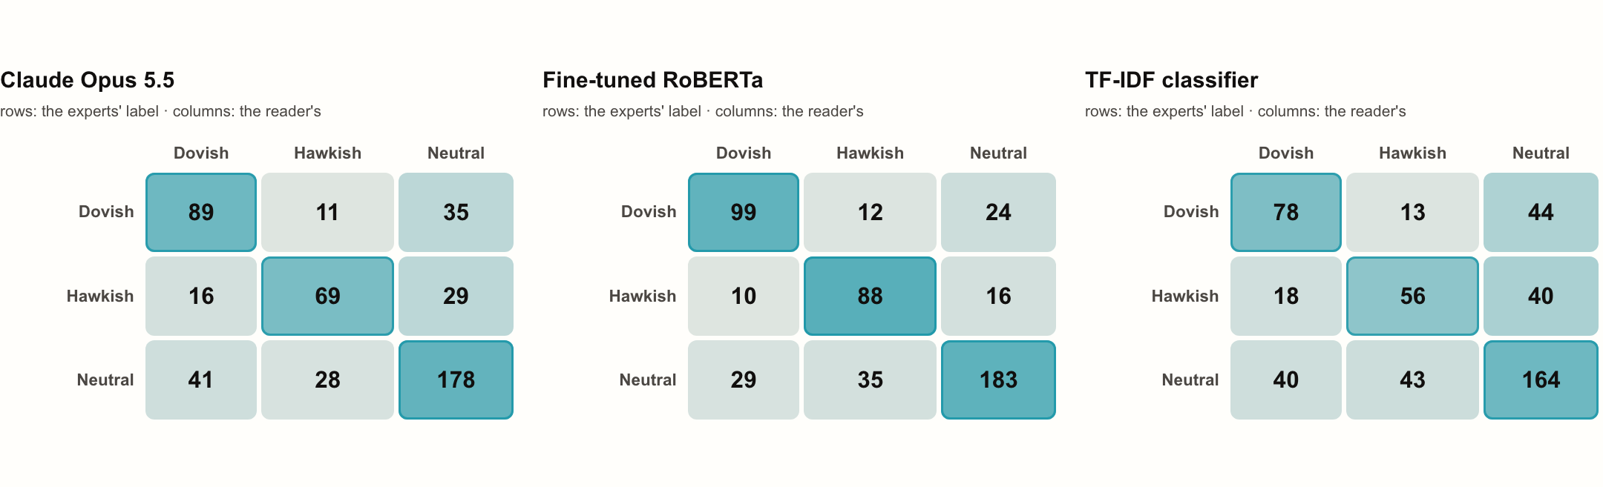
02
READERS AND VALIDATION
18 / 46
Commonest miss: neutral read as dovish
Each reader's labels against the experts' on the 496 test sentences
41
of 247 neutral test sentences Claude read as dovish
Dovish recall: Claude 66% · RoBERTa 73%
Hawkish recall: Claude 61% · RoBERTa 77%
Neutral recall: Claude 72% · RoBERTa 74%
Source: Trillion Dollar Words test split; rows are the experts’ labels, columns the reader’s.
Notes:
The matrices count the 496 test sentences by the experts' label in rows and the reader's label in columns. Claude's largest error is reading neutral sentences as dovish: it leans where the annotators saw none, which fits a reader of whole documents applied to single sentences. For the desk: Shading is each row's share: a dark diagonal is a reader that agrees with the experts.
Source: Trillion Dollar Words test split; rows are the experts’ labels, columns the reader’s.

Slide 19
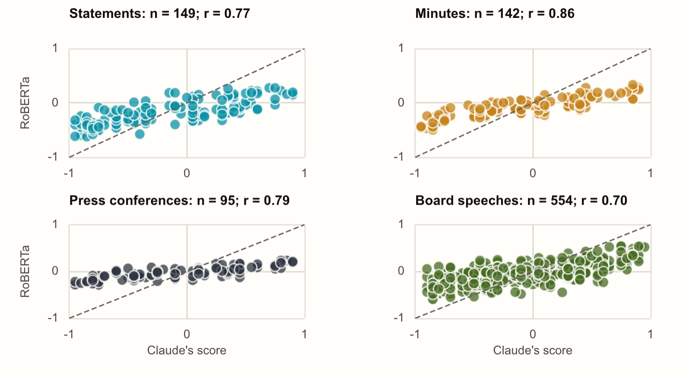
02
READERS AND VALIDATION
19 / 46
Trained on the labels, RoBERTa beats Claude
The same 1,984 hand-labeled sentences improve accuracy; Claude needs no task-specific training
0.74
macro-F1 on the same 496 test sentences; Claude, with no labels, reaches 0.66 and TF-IDF on the same labels 0.58
Best of 9 settings on the same five folds: RoBERTa-large, learning rate 2e-5, 9 epochs; added after the results
Five seeds averaged; alone 0.71 to 0.74
Agreement with Claude on documents, r: statements 0.77 · minutes 0.86 · press conferences 0.79 · speeches 0.70
Source: RoBERTa (Liu et al., 2019); Trillion Dollar Words (Shah, Paturi and Chava, 2023).
Notes:
The obvious question after the last slide: what if, instead of an LLM, we train a transformer on the same 1,984 hand-labeled sentences the TF-IDF classifier learns from? We fine-tuned RoBERTa, tried 9 settings on the same five folds, refit the best with five seeds and read the test sentences once. It reaches 0.74, above Claude's 0.66. On whole documents the two readers mostly agree: r = statements 0.77 · minutes 0.86 · press conferences 0.79 · speeches 0.70. Because it came after the results, it is a reference, not part of H1. For the desk: Labels buy accuracy on sentences like these; Claude needs none, reads whole documents and quotes its evidence.
Source: RoBERTa (Liu et al., 2019); Trillion Dollar Words (Shah, Paturi and Chava, 2023).

Slide 20
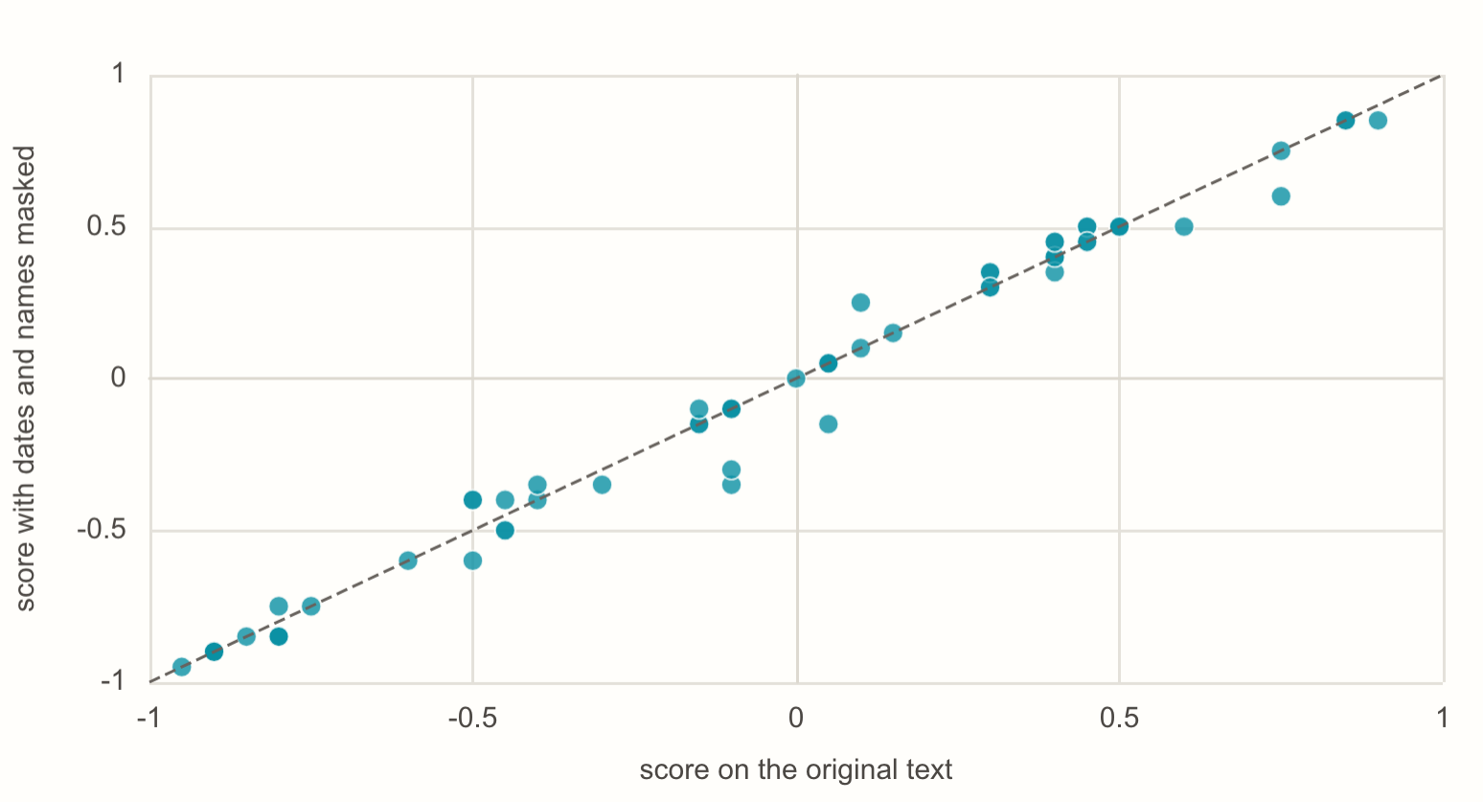
02
READERS AND VALIDATION
20 / 46
Recognition and score stability
Masked scores track raw scores, a partial reassurance rather than proof against memorization
99%
of masked statements dated to the exact month: Claude recognizes them
BUT
r = 0.99
between its scores with and without dates, names and rates, on 60 documents
Same overall stance on 93% of masked documents
Source: audit.py: masked and raw readings, month identification.
Notes:
An honest worry: Claude has read history, including what markets did. With every date, name and rate level masked, it still dates 99% of statements to the exact month, so it recognizes them. But its scores barely move when those details are removed: correlation 0.99. The check partly addresses recognition risk; it cannot rule out contamination. For the desk: The model knows Fed history, so trust rests on two checks: masked scores match, and the post-cutoff sample keeps growing.
Source: audit.py: masked and raw readings, month identification.

Slide 21
02
READERS AND VALIDATION
21 / 46
Stable scores under masking and re-reading
Masking dates and names barely moves scores; it cannot rule out contamination
100%
99%
0.996
152 repeated documents: stance within one step on the five-point scale
of 149 masked statements dated to the exact month
correlation between two separate batches on 152 documents
Same stance on 94.7% of 152 repeated documents
r = 0.99
100%
Mean change 0.023 on a scale of −1 to +1
masked against raw scores on 60 documents
same stance on the 8 anchors re-read in 2026-10; mean change 0.025
Drift flag: mean change above 0.10 or stance agreement below 75%
Source: audit.py.
Notes:
Four checks. A separate batch of 152 documents re-scored gives r of 0.996. Masked statements are dated to the exact month almost every time, consistent with recognition but not proof of memorization. Scores with dates, names and rate levels masked track the raw ones at r of 0.99. Every month eight anchor documents are read again through the current model and pipeline; a change past the limits starts a new experiment. For the desk: Masking dates and names barely changes scores; recognition risk and possible shared bias remain.
Source: audit.py.

Slide 22
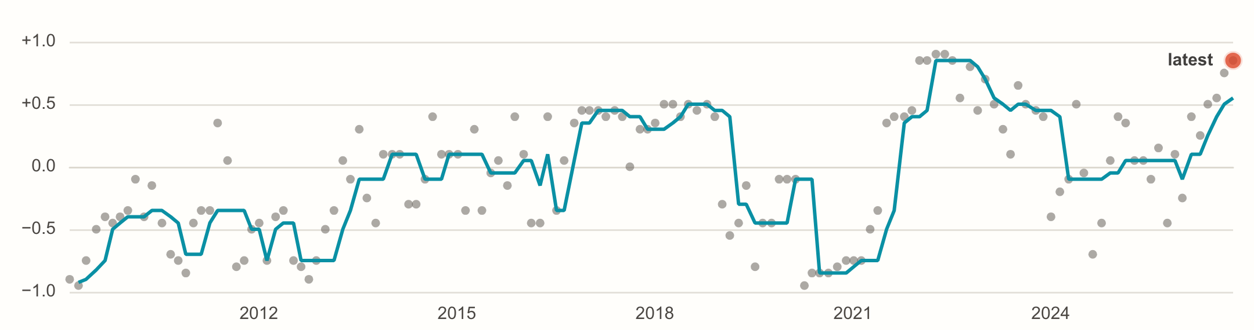
03
INDEX, YIELDS AND DURATION
22 / 46
Fed language is running hawkish
Into the 28 October decision; the latest minutes against every set since 2009
96th
percentile: the latest minutes against every set since 2009
Statement 95th
Press conference 95th
Last 25 speeches 90th
For the desk
Words lean hawkish and the 2-year sits +81 bp over the overnight rate: language and pricing point the same way.
Source: FOMC minutes since 2009, scored by Claude Opus 5.5.
Notes:
Each dot is a set of minutes scored by Claude Opus 5.5; the line is a rolling median. The latest minutes, released 7 October, rank in the 96th percentile of all minutes since 2009.
Source: FOMC minutes since 2009, scored by Claude Opus 5.5.

Slide 23
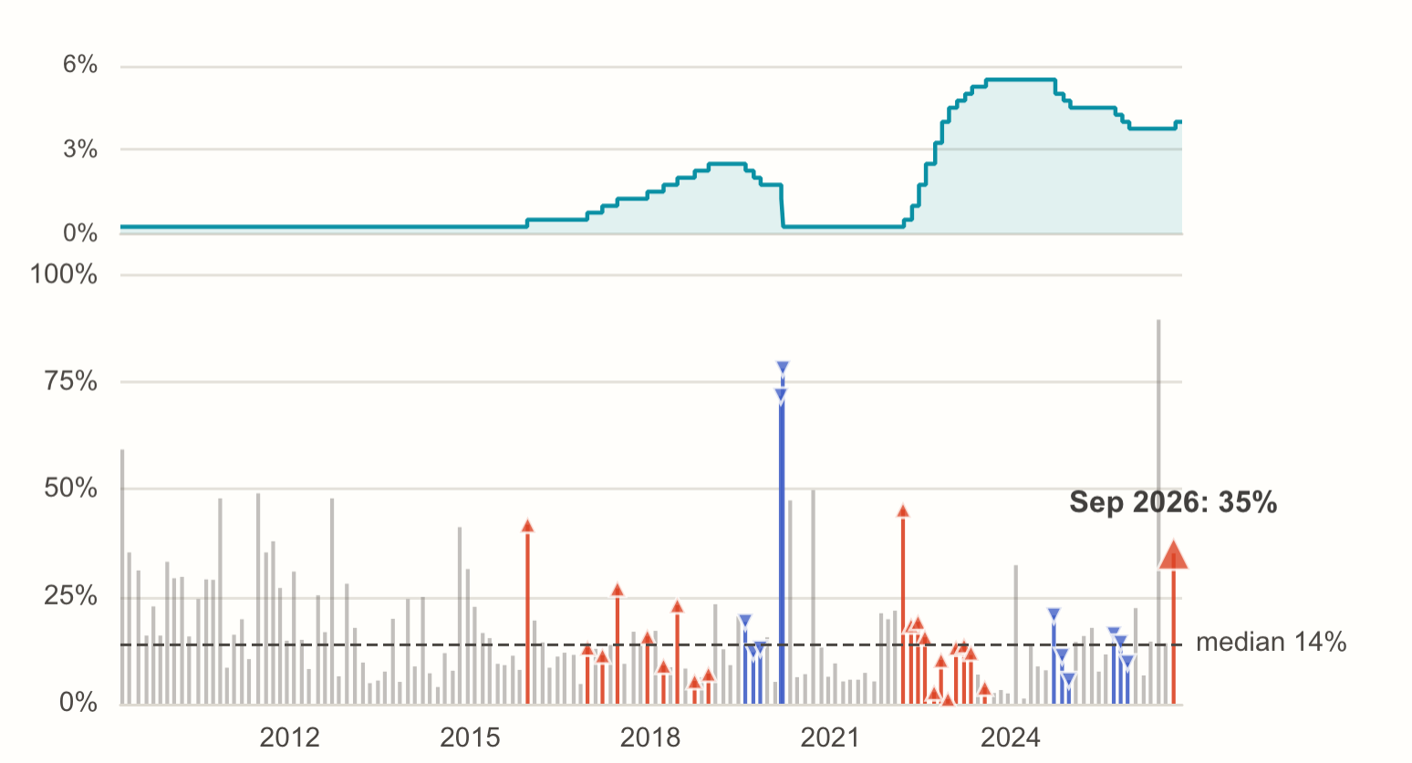
03
INDEX, YIELDS AND DURATION
23 / 46
The September hike rewrote 35% of the statement
A word-level redline of every decision against the one before
35%
of the wording changed against the previous decision (median since 2009: 14%)
+25 bp to 3.75–4.00%
Vote 12–0
3 dissents at the previous meeting wanted a hike
Source: FOMC statements since 2009 (21 hikes, 11 cuts, 111 holds).
Notes:
Every statement is parsed for the decision and compared word by word with the previous one. The September hike rewrote 35 percent of the statement against a median of 14 percent. At the previous meeting 3 members had dissented for a hike. For the desk: Read the redline, not only the decision: new phrases and vanished dissents show how much conviction is behind a move.
Source: FOMC statements since 2009 (21 hikes, 11 cuts, 111 holds).

Slide 24
03
INDEX, YIELDS AND DURATION
24 / 46
1,213 regressions, one FDR family
Exploratory main-grid tests share one BH adjustment; diagnostics are separate
26 / 198
Δy = α + β · tone_z + γ' · controls + ε
# OLS, HC1 errors
main tests survive q < 0.10, 16 of them on Claude's reading
tone_z
a reader's score (level) or its change since the
previous document of the type (shift), standardized
β in basis points per standard deviation of tone
groups
statements, minutes, press conferences, speeches
(and the Chair's against other members')
y
3m, 2y, 5y, 10y, 30y and 2s10s over the window;
Statements are compared decision with decision
the day before (placebo); 5 and 20 days after (drift)
controls
3-month bill (the surprise), the announced move,
TF-IDF tone of the same document; split samples
Controls and split samples are exploratory diagnostics outside the main family
family
Benjamini-Hochberg q over the 198 main tests
Source: evaluate/event_study.py.
Notes:
One specification across the grid: the yield change over the release window on standardized tone, with HC1 errors. The main grid crosses four document groups, the readers, level and shift, and six outcomes: 198 tests, with Benjamini-Hochberg q-values across all of them. 26 survive at q below 0.10. Controls, split samples, the day-before placebo and the drift outcomes are reported beside each test, outside the family. For the desk: BH adjustment addresses the main-grid search; it does not identify an exogenous communication shock.
Source: evaluate/event_study.py.

Slide 25
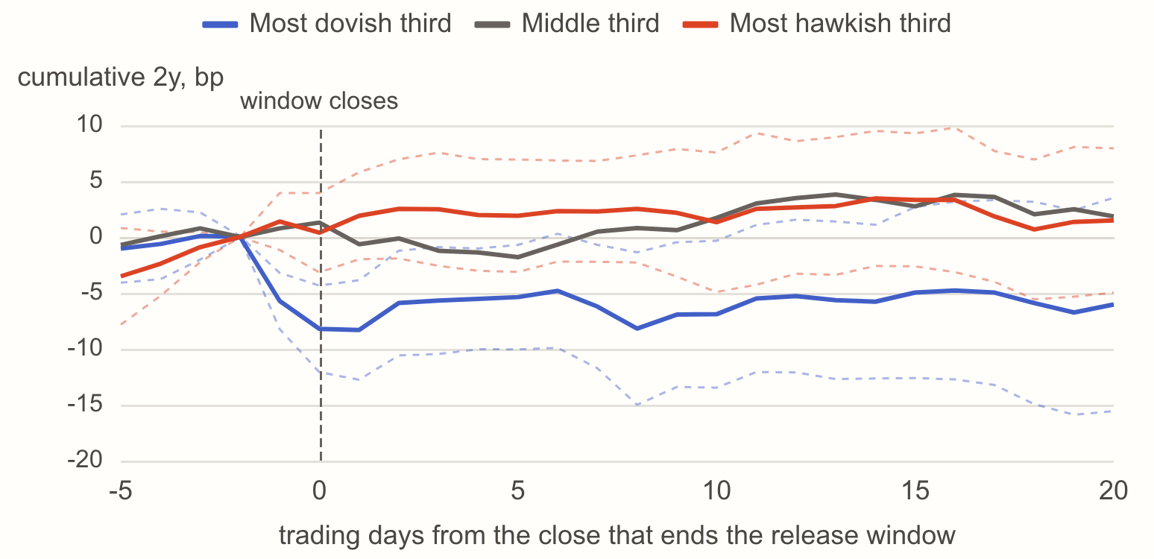
03
INDEX, YIELDS AND DURATION
25 / 46
Tone and 2-year release-window yield changes
Press conferences: change in the level score between releases
+3.9 bp
Associated 2-year move per SD of score change (t = 3.90, q = 0.007; Claude Opus 5.5)
Day before: t = 1.71 (placebo)
3-month bill as a surprise control: t = 3.20
TF-IDF tone as a control: t = 3.57
For the desk
No detectable five-day drift (t = 0.37); this does not establish full pricing.
Source: Treasury par yields; 94 release windows; evaluate/event_study.py.
Notes:
The lines show the average path of the 2-year around release days for the most dovish, middle and most hawkish thirds of tone shift in press conferences. One SD more hawkish accompanies a 2-year move of +3.9 basis points over the release window, t of 3.90. The day before: t of 1.71. With the 3-month bill as a control: t of 3.20. With the TF-IDF classifier's tone of the same documents as a control, Claude's tone still has a t of 3.57; it adds an association beyond the TF-IDF score.
Source: Treasury par yields; 94 release windows; evaluate/event_study.py.

Slide 26
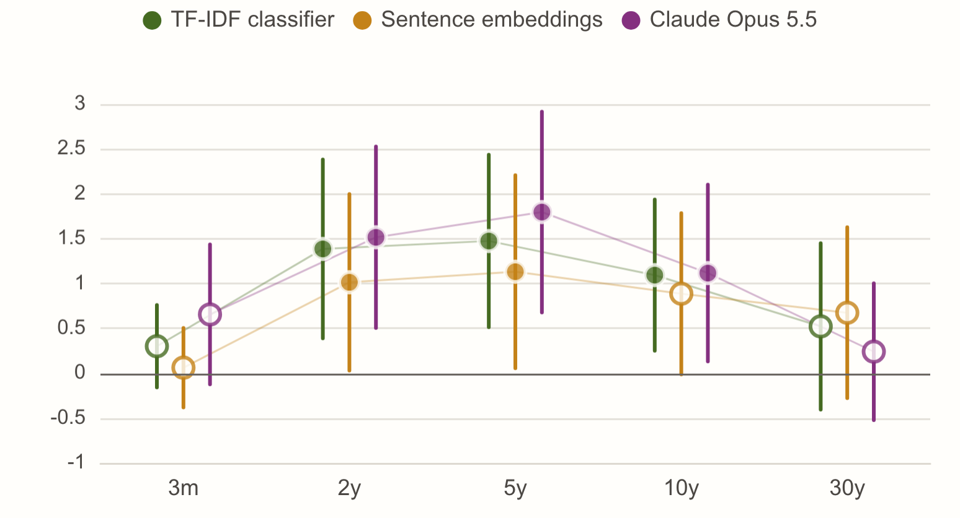
03
INDEX, YIELDS AND DURATION
26 / 46
Statement tone shifts across the curve
Level-score changes between policy decisions; statement and conference windows overlap
+1.8 bp
5-year move per standard deviation of the statement-to-statement shift in Claude’s score (t = 3.15)
2-year: t = 2.94
10-year: t = 2.22
Meetings without a press conference: t = 1.91 (n = 46)
Press conference’s tone as a control: t = 0.01
Source: FOMC statements and Treasury par yields; evaluate/event_study.py.
Notes:
This is the brief’s tone shift between consecutive statements. We regress each yield’s move over the statement window on the change in level score since the previous decision. The strongest association is at the 5-year; the result is descriptive, not a causal estimate. The yields are the Treasury’s daily par curve, the same series FRED republishes; FRED was unavailable when we last ran the pipeline, and the next run tries it first again. For the desk: Daily fixes cannot isolate statement information from an overlapping press conference.
Source: FOMC statements and Treasury par yields; evaluate/event_study.py.

Slide 27
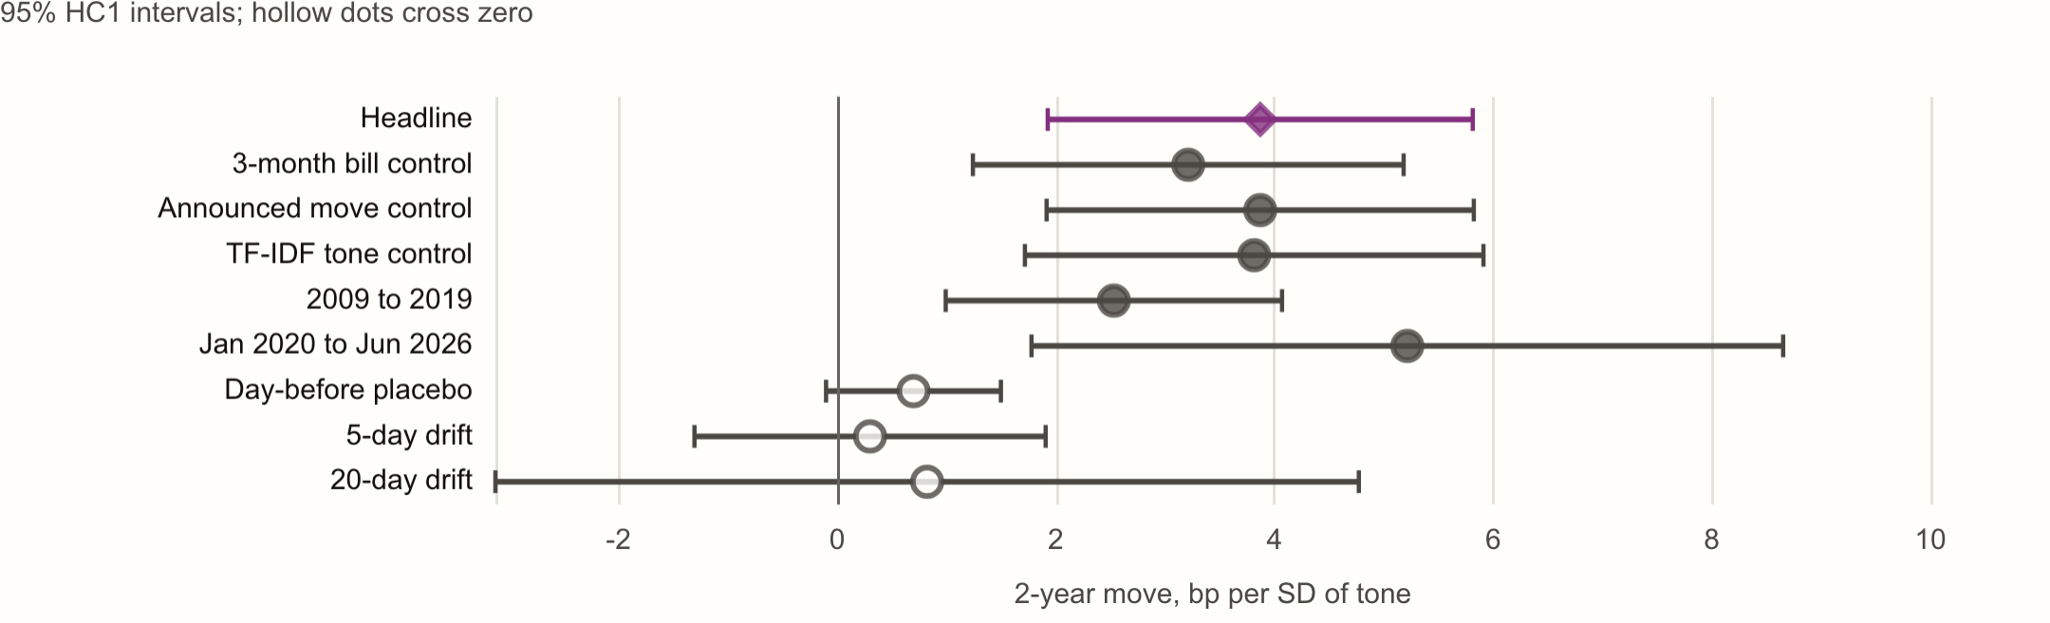
03
INDEX, YIELDS AND DURATION
27 / 46
The press-conference association across checks
The association survives controls and sample splits; no significant later drift
t = 3.90
+3.87 bp on the 2-year per standard deviation of Claude Opus 5.5's shift
3-month bill control: t = 3.20
Announced move control: t = 3.88
TF-IDF tone control: t = 3.57
Source: Stored event-study estimates; evaluate/event_study.py.
Notes:
The strongest 2-year relationship, read across every robustness row. The near-term surprise, the announced move and the TF-IDF tone of the same transcript each leave it significant, so Claude reads something the decision and word counts do not. It holds in both halves of the sample. The day-before placebo is weaker and later drift is not statistically detectable; full market pricing is not established. For the desk: Control and split-sample checks do not separate an exogenous language shock from shared news.
Source: Stored event-study estimates; evaluate/event_study.py.

Slide 28
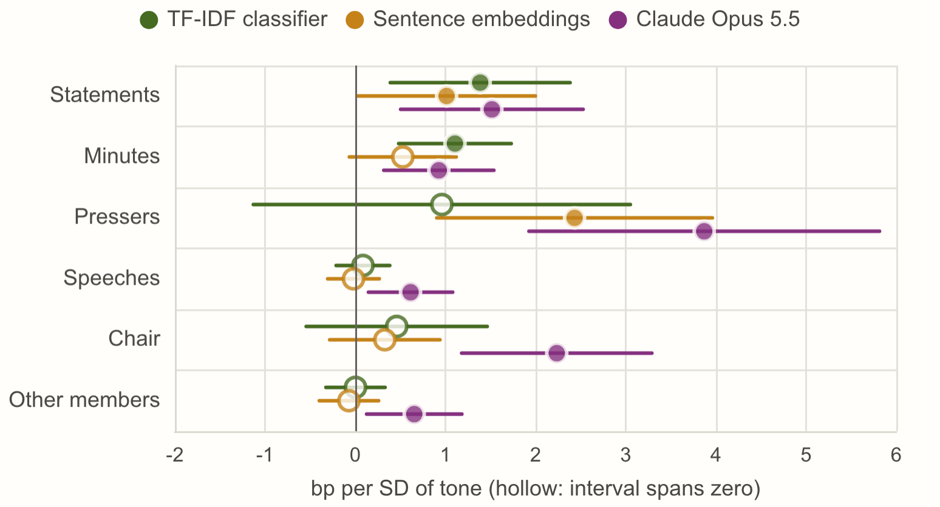
03
INDEX, YIELDS AND DURATION
28 / 46
Claude accounts for 16 of 26 surviving tests
Exploratory release-window associations; BH adjustment across 198 tests
26 / 198
main release-window tests with Benjamini-Hochberg q below 0.10
Claude: 16 of 54 tests
Dictionary, TF-IDF and embeddings: 10 of 144
Placebo, drift, controls and split samples are separate diagnostics
Source: Benjamini and Hochberg (1995); evaluate/event_study.py.
Notes:
We ran 198 exploratory release-window regressions and corrected for that family. 26 survive at a 10 percent false-discovery rate, and 16 of them use Claude’s reading. The chart shows the 2-year coefficients by document group for the three strongest readers. For the desk: False-discovery control addresses specification search, not shared news or causal identification.
Source: Benjamini and Hochberg (1995); evaluate/event_study.py.

Slide 29
03
INDEX, YIELDS AND DURATION
29 / 46
A trade fixed in advance
Standardize, cap, hold five days, pay costs: the code is the pre-registration
−0.18
z_i
= (s_i − mean_earlier) / sd_earlier
# same type, ≥ 12 earlier
θ_i
= −clip(z_i, −2, 2) / 2
# hawkish → shorter
Sharpe of the pre-registered tilt: Claude on minutes and speeches, next-day entry
pos_t = clip(Σ θ_i over open trades, −1, 1)
# each held 5 days
r_t
= pos_(t−1) · (r_IEF − r_SHY) − 2 × 1 bp × |Δpos_t|
tilt = 0.192 of the portfolio per unit
# ± 1 year of duration
Newey-West t = −0.79; hit rate 51%
PSR (probabilistic Sharpe) =
Φ((SR − 0) · √(T−1) / √(1 − γ3·SR + (γ4−1)/4 · SR²))
Shuffled-score placebo p = 0.28 (500 draws)
DSR (deflated Sharpe): benchmark = E[max SR of N no-skill variants]
SR: daily Sharpe; T: days; γ3: skewness; γ4: kurtosis; Φ: normal CDF
Probabilistic Sharpe 22%; −10 bp a year on AGG
For the desk
Every parameter was written down before the first run; the code is the pre-registration.
Source: Bailey and López de Prado (2012, 2014); evaluate/backtest.py.
Notes:
Signals are standardized against earlier documents of the same type only. A hawkish document sets a negative position, capped so one signal moves at most half a unit and all open trades at most one. Returns are the IEF-minus-SHY spread with costs on both legs for every change. The probabilistic Sharpe ratio allows for skew and fat tails; the deflated one raises the bar to what the best of all variants would show by luck.
Source: Bailey and López de Prado (2012, 2014); evaluate/backtest.py.

Slide 30
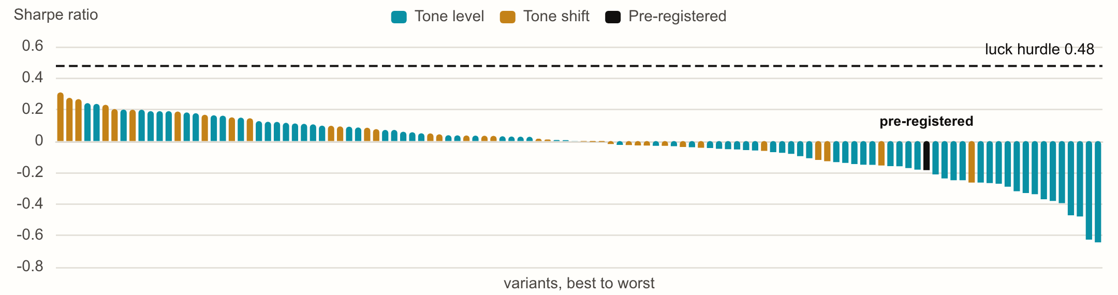
03
INDEX, YIELDS AND DURATION
30 / 46
No reliable delayed trading edge
One primary specification; every exploratory variant is counted in the search
−0.18
Sharpe after costs: Claude on minutes and speeches, next-day entry, 5-day hold
Placebo p = 0.28; probabilistic Sharpe 22%
116 variants; expected-best no-skill Sharpe 0.48
0 pass DSR 95%; active AGG −10 bp/year
21 Oct correction: Sharpe −0.23 → −0.18; verdict unchanged
For the desk
PSR tests Sharpe against zero; DSR raises the benchmark for the search across all variants.
Source: Yahoo Finance ETF closes; Bailey and López de Prado (2014); evaluate/backtest.py; docs/DESIGN.md.
Notes:
The primary tilt was specified before results: Claude's level scores on minutes and speeches, next-day ETF entry, five-day hold, after costs. Its Sharpe is -0.18. All 116 tested variants are reported; 0 pass the 95% deflated-Sharpe criterion, against an expected-best no-skill Sharpe of 0.48. PSR compares the primary Sharpe with zero; DSR adjusts the comparison for the search. The primary test was rerun once on 21 October 2026 after code review restored the speech-availability buffer and decision-with-decision comparisons in the written design. Sharpe changed from −0.23 to -0.18; the verdict did not change. This daily-horizon result does not establish that every possible trading edge has disappeared.
Source: Yahoo Finance ETF closes; Bailey and López de Prado (2014); evaluate/backtest.py; docs/DESIGN.md.

Slide 31
03
INDEX, YIELDS AND DURATION
31 / 46
From a Fed document to duration exposure
A traceable rule replay connects evidence with sizing and its historical test
01
02
Read the evidence
Replay the fixed rule
A scored Fed document, its source and policy-relevant evidence spans
Earlier same-type peers, a standardized score and explicit delayed entry
03
04
Translate to money
Challenge the result
User capital and duration budget, dollar DV01, ETF legs and round-trip cost
Parallel shocks, the stored historical test and prospective evaluation
Source: duration.py; frozen reader and entry rules from the backtest.
Notes:
Open a document and choose Explore duration. The workspace reads its score from the frozen primary model. It standardizes only against earlier eligible documents of the same type. The fixed rule maps that z-score to a share of the duration budget, as in the historical test. The user supplies capital, portfolio duration and the budget; an equal-dollar ETF overlay then gives dollar DV01, round-trip trading cost and parallel-shock P&L. Non-primary types, insufficient history and low policy relevance receive no rule-sized trade. Manual overrides remain labeled. Historical and forward tests stay one click away, including the negative H3 result. This tool does not add evidence of profitability.
Source: duration.py; frozen reader and entry rules from the backtest.

Slide 32
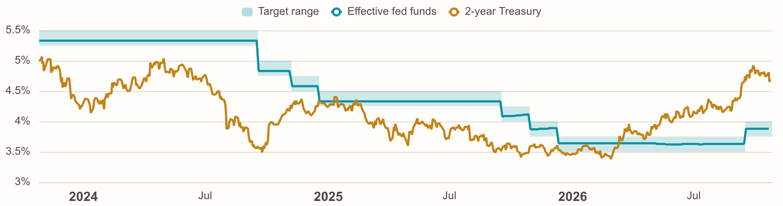
04
FORWARD CHECKS AND SYSTEM
32 / 46
The market leans to more hikes
The 2-year sits 81 bp above the overnight rate
+81 bp
2-year Treasury minus the effective fed funds rate
Target 3.75–4.00%
EFFR 3.88%
Next decision 28 October
Latest vote 12–0
For the desk
Into the next decision, the curve prices more tightening than the overnight rate shows.
Source: New York Fed (EFFR, SOFR); FRED or U.S. Treasury (2-year); FOMC minutes (roster).
Notes:
This is the live Fed-now page. The band is the target range, the blue line is where overnight money trades, and the orange line is the 2-year. The gap between the last two is a rough read of where the market thinks policy is going.
Source: New York Fed (EFFR, SOFR); FRED or U.S. Treasury (2-year); FOMC minutes (roster).

Slide 33
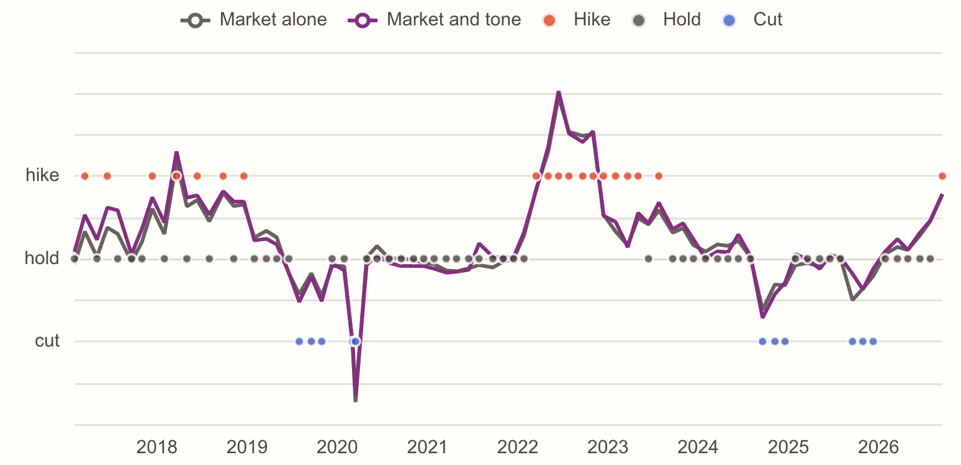
04
FORWARD CHECKS AND SYSTEM
33 / 46
No forecast gain from tone detected
Exploratory expanding-window forecasts use only earlier decisions
0.63
market-only in-sample R² across 142 decisions; pre-meeting 3-month and 2-year spreads over policy
With Claude's tone: R² 0.64 (F-test p = 0.04)
Forecasts from 2017: MSE 0.153 with tone, 0.149 without (p = 0.68)
79 forecasts, 30 of them moves
Exploratory: added after the results
For the desk
Adding tone does not reduce real-time forecast error in this sample; the test is exploratory.
Source: FOMC decisions and pre-meeting Treasury yields; evaluate/forecast.py.
Notes:
Does Claude's reading add to what the market already prices about the next decision? For each of the 142 decisions since 2009 we model the decision (cut, hold or hike) on the 3-month bill and 2-year over the policy rate at the last close before it, and on the tone of the latest minutes, the speeches of the previous 60 days and the previous statement. The market's lean alone explains 63%; tone adds a little in sample. In real time, forecasting every decision from 2017 with only earlier data, adding tone does not lower the error. We added this test after the results, so treat it as exploratory.
Source: FOMC decisions and pre-meeting Treasury yields; evaluate/forecast.py.

Slide 34
04
FORWARD CHECKS AND SYSTEM
34 / 46
Market predictors and the next decision
No reduction in real-time forecast error from tone
Input | Per SD | t | p
3-month bill over the policy rate | +0.303 | 6.70 | < 0.001
2-year over the policy rate | +0.077 | 2.24 | 0.025
Tone of the latest minutes | +0.061 | 1.19 | 0.234
Tone of speeches, last 60 days | −0.078 | −1.41 | 0.160
Tone of the previous statement | +0.063 | 1.35 | 0.176
R², market alone → with tone | 0.625 → 0.644
F-test of the three tone terms | F = 2.82 |  | 0.041
Real-time MSE from 2017: tone + market vs market | 0.153 vs 0.149 |  | 0.68
R² 0.63
from the 3-month bill and 2-year over the policy rate alone, 142 decisions
Decision coded −1, 0, +1; linear model, HC1 errors
Inputs per standard deviation; all strictly before the decision day
Expanding window: each of 79 forecasts uses only earlier decisions
Source: evaluate/forecast.py.
Notes:
Each decision since 2009 is modeled on the market's lean the evening before and on the tone of the latest minutes, recent speeches and the previous statement. In sample the tone terms are jointly significant at the 5% level; R² is 0.625 for the market and 0.644 with tone. Forecasting each decision from 2017 with only earlier data, adding tone does not lower the error. For the desk: Adding tone does not lower real-time forecast error in this sample; this result is exploratory.
Source: evaluate/forecast.py.

Slide 35
04
FORWARD CHECKS AND SYSTEM
35 / 46
After the freeze, nothing is re-fit
The same rules run on new data only, as it is collected
4
Type | Reads | bp per SD | t | q
Minutes | change in tone | +0.93 | 2.98 | 0.036
Press conferences | change in tone | +3.87 | 3.90 | 0.007
Speeches | tone | +0.85 | 3.25 | 0.029
Statements | Claude's comparison with the last decision | +1.96 | 2.97 | 0.036
frozen 2-year rules, one per document type, written on 2026-10-21
No release scored since the 2026-10-21 freeze yet
The pre-registered trade: +0.0 bp over 2 trading days
A one-sided binomial test from 10 releases; no verdict before a year
For the desk
Rules and coefficients were frozen before these releases; no post-freeze refitting.
Source: evaluate/forward.py; data/forward/rules.json.
Notes:
On 21 October 2026 the research was frozen. For each document type the strongest surviving 2-year relationship was written to a file with its coefficient and the in-sample mean and SD of its tone measure. Every evening each new release gets a predicted move beside its actual one, and the pre-registered trade runs through the backtest's own code, counted from the first close after the freeze.
Source: evaluate/forward.py; data/forward/rules.json.

Slide 36
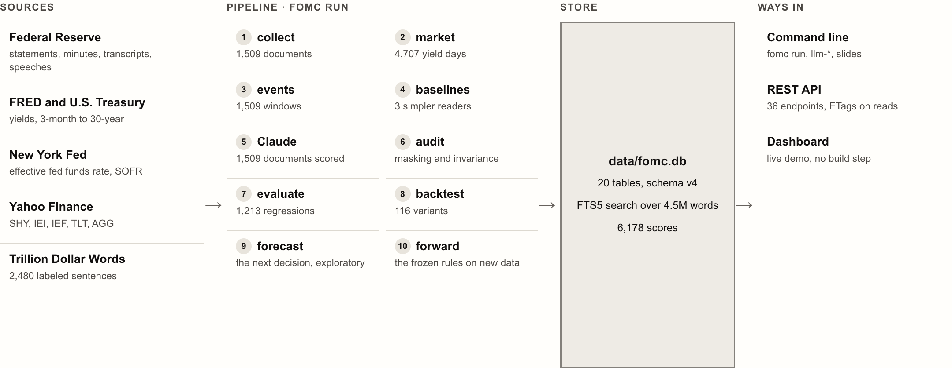
04
FORWARD CHECKS AND SYSTEM
36 / 46
Ten stages, one store, three ways in
Five public sources feed a pipeline that writes a single SQLite store
Source: Project code in src/fomc/ (Python 3.12, SQLite, FastAPI, ECharts), deployed on Cloud Run.
Notes:
The architecture in one picture. Five public sources feed ten pipeline stages. Every stage writes to a single SQLite store, and three front doors read it: the command line that runs the research, a REST API, and the dashboard, deployed as a read-only demo. Why it matters: Stages talk only through the store, so each can be rerun, tested or replaced on its own.
Source: Project code in src/fomc/ (Python 3.12, SQLite, FastAPI, ECharts), deployed on Cloud Run.

Slide 37
04
FORWARD CHECKS AND SYSTEM
37 / 46
Ten stages, one SQLite store
Stages talk only through the store and rerun only when their inputs change
Stage | Reads | Writes | Skipped when
collect | Fed calendar and pages, cached by URL | documents, full-text index, committee | never: always runs
market | FRED (Treasury fallback), Yahoo, New York Fed | yields, etf_prices, policy_rates | once a day
events | documents, yields, ETF closes | events, decisions | inputs unchanged
baselines | texts, labels, saved readers | scores, validity | texts, code, records unchanged
llm-sync | data/llm/*.json | llm_records, scores | records unchanged
audit | masked, repeated and re-read records | meta.audit | records unchanged
evaluate | scores, events, yields | event_study, event_curves | frozen since the freeze
backtest | scores, events, ETF closes | backtests, backtest_curves | frozen
forecast | scores, decisions, yields | meta.forecast | frozen
forward | the same, after the freeze | meta.forward | inputs unchanged
Source: db.py, store.py and cli.py.
Notes:
fomc run walks ten stages in order. Each stage's inputs are hashed, files, code and the parts of the settings it reads, and the stage is skipped when the hash matches the last run. Since the freeze the research stages are skipped regardless, unless asked to unfreeze. Full-text search is an FTS5 index over the documents table without duplicating text. The store: 20 tables, schema v4 with automatic migrations; every stage run is logged in pipeline_runs.
Source: db.py, store.py and cli.py.

Slide 38
04
FORWARD CHECKS AND SYSTEM
38 / 46
One read-only API serves everything
Read-only and keyless: dashboard, unified story, feed and exports
36
/feed.xml
0
JSON endpoints; reads revalidate by ETag, a 304 when unchanged
Atom feed: lean, percentile and the Fed's words for each new document
build steps: vanilla JavaScript, ECharts, self-hosted fonts and icons
Reproduce
One story
1,601
make setup, make demo-data, then make serve. The supplied snapshot needs no API key.
Introduction and technical detail; PDF and editable PowerPoint exports
source files cached by URL, so nothing is downloaded twice
Source: api.py and web/app.js.
Notes:
FastAPI serves 36 JSON endpoints; every read carries a validator, so an unchanged response costs a 304. The front end has no build step. The deck is rendered by parallel headless Chrome into one unified story with PDF and editable PowerPoint exports. An Atom feed gives each new document with its reading. Security: The hosted app holds no key: settings, scoring and labeling are locked by FOMC_PUBLIC=1.
Source: api.py and web/app.js.

Slide 39
04
FORWARD CHECKS AND SYSTEM
39 / 46
Automated refresh and spending guards
Configured schedules, spending caps and checks for missing data
01
02
03
Trigger
Refresh
Build
Configured: 7:30 p.m. ET daily; 2:25 p.m. ET on release afternoons; every main push
documents and prices; Claude on what is new, at most 40 jobs and 5 USD a month
keyless sign-in (workload identity federation); Cloud Build to Artifact Registry
04
05
06
Serve
Guard
Cap
Cloud Run, 1 vCPU, 1 GiB, 0 to 3 instances, warm by a free ping; fedtone.web.app
fomc doctor --strict: statements, minutes, prices and readings must keep arriving
a 1 USD budget unlinks billing through Pub/Sub and a function
Source: .github/workflows/refresh.yml; docs/OPERATIONS.md.
Notes:
A workflow is configured for every evening and the afternoon of a statement or minutes, after a fifteen-second check. It refreshes data, scores what is new under the caps, runs the forward test, then signs in to Google Cloud without a key and rolls out a new revision. A strict check fails the run if a scheduled release never arrives. The service scales to zero, kept warm by a free scheduler ping. These are configured controls; verify the workflow and cloud build's terminal state before treating a refresh as successful. Operations: A refresh that stops bringing things in fails loudly: GitHub emails the owner.
Source: .github/workflows/refresh.yml; docs/OPERATIONS.md.

Slide 40
04
FORWARD CHECKS AND SYSTEM
40 / 46
132 offline tests, no model calls
Checks cover timing, scoring, statistics, the API, operations and delivery
132
Suite | Tests | Guards
duration | 37 | duration sizing, prior-only signals, source badges, input checks
store_api | 32 | store, migrations, API, public mode, feed, the decks
research | 16 | decisions, false discovery, PSR and DSR, event panels
ops | 8 | release days, the monthly cap, drift, the strict check
submission | 8 | the code archive, the four deliverables, this test count
timing | 8 | release windows, holidays, entries that earn only later
text_and_scoring | 7 | cleaning, sentences, dictionary signs, quote checks
finetune | 4 | fine-tuning bookkeeping, without PyTorch
members | 4 | quoted biographies, shifts in tone, what changed
scorer_offline | 4 | the scoring engine against a stub client, no key
forward | 3 | the freeze: returns after it only, rules that cannot move
forecast | 1 | the next-decision inputs never look ahead
tests that pytest collects in this revision; none needs a key or calls a model
Locked versions in requirements.lock, one file for every OS
A guard keeps the research stack out of the hosted image
Lint and a front-end check run beside the tests
Source: pytest collection of this revision (src/fomc/test_inventory.json).
Notes:
132 tests run offline on this revision. The duration tests check the sizing identities, prior-only signals and input validation. The timing suite holds the no-look-ahead rules. The scoring engine is tested against a stub client, so the suite never spends money. The research tests check Benjamini-Hochberg against statsmodels and the Sharpe statistics. The operations tests cover the release-day check, the cap, drift and the strict freshness check. For the desk: The rules that make a result trustworthy, like no look-ahead, are tests, not intentions.
Source: pytest collection of this revision (src/fomc/test_inventory.json).

Slide 41
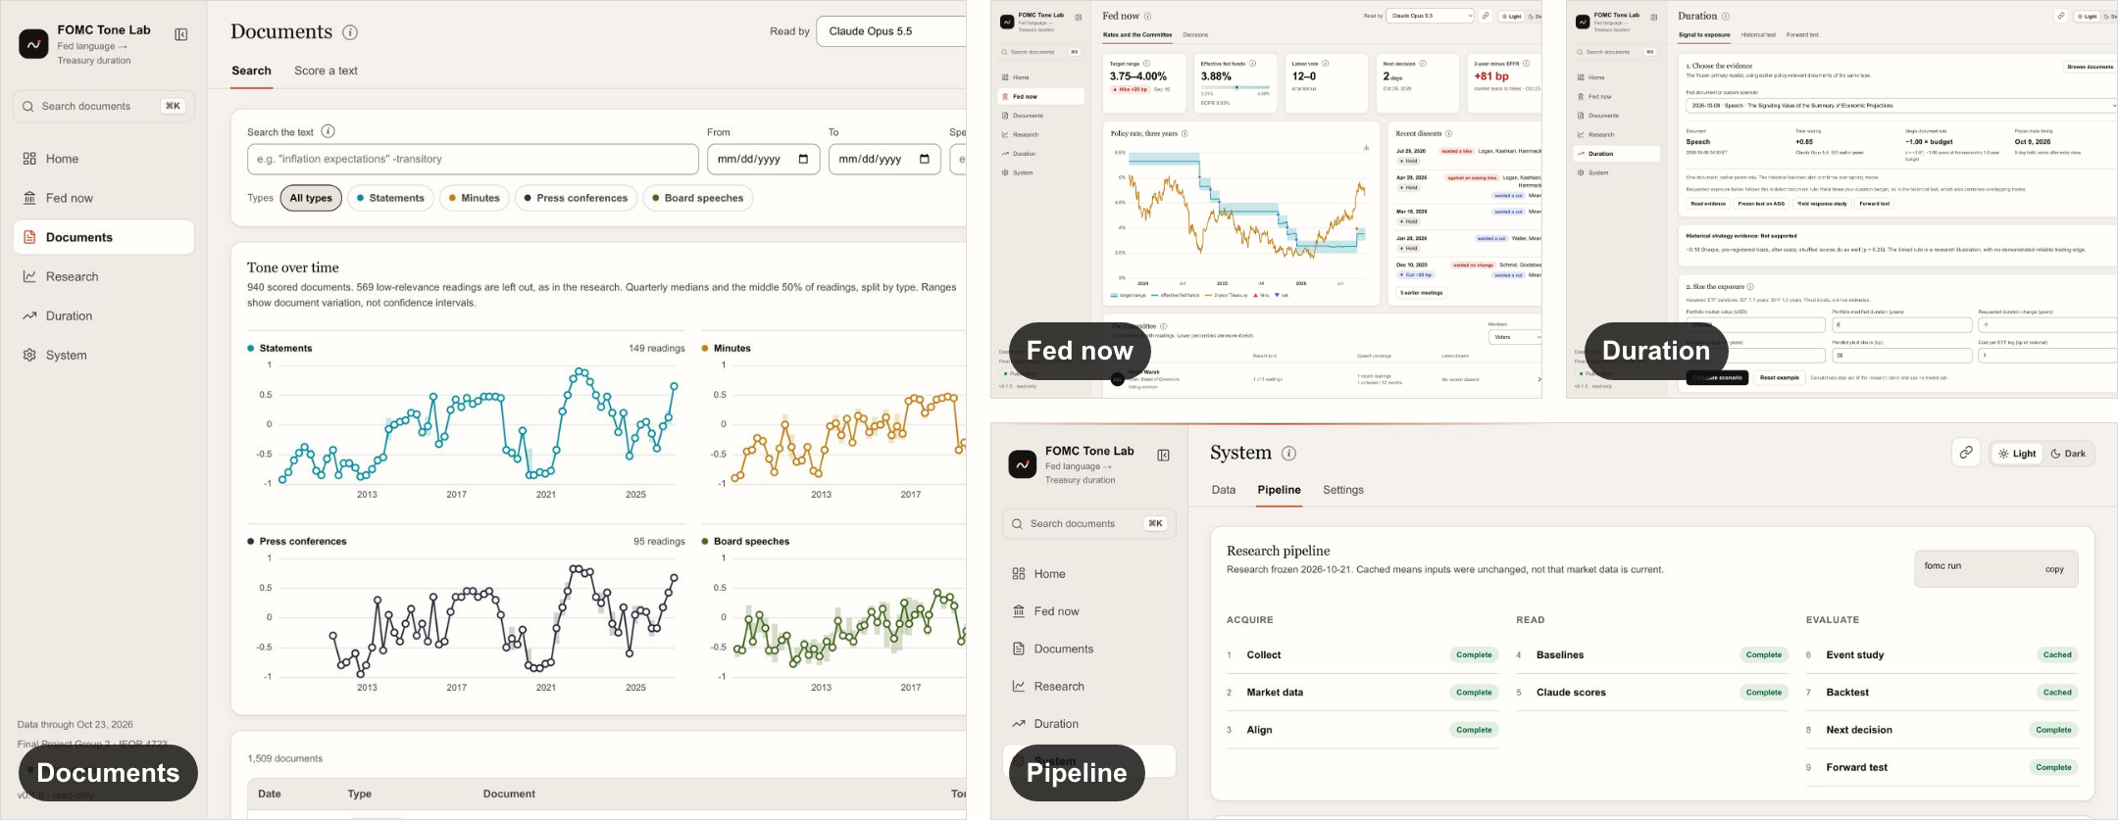
04
FORWARD CHECKS AND SYSTEM
41 / 46
A dashboard a rates desk could open every morning
Source documents, clearer comparisons and a linked duration workspace
Source: fedtone.web.app (read-only demo).
Notes:
This is the product: a home page with the Fed pulse and the four findings, the Fed-now pages with rates, the Committee (click a member for their background, the tone of every speech and their dissents) and every decision redlined, and the research pages. It is live; we can switch to it now. Try it: Everything in this deck is one click away in the live app, with the source documents behind every number.
Source: fedtone.web.app (read-only demo).

Slide 42
05
CONCLUSIONS AND LIMITS
42 / 46
What we added beyond the brief
Measurement checks, a forward test, and a system that keeps the evidence auditable
RoBERTa
Forward test
Monthly re-reads
Member timelines
Fine-tuned on the same labels; a reference added after the results, outside H1
Frozen coefficients and trading rules applied only to releases after the freeze
The same anchor documents reveal changes in the model or scoring pipeline
Fed biographies, speech-tone turning points, titles and dissent histories
Atom feed
Freeze guards
Refresh and caps
Shared store
Subscribe to new releases, their tone and links to the Fed's source documents
Research and baseline results stay fixed while new documents receive scores
Automatic collection and refresh, with spending limits and freshness checks
The unified story and read-only dashboard read the same versioned store
Source: Project code; docs/ASSIGNMENT.md.
Notes:
These additions extend the brief without changing the frozen H1 to H4 results. The trained transformer and forecast are exploratory references. The forward test uses new releases under fixed rules.
Source: Project code; docs/ASSIGNMENT.md.

Slide 43
05
CONCLUSIONS AND LIMITS
43 / 46
Topic 4 coverage and its limits
Seven functional requirements have evidence, with profitability reported honestly
Requirement | Delivered evidence | Boundary
Four Fed text types | 1,509 documents | Board speeches only
Claude rubric and evidence | 1,509 main readings | Recognition remains possible
Simpler text baselines | Dictionary, TF-IDF, embeddings | Public expert labels
Treasury curve test | 3m, 2y, 5y, 10y and 30y | Treasury fallback disclosed
Bond portfolio duration tilt | 116 variants, AGG / IEI | Fixed risk assumptions
Release-time backtest | Delayed entry, costs, placebos | Daily data, not ticks
Minutes, speeches and shifts | Primary and exploratory tests | No reliable H3 edge
Source: docs/ASSIGNMENT.md and docs/BRIEF_AUDIT.md.
Notes:
The seven components in the brief are implemented. A negative trading result does not mean the backtest is missing. The corpus covers the four requested document types. Claude scores have a defined rubric and evidence spans. Dictionary and sentence-embedding baselines share an expert-labeled test. Five Treasury tenors use the FRED series with an official Treasury fallback. AGG and IEI views expose the delayed duration tilt, including costs and multiple-testing controls. Daily windows respect public-release times but cannot identify minute-by-minute pricing. Minutes, speeches and statement shifts are all tested. Optional post-cutoff human annotation was not run and is not presented as completed.
Source: docs/ASSIGNMENT.md and docs/BRIEF_AUDIT.md.

Slide 44
05
CONCLUSIONS AND LIMITS
44 / 46
Three things a rates desk can use
What the evidence supports, and how to use it
01
02
03
Higher agreement on public expert labels
Tone accompanies release-window repricing
No delayed trading edge detected
Public-label macro-F1 0.66 against 0.58 for the best baseline without task-specific training (trained RoBERTa: 0.74); no post-cutoff human validation was run.
26 of 198 exploratory release-window tests survive adjustment, 16 on Claude’s reading. Shared news and overlapping releases prevent a causal interpretation.
The pre-registered trade has a Sharpe of −0.18 (placebo p = 0.28); no variant clears the luck hurdle.
Source: Project results, frozen 21 October 2026.
Notes:
Three takeaways. Claude outperforms the stated baselines on public expert sentences, with no task-specific training, but public-label exposure remains possible. Tone is associated with release-window yield changes. The tested delayed duration tilt does not beat chance; this does not prove full market pricing. For the desk: Use the evidence-linked index for inspection; the tested daily tilt does not establish an investable edge.
Source: Project results, frozen 21 October 2026.

Slide 45
05
CONCLUSIONS AND LIMITS
45 / 46
What would change our minds, and what we do next
H1 is supported on public expert labels; independent human validation remains absent
01
02
03
04
Daily closes, not ticks
Small post-cutoff sample
No post-cutoff human test
Public labels may be familiar
Release windows use the 3:30 p.m. Treasury fix; intraday data would sharpen the statement tests.
34 documents since the configured post-cutoff date, 2026-07-01; no independent human reference.
150 sentences have model predictions. No post-cutoff human or cross-model validation was performed.
Expert labels may be in the model's training data. Masking dates and names partly addresses this risk.
Next
Independent labels, intraday yields, and more frozen-rule releases would strengthen the evidence.
Source: docs/DESIGN.md (limitations); docs/PRODUCT_VALIDATION.md.
Notes:
Limits, stated plainly. We use daily closes; intraday data would sharpen the statement tests. The sample after the configured cutoff is still small. The post-cutoff human test was not run. H1 is supported on the public expert labels, which may have appeared in training. The masking audit only partly addresses that risk.
Source: docs/DESIGN.md (limitations); docs/PRODUCT_VALIDATION.md.

Slide 46
Final Project Group 2 · IEOR 4723, AI-Augmented Investment Management, Fall 2026
Thank you
Questions and discussion
fedtone.web.app
github.com/flukier1016/fomc-tone-lab
Genie Zhang
Hong-syuan Lin
Myron Pang
Weijun Situ
Notes:
Thank you. Happy to take questions, or to open any page of the dashboard live. The code is public at github.com/flukier1016/fomc-tone-lab, with the same files as the submitted code ZIP.

