Slide 1
The Modern Chancery Hand?
Educational Technologies at Berkeley Today
J. Bradford DeLong
2017-08-13
<https://www.icloud.com/keynote/0yKJfOMN5SvDtK_K7tjWAstcA>
<https://github.com/braddelong/public-files/blob/master/chancery-hand-educational-technologies-at-berkeley.pptx>
2017-08-13 Educational Technologies Here at Berkeley

Slide 2
Why We Are Moving to Computer Problem Sets
The Economics Department is responding to the current Berkeley budget crisis enforcing a work speedup on our GSI section leaders:
Instead of teaching 2 sections of 30 for a 50% GSI salary
They will be teaching 3 sections of 25
They are underpaid anyway
Hence we need to offload the problem set grading part of their job onto our machines...
This is an opportunity and a challenge:
The opportunity: you have to learn (or remember) a little Python for simple programming exercises
The challenge: you have to learn (or remember) a little Python for simple programming exercises
The opportunity: you learn how to do more things in problem sets
The challenge: we can demand that you do more things in problem sets
The opportunity: you will master important tools

Slide 3
Why We Are Moving to Computing
Four Stages in the western European academic intellectual tradition:
The Visible College: Scribal literacy and Roman numeracy
The Invisible College: Print literacy and Arabic numeracy
The Republic of Letters: Enlightenment critical thinking and the scientific method
The Unseen University...

Slide 4
Rules for Computer Programming
Three principles:
Find a program that does almost what you want to do:
Inspect the source code…
Tweak it and see if that does the job…
Google the error message…
Remember: conda install/update is your best friend...

Slide 5
Things Go Wrng!
Gandalf the Grey, Python νb, confronting unexpected behavior from a pandas.DataFrame:

Slide 6
Deep Wizardry…
Harold Abelson and Gerald Jay Sussman with Julie Sussman (1993): Structure and Interpretation of Computer Programs:
Computational processes are abstract beings that inhabit computers. As they evolve, processes manipulate other abstract things called data. The evolution of a process is directed by a pattern of rules called a program. People create programs to direct processes. In effect, we conjure the spirits of the computer with our spells.
The programs we use to conjure processes are like a sorcerer's spells. They are carefully composed from symbolic expressions in arcane and esoteric programming languages that prescribe the tasks we want our processes to perform.
A computational process, in a correctly working computer, executes programs precisely and accurately. Thus, like the sorcerer's apprentice, novice programmers must learn to understand and to anticipate the consequences of their conjuring…

Slide 7
Why Python?
Something Seth Lloyd said to me in May: "I have made it a lifelong goal to only have to know one computer language at a time..."
He has had some success in his career: "Nam P. Suh Professor of Mechanical Engineering and Engineering Systems and Director of the Center for Extreme Quantum Information Theory at MIT. External Adjunct Fellow at the Santa Fe Institute. Ph.D. (Physics), Rockefeller University. M. Phil. (Philosophy), Cambridge University. B.A. (Physics), Harvard University..."
"Quantum Mechanic"

Slide 8
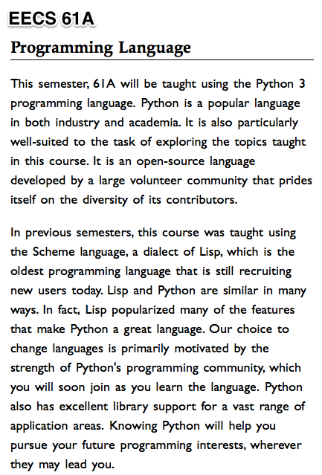
Berkeley as Python (or, at Least, Jupiter Notebook) Central

Slide 9
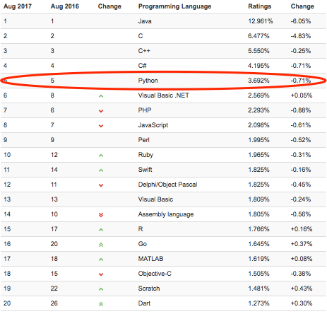
Python as Least Unfriendly
Kunal Marwaha says:
Python is the best of both worlds—the functionality of a general-purpose language but with different “packages” for different disciplines…
Python is friendly to novices. Most languages can do what you need, but efficiency depends on how quickly you can learn it…
The user community of each language makes a big difference…
Python is the fifth most popular programming language and is open source.
If you have never programmed and are working on a research problem, Python is almost certainly the best language to try first…

