Slide 1
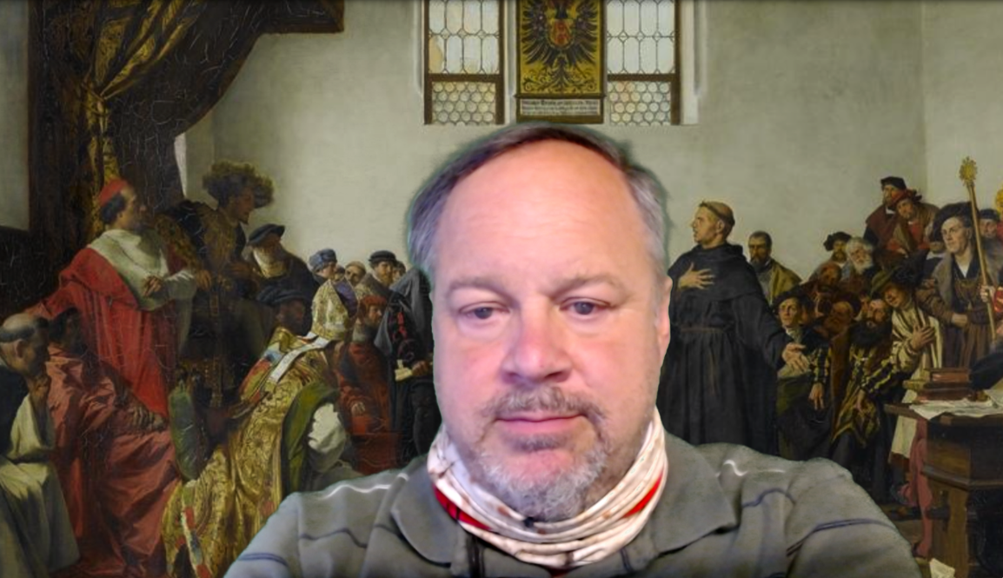
Introduction: Module 1.1. Themes Video
What are the big themes we are going to be dealing with in this course on the economic history of the long 20th century?
Big Ideas!: The idea behind taking any course is to build your human capital by making useful facts, patterns, and ways of thinking part of your own mental-intellectual panoply. And the key to doing that is to arranging them around “Big Ideas”. What are the Big Ideas—the major themes—of this course?
<https://youtu.be/pXRs2OLUhKo> <https://github.com/braddelong/public-files/blob/master/econ-115-module-1-1-themes-%23tceh.pptx>
6:50 of video
Notes:
Jump forward two- or three-thousand years from now. Then, in our future, history as _we_ know it will have been boiled down to its bare core. If there is somebody like me, working at a task something like this, informing students of the Big Ideas of a history course.
And then they will probably try to highlight a few Big Ideas about the history of the 20th century:
1. That the history of the twentieth century was overwhelmingly _economic_: the economy was the dominant arena of events and changes, and economic changes were the driving force behind other changes in a way never seen before in any century-long time span.
2. That the twentieth century saw the material wealth of humankind explode beyond all previous imagining: we—at least those of us who belong to the upper middle class and live in the industrial core of the world economy—are now far richer than the writers of previous centuries’ utopias could have imagined. Spearheaded in the American economy—“the furnace where the future was being forged”, in the words of communist Russian revolutionary Leon Trotsky—by the coming of the industrial research lab and the modern corporation to rationalize and routinize the process of inventing and diffusing technology; reinforced by globalization that interconnected everyone’s destiny with the destinies of billions of others thousands of miles away, the transformation of humanity from a state of general poverty to one in which there was enough wealth that, as my friend Max Singer used to say, a truly human world was within our grasp.
3. That alongside the coming of wealth was the coming of health and long life, and this had extraordinarily far-reaching ramifications: the escape from Malthusian poverty as the check on human fertility, the arrival of modern feminism and the decline—not fall—of patriarchy, the approach of zero population growth.
4. That a lot went wrong in the twentieth century. Its tyrannies were more brutal, bloody, & barbaric than in previous centuries. And—astonishingly—they had much of their origins in _economic_ discontents and _economic_ ideologies. People killed each other in large numbers over questions of how the economy should be organized. A declining significance of caste and ethnicity in hemming people into unfreedom was offset by a rising significance of parental wealth in restricting people via relative poverty to lives of relative drudgery and imprisonment. And governments, over and over again, failed to manage their economies to produce steady full employment, equitable growth, a sense of stability, and a sense that people received what they were owed and got what they deserved to get.
A word about the first of these—that the history of the 20th century was in a very important sense primarily _economic_. For most centuries, the core of history—the most interesting and important parts—was only tangentially at best related to the _economic_. For most centuries, the core of their history was, instead, intellectual or religious or political or cultural. The background behind me shows an 1877 interpretation of a moment that is at the core of the history of western Eurasia—what we usually call “Europe”—in the 1500s: the religious struggles of the Protestant Reformation and the Catholic Reformation. This moment is when the Holy Roman Emperor asks the monk and religious reformer Martin Luther to abandon some of his theological claims in order to maintain religious unity and concord among German Christians, and avoid bloody and brutal lengthy wars. Luther responds that his conscience will not let him. And Europe descends into nearly two centuries of near-genocidal religious war.
The consolidation of Christianity in the Roman Empire, the spread of Islam, the Protestant Reformation, the Italian Renaissance, Ming Dynasty artistic creations, the American and French Revolutions, the conquests of the _Devlet-i ʿAlīye-i ʿOsmānīye (what Britos called the Ottoman Empire) and the consolidation of the holdings of the Gurkani dynasty (what Britons called the Moghul Empire)—these are the things of which history principally consists. The economy the background against which the action of a play took place, for its changes were only visible in what Fernand Braudel called the _longue durée_—the long run.
Not so the history of the 20th century. The economy and economic events and changes are at its core.
And let me add a fifth Big Idea:
5. Our predecessors, many of them at least, would be amazed that, with the wealth and power, the technological and organizational tools, the knowledge and communications that we now possess, humanity has not done much more than it has done to make of the world a utopia. In the aftermath of World War I, Irish poet William Butler Yeats wrote of how positive utopian and millennial hopes seemed to be going wrong. The stories were that history was supposed to have a beautiful and miraculous end: a chosen one born in the city of King David—Bethlehem—to lead us all to a heavenly New Jerusalem.
But, Yeats wrote in his poem _The Second Coming_, it was not so.
It was not a chosen one but rather a “rough beast” “with lion body and the head of a man/a gaze blank and pitiless as the sun”. And its motion toward Bethlehem was a “slouching” one. Yeats’s poem has been called the “most pillaged” in modern times because it speaks to us. The history of the 20th century has seen us as a race are at best slouching, if that, towards something that might be a utopia, maybe.

Slide 2
Big Ideas of 20th Century History
History overwhelmingly economic…
Material wealth explodes beyond all previous imagining…
Health, long life, & their consequences—feminism…
That nevertheless a lot went wrong: tyranny, inequality, depression…
Notes:
1. That the history of the twentieth century was overwhelmingly _economic_: the economy was the dominant arena of events and changes, and economic changes were the driving force behind other changes in a way never seen before in any century-long time span.
2. That the twentieth century saw the material wealth of humankind explode beyond all previous imagining: we—at least those of us who belong to the upper middle class and live in the industrial core of the world economy—are now far richer than the writers of previous centuries’ utopias could have imagined. Spearheaded in the American economy—“the furnace where the future was being forged”, in the words of communist Russian revolutionary Leon Trotsky—by the coming of the industrial research lab and the modern corporation to rationalize and routinize the process of inventing and diffusing technology; reinforced by globalization that interconnected everyone’s destiny with the destinies of billions of others thousands of miles away, the transformation of humanity from a state of general poverty to one in which there was enough wealth that, as my friend Max Singer used to say, a truly human world was within our grasp.
3. That alongside the coming of wealth was the coming of health and long life, and this had extraordinarily far-reaching ramifications: the escape from Malthusian poverty as the check on human fertility, the arrival of modern feminism and the decline—not fall—of patriarchy, the approach of zero population growth.
4. That a lot went wrong in the twentieth century. Its tyrannies were more brutal, bloody, & barbaric than in previous centuries. And—astonishingly—they had much of their origins in _economic_ discontents and _economic_ ideologies. People killed each other in large numbers over questions of how the economy should be organized. A declining significance of caste and ethnicity in hemming people into unfreedom was offset by a rising significance of parental wealth in restricting people via relative poverty to lives of relative drudgery and imprisonment. And governments, over and over again, failed to manage their economies to produce steady full employment, equitable growth, a sense of stability, and a sense that people received what they were owed and got what they deserved to get.

Slide 3
A World About the First…
Before 1800 or so history not substantially economic…
Before 1870 or so history not primarily economic…
Back then, history was:
Religious or intellectual or political or cultural
Since 1870 history has been primarily economic…
Notes:
A word about the first of these—that the history of the 20th century was in a very important sense primarily _economic_. For most centuries, the core of history—the most interesting and important parts—was only tangentially at best related to the _economic_. For most centuries, the core of their history was, instead, intellectual or religious or political or cultural. The background behind me shows an 1877 interpretation of a moment that is at the core of the history of western Eurasia—what we usually call “Europe”—in the 1500s: the religious struggles of the Protestant Reformation and the Catholic Reformation. This moment is when the Holy Roman Emperor asks the monk and religious reformer Martin Luther to abandon some of his theological claims in order to maintain religious unity and concord among German Christians, and avoid bloody and brutal lengthy wars. Luther responds that his conscience will not let him. And Europe descends into nearly two centuries of near-genocidal religious war.
The consolidation of Christianity in the Roman Empire, the spread of Islam, the Protestant Reformation, the Italian Renaissance, Ming Dynasty artistic creations, the American and French Revolutions, the conquests of the _Devlet-i ʿAlīye-i ʿOsmānīye (what Britos called the Ottoman Empire) and the consolidation of the holdings of the Gurkani dynasty (what Britons called the Moghul Empire)—these are the things of which history principally consists. The economy the background against which the action of a play took place, for its changes were only visible in what Fernand Braudel called the _longue durée_—the long run.
Not so the history of the 20th century. The economy and economic events and changes are at its core.

Slide 4
A Fifth Big Idea
We are rich! Where is our utopia?
William Butler Yeats: The Second Coming:
Turning and turning in the widening gyre The falcon cannot hear the falconer; Things fall apart; the centre cannot hold; Mere anarchy is loosed upon the world….
Surely some revelation is at hand; Surely the Second Coming is at hand…. A shape with lion body and the head of a man, A gaze blank and pitiless as the sun… The darkness drops again; but now I know That twenty centuries of stony sleep Were vexed to nightmare by a rocking cradle, And what rough beast, its hour come round at last, Slouches towards Bethlehem to be born?
Notes:
And let me add a fifth Big Idea:
5. Our predecessors, many of them at least, would be amazed that, with the wealth and power, the technological and organizational tools, the knowledge and communications that we now possess, humanity has not done much more than it has done to make of the world a utopia. In the aftermath of World War I, Irish poet William Butler Yeats wrote of how positive utopian and millennial hopes seemed to be going wrong. The stories were that history was supposed to have a beautiful and miraculous end: a chosen one born in the city of King David—Bethlehem—to lead us all to a heavenly New Jerusalem.
But, Yeats wrote in his poem _The Second Coming_, it was not so.
It was not a chosen one but rather a “rough beast” “with lion body and the head of a man/a gaze blank and pitiless as the sun”. And its motion toward Bethlehem was a “slouching” one. Yeats’s poem has been called the “most pillaged” in modern times because it speaks to us.
The history of the 20th century has seen us as a race at best slouching, if that, towards something that might be a utopia, maybe.

Slide 5
Addendum: Script
Jump forward two- or three-thousand years from now. Then, in our future, history as _we_ know it will have been boiled down to its bare core. If there is somebody like me, working at a task something like this, informing students of the Big Ideas of a history course.
And then they will probably try to highlight a few Big Ideas about the history of the 20th century:
1. That the history of the twentieth century was overwhelmingly _economic_: the economy was the dominant arena of events and changes, and economic changes were the driving force behind other changes in a way never seen before in any century-long time span.
2. That the twentieth century saw the material wealth of humankind explode beyond all previous imagining: we—at least those of us who belong to the upper middle class and live in the industrial core of the world economy—are now far richer than the writers of previous
imagining: we—at least those of us who belong to the upper middle class and live in the industrial core of the world economy—are now far richer than the writers of previous centuries’ utopias could have imagined.
Spearheaded in the American economy—“the furnace where the future was being forged”, in the words of communist Russian revolutionary Leon Trotsky—by the coming of the industrial research lab and the modern corporation to rationalize and routinize the process of inventing and diffusing technology; reinforced by globalization that interconnected everyone’s destiny with the destinies of billions of others thousands of miles away, the transformation of humanity from a state of general poverty to one in which there was enough wealth that, as my friend Max Singer used to say, a truly human world was within our grasp.
3. That alongside the coming of wealth was the coming of health and long life, and this had

Slide 6
Addendum: Script 2
extraordinarily far-reaching ramifications: the escape from Malthusian poverty as the check on human fertility, the arrival of modern feminism and the decline—not fall—of patriarchy, the approach of zero population growth.
4. That a lot went wrong in the twentieth century. Its tyrannies were more brutal, bloody, & barbaric than in previous centuries. And—astonishingly—they had much of their origins in _economic_ discontents and _economic_ ideologies. People killed each other in large numbers over questions of how the economy should be organized. A declining significance of caste and ethnicity in hemming people into unfreedom was offset by a rising significance of parental wealth in restricting people via relative poverty to lives of relative drudgery and imprisonment. And governments, over and over again, failed to manage their economies to produce steady full employment, equitable growth, a sense of stability, and a sense that people received what they were owed and got
what they deserved to get.
A word about the first of these—that the history of the 20th century was in a very important sense primarily _economic_. For most centuries, the core of history—the most interesting and important parts—was only tangentially at best related to the _economic_. For most centuries, the core of their history was, instead, intellectual or religious or political or cultural.
The background behind me shows an 1877 interpretation of a moment that is at the core of the history of western Eurasia—what we usually call “Europe”—in the 1500s: the religious struggles of the Protestant Reformation and the Catholic Reformation. This moment is when the Holy Roman Emperor asks the monk and religious reformer Martin Luther to abandon some of his theological claims in order to maintain religious unity and concord among German Christians, and avoid bloody and brutal lengthy wars. Luther responds that his

Slide 7
Addendum: Script 3
conscience will not let him. And Europe descends into nearly two centuries of near-genocidal religious war.
The consolidation of Christianity in the Roman Empire, the spread of Islam, the Protestant Reformation, the Italian Renaissance, Ming Dynasty artistic creations, the American and French Revolutions, the conquests of the _Devlet-i ʿAlīye-i ʿOsmānīye (what Britos called the Ottoman Empire) and the consolidation of the holdings of the Gurkani dynasty (what Britons called the Moghul Empire)—these are the things of which history principally consists. The economy the background against which the action of a play took place, for its changes were only visible in what Fernand Braudel called the _longue durée_—the long run.
Not so the history of the 20th century. The economy and economic events and changes are at its core.
And let me add a fifth Big Idea:
5. Our predecessors, many of them at least, would be amazed that, with the wealth and power, the technological and organizational tools, the knowledge and communications that we now possess, humanity has not done much more than it has done to make of the world a utopia. In the aftermath of World War I, Irish poet William Butler Yeats wrote of how positive utopian and millennial hopes seemed to be going wrong. The stories were that history was supposed to have a beautiful and miraculous end: a chosen one born in the city of King David—Bethlehem—to lead us all to a heavenly New Jerusalem.
But, Yeats wrote in his poem _The Second Coming_, it was not so.
It was not a chosen one but rather a “rough beast” “with lion body and the head of a man/a gaze blank and pitiless as the sun”. And its motion toward Bethlehem was a “slouching”

Slide 8
Addendum: Script 4
one.
Yeats’s poem has been called the “most pillaged” in modern times—the most used and most cited. Why? Because it speaks to us, powerfully.
The history of the 20th century has seen us as a race at best slouching, if that, towards something that might be a utopia, maybe.

