Slide 1

Lectures, Slides, & Q&A: 4. Logistics
Lecture slides with audio:
Activity flow
<https://github.com/braddelong/public-files/blob/master/econ-115-module-0-lecture-1-activities-%23tceh.pptx>
The educational process
<https://github.com/braddelong/public-files/blob/master/econ-115-module-0-lecture-2-education-process-%23tceh.pptx>
Dasgupta’s take on economics
<https://github.com/braddelong/public-files/blob/master/econ-115-module-0-lecture-3-dasguptas-takes-%23tceh.pptx>
Logistics
<https://github.com/braddelong/public-files/blob/master/econ-115-module-0-lecture-4-logistics-%23tceh.pptx>
Link
Link

Slide 2
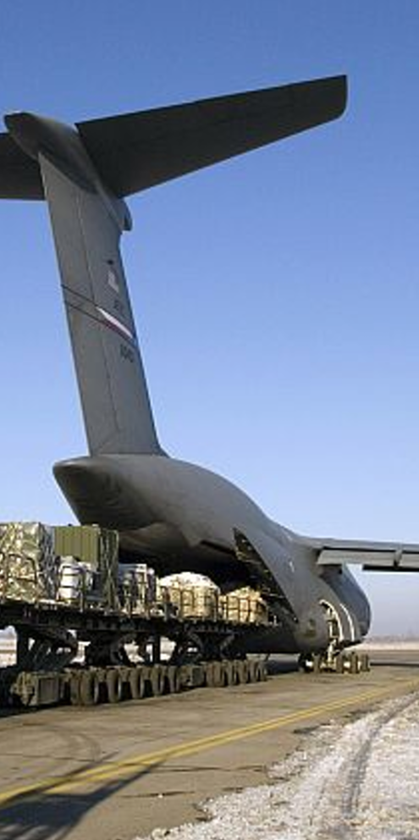
Lecture: Logistics
Syllabus & course policies:
In the usual bCourses place: <https://bcourses.berkeley.edu/courses/1493152/assignments/syllabus>
Required readings for the course:
Principally: J. Bradford DeLong (2020): Slouching Towards Utopia?: An Economic History of the Long 20th Century
And also: Partha Dasgupta (2007): Economics: A Very Short Introduction <https://delong.typepad.com/files/dasgupta-economics.pdf>
Barry Eichengreen (2008): Globalizing Capital: A Short History of the World Monetary System <https://delong.typepad.com/files/eichengreen-globalizing.pdf>
Robert Skidelsky (2010): Keynes: A Very Short Introduction <https://delong.typepad.com/files/skidelsky-keynes.pdf>
Robert Allen (2011): Global Economic History: A Very Short Introduction <https://delong.typepad.com/files/allen-geh.pdf> <https://www.icloud.com/pages/0jK0cjqqw-D4wRayNOo87pLYw>
Plus: Andy Matuschak (2019): Why Books Don’t Work
Grading:
Quizes: 0
Discussion threads: 30 x 2 = 60 (0, 1, 2, 3)
Problem sets: 15 x 4 = 60 (0, 1, 2, 4, 5)
Zoom breakout & other participation: 20
Final paper: 60
UNWRITTEN
Notes:
As to the logistics of this course… They are standard: the syllabus and course policies are in their usual bCourses place; our course number for bCourses is 1493152. You are responsible for reading and knowing the syllabus and course policies.
The principal required reading for the course is the draft of my 20th century economic history book, which I am distributing to you.
That is not the only required book, however. We require you—as class begins—to read Partha Dasgupta’s Economics: A Very Short Introduction as a warmup exercise: it is not a substitute for but rather a complement to Econ 1, and it is meant to remind you of economics as a discipline and get your thoughts moving as to what a history course like this that is an economic history course is likely both to see clearly and not see at all as we look at world history in the 20th century.
We require you—as class begins—to read Robert Allen’s Global Economic History: A Very Short Introduction as a cooldown exercise and as a review. Allen has a somewhat different take on the world economy in the 20th century than I do. Reading him will: (a) provide a critique of my interpretation that you may find useful, (b) remind you of my interpretation, especially where it differs from his, and so aid in active learning, and (c) possibly strike sparks for questions you might investigate as you go about researching for your final papers.
In between, we have Barry Eichengreen (2008): Globalizing Capital: A Short History of the World Monetary System, which we will read throughout the course. The international monetary system is the nervous system of the world economy. Its functions and dysfunctions are key. Barry provides a lot more background into how it functioned in different eras and thus how it fed into the rest of world economic history than I do. In between, we also have Robert Skidelsky (2010): Keynes: A Very Short Introduction. It is said that the history of the fall of the Roman Republic in the -100s is, given our source limitations, essentially the biography of the Roman consul and politician Marcus Tullius Cicero. A huge chunk of 20th century global economic history is the biography of John Maynard Keynes and his ideas. And Skidelsky is a brilliant writer: truly a pleasure to read or so I find him.
Plus we will assign a number of articles—the first of which, Andy Matuschak: Why Books Don’t Work, you should have already read before you got to this lecture.
A note on grading. We will bump up the grades of people whose contributions to synchronous discussions make us think that they got the shaft in the formal point-attribution grading process—that is what the 20 “participation” points are. Quizzes are ungraded: they are supposed to be low stakes exercises. Otherwise, we will split points between asynchronous web discussions, problem sets, and the final paper 1/3-1/3/-1/3.
Contributions to each of the 30 discussion threads will be graded on a 0-2 scale: 0 means that you did not complete the assignment before it closed; 1 means that in our view you simply phoned in your contribution, and did not make an effort; 2 means that you attempted to make a serious contribution to the discussion; 3 we reserve for someone whose contribution genuinely taught us something.
The 15 problem sets will be graded on a 0-4 scale. 0 means that no assignment was submitted or that it was submitted more than 48 hrs after the assignment closed; 1 means that the assignment was submitted up to 48 hrs late; 2 means that the assignment was phoned in, with major components not seriously attempted; 3 means that you attempted all the major pieces but did not successfully complete some important aspects; 4 means that you successfully completed the problem set; 5 means that your problem set was sufficiently ingenious and excellent that it taught us, the instructors, something.

Slide 3
Grading
Haas:
Mean elective grade: about 3.5
That seems reasonable: B+/A-
Grading:
Quizes: 0
Discussion threads: 30 x 2 = 60 (0, 1, 2, 3)
Problem sets: 15 x 4 = 60 (0, 1, 2, 4, 5)
Zoom breakout & other participation: 20
Final paper: 60
Points to letter grades:
The way it works is this:
We form our holistic assessment of the degree of effort and accomplishment of the class as a whole,
largely but not exclusively based on the scores people receive on assignments.
That assessment then sets the grade distribution.
We then take the assignment scores, adjust them for notable participation-based assistance in helping others learn, and rank all of you students.
By effort & achievement.
Thus there is not a strict curve:
someone else doing better does not lower your grade.
In fact, it is the opposite—your helping someone else do better raises the average grade and, to the extent that we notice, directly raises yours as well.
But there is also not a rigid set of numerical cutoffs you will be able to count on
Oral exams for edge cases…
UNWRITTEN
Notes:
As to the logistics of this course… They are standard: the syllabus and course policies are in their usual bCourses place; our course number for bCourses is 1493152. You are responsible for reading and knowing the syllabus and course policies.
The principal required reading for the course is the draft of my 20th century economic history book, which I am distributing to you.
That is not the only required book, however. We require you—as class begins—to read Partha Dasgupta’s Economics: A Very Short Introduction as a warmup exercise: it is not a substitute for but rather a complement to Econ 1, and it is meant to remind you of economics as a discipline and get your thoughts moving as to what a history course like this that is an economic history course is likely both to see clearly and not see at all as we look at world history in the 20th century.
We require you—as class begins—to read Robert Allen’s Global Economic History: A Very Short Introduction as a cooldown exercise and as a review. Allen has a somewhat different take on the world economy in the 20th century than I do. Reading him will: (a) provide a critique of my interpretation that you may find useful, (b) remind you of my interpretation, especially where it differs from his, and so aid in active learning, and (c) possibly strike sparks for questions you might investigate as you go about researching for your final papers.
In between, we have Barry Eichengreen (2008): Globalizing Capital: A Short History of the World Monetary System, which we will read throughout the course. The international monetary system is the nervous system of the world economy. Its functions and dysfunctions are key. Barry provides a lot more background into how it functioned in different eras and thus how it fed into the rest of world economic history than I do. In between, we also have Robert Skidelsky (2010): Keynes: A Very Short Introduction. It is said that the history of the fall of the Roman Republic in the -100s is, given our source limitations, essentially the biography of the Roman consul and politician Marcus Tullius Cicero. A huge chunk of 20th century global economic history is the biography of John Maynard Keynes and his ideas. And Skidelsky is a brilliant writer: truly a pleasure to read or so I find him.
Plus we will assign a number of articles—the first of which, Andy Matuschak: Why Books Don’t Work, you should have already read before you got to this lecture.
A note on grading. We will bump up the grades of people whose contributions to synchronous discussions make us think that they got the shaft in the formal point-attribution grading process—that is what the 20 “participation” points are. Quizzes are ungraded: they are supposed to be low stakes exercises. Otherwise, we will split points between asynchronous web discussions, problem sets, and the final paper 1/3-1/3/-1/3.
Contributions to each of the 30 discussion threads will be graded on a 0-2 scale: 0 means that you did not complete the assignment before it closed; 1 means that in our view you simply phoned in your contribution, and did not make an effort; 2 means that you attempted to make a serious contribution to the discussion; 3 we reserve for someone whose contribution genuinely taught us something.
The 15 problem sets will be graded on a 0-4 scale. 0 means that no assignment was submitted or that it was submitted more than 48 hrs after the assignment closed; 1 means that the assignment was submitted up to 48 hrs late; 2 means that the assignment was phoned in, with major components not seriously attempted; 3 means that you attempted all the major pieces but did not successfully complete some important aspects; 4 means that you successfully completed the problem set; 5 means that your problem set was sufficiently ingenious and excellent that it taught us, the instructors, something.

