Slide 1
Sample Flutter App

Slide 2
import 'package:flutter/material.dart';
void main() {
runApp(const MyApp());
}
class MyApp extends StatelessWidget {
const MyApp({super.key});
@override
Widget build(BuildContext context) {
return MaterialApp(
title: 'Flutter Demo',
theme: ThemeData(
colorScheme: .fromSeed(seedColor: Colors.deepPurple),
),
home: const MyHomePage(title: 'Flutter Demo Home Page'),
);
}
}
For iOS, you can use
import 'package:flutter/cupertino.dart';
Run the app described in the MyApp class.
A stateful widget stores some information as it runs. (That information may change during the run.)
A stateless widget doesn’t have any information that might change, so none needs to be stored.
End of the MyApp class declaration.

Slide 3
import 'package:flutter/material.dart';
void main() {
runApp(const MyApp());
}
class MyApp extends StatelessWidget {
const MyApp({super.key});
@override
Widget build(BuildContext context) {
return MaterialApp(
title: 'Flutter Demo',
theme: ThemeData(
colorScheme: .fromSeed(seedColor: Colors.deepPurple),
),
home: const MyHomePage(title: 'Flutter Demo Home Page'),
);
}
}
The Flutter SDK defines a class named StatelessWidget. The MyApp class inherits the definitions in StatelessWidget, adds some new definitions, and overrides some of the existing StatelessWidget definitions.
Overriding the StatelessWidget class’s build definition. Describing how to build this widget on the phone’s screen. This method gets called automatically. You never call it in your code.
When Flutter calls the build method, it sends an object to the method (a context). This context object contains information about any other things in the app.

Slide 4
import 'package:flutter/material.dart';
void main() {
runApp(const MyApp());
}
class MyApp extends StatelessWidget {
const MyApp({super.key});
@override
Widget build(BuildContext context) {
return MaterialApp(
title: 'Flutter Demo',
theme: ThemeData(
colorScheme: .fromSeed(seedColor: Colors.deepPurple),
),
home: const MyHomePage(title: 'Flutter Demo Home Page'),
);
}
}
In the Dart programming language, a method typically has the form
ReturnType methodName(parameters) {
statements to execute when the method is called;
}

Slide 5
Widget build(BuildContext context) {
return MaterialApp(
title: 'Flutter Demo',
theme: ThemeData(
colorScheme: .fromSeed(seedColor: Colors.deepPurple),
),
home: const MyHomePage(title: 'Flutter Demo Home Page'),
);
}
}
Calling the constructor of the MaterialApp class.
The MaterialApp class’s constructor has 38 parameters, three of which are used in this constructor call. In this example, each parameter has a name (such as title) and a value (such as ‘Flutter Demo’).

Slide 6
For the theme parameter, it calls the Flutter SDK’s ThemeData constructor which, in turn, calls a constructor named .fromSeed. The value of the .fromSeed constructor’s seedColor parameter is the constant deepPurple, which is defined inside the Colors class.
Widget build(BuildContext context) {
return MaterialApp(
title: 'Flutter Demo',
theme: ThemeData(
colorScheme: .fromSeed(seedColor: Colors.deepPurple),
),
home: const MyHomePage(title: 'Flutter Demo Home Page'),
);
}
}
class MyHomePage extends StatefulWidget {
const MyHomePage({super.key, required this.title});
final String title;
For the home parameter, it calls the MyHomePage constructor with the value of the constructor’s title parameter being 'Flutter Demo Home Page’.

Slide 7
class MyHomePage extends StatefulWidget {
const MyHomePage({super.key, required this.title});
final String title;
@override
State<MyHomePage> createState() => _MyHomePageState();
}
class _MyHomePageState extends State<MyHomePage> {
int _counter = 0;
void _incrementCounter() {
setState(() {
_counter++;
});
}
Boilerplate code
When describing an action to be taken, you must call setState and you must call it this way.
An action to be taken.

Slide 8
Widget build(BuildContext context) {
return Scaffold(
body: Center(
child: Column(
mainAxisAlignment: .center,
children: [
const Text('You have pushed the button this many times:'),
Text(
'$_counter',
style: Theme.of(context).textTheme.headlineMedium,
),
],
),
),
floatingActionButton: FloatingActionButton(
onPressed: _incrementCounter,
tooltip: 'Increment',
child: const Icon(Icons.add),
),
);
}
A Scaffold object has some handy pre-built things, like a body and a floatingActionButton.
The Scaffold object’s body consists of a Centering layout widget.
The Center object’s only child is a layout widget that arranges its children in a column.
The Column object’s children is a list of Text widgets.

Slide 9
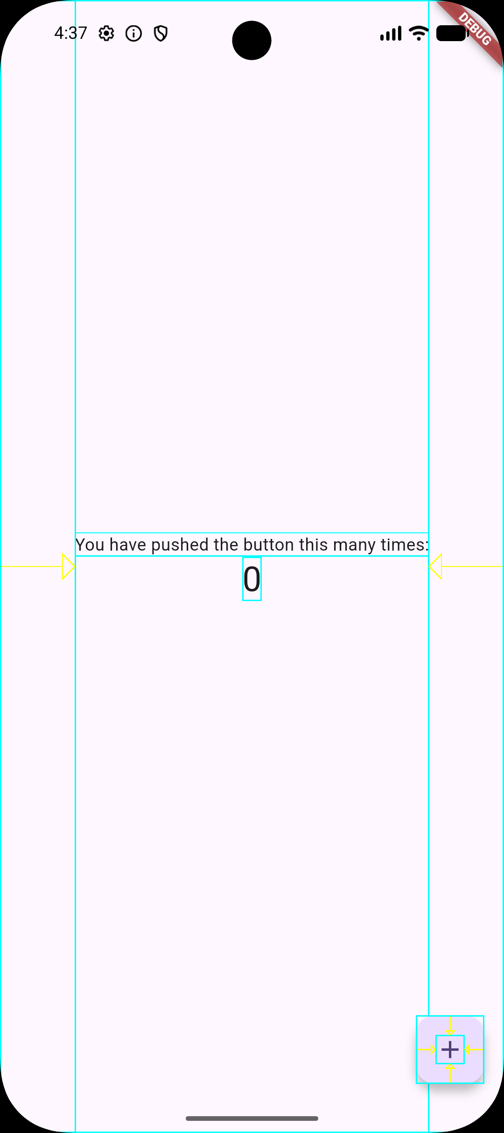

Flutter Inspector
Then look at the device screen.

