Slide 1
Fast-Foreward merge
3 way merge
master
master
C1
C2
C3
C4
C1
C2
C3
C4
dev
C5
C6
dev
master
master
C1
C2
C3
C4
C1
C2
C3
C4
C7
dev
C5
C6
dev

Slide 2
3 – way merge

Slide 3
HEAD
master
815a8
720b2
e6693

Slide 4
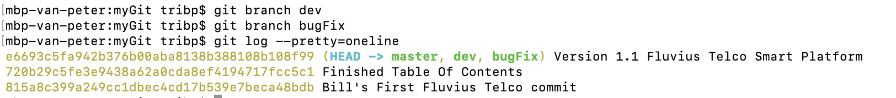
HEAD
master
815a8
720b2
e6693
dev
bugFix
Remark: HEAD still points at master

Slide 5
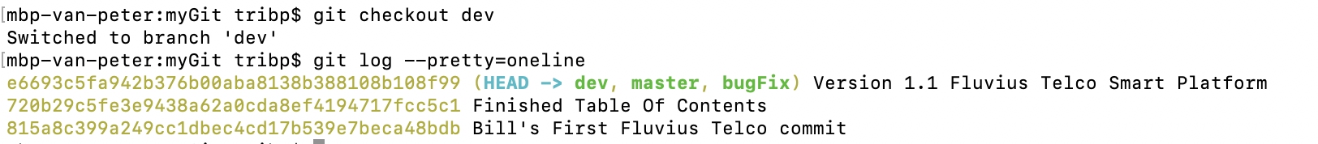
master
815a8
720b2
e6693
HEAD
dev
bugFix
Remark: HEAD points at dev

Slide 6
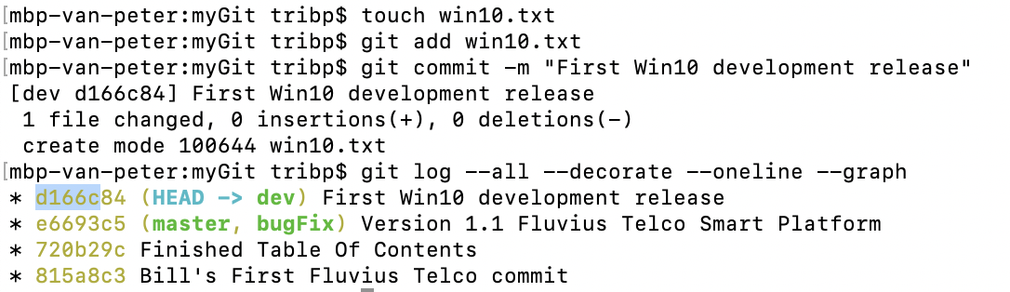
master
815a8
720b2
e6693
d166c
bugFix
dev
HEAD

Slide 7
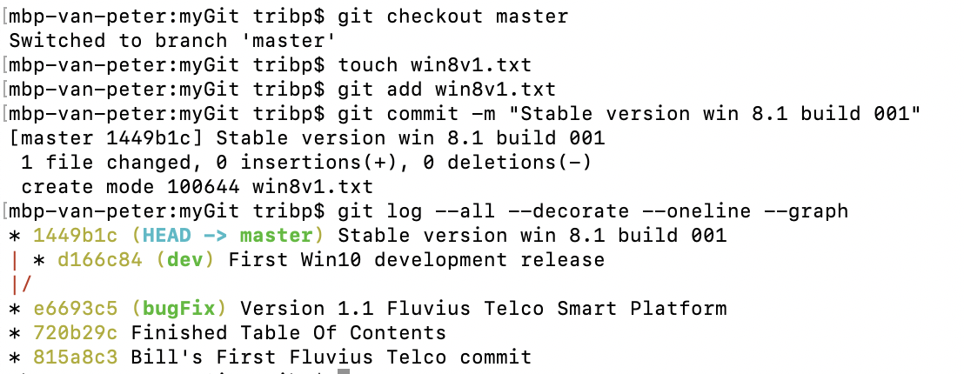
master
HEAD
815a8
720b2
e6693
1449B
bugFix
d166c
dev

Slide 8
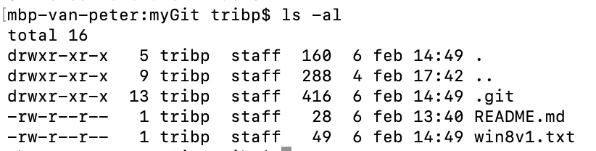
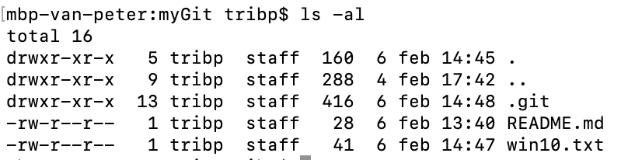
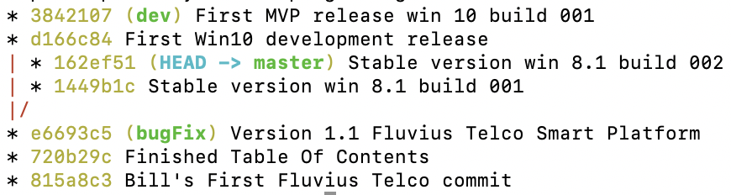
master
HEAD
815a8
720b2
e6693
1449B
162ef
d166c
38421
bugFix
dev

Slide 9
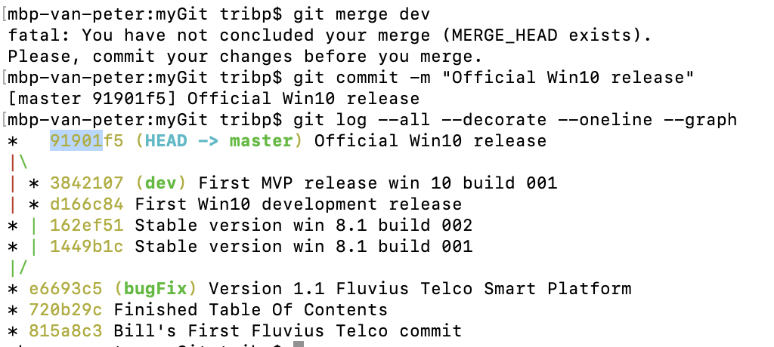
master
HEAD
815a8
720b2
e6693
1449B
162ef
91901
bugFix
d166c
38421
dev

Slide 10
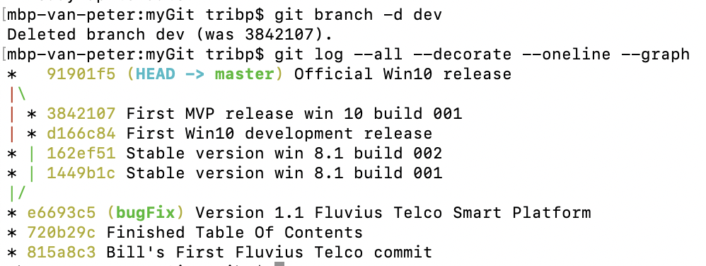
master
HEAD
815a8
720b2
e6693
1449B
162ef
91901
bugFix

Slide 11
Fast-Foreward merge

Slide 12
HEAD
master
af2da

Slide 13
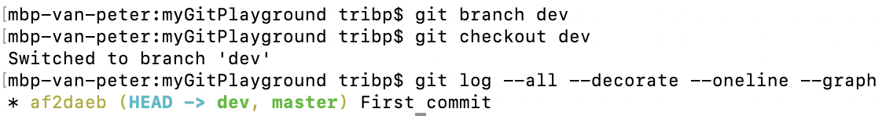
master
af2da
dev
HEAD

Slide 14
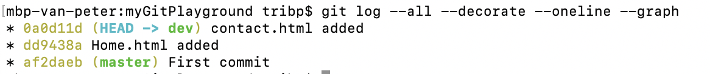
master
af2da
dd943
0a0d1
dev
HEAD

Slide 15
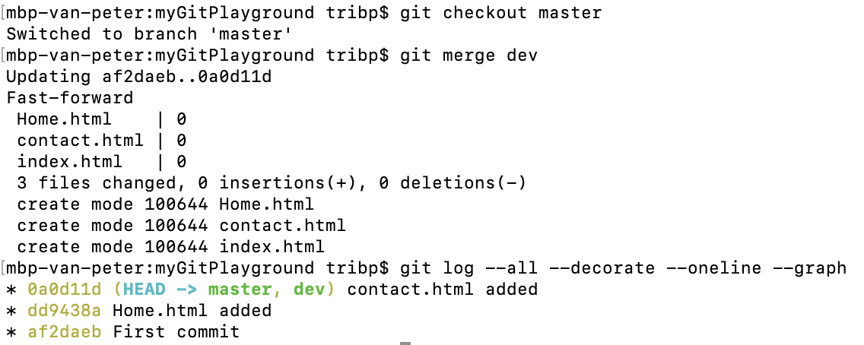
HEAD
master
af2da
dd943
0a0d1
dev

Slide 16
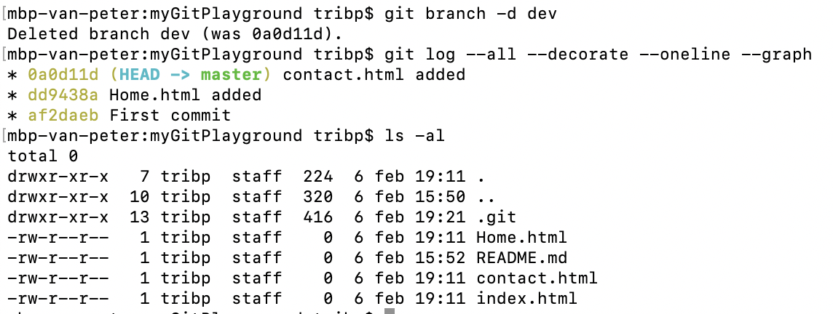
HEAD
master
af2da
dd943
0a0d1

Slide 17
Rebase

Slide 18
Rebase
Next = 2 options
master
C1
C2
C3
C4
git checkout master
git merge dev
master
FF merge
C1
C2
C3
C4
C5
C6
C5
C6
dev
git checkout dev
git rebase master
dev
master
Rebase
master
C1
C2
C3
C4
C1
C2
C3
C4
C5
C6
dev
C5
C6
git checkout master
git rebase dev
dev

