Slide 1
Git

Slide 2

Git lifecycle
clone / pull
fetch
Repository
Workspace
Untracked
Files
Index
push
commit
add
Remote
Local

Slide 3
Fast-Foreward merge
3 way merge
master
master
C1
C2
C3
C4
C1
C2
C3
C4
dev
C5
C6
dev
master
master
<img src="images/git_dir_1commit.png" width = "600px">
C1
C2
C3
C4
C1
C2
C3
C4
C7
dev
C5
C6
dev

Slide 4
Fast-Foreward merge

Slide 5
HEAD
master
af2da

Slide 6
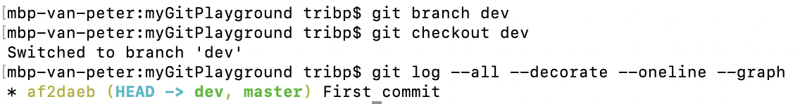
master
af2da
dev
HEAD

Slide 7
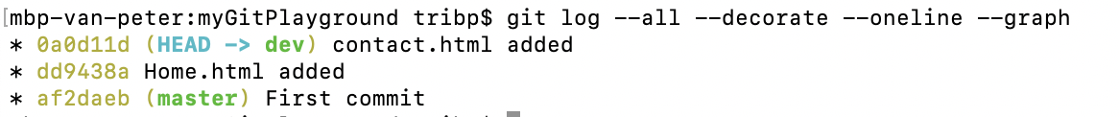
master
af2da
dd943
0a0d1
dev
HEAD

Slide 8
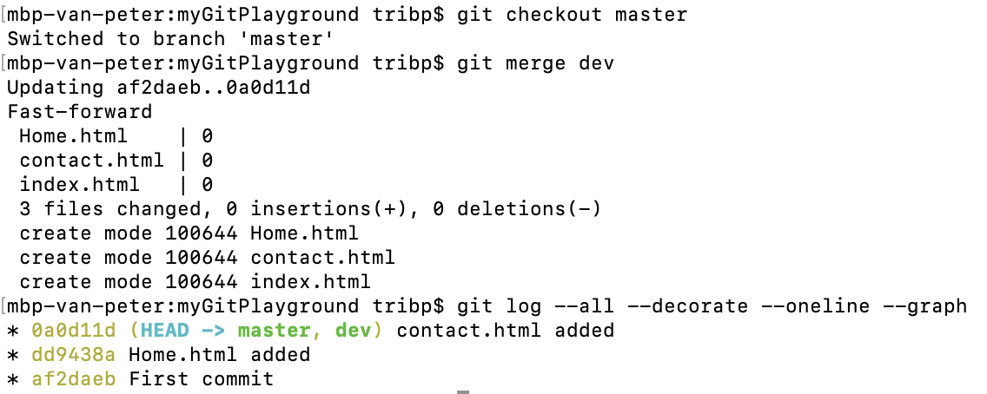
HEAD
master
af2da
dd943
0a0d1
dev

Slide 9
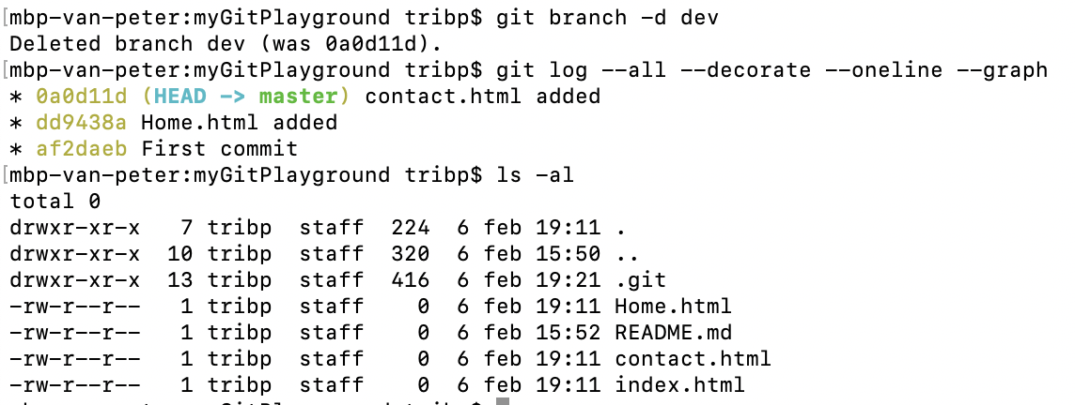
HEAD
master
af2da
dd943
0a0d1

Slide 10
3 – way merge

Slide 11
HEAD
master
815a8
720b2
e6693

Slide 12
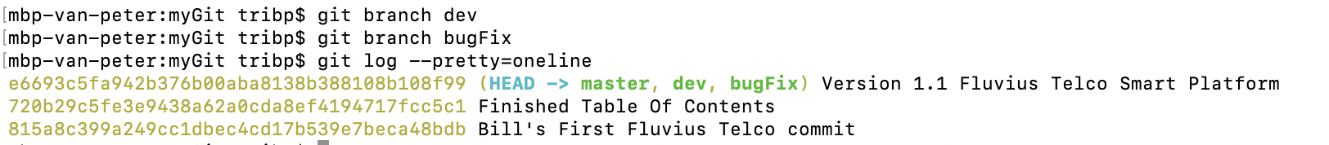
HEAD
master
815a8
720b2
e6693
dev
bugFix
Remark: HEAD still points at master

Slide 13
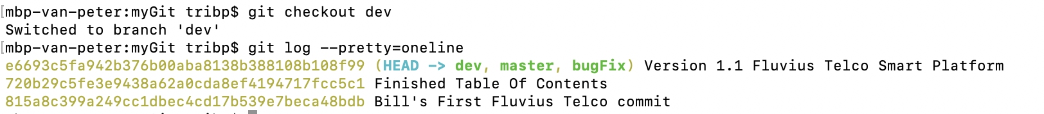
master
815a8
720b2
e6693
HEAD
dev
bugFix
Remark: HEAD points at dev

Slide 14
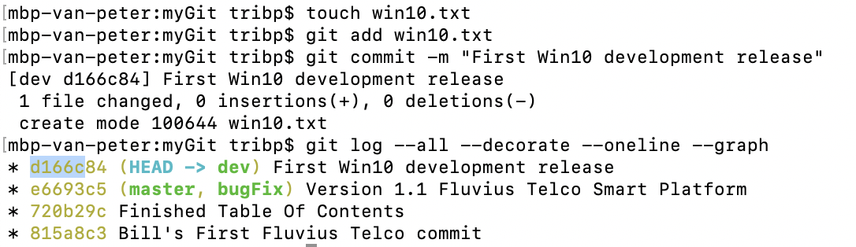
master
815a8
720b2
e6693
d166c
bugFix
dev
HEAD

Slide 15
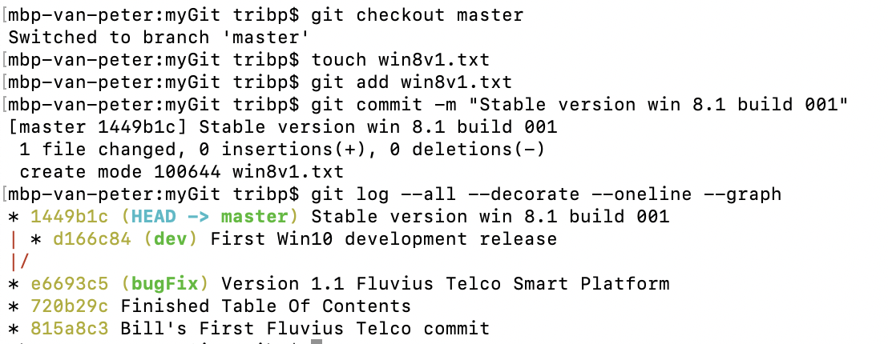
master
HEAD
815a8
720b2
e6693
1449B
bugFix
d166c
dev

Slide 16
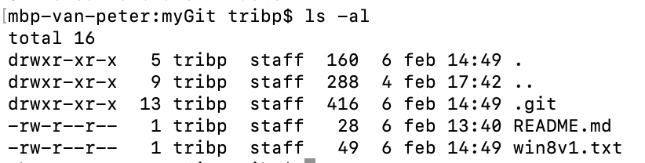
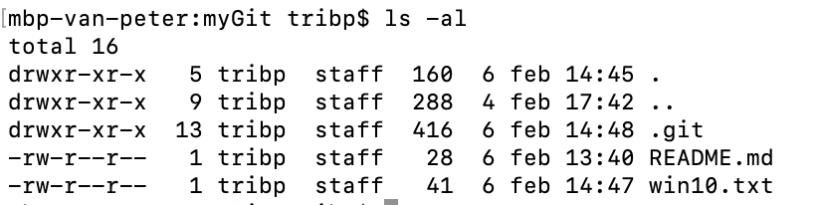
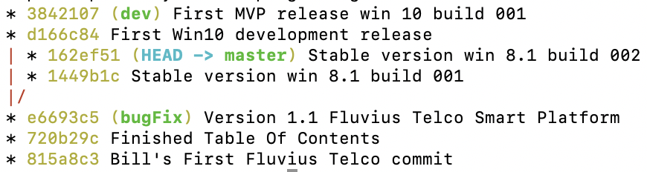
master
HEAD
815a8
720b2
e6693
1449B
162ef
d166c
38421
bugFix
dev

Slide 17
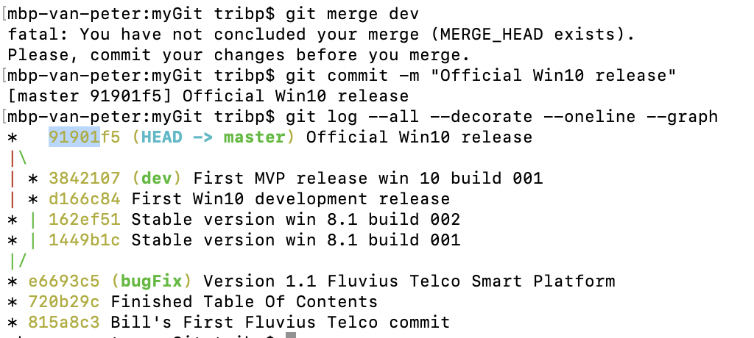
master
HEAD
815a8
720b2
e6693
1449B
162ef
91901
bugFix
d166c
38421
dev

Slide 18
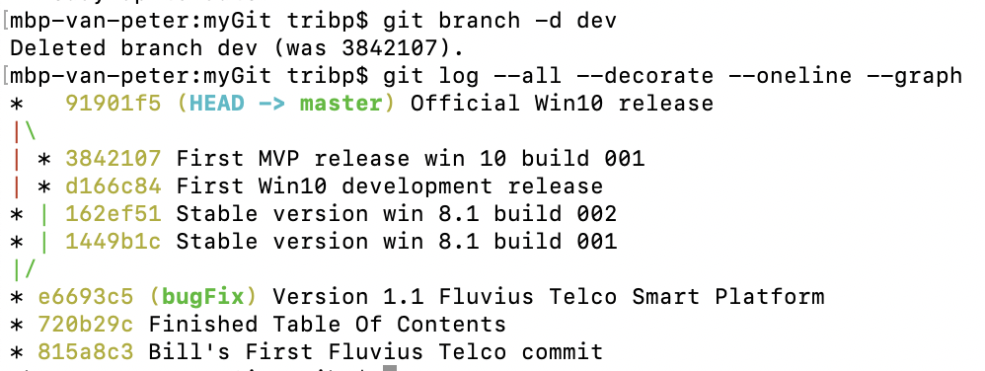
master
HEAD
815a8
720b2
e6693
1449B
162ef
91901
bugFix

Slide 19
Rebase

Slide 20
Rebase
Next = 2 options
master
C1
C2
C3
C4
git checkout master
git merge dev
master
FF merge
C1
C2
C3
C4
C5
C6
C5
C6
dev
git checkout dev
git rebase master
dev
master
Rebase
master
C1
C2
C3
C4
C1
C2
C3
C4
C5
C6
dev
C5
C6
git checkout master
git rebase dev
dev

