Slide 1
PerfFlowAspect: Scalable Composition and Analysis Techniques for Scientific Workflows
https://perfflowaspect.readthedocs.io/en/latest/
May 11, 2023
Team: Tapasya Patki, Stephanie Brink, Aliza Lisan , Dan Milroy, Jae-Seung Yeom Previous members: Dong Ahn, Stephen Herbein , Frank Di Natale

Slide 2
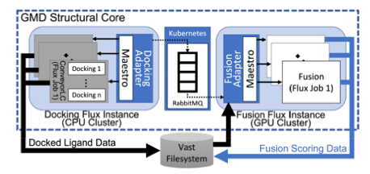
There is a paucity of techniques that can effectively analyze the end-to-end performance of a composite science workflow
HPC researchers are introducing and composing disparate workflow management technologies to enable scalable end-to-end science
MuMMI: cancer workflow, Maestro + Flux
COVID-19 drug design: Maestro, Flux, ATOM
Generative Molecular Design (GMD) pipeline and micro-services running on on-prem. Kubernetes
ECP ExaWorks project (https://exaworks.org): collection of composable tools!
Holistic performance analysis is challenging due to multiple binaries, underlying frameworks, multiple clusters, etc.
Src: Scalable Composition and Analysis Techniques for Massive Scientific Workflows
Best Paper Award at e-Science, 2022.

Slide 3
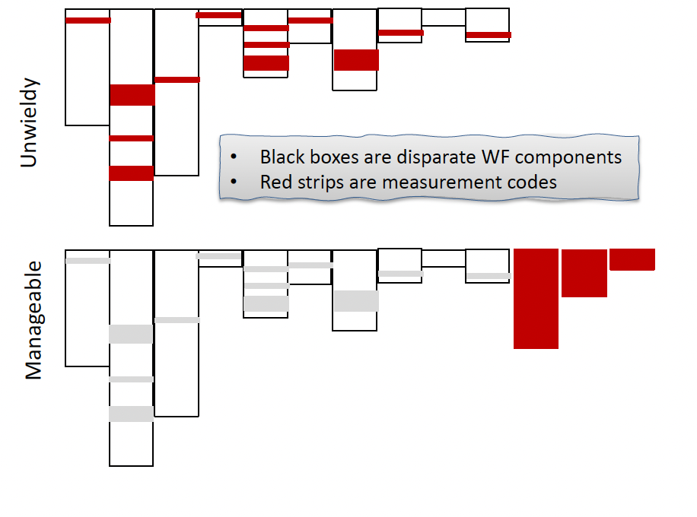
PerfFlowAspect : cross-cutting performance-analysis concerns across disparate workflow-management technologies and components.
Aspect-Oriented Programming Paradigm
Minimum modifications to the disparate workflow-management technologies
Modularize the performance analysis concerns
Allow for customization of performance analysis ‘actions’ or ‘advices’: timing or utilization measurements, hardware performance counters, etc

Slide 4
Common Aspect-Oriented Programming (AOP) Terminology
Join Points: A point in a program’s execution in which the behavior can be modified by AOP. The candidate points are method invocations.
Pointcuts: An expression used to match join points (creating a set of join points), allows you to specify to AOP where and when in the code to make modifications.
Advice: Defines the additional behavior or action that will be inserted into the code, specifically at each join point matched by the pointcut.
Aspect: The collection of the pointcut expression and the advice.
Weaver: Applies aspects into the code, modifying code at join points with matching pointcuts and associated advices. The combining of aspects and code enables execution of cross-cutting concerns.

Slide 5
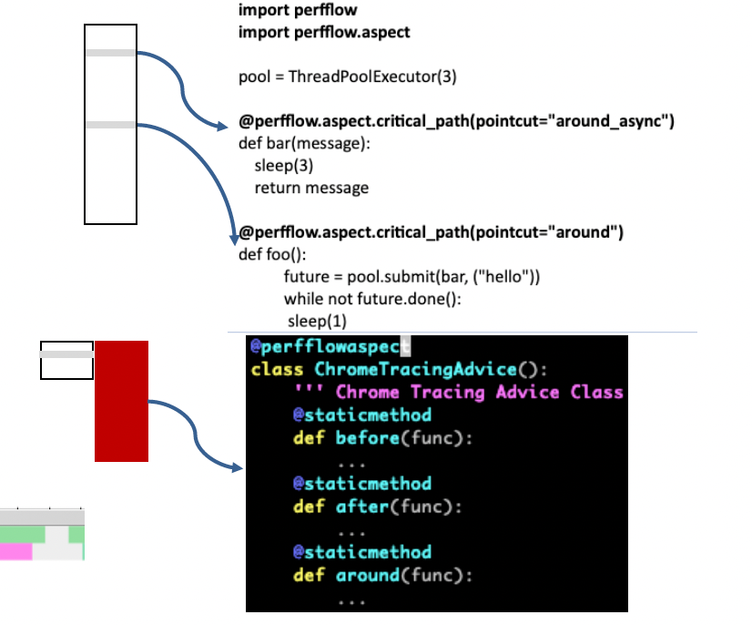
PerfFlowAspect : cross-cutting performance-analysis concerns across disparate workflow-management technologies and components.
Prototype using decorators for Python and LLVM-based library for C++
Advice (or action) emits tracing event data every time the annotated functions is called
Utilize Chrome Tracing Format (CTF) and Perfetto visualizer

Slide 6
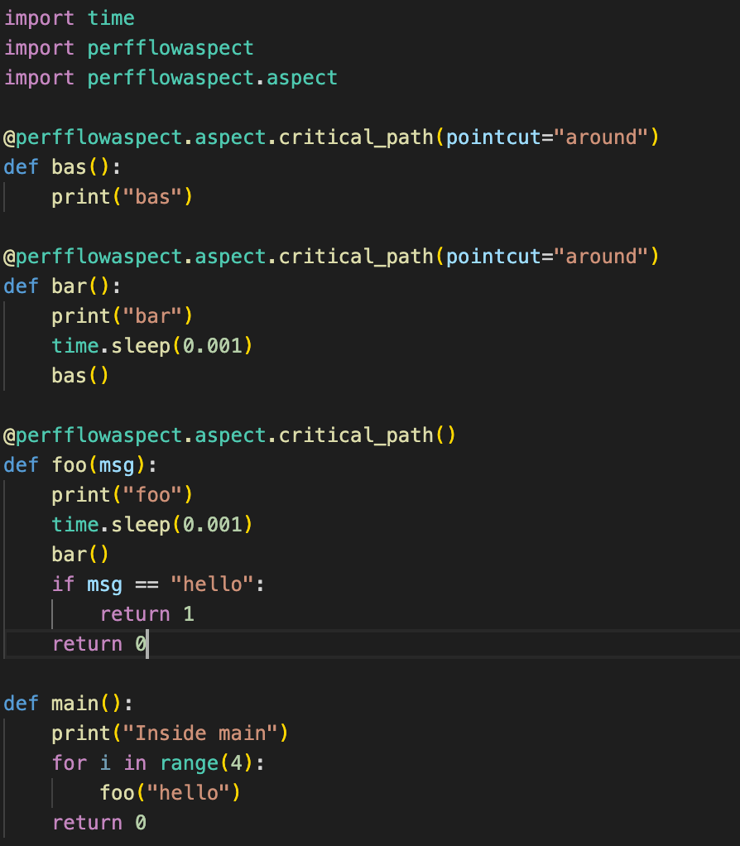
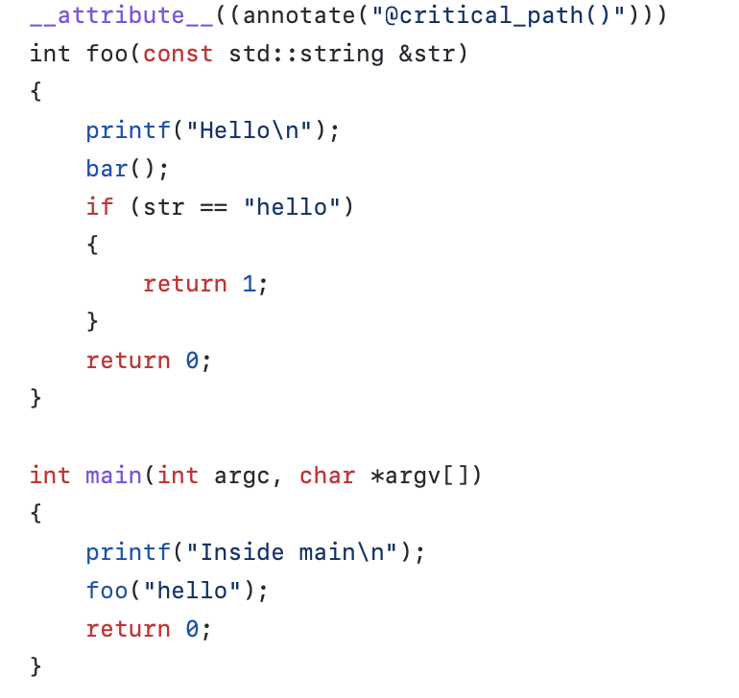
PerfFlowAspect: Examples of annotations
Simple, minimally-intrusive annotated functions on the critical path of the execution of the program
At each annotated function, AOP based performance metrics are collected.

Slide 7
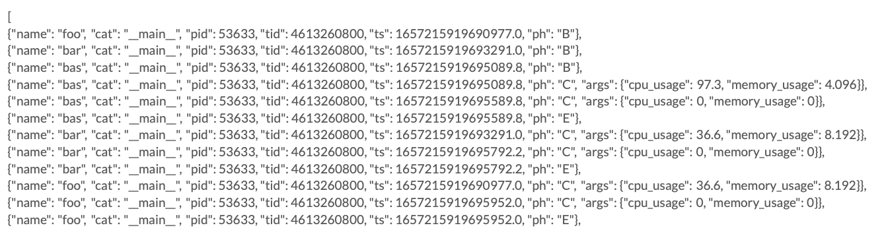
PerfFlowAspect: Chrome Tracing Format
Running the annotated code and the associated advice with it will produce a performance trace data file which uses the Chrome Tracing Format in JSON.

Slide 8
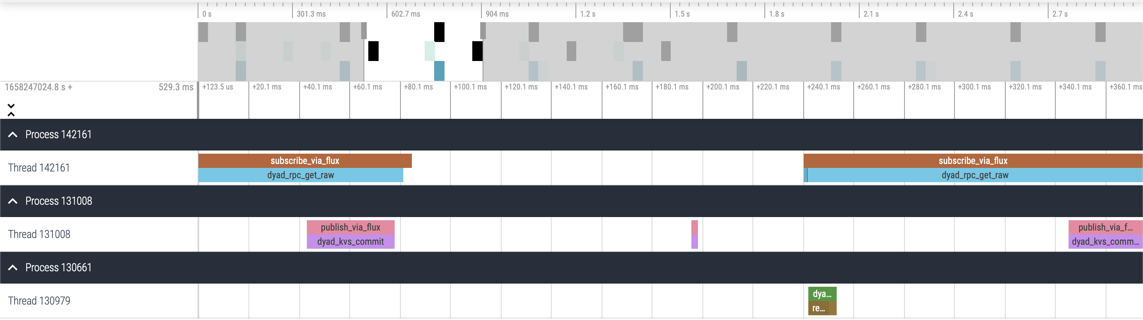
Visualizing traces using the Perfetto UI: DYAD Example

Slide 9
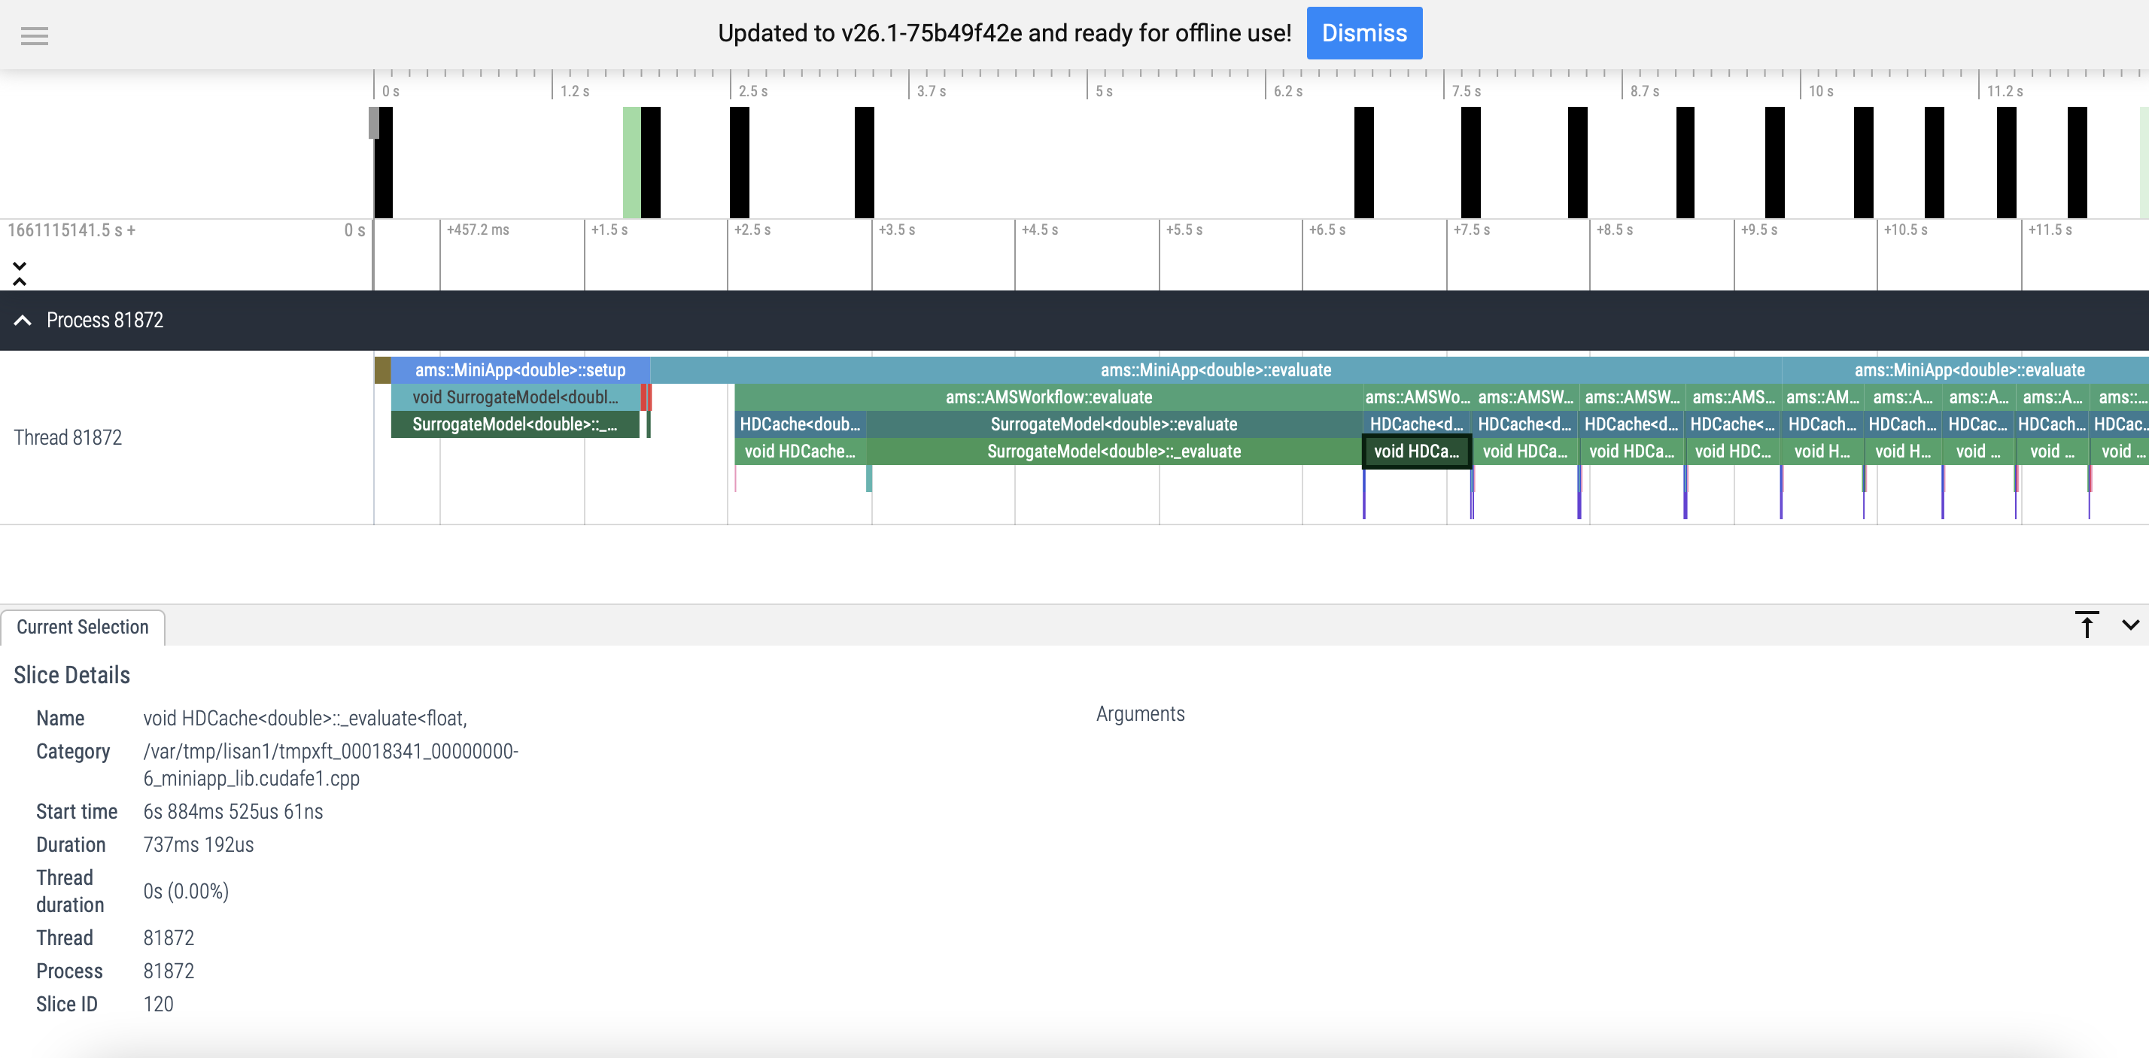
Visualizing traces using the Perfetto UI: AMS Example

Slide 10
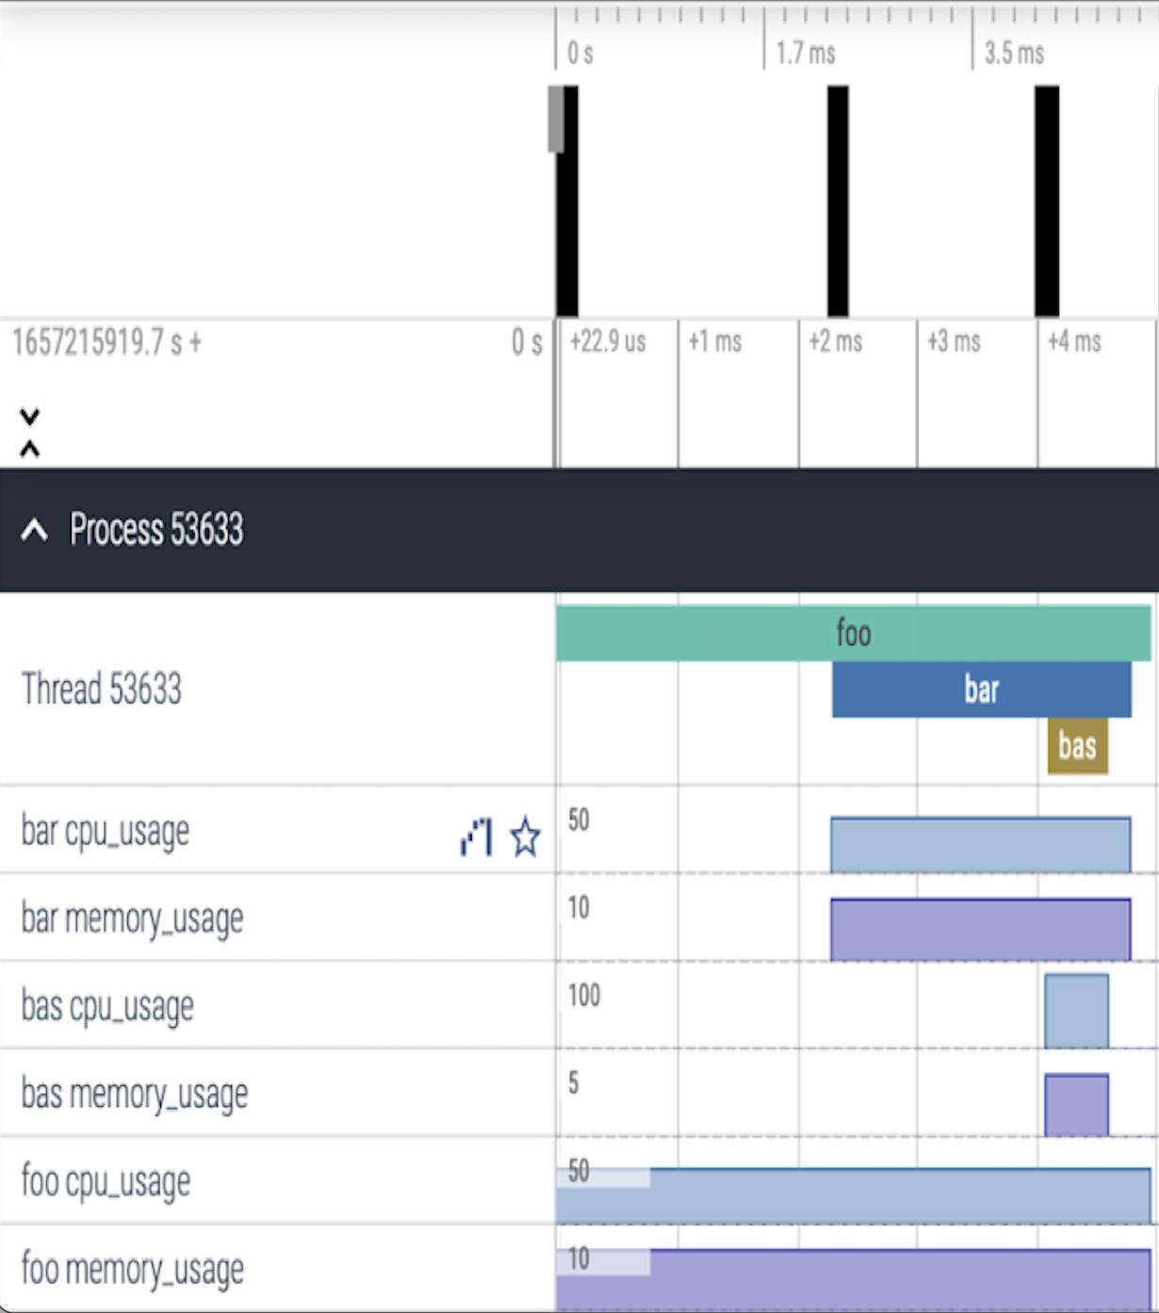
PerfFlowAspect: Work in Progress
Better support for multi-process, multi-thread visualizations
Improve code quality, test coverage, and documentation
Add performance metrics such as GPU usage and other performance counters, add Hatchet support
Integrate PerfFlowAspect with AMS workflow in order to analyze its performance
Identify other workflows of interest

Slide 11
Thank you!

