Slide 1
Most Navigable Neighborhood in Pittsburgh
Team 32 – Gold ‘n Blue
Zezhong Chen, Matthew Kindja, & John Lovre
CMPINF 0010 – Spring 2024

Slide 2

What Makes a Great Neighborhood?
Transportation
Easy to get around
Accessibility and safety

Slide 3



Metrics
Parking meters
Accessibility of public parking
Bus stops
Availability of public transportation
Crosswalks
Safety for pedestrian traffic

Slide 4
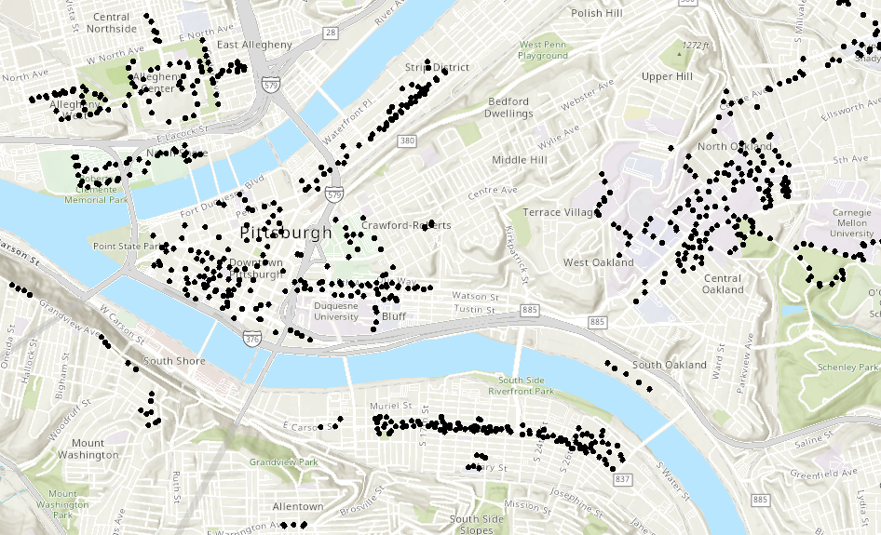
Parking Meters – Map of Locations
Source: https://pghgishub-pittsburghpa.opendata.arcgis.com/datasets/pittsburghpa::pittsburgh-parking-authority-terminals/explore

Slide 5
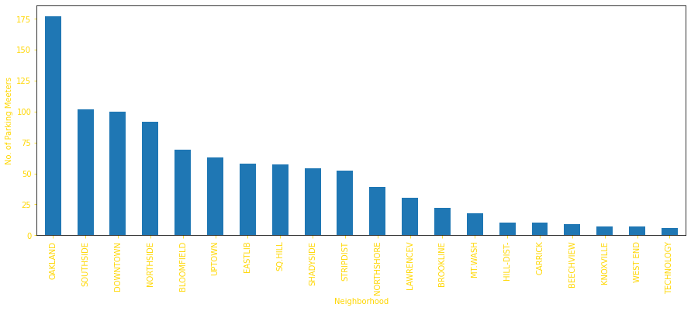
Parking Meters – Top 20 Neighborhoods
To see how we got these results click here…

Slide 6
Bus Stops

Slide 7
Crosswalks

Slide 8
Conclusion – Most Navigable Overall

Slide 9
Datasets
Parking meters
https://data.wprdc.org/dataset/parking-meters-pittsburgh-parking-authority/resource/72fff5c4-5ef2-4437-9e40-e2d999d455ed
Bus stops
https://data.wprdc.org/dataset/prt-transit-stop-usage/resource/3f40b94b-4ac4-48f1-8c61-8439d2d2f420
Crosswalks
https://data.wprdc.org/dataset/sidewalk-to-street-walkability-ratio/resource/b90ccee1-c0aa-43b9-93e2-8a25e690c393

Slide 10
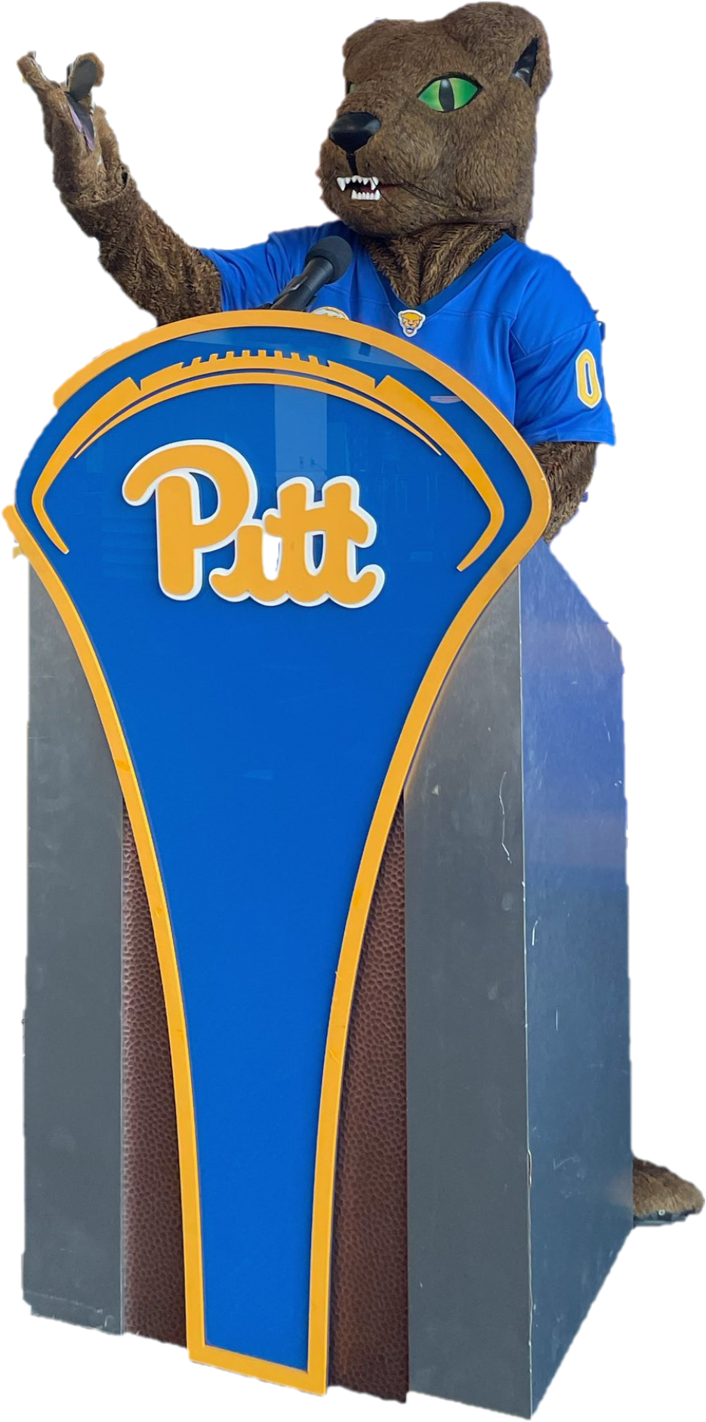
Questions?

