Slide 1
Most Navigable Neighborhood in Pittsburgh
Team 32 – Gold ‘n Blue
Zezhong Chen, Matthew Kindja, & John Lovre
CMPINF 0010 – Spring 2024

Slide 2

What Makes a Great Neighborhood?
Transportation
Easy to get around
Accessibility and safety

Slide 3



Metrics
Parking meters
Accessibility of public parking
Bus stops
Availability of public transportation
Walkability
Availability of foot transportation infrastructure

Slide 4
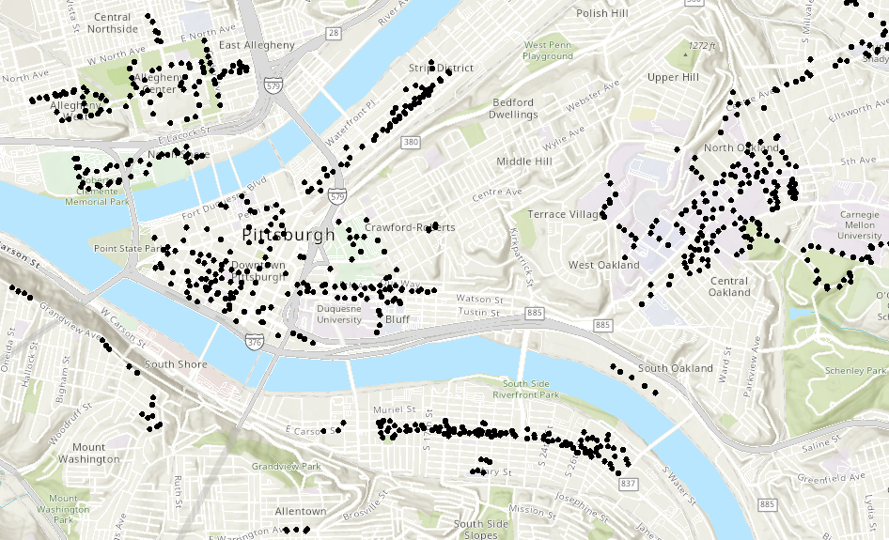
Parking Meters – Map of Locations
Source: https://pghgishub-pittsburghpa.opendata.arcgis.com/datasets/pittsburghpa::pittsburgh-parking-authority-terminals/explore

Slide 5
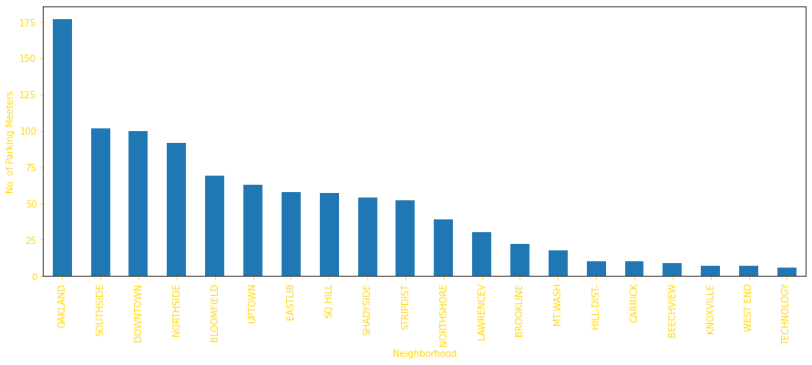
Parking Meters – Top 20 Neighborhoods
Why Parking Meters?
Parking meters are a representation of available on street parking. On street parking is important when traveling to and around a neighborhood to allow commuters and residents a place to safely leave their vehicles.
To see how we got these results click here…

Slide 6
Bus Stops

Slide 7
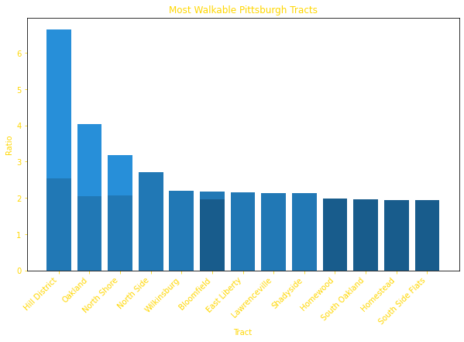
Walkability
Why Walkability?
Reliable transportation is crucial to city life. Access to the diverse arrangement of amenities found throughout Pittsburgh is imperative to a healthy, active life and participation is one’s community. Effective infrastructure for foot transportation affords citizens a comfortable way to enjoy the outdoors, something especially crucial in densely populated suburbs.

Slide 8
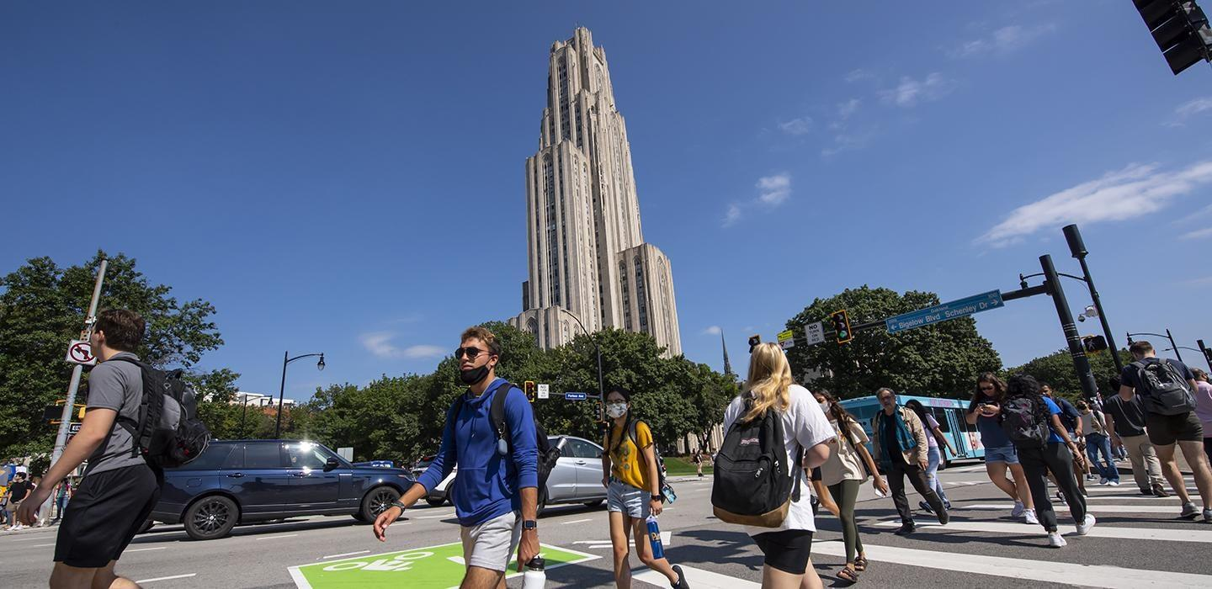
Conclusion – Most Navigable Overall
Oakland!
Notes:
How we determined: 1) Oakland contained the most number of parking meters per metric one. 2) Oakland was the second most walkable neighborhood per metric two…however, if you include the results for South Oakland into this count, it is very close to the top result, Hill District. 3) …

Slide 9
Datasets
Parking meters
https://data.wprdc.org/dataset/parking-meters-pittsburgh-parking-authority/resource/72fff5c4-5ef2-4437-9e40-e2d999d455ed
Bus stops
https://data.wprdc.org/dataset/prt-transit-stop-usage/resource/3f40b94b-4ac4-48f1-8c61-8439d2d2f420
Walkability
https://data.wprdc.org/dataset/sidewalk-to-street-walkability-ratio/resource/b90ccee1-c0aa-43b9-93e2-8a25e690c393

Slide 10
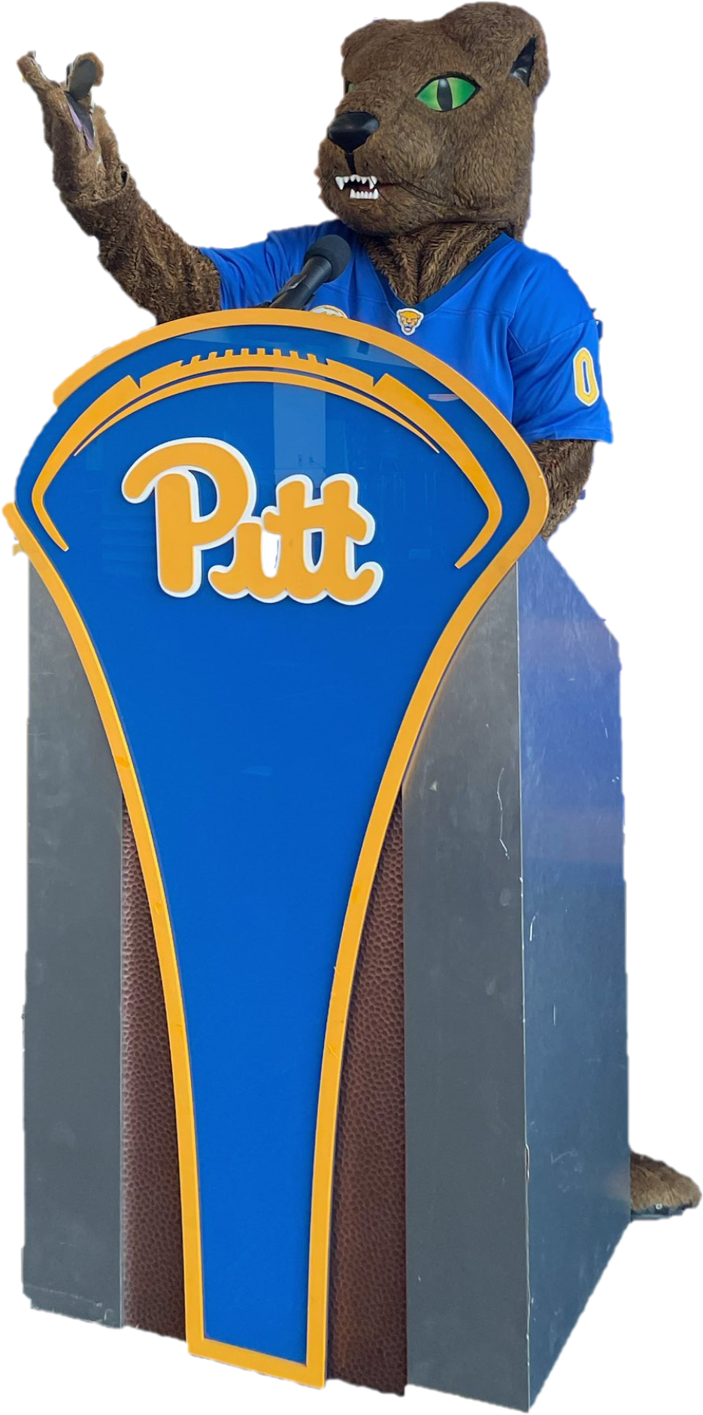
Questions?

