Slide 1
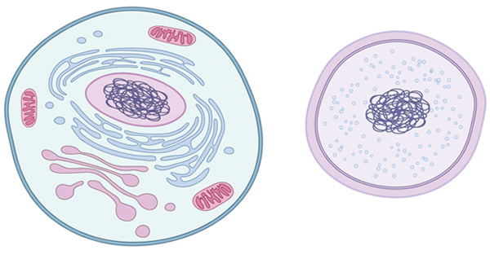
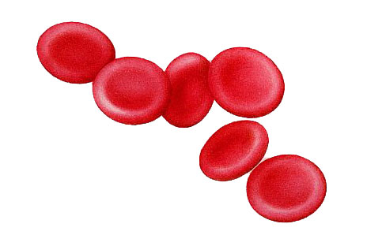
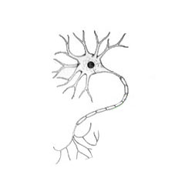
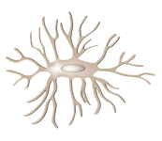
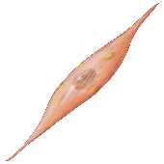
Plastic
Differentiates
Self-renewal
Notes:
A stem cell has several characteristics which make it special. First, a stem cell is plastic which means it can become any of the cell types within our body. Second, a stem cell can go through a process known as differentiation. During differentiation the stem cell becomes one of the specialized cells within our body like neurons in the brain. Finally, a stem cell can self-renew indefinitely in a laboratory setting which makes it easier for scientists to study them.

Slide 2
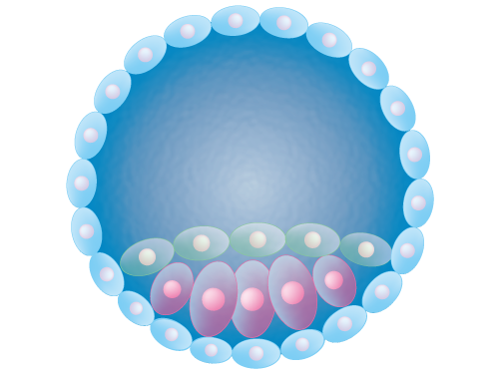
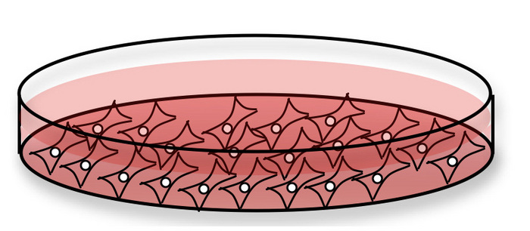
Inner cell mass
Notes:
Stem cells can be isolated from a fertilized egg. When an egg is fertilized it goes through several divisions until it becomes a blastocyst. Within the blastocyst there is an inner cell mass that contains cells that will become all of the cells of a fully developed human. By isolating the inner cell mass from the blastocyst, embryonic stem cells can be grown in the lab.

Slide 3
Asymmetric Division
Stem cell
more specialized
Specialized cell
Notes:
As was said before stem cells can differentiate into all the cell types in the body. How does this happen? Stem cells can become more specialized cells through a differentiation process. During this process, the stem cell goes through asymmetric division. Asymmetric division produces two new cells. One of these cells is identical to the original stem cell and retains all the special properties of stem cells. The second cell is known as a progenitor cell and is slightly more specialized than a stem cell. This means that the progenitor cell can still become different cells within the body but it has already made commitments that limit it from becoming any type of cell. The progenitor cell continues to go through asymmetric division producing more and more specialized cells until it produces a completely specialized cell that can no longer go through division and become any other type of cell.

Slide 4

-Stem cell niche location
Notes:
In addition to embryonic stem cells that can be isolated from a blastocyst, there are also stem cells in all adults. These are referred to as adult stem cells and they reside in various locations throughout the body known as stem cell niches. Usually, these cells remain stable but signals released from other cells can cause adult stem cells to differentiate into more specialized cells. Adult stem cells are easy to isolate and a patient can use their own stem cells to treat their disease. However, there are some limitations of using adult stem cells. Adult stem cells can’t become all of the different types of cells. They are more specialized and can only give rise to certain types of specialized cells. For example, mesenchymal stem cells which can be found in bone marrow, gives rise to bone, muscle and fat cells.

Slide 5
DNA Sequence
Transcription factors
Controlled gene expression
Notes:
Previous and current research has focused on determining methods for controlling stem cell differentiation into specific specialized cell types. You know from your science classes that all the cells in your body contain the same DNA. Cells read DNA sequences to determine which genes to express. Different specialized cells express different genes. But if all cells have the same DNA how do they make different genes? Transcription factors are proteins that can control the genes that a cell expresses. They bind to DNA and control what parts of the sequence the cell can read which leads to them expressing different genes. Therefore, by identifying the transcription factors that go along with specialized cell types scientists can control which cells stem cells differentiate into.

Slide 6
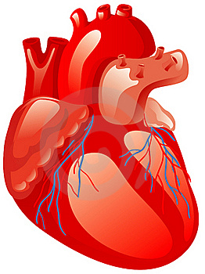

Transcription factors
dead cardio myocytes
Notes:
So why do we care about what type of cell a stem cell becomes? Some diseases are caused or have the effect of a decreased number of essential cell types. For example, during a heart attack thousands of cardiac muscle cells die. Without these cells the heart functions at a lower level. In the past, a diseased heart may be replaced with a healthier donor heart. Unfortunately, there are more diseased hearts than there are healthy donor hearts. By controlling the growth of stem cells into cardio myocytes, the differentiated myocytes can be directly injected into the heart to replace the lost cells.

Slide 7
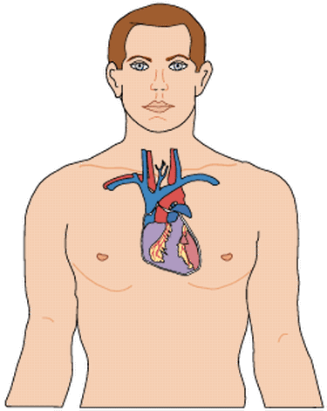
brain injury
Blindness
Heart attack
Wound healing
Cancers
Notes:
Many diseases that people suffer from can be cured or treated using stem cells! That’s why so many scientists are conducting research to fully understand them and find ways to make them. They are finding efficient ways to harvest stem cells from the body or alter cells to make them into stem cells.

Slide 8
References
http://www.nature.com/scitable/topicpage/what-is-a-cell-14023083
http://medicalpicturesinfo.com/red-blood-cells/
https://commons.wikimedia.org/wiki/File:Blastocyst_embryo.png
https://www.pinterest.com/pin/543457880006575529/
http://www.nature.com/scitable/content/cells-growing-in-a-tissue-culture-14264811
http://www.123rf.com/photo_13781019_human-heart.html
http://www.personaldevelopmentguy.com/drawings-of-hearts.html

