Slide 1
Open Authentication
(OAUTH)

Slide 2
What is OAUTH?
Stands for Open Authorization
An open-standard authorization protocol (OAuth 1.0)/framework (OAuth 2.0)
Describes how unrelated servers and services can safely allow authenticated access to their assets
Doing so without sharing initial, related, single logon credential
Known as secure, third-party, user-agent, delegated authorization
OAuth 1.0 released in 2010 & OAuth 2.0 released in 2012

Slide 3
How does OATH work?
Individual visits a specific website
an action is initiated to post a link to their Twitter feed
Specific site requests a token from Twitter
Twitter provides the specific website with a token
Twitter provides a secret code
Secret is used as a security measure

Slide 4
History of OATH 1.0
December 2007 – OAuth 1.0 addresses delegation with a framework based on digital signatures
2008 – Google begins OAuth 1.0 support
2010 – Twitter forces all third-party apps to use OAuth 1.0
Secure, but a challenge to implement
Required crypto-implementation and crypto-interoperability
Little support at present

Slide 5
History of OAUTH 2.0
2012 – OAuth 2.0 comes out
2012 – Google moves away from OAuth 1.0 to 2.0
More interoperable & flexible between sites & devices
Introduced concept of token expiration
Not compatible with OAuth 1.0
Not supported by many original OAuth founders & supporters

Slide 6
Facts about OAUTH 2.0
It is transport-dependent
It is centered around barrier tokens
Easier to work with than 1.0
Much more flexible
Has the separation of duties
More difficult to build security

Slide 7
Why is OAUTH popular?
Users appreciate only having to log on once to use multiple services
Website owners appreciate not having to contain their own authentication system with the ability to scale to gigantic proportions
2.0 Adopted by Amazon, Facebook, Instagram, LinkedIn, Microsoft, Netflix and Paypal
1.0 has crypto underpinnings so 2.0 is easier to implement
2.0 is more usable for large enterprises and more

Slide 8
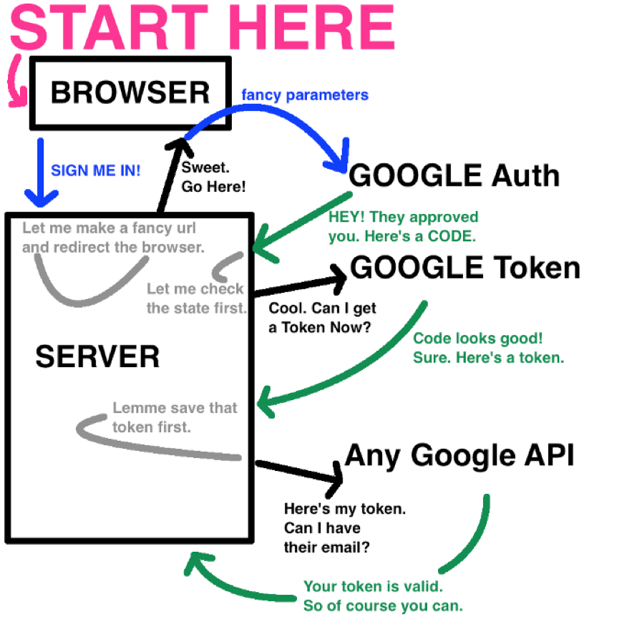
End to End Flow of an OAUTH API
Chapple,, 2018

Slide 9
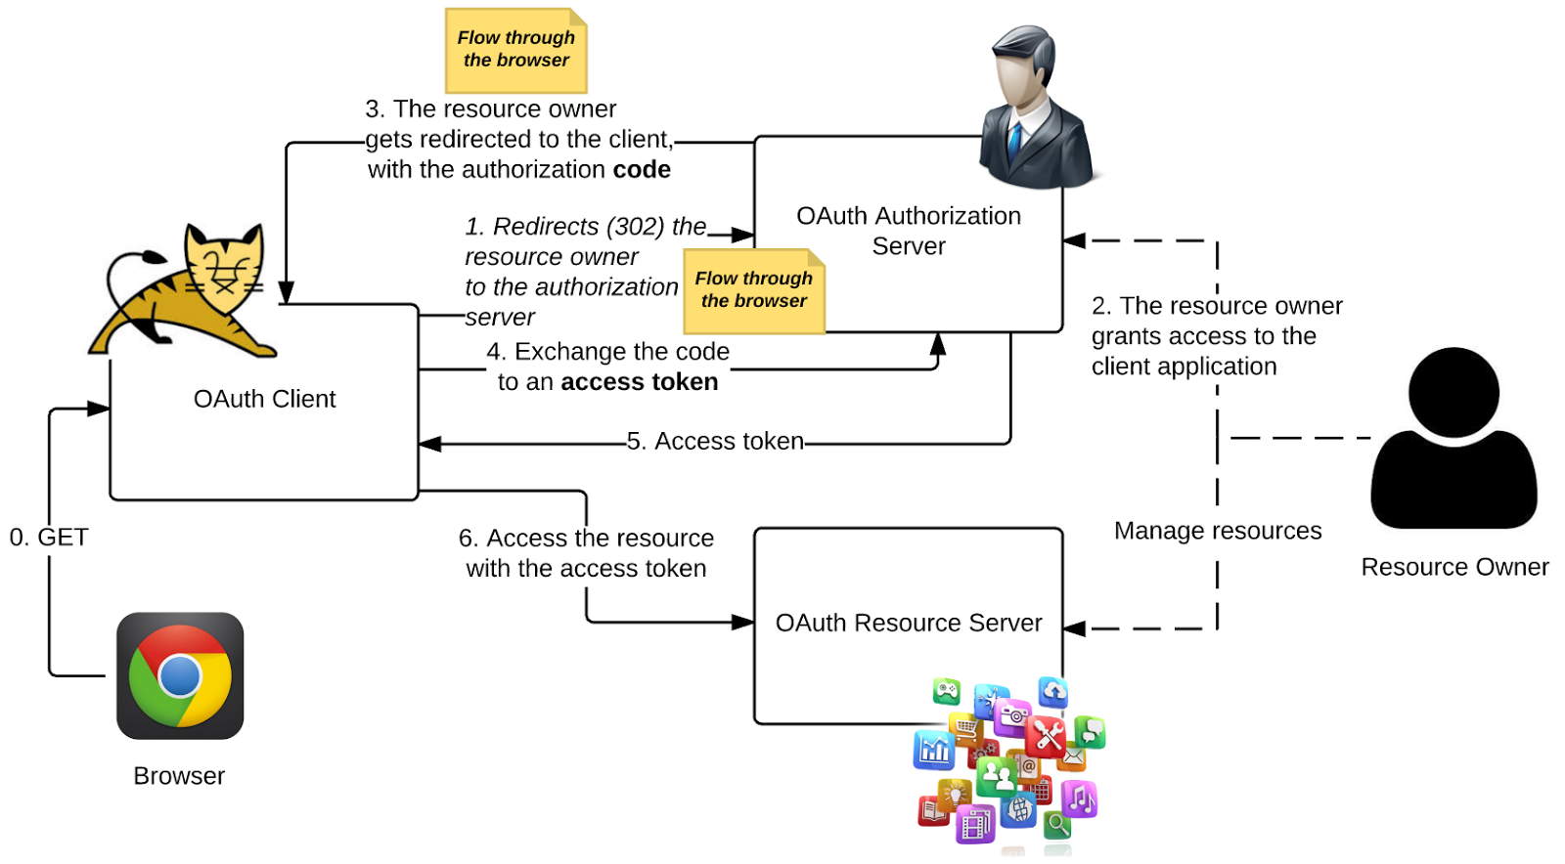
End to End Flow of an OAUTH API
Siriwardena,, 2019

Slide 10
References
Valerie Chapple. (2018 Feb 22). The Nitty-Gritty of Oauth 2.0Retrieved from Flow (article). Retrieved December 11, 2019, from https://medium.com/@valeriechapple/how-to-truly-understand-oauth-2-0-69dd3e7574c6
Roger Grimes. (2017 Aug 16). What Is Oauth? How The Open Authorization Framework Works (article). Retrieved December 11, 2019, from https://www.csoonline.com/article/3216404/what-is-oauth-how-the-open-authorization-framework-works.html
Synopsys Editorial Team. (2016, Mar 11). What’s The Difference? OAuth 1.0 vs OAuth 2.0 (blog). Retrieved December 11, 2019, from https://www.synopsys.com/blogs/software-security/oauth-2-0-vs-oauth-1-0/
Siriwardena, P. (2018, January 18). OAuth 2.0 Token Binding. Retrieved March 11, 2019, from https://medium.facileogin.com/oauth-2-0-token-binding-e84cbb2e60.

