Slide 1
Technology Value Stream
Web-430

Slide 2
What is a Technology Value Stream?
Series of steps used to deliver value, from concept or customer order to delivery of a tangible result for the customer.
It begins with a significant event triggering the flow of value. It ends when value has been delivered—a shipment, customer purchase, or solution deployment.
A value stream contains people who do the work, systems they develop or operate, and the flow of information and materials.

Slide 3
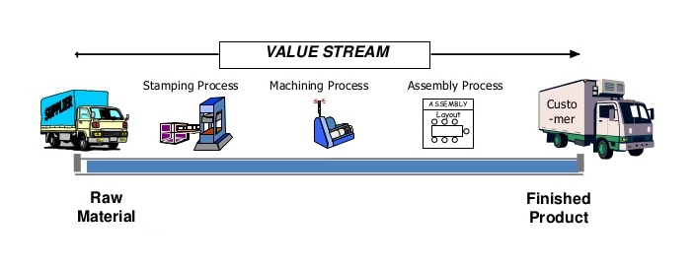
Diagram of a Technology Value Stream
Dragon1 (n.d.) jpg

Slide 4
Lead Time vs. Processing Time
Lead and Processing time are two measures commonly used to measure performance in value streams.
Lead time clock starts when the request is made and ends when it is fulfilled.
Process time clock starts only when we begin work on the customers request. Specifically, it omits the time that the work is in queue, waiting to be processed.

Slide 5
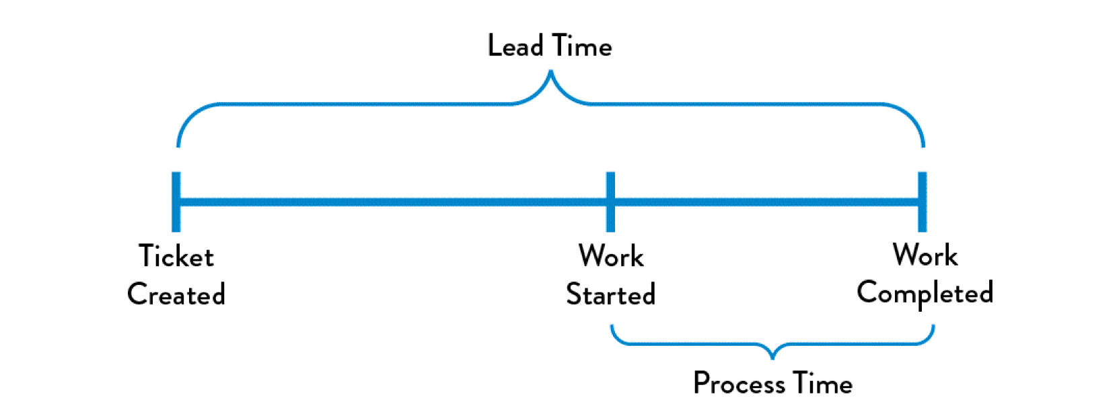
Lead Time vs Processing Time Diagram
DevOps (n.d.) jpg

Slide 6
The Common Scenario: Deployment Lead Times Requiring Months
Lead times can require months.
This is common in large, complex organizations that are working with tightly-coupled, monolithic applications, often with scarce integration test environments, long test and production environment lead times, high reliance on manual testing, and multiple required approval processes.

Slide 7
The Common Scenario: Deployment Lead Times Requiring Months Continued
When there are long deployment lead times.
This can lead to the team discovering that nothing works at the end of the project when the development team merges all the changes together.
This results in code that no longer works correctly or passes any of our tests.
Fixing each problem requires days or weeks of investigation to determine who broke the code and how it can be fixed, and still results in poor customer outcomes.

Slide 8
Our DevOps Ideal: Deployment Lead Times by Minutes
DevOps Ideal, developers receive fast, constant feedback on their work
This enables them to quickly and independently implement, integrate, and validate their code, and have the code deployed into the production environment

Slide 9
Our DevOps Ideal: Deployment Lead Times by Minutes
We achieve this by continually checking small code changes in to our version control repository, performing automated and exploratory testing against it, and deploying it into production.
This enables us to have a high degree of confidence that our changes will operate as designed in production and that any problems can be quickly detected and corrected.

Slide 10
Our DevOps Ideal: Deployment Lead Times by Minutes
This is achieved when we have architecture that is modular, well encapsulated, and loosely-coupled so that small teams failures being small and contained, and without causing global disruptions.
Our deployment lead time is measured in minutes or, in the worst case, hours.

Slide 11
References
Scaled Agile. (2018, October 4). What's new in SAFe 4.6? Retrieved December 20, 2019, from https://www.scaledagileframework.com/value-streams/
THORPE, S. (2019, February 06). DevOps Handbook Series Part 1: The Three Ways. Retrieved December 20, 2019, from https://caylent.com/devops-handbook-part-1-the-three-ways-2/
DevOps (Ed.). (2019, August 25). DevOps Handbook Series Part 1: The Three Ways. Retrieved December 20, 2019, from https://caylent.com/devops-handbook-part-1-the-three-ways-2.

