Slide 1
Two-Pizza Team Rule

Slide 2
What is the Two-Pizza Rule?
Jeff Bezos (CEO of Amazon) is credited with this rule
Jeff coined this phrase in 2002
“If a team couldn’t be fed with two pizzas….it is too big”!
Ideal size team is a two-pizza team
Usually a team of 5-10 people

Slide 3
Problems with Large Teams
If the group gathered is too large, efficiency & productivity goes down
Group leaders can have a hard time connecting with everyone in the group
Hard to connect with people
Interactions tend to be more shallow
Large groups tend to have more process problems in carrying out collective work

Slide 4
Why isn’t a bigger team better?
It is enticing to think more people will get more work done...but people in smaller teams are more productive
People become less engaged as numbers of teams go up
More people require more coordination and management
Communication becomes more difficult as teams expand
Hidden costs with large teams
Coordination Costs
Motivation Costs
Relational Costs

Slide 5
Problems Caused When Teams Grow
Less social pressure when groups are larger
Relational Loss - people feel they have less support when their group grows
Emotional Support
Problem Solving - Information Support
How work can be performed when there are setbacks becomes more difficult
People feel isolated and more stressed

Slide 6
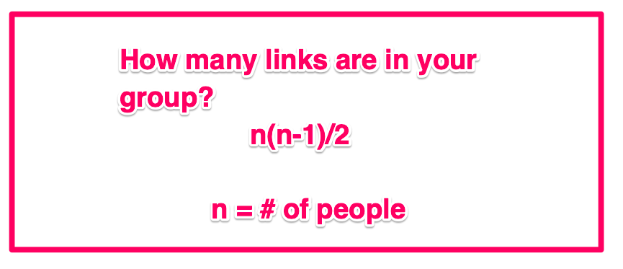
Links between People in a Group
The Number of Links between people becomes the problem
Formula for determining the number of links between people in a group
(Choi, 2018)

Slide 7
Using the formula...
As the group size increases….the links increase….some examples of using the formula are:
A team of 6 people
This creates 15 links between people!
Team of 12 people
This creates 66 links between people!
Business team of 50 people
Creates 1,225 links between people!

Slide 8
How can I start the Two-Pizza Rule?
Figure out a ‘magic number’ of people
Stick with single digits of people
6 or 7 is ideal
Follow the ‘Cheers’ rule
The more you can do to bring people together the better your team will be.
Make teamwork easier through being transparent
Provide teams data on their work

Slide 9
Team Scaling Fallacy
Researchers Bradley Staats, Katherine Milkman and Craig Fox did an experiment with researching teams building with Legos to create a figure.
2 person teams took 36 minutes to construct a figure
4 person teams took 52 minutes to construct a figure
This is 44% longer!

Slide 10
Ideas for the Two-Pizza Rule
Make teams feel smaller
Spend time getting to know team members
Transparency
Prevent social loafing and free-riding
Feedback
Frequent feedback is necessary

Slide 11
References
Choi, J. (2018, December 6). The Science Behind Why Jeff Bezo’s Two-Pizza Team Rule Works. Retrieved January 9, 2020 from http://blog.idonethis.com/two-pizza-team/
Choi, J. (2016, March 22). Jeff Bezos’ 2 Pizza Rule: Why Small Teams Work More Productively. Retrieved January 9, 2020 from https://beffer.com/resources/small-teams-why-startups-often-win-against-google-and-facebook-the-science-behind-why-smaller-teams-get-more-done

