Slide 1
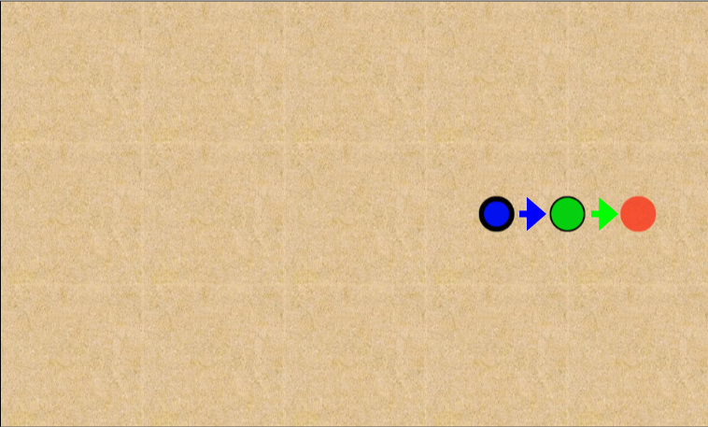
1. Short Distance v1

Slide 2
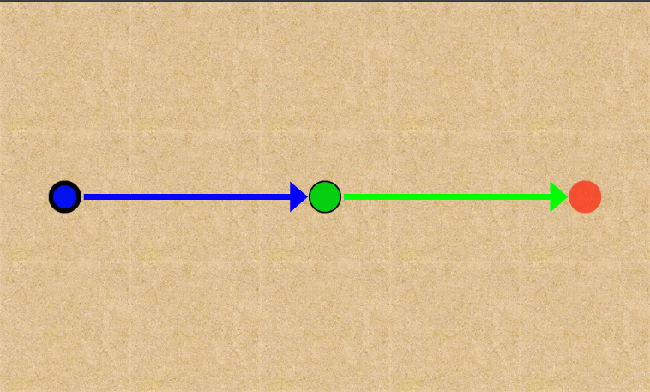
2. Medium Distance v2

Slide 3
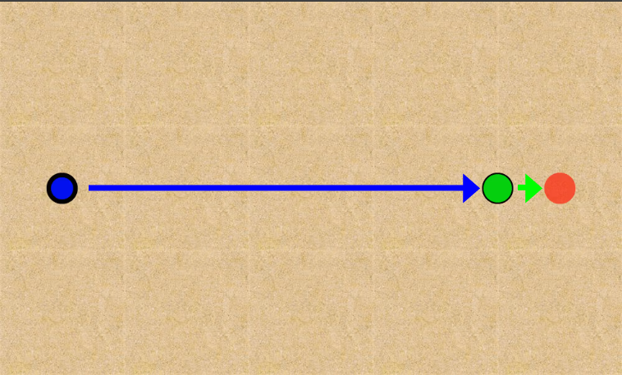
3. Long Distance v1

Slide 4
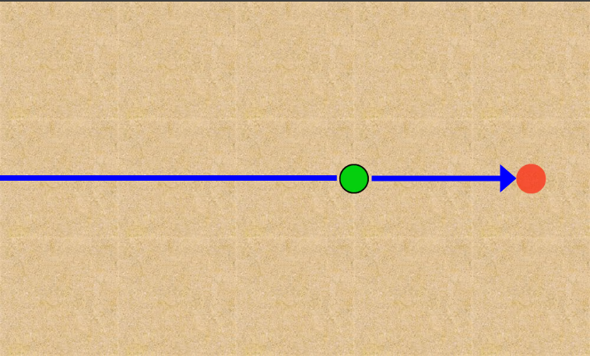
4. Long Distance v2

Slide 5
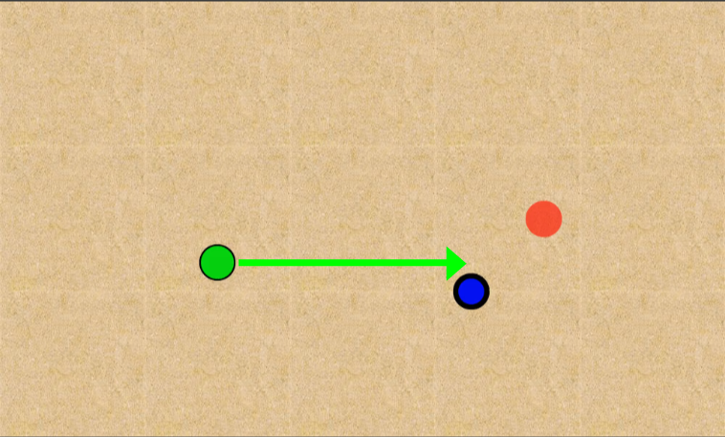
5. Static

Slide 6
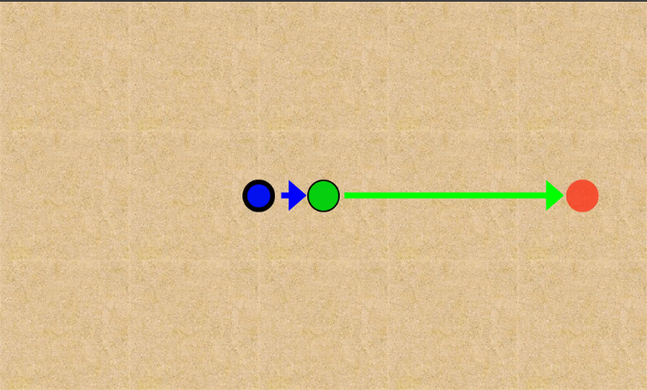
6. Slow Collision

Slide 7

7. Fast Collision

Slide 8
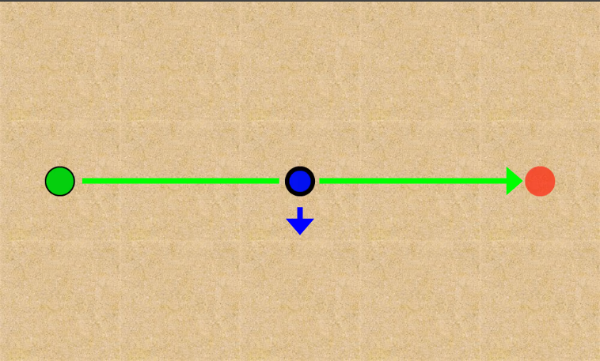
8. Dodge

Slide 9
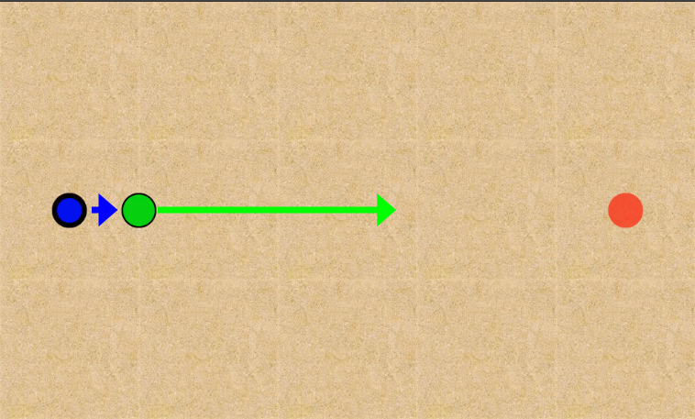
9a. Double Push

Slide 10
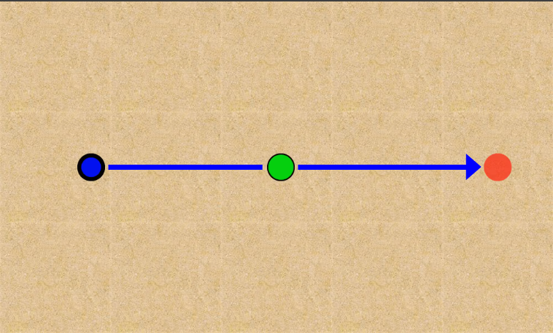
9b. Double Push

Slide 11
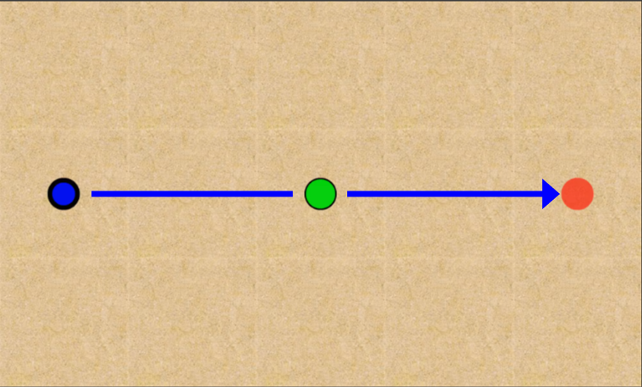
10. Medium Push

Slide 12
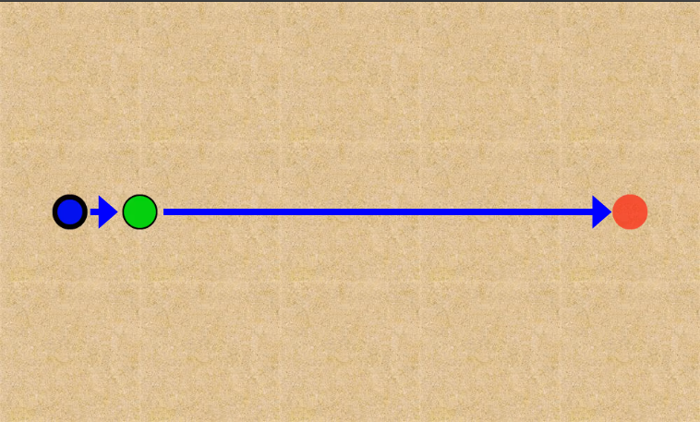
11. Long Push

Slide 13
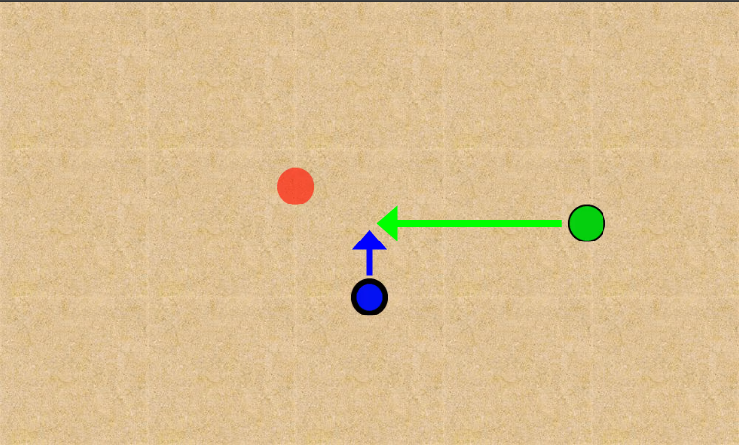
12. Moving

Slide 14
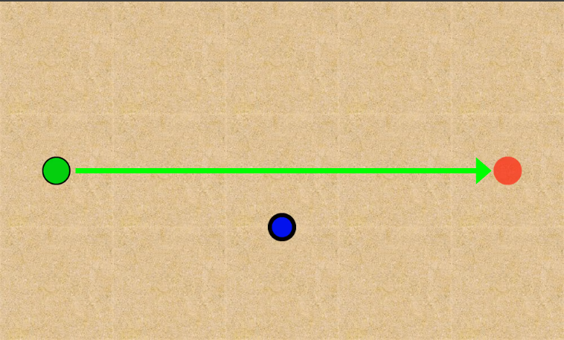
13. No Touch

Slide 15
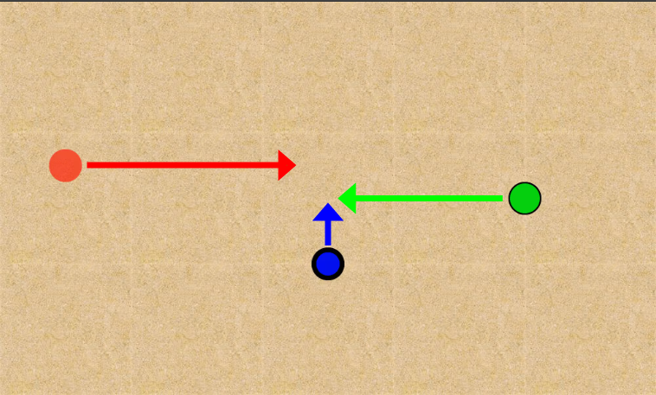
14. Victim Moving Moving

Slide 16
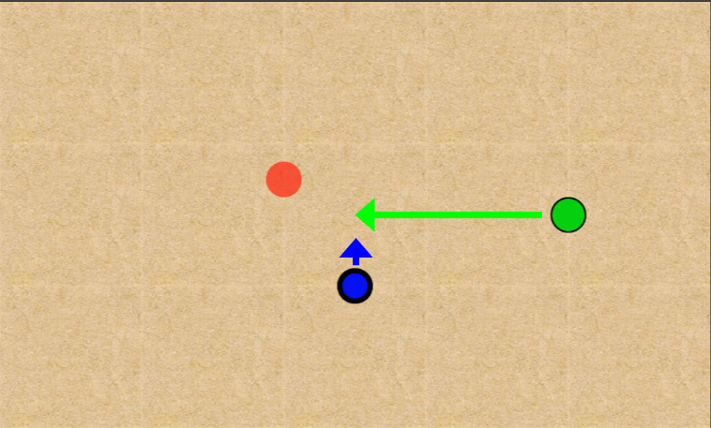
15. Victim Moving Static

Slide 17
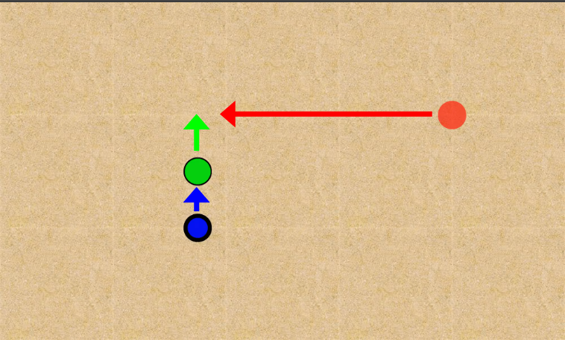
16. Victim Static Moving

Slide 18
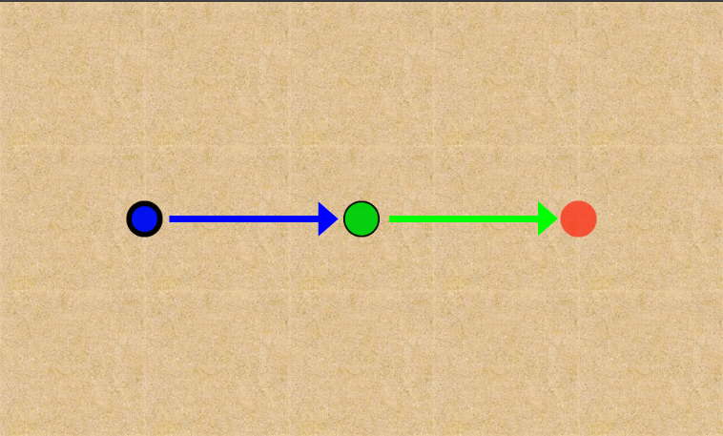
17. Victim Static Static

Slide 19
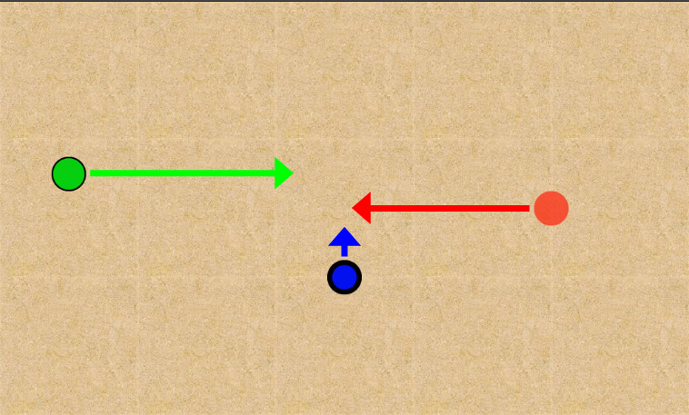
18. Harm Moving Moving

Slide 20
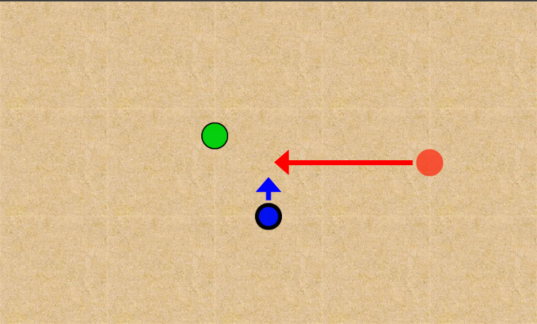
19. Harm Moving Static

Slide 21
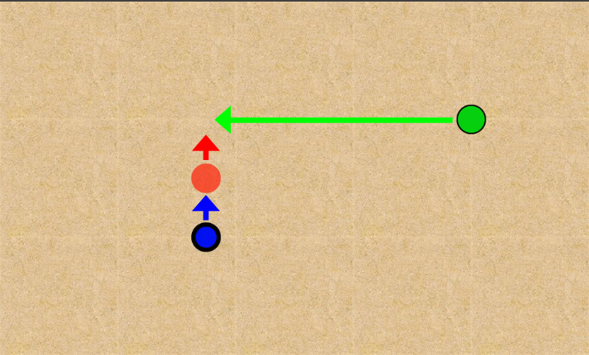
20. Harm Static Moving

Slide 22
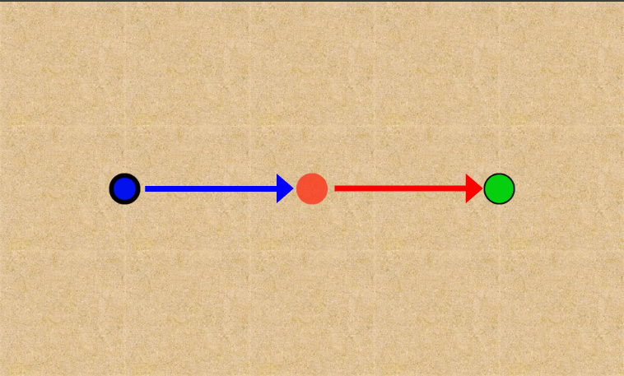
21. Harm Static Static

Slide 23
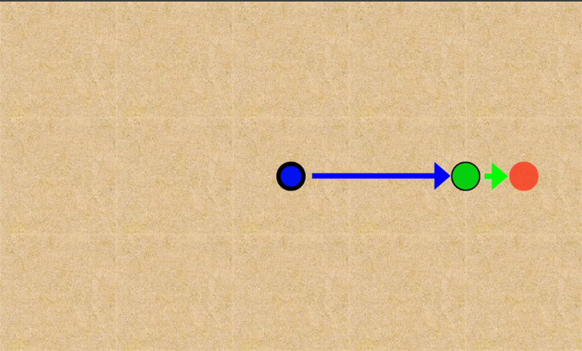
22. Medium Distance v1

Slide 24
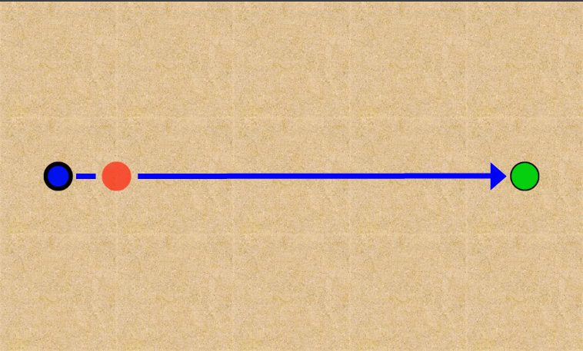
23. Push Fireball

