Slide 1
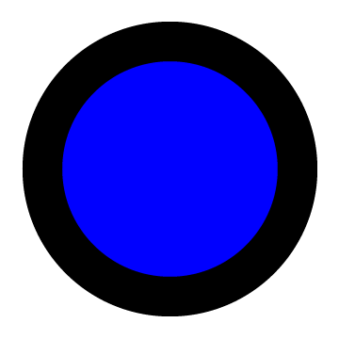

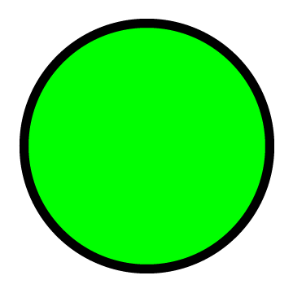
Thick skin
Blue
Fireball
Green

Slide 2
Blues can see Fireballs and are not hurt when they touch them.

Slide 3

Greens can not see Fireballs and are burned when they touch them.

Slide 4
Both Blues and Greens are highly intelligent and social and often interact with each other.

Slide 5
The Red Orbs are not alive but they can be pushed around by the magnetic winds of Gaya.
Below you can see a Red Orb being pushed by magnetic winds.

Slide 6
Below you can see a Blue finding and pushing around a Red Orb without getting harmed.

Slide 7
Below you can see a Green bumping into a Red Orb and being severely burned.

Slide 8
Most of the time, Greens and Blues live together peacefully.
Below you can see a Blue saving a Green from a Fireball being pushed by magnetic winds.

Slide 9
However, there are several known cases where different Blues were involved in harming a Green.

Slide 10
The clips you will be shown next are examples of those cases.

Slide 11
Your task is to watch the clips and make a judgment about how responsible the Blue was for what happened to the Green.
You must watch the clip twice before making your judgment.

