Slide 1

Spatiotemporal model of proteolysis in Caulobacter cell cycle
Xiangyu Yao, Rachel Xu
CS6824
Reference1: An Adaptor Hierarchy Regulates Proteolysis during a Bacterial Cell Cycle, Joshi et al., 2015, Cell 163: 419–431.
Reference2: Dynamical Localization of DivL and PleC in the Asymmetric Division Cycle of Caulobacter crescentus: A Theoretical Investigation of Alternative Models, Subramanian et al., 2015, PLOS Computational Biology 11(7): e1004348.

Slide 2
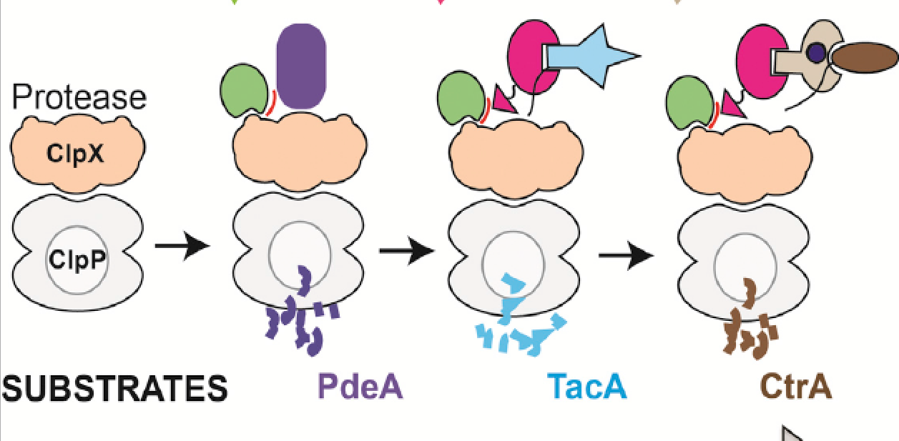

RcdA
PopA & c-di-GMP
CpdR
Complex 1
Complex 2
Complex 3

Slide 3




Model 1
kf_b
CpdR_f
CpdR_b
kb_f
ks
k$1^{+}$
ClpXP + CpdR ClpXP:CpdR (Complex 1)
k$1^{−}$
k$2^{+}$
kd
k$2^{−}$
CpdR~P
DivK~P

Slide 4
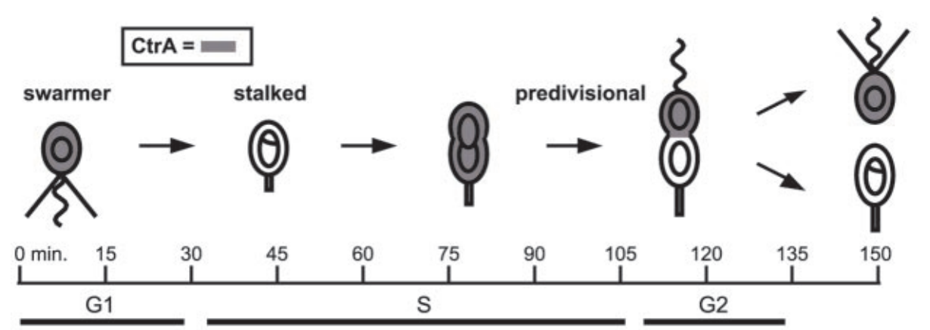

Simulation Scheme

Slide 5
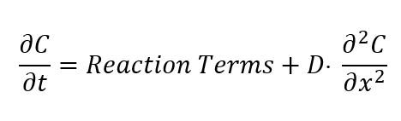
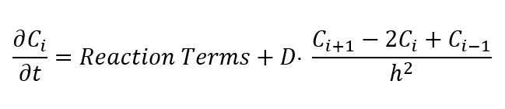
Simulation Scheme
Use finite difference method to get numerical approximation of PDE system
1
2
3
...
i
N
h
Kartik Subramanian et al.,2015

Slide 6
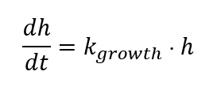
Boundary condition and growth rule
No-flux boundary condition at x=0 and x=L
Put additional 2 compartment C0 and C101, and in each time step C0=C1, C101=C100
Exponential growth for a cell and the corresponding each compartment
Kartik Subramanian et al.,2015

Slide 7
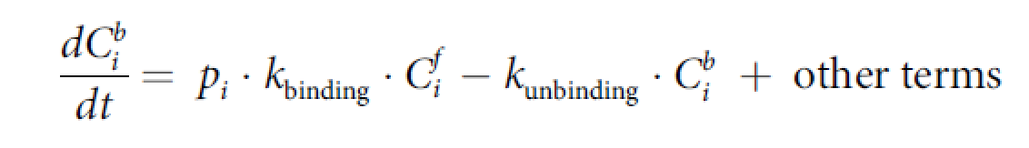
Enforce localization based on observed distributions
define rates of binding and unbinding of species C to docking proteins in compartment i as follows
c-di-GMP; CpdR.
Kartik Subramanian et al.,2015

Slide 8
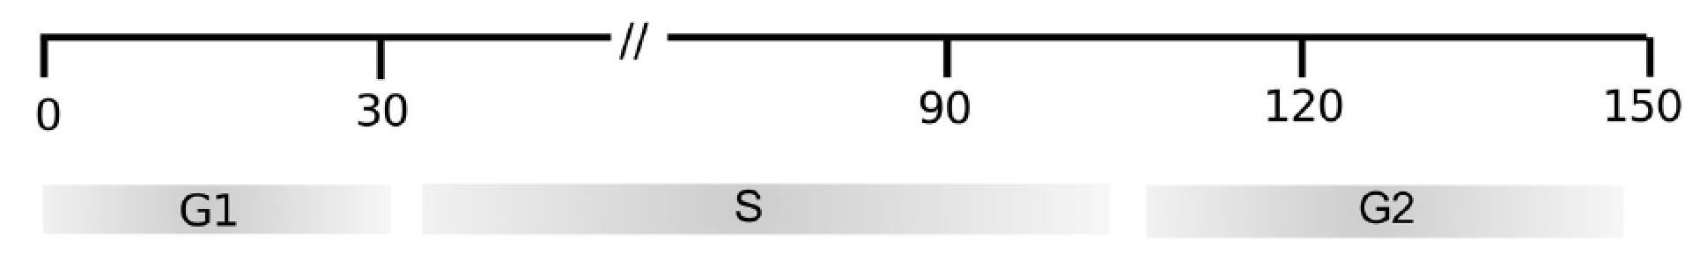
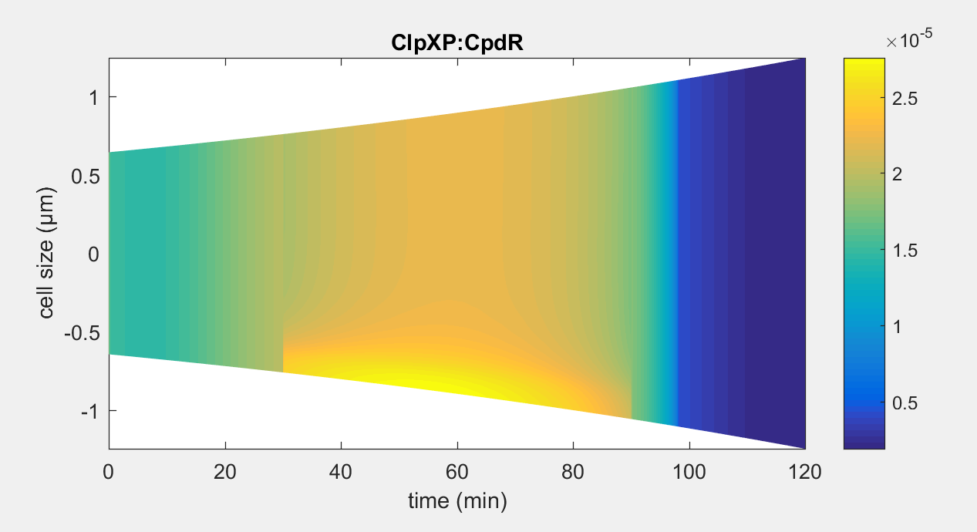
Temporal dynamics of species in our model – before division

Slide 9
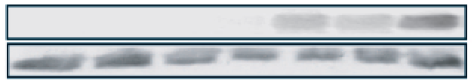
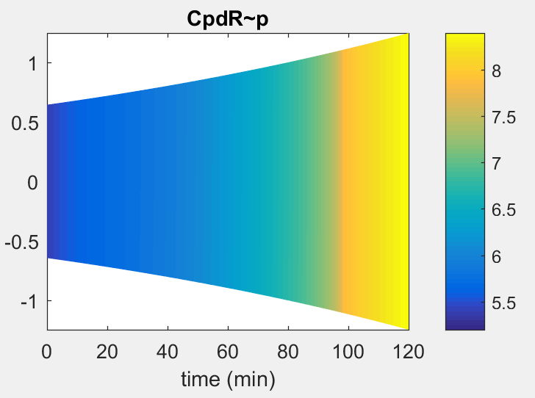
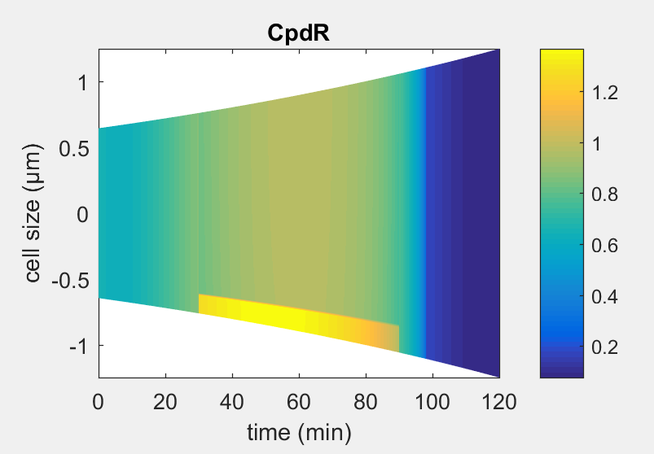
Temporal dynamics of species in our model – before division
CpdR~P
CpdR

Slide 10
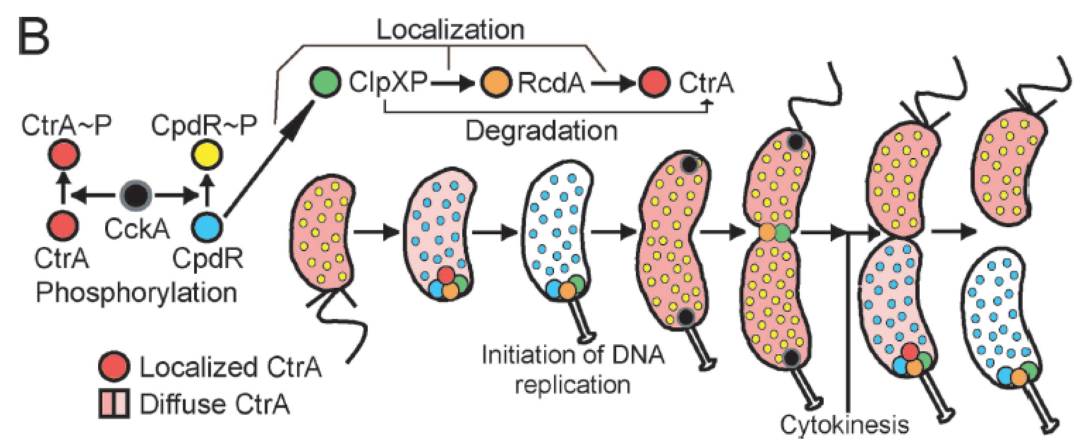
Temporal dynamics of species in our model – before division

Slide 11
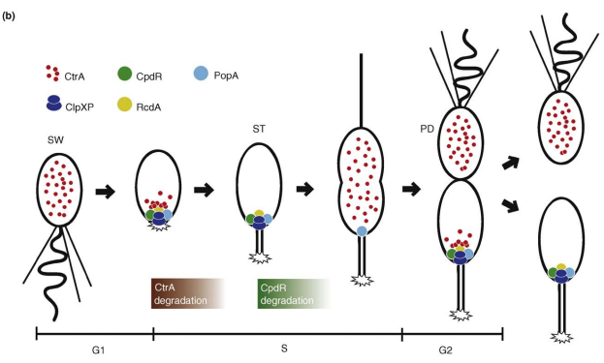
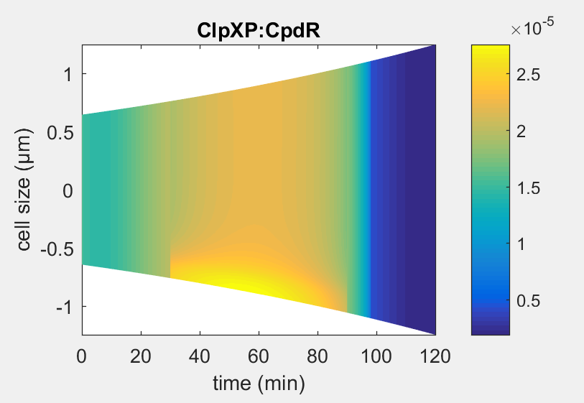
Spatial dynamics of species in our model – before division

Slide 12
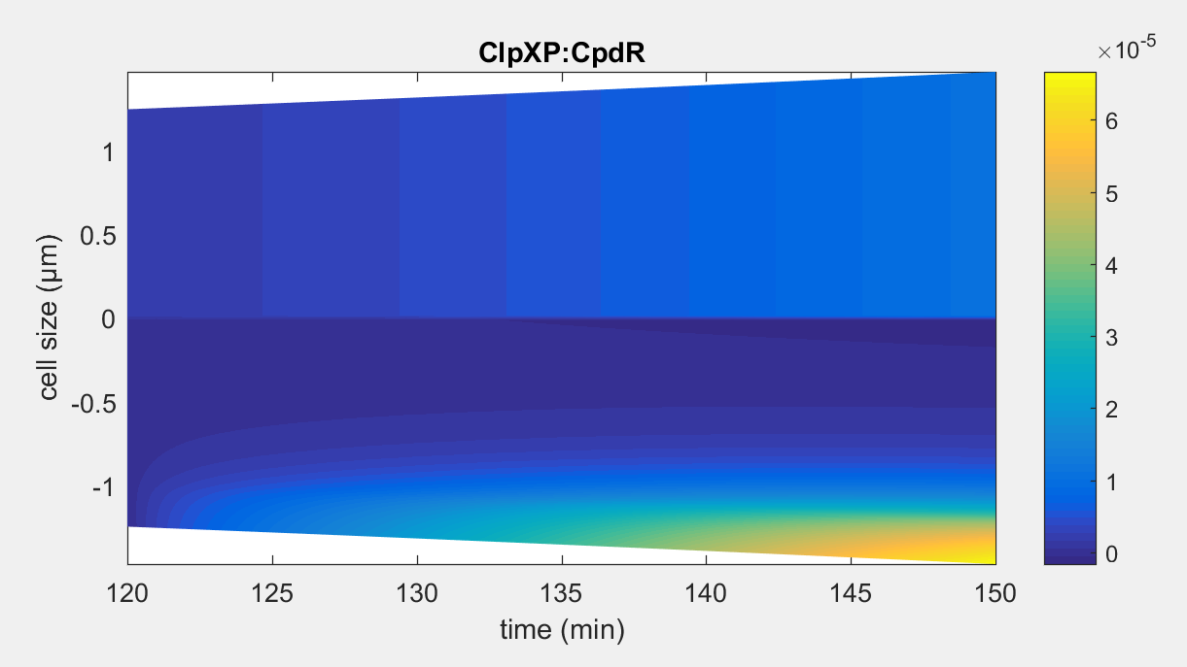
Temporal dynamics of species in our model – after division

Slide 13
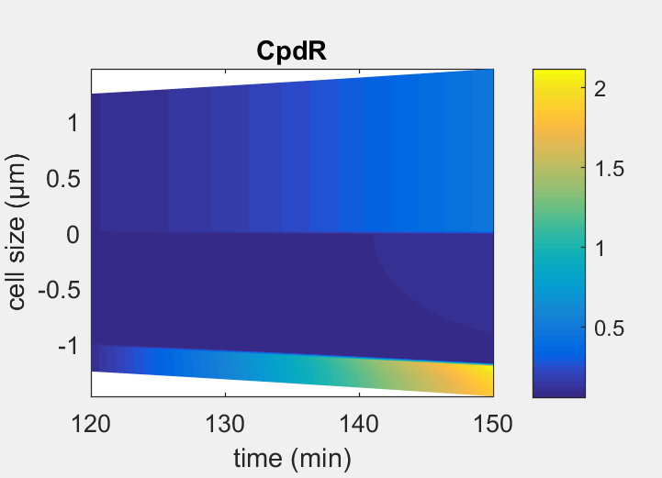
Temporal dynamics of species in our model – after division

Slide 14
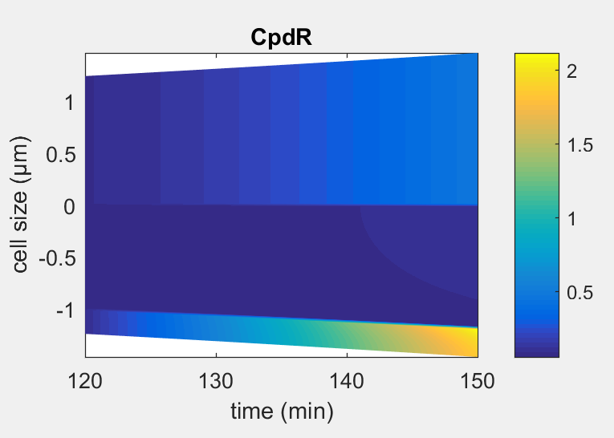
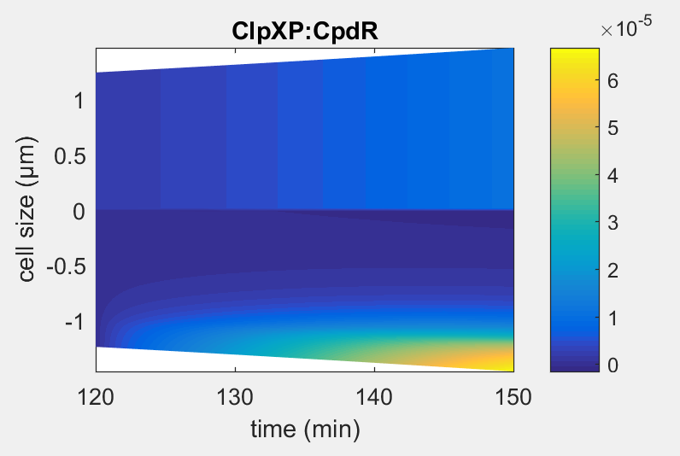
Spatial dynamics of species in our model – after division

Slide 15
RcdA
PopA & c-di-GMP
CpdR
Complex 1
Complex 2
Complex 3

Slide 16
Model 2
ks
k3+
Complex 1 + RcdA ClpXP:CpdR:RcdA (Complex 2)
K3-
kd

Slide 17
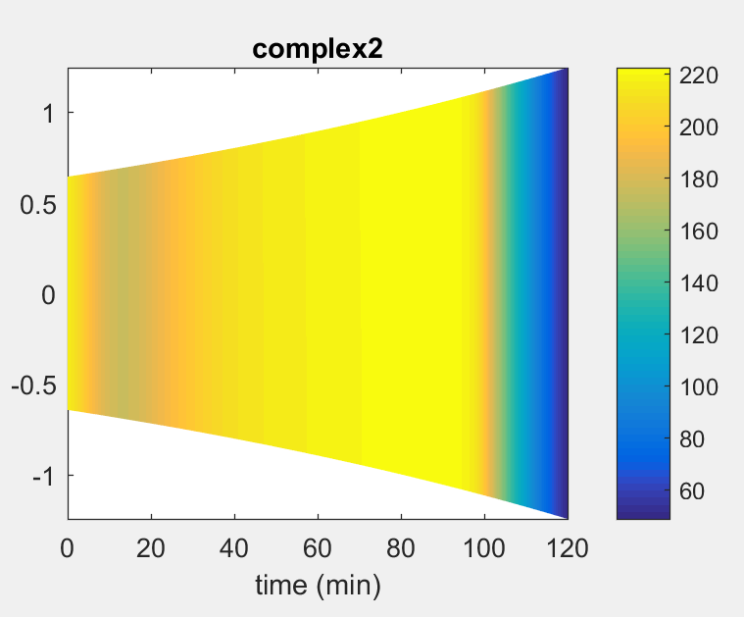


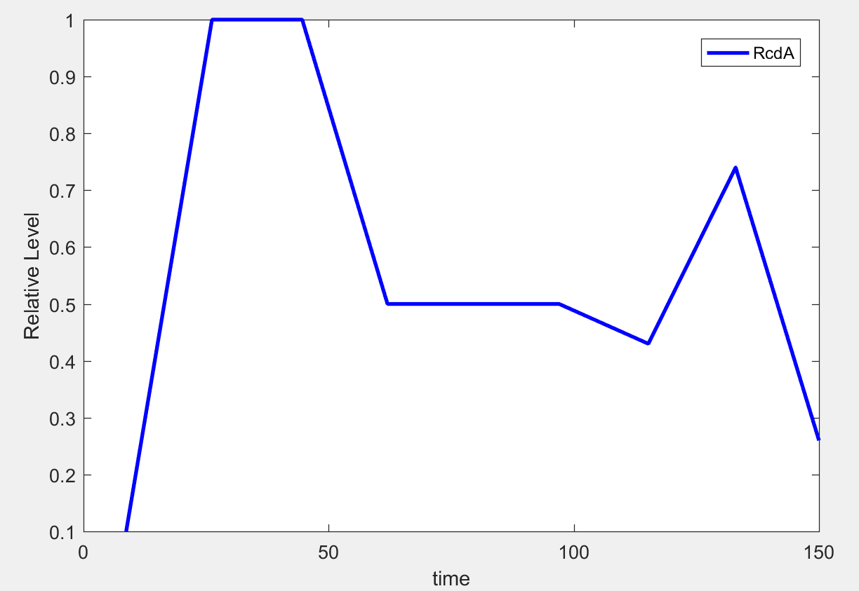
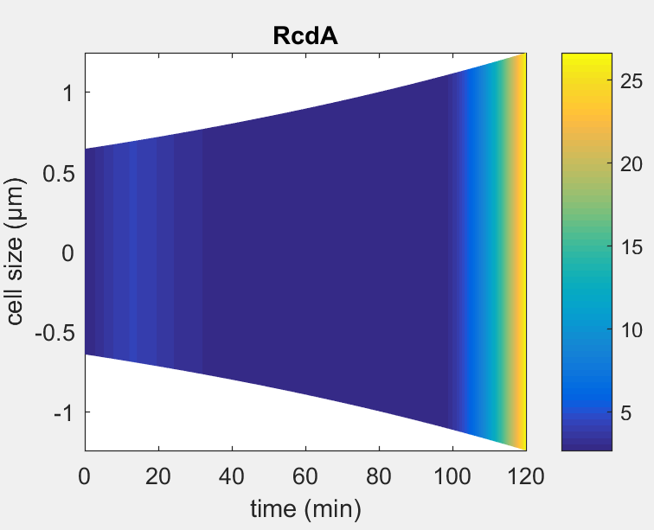
Temporal dynamics of species in our model – before division
TacA
RcdA

Slide 18
Model 3
PleD
k4+
PopA +
2cdG
PopA:2cdG
k4-
pDeA
k5+
ClpXP:CpdR:RcdA (Complex 2) + PopA:2cdG Complex 3
k5-

Slide 19

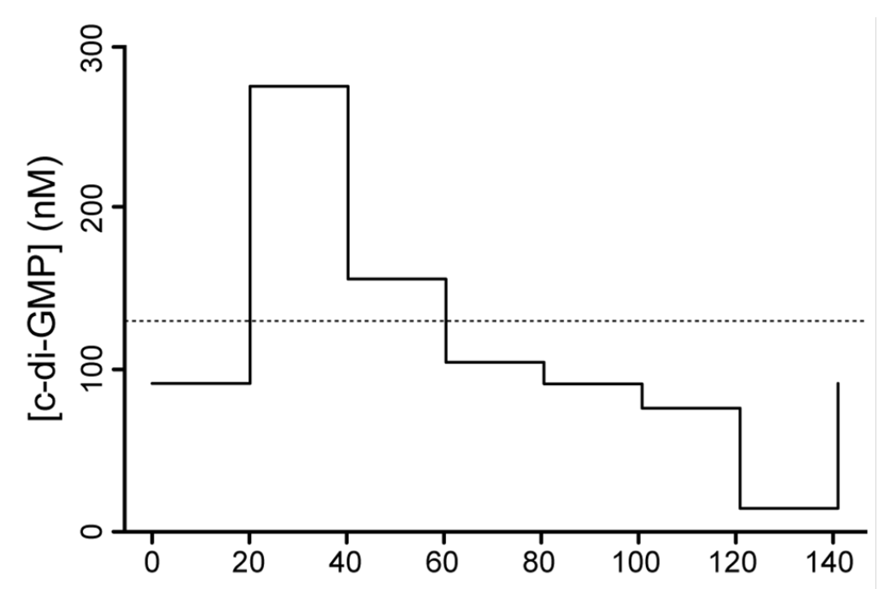
Temporal dynamics of species in our model from experiments

Slide 20
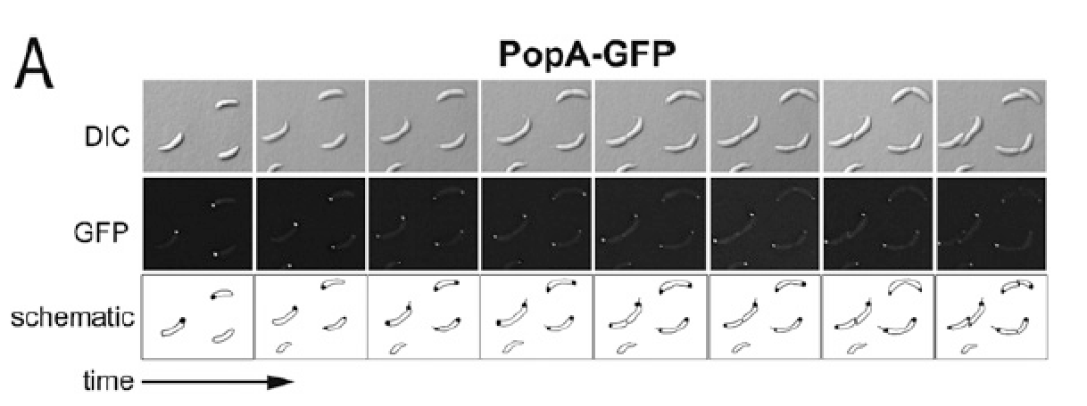
Spatial dynamics of species in our model from experiments

Slide 21
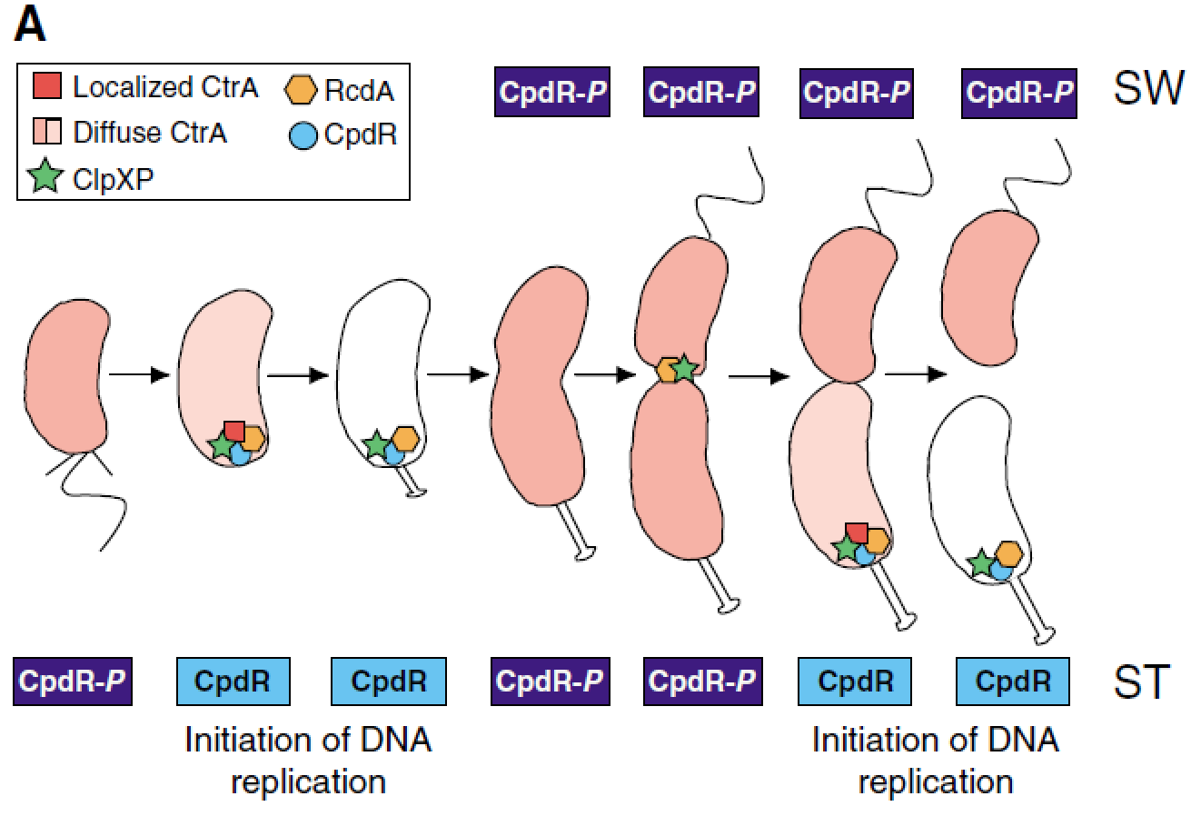
Spatial dynamics of species in our model from experiments

