Slide 1

Spatiotemporal model of proteolysis in Caulobacter cell cycle
Xiangyu Yao, Rachel Xu
CS6824
Reference1: An Adaptor Hierarchy Regulates Proteolysis during a Bacterial Cell Cycle, Joshi et al., 2015, Cell 163: 419–431.
Reference2: Dynamical Localization of DivL and PleC in the Asymmetric Division Cycle of Caulobacter crescentus: A Theoretical Investigation of Alternative Models, Subramanian et al., 2015, PLOS Computational Biology 11(7): e1004348.

Slide 2
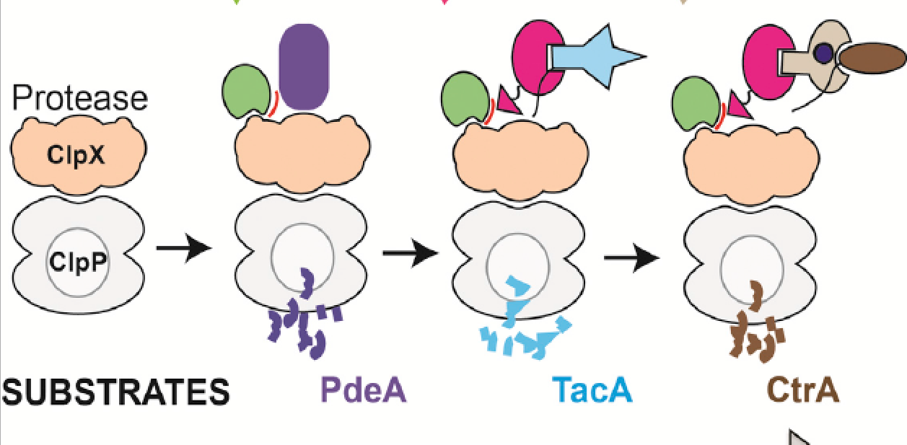

RcdA
PopA & c-di-GMP
CpdR
Complex 1
Complex 2
Complex 3

Slide 3




Model 1
kf_b
CpdR_f
CpdR_b
kb_f
ks
k$1^{+}$
ClpXP + CpdR ClpXP:CpdR_b (Complex 1)
k$1^{−}$
k$2^{+}$
kd
k$2^{−}$
CpdR~P
DivK~P

Slide 4
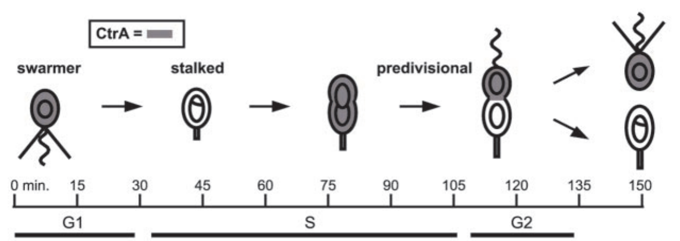

Simulation Scheme

Slide 5
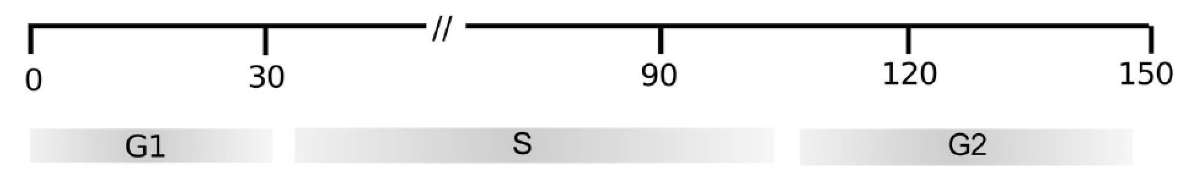
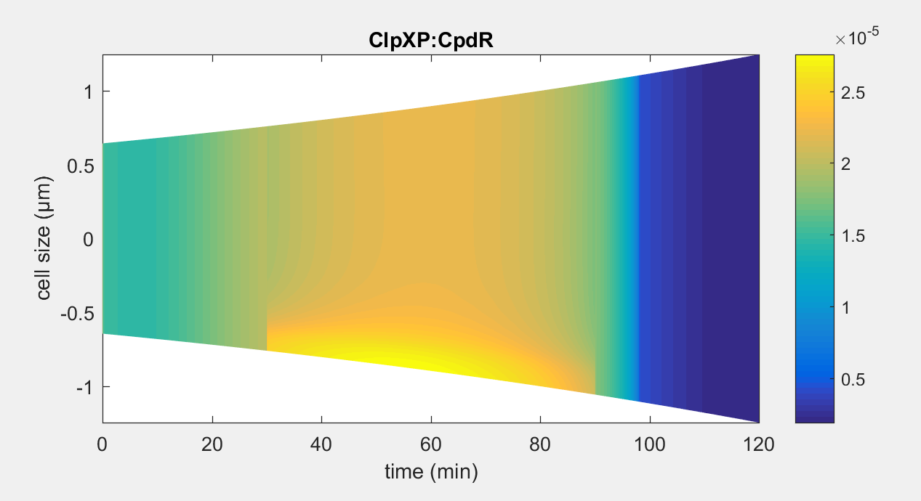
Temporal dynamics of species in our model – before division

Slide 6
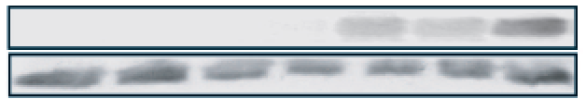
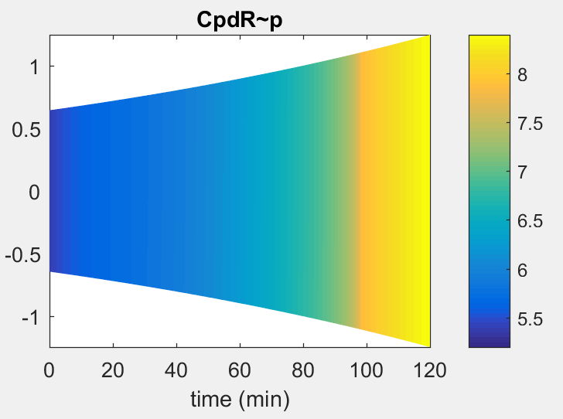
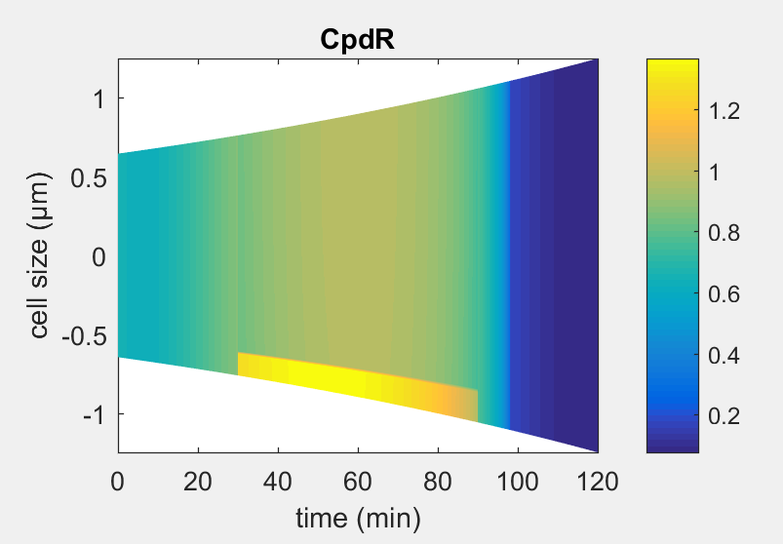
Temporal dynamics of species in our model – before division
CpdR~P
CpdR

Slide 7
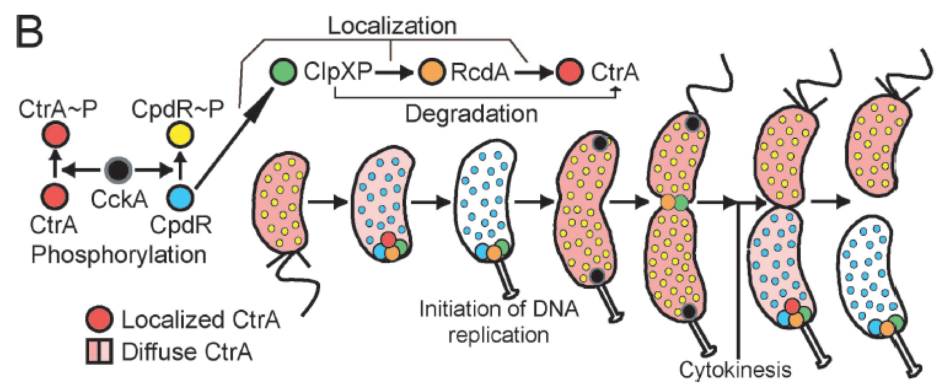
Temporal dynamics of species in our model – before division

Slide 8
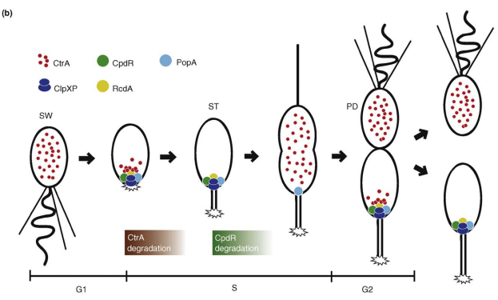
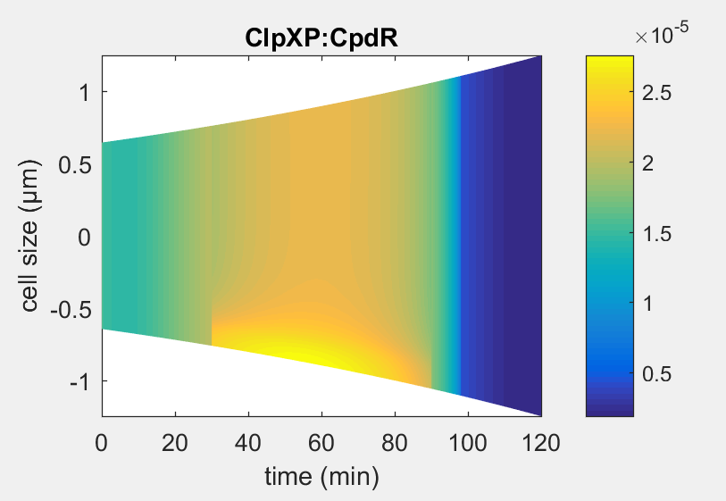
Spatial dynamics of species in our model – before division

Slide 9
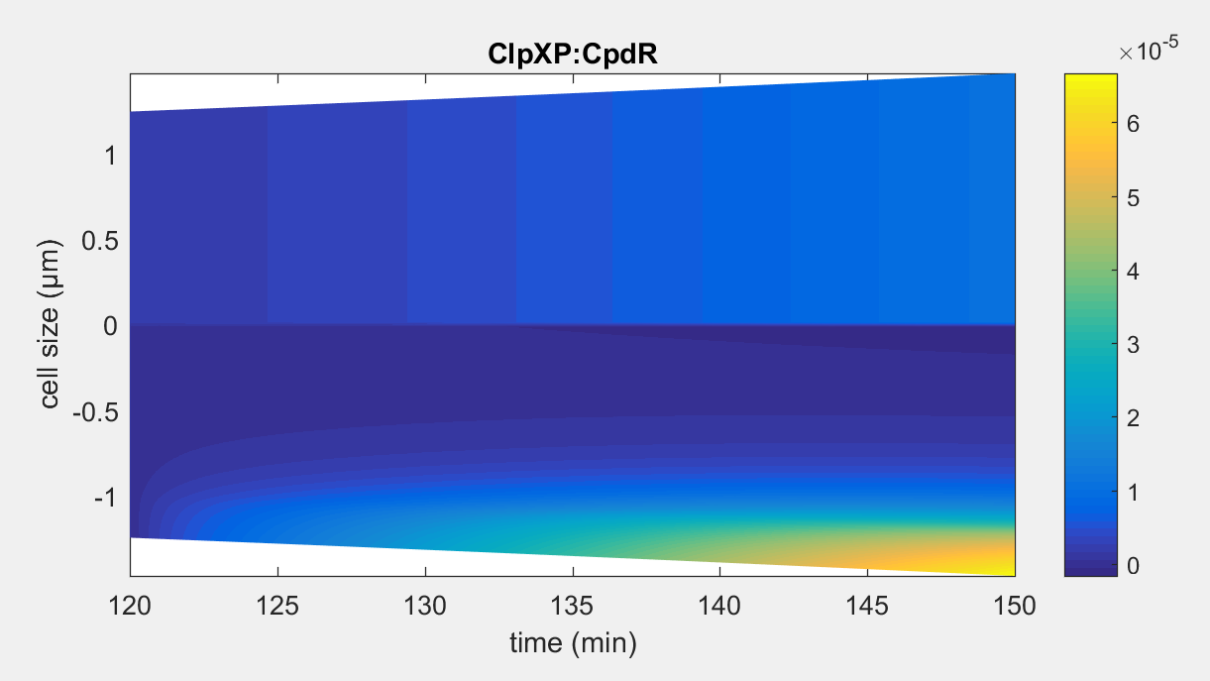
Temporal dynamics of species in our model – after division

Slide 10
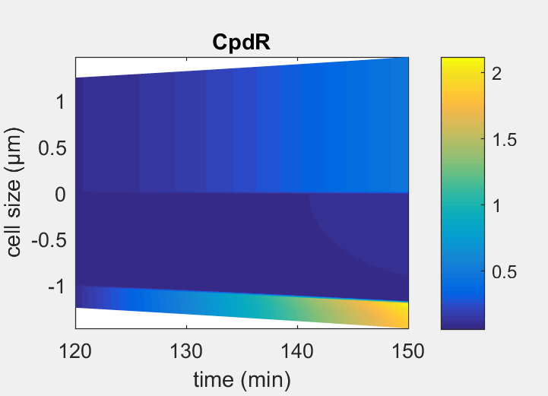
Temporal dynamics of species in our model – after division

Slide 11
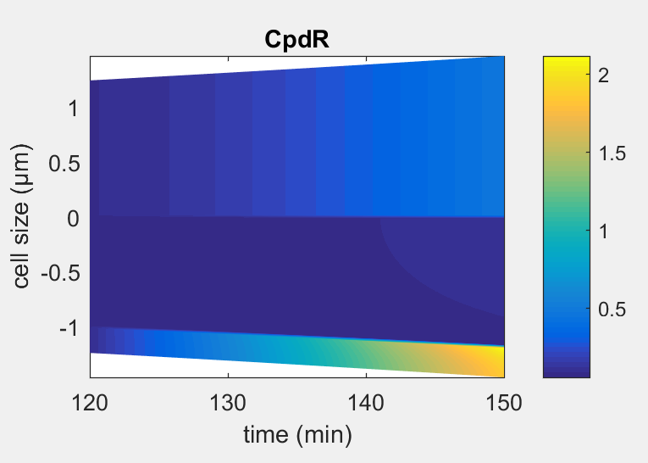
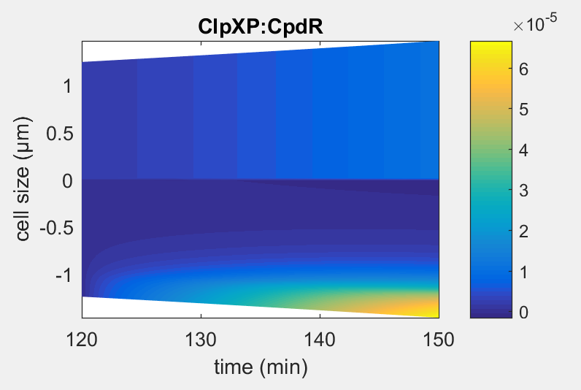
Spatial dynamics of species in our model – after division

Slide 12
RcdA
PopA & c-di-GMP
CpdR
Complex 1
Complex 2
Complex 3

Slide 13
Model 2
ks
k3+
Complex 1 + RcdA ClpXP:CpdR:RcdA (Complex 2)
K3-
kd

Slide 14
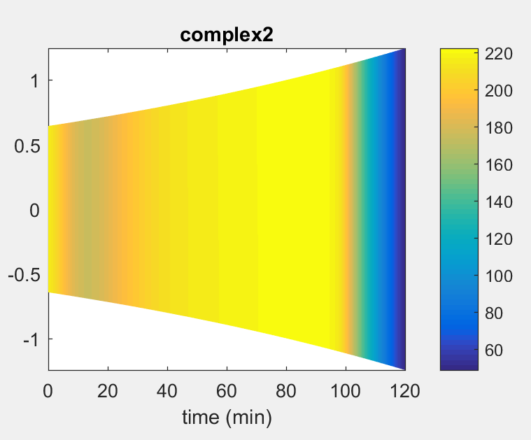


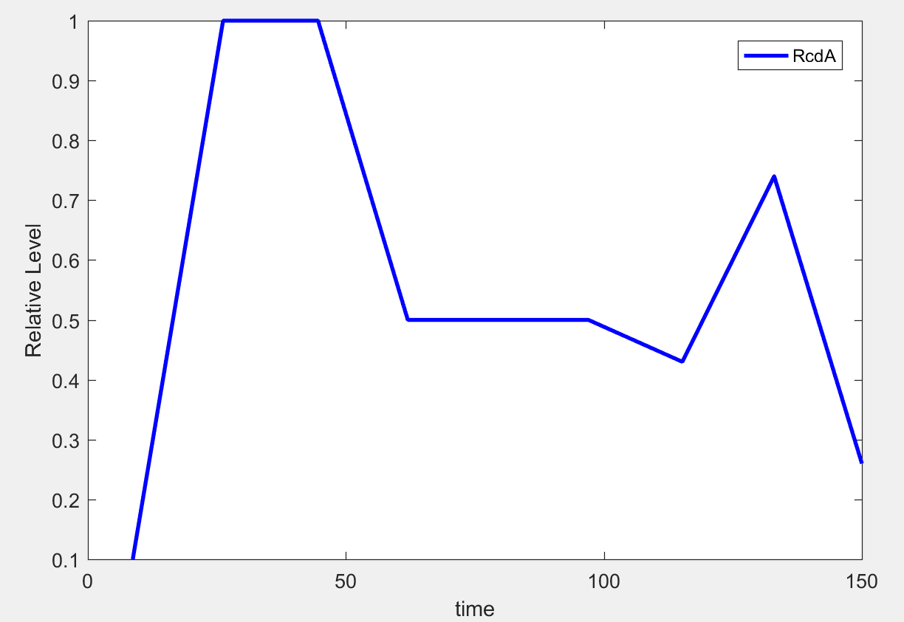
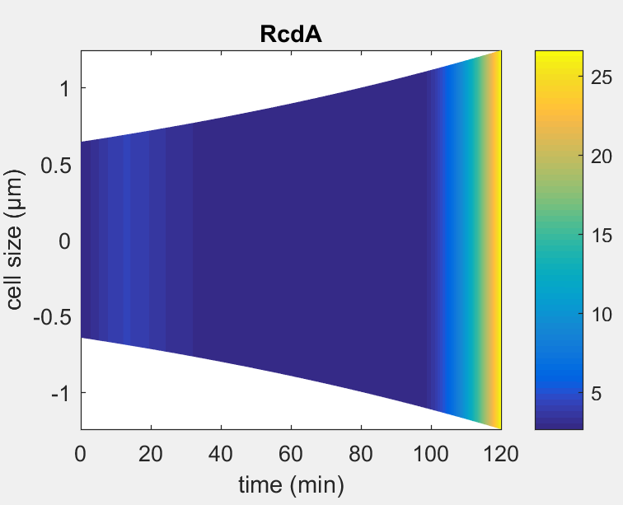
Temporal dynamics of species in our model – before division
TacA
RcdA

Slide 15
Model 3
PleD
k4+
PopA +
2cdG
PopA:2cdG
k4-
pDeA
k5+
ClpXP:CpdR:RcdA (Complex 2) + PopA:2cdG Complex 3
k5-

Slide 16

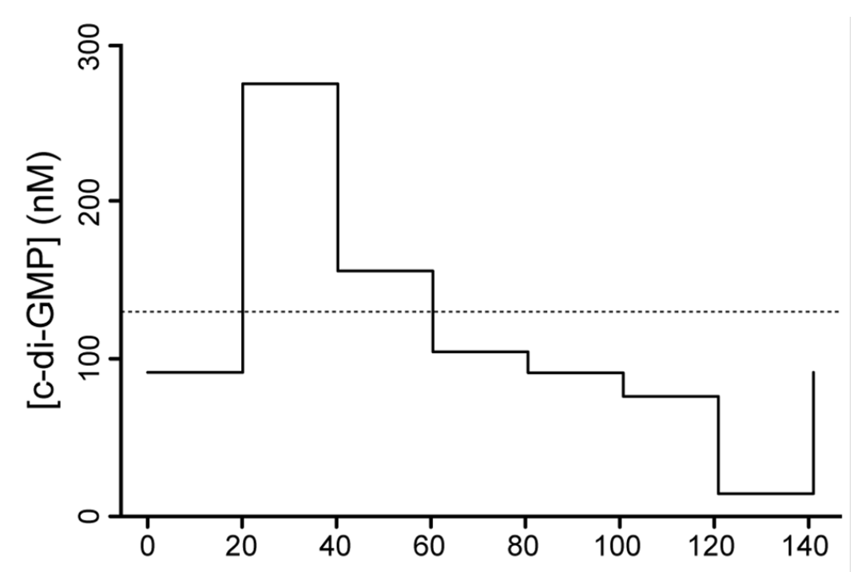
Temporal dynamics of species in our model from experiments

Slide 17
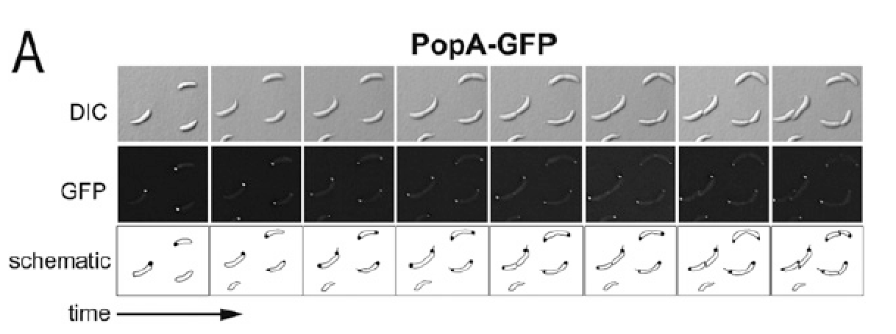
Spatial dynamics of species in our model from experiments

Slide 18
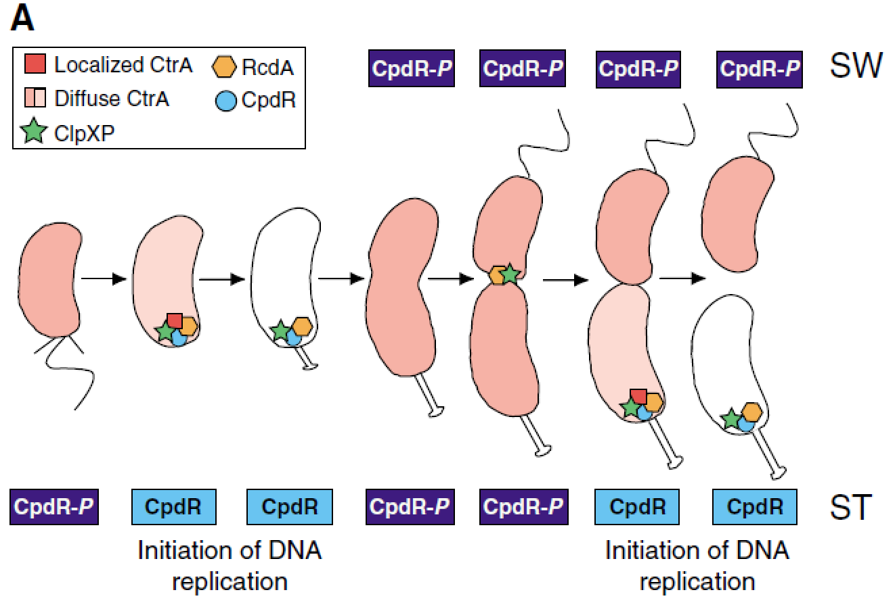
Spatial dynamics of species in our model from experiments

