Slide 1

Spatiotemporal model of proteolysis in Caulobacter cell cycle
Xiangyu Yao, Rachel Xu
CS6824
Reference1: An Adaptor Hierarchy Regulates Proteolysis during a Bacterial Cell Cycle, Joshi et al., 2015, Cell 163: 419–431.
Reference2: Dynamical Localization of DivL and PleC in the Asymmetric Division Cycle of Caulobacter crescentus: A Theoretical Investigation of Alternative Models, Subramanian et al., 2015, PLOS Computational Biology 11(7): e1004348.

Slide 2




Model 1
kf_b
CpdR_f
CpdR_b
kb_f
ks
k$1^{+}$
ClpXP + CpdR ClpXP:CpdR_b (Complex 1)
k$1^{−}$
k$2^{+}$
kd
k$2^{−}$
CpdR~P
DivK~P

Slide 3
Model 2
ks
k3+
Complex 1 + RcdA ClpXP:CpdR:RcdA (Complex 2)
K3-
kd

Slide 4
Model 3
PleD
k4+
PopA +
2cdG
PopA:2cdG
k4-
pDeA
k5+
ClpXP:CpdR:RcdA (Complex 2) + PopA:2cdG Complex 3
k5-

Slide 5
Our hypothesis Localization of proteases affects the spatial temporal profile of proteins

Slide 6

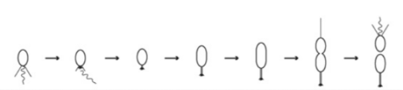
Temporal dynamics of species in our model from experiments

Slide 7
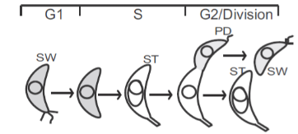


Slide 8
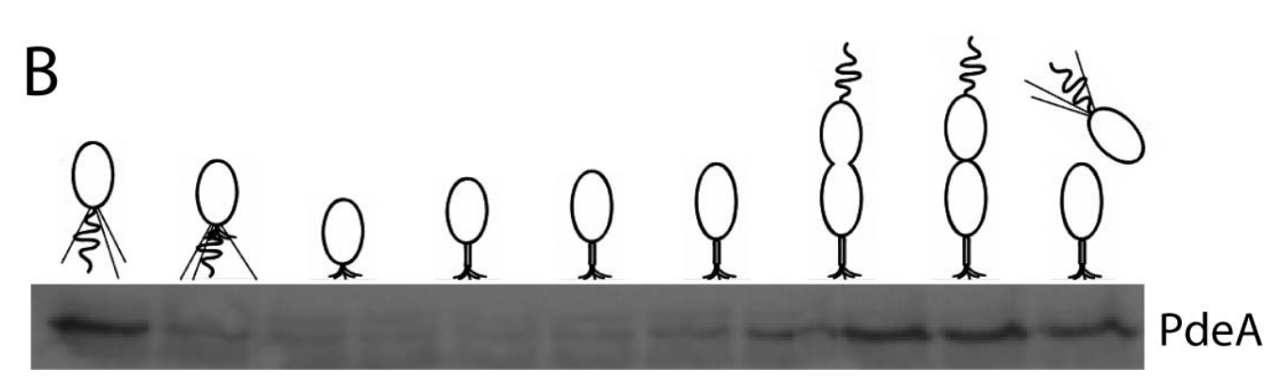

Slide 9
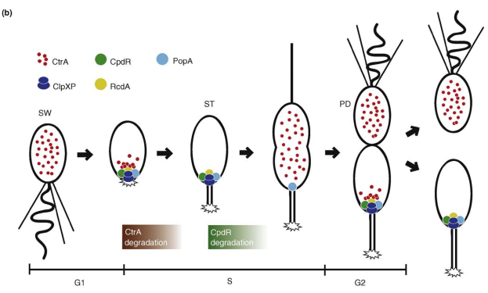
Spatial dynamics of species in our model from experiments

Slide 10
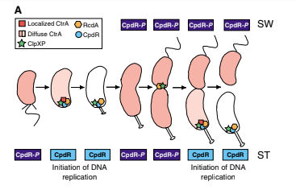

Slide 11
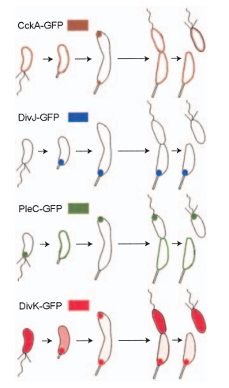

Slide 12
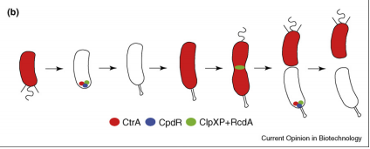

Slide 13
Simulation Result

