Slide 1
Bench Test of AlpacaPi ROR Controller

Slide 2
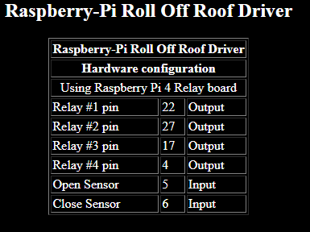
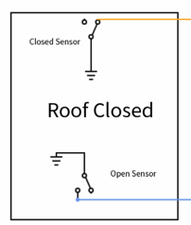
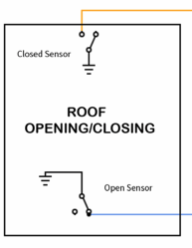
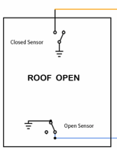
Opening the Roof
GPIO5
Roof State: Roof Closed
Closed Sensor Closed (GPIO 6),
Open Sensor Open (GPIO 5),
Close Shutter indicates “Open Shutter”
Shutter Position indicates “Closed”.
Sequel of Events:
Push Shutter Button and roof is in transient
Open Shutter button will gray out
Closed Sensor contacts will open
Open Sensor contacts will remains open
Should say Slewing until Open Relay is fully open
Roof Full Closed
Open Relay contact will close
Close Relay contacts will remain open
Shutter button will switch to “Close Shutter”
GPIO6
GPIO5
GPIOs are backwards
GPIO6
GPIO5
GPIO6

Slide 3
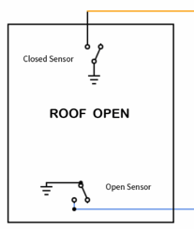
Closing the Roof
GPIO5
Roof State: Roof Open
Closed Sensor open (GPIO 6),
Open Sensor closed (GPIO 5),
Close Shutter indicates “Close Shutter”
Shutter Position indicates “Open”.
Sequel of Events:
Push Shutter Button and roof is in transient
Close Shutter button will gray out
Open Sensor contacts will open
Close Sensor contacts will remains open
Should say Slewing until Closed Relay is fully open
Roof Full Closed
Close Relay contact will close
Open Relay contacts will remain open
Shutter button will switch to “Open Shutter”
GPIO6
GPIO5
GPIOs are backwards
GPIO6
GPIO5
GPIO6

