Slide 1
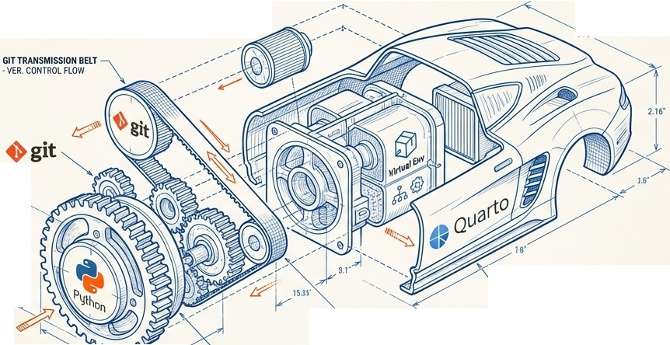
-+ +-
,1---------------------+----------------------17
The Modern Analyst's Toolkit
From Chaos to Clarity: The Architecture of Reproducible Research
VIRTUALENV HOUSINGUNIT �
DEPENDENCYISOLATIONCHAMBER\
REPRODUCIBLE
_,:r-, OUTPUT
s1s·IIY"
2.16'
�QUARTO OUTERCASING
PUBLISHINGFRAMEWORK &RENDERINGENGINE
DATA INPUT FLOW
'--
GIT TRANSMISSIONBELT
VER.CONTROLFLOW
3. �3.11'
'-- BASE GEAR ASSY
PYTHONv3.11
Understanding the *Why* Behind the Workflow: Quarto I Python I Environmental Architecture
�L+1
I'S\ Noteb+ookTLM

Slide 2
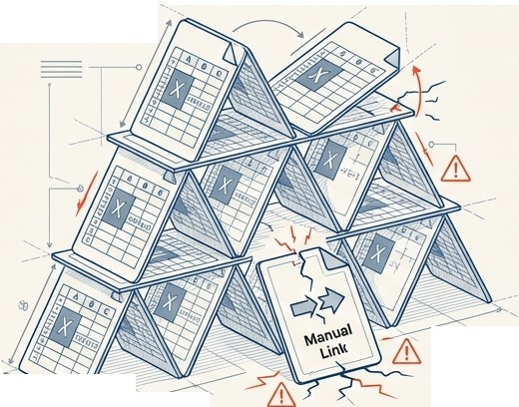
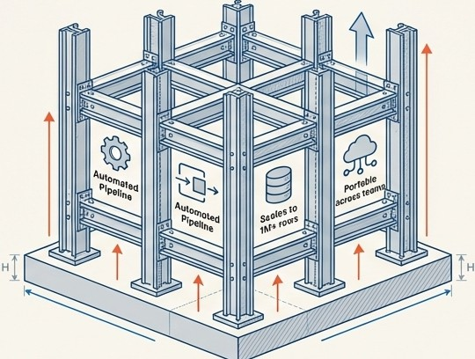

Moving Beyond ''It Works on My Machine''
The Ad-Hoc Method
Reproducible Research
""
--
-
-- .-
�
-
-- ' ---------•s:t.
-
"
Fragile links
Manual updates
Unsealable
Zero reproducibility
Version Controlled
Automated Pipeline
Scales to 1M+ rows
Portable across teams
1-
* � Core Concept: We build systems, not just spreadsheets. � * I
Jc1 1 ' ' I'S\ NotebookLM

Slide 3

The Cockpit: Your IDE (Cursor Al)
k_{I}
A
Why use an IDE?
1. Unified Interface:Edit code and manage files 1n one view.
-
000
�➔
p
I
IDg CD 08
'
19
p
X9
...
-
X
!> ID ...
V
,
2
>
[Q] r
>-
>-
3
4
-
(
(
..
Ouarto
•
•
l;>
>
5
•
-
•
1
�
8§>
••
2. Extensions:Tools like 'Quarto' for syntax highlighting and 'Live Preview' for real-time feedback.
)
Live Previ,ew
File Explorer•
o
Editor & Extensions
C �
H
•
,
,
}
A
,,,
Visualizing project structure
-
{
13
,.
(
..
,.
,
•
,,.
}₋
·-
,.
,.
20
)
I-
vllDliil�x
H
3.Analogy: If Python is the engine, the IDEis the dashboard and steering wheel.
D
B
®
H
€1
>
>
- -
-
0 @£0
0
:::J:s
H�
I,
:I
A
8
I
TheTerminal: Direct OS communication
*
L�L_..:
I• I I I I I I •I
.:._�.;_;
;_�_
_:
:_.:....:....;...!....;._;_;
...!:...
; ;_..!....;._.c...:....!.
;
:_; ;._;_.;...: ;.
;._; l,j;:;•;:,,:=-, I'S\ NotebookLM

Slide 4




Ground Zero: Navigating the File System
t
IC·/
-(
The Root) ...
• � ·····••····•·······
Absolute Path:
/
.·.•••••••• C:/Users/Student/Documents/your-portfolio/data.csv
�-------�-�
•·.• �···
(Breaks on other computers)
/
••••••••••••••
••• •••
....•···· ••••••1·u�ers/Student/DocumentsI
••••
•••
••••
••••••••••••••••••••••
•••••••
your-portfolio (The Working Directory)l
••
••••••
..•{
fcjata.CS� 4◄i-------
Relative Path: ./data.csv (Portable)
:.... ·•········•·....
..1f
•
•• • • ••• ••
I■⁻
i�i
N
Absolute Path: -·· • • • • • • • • • • • • • •
-
C:/Users/Student/Documents/your-portfolio/data.csv
-
Key,lnsight
BOX;
�
(Breaks on other computers)
IThe-;-Working Directory' is where your code
w�
�E
•
is currently standing. Always use relative
s
paths so your code works on any machine�
U::--------=--�
Isl\ NotebookLM

Slide 5
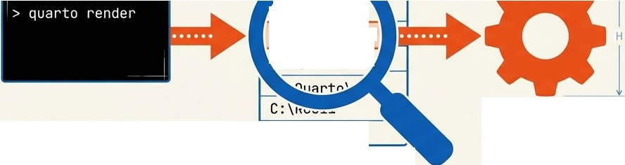


The Interface: Speaking the Computer's Language
The Terminal is not magic. It is a text-based method to execute programs.
---A--�
1I+-<--
H --➔1
---A---
ThePATH
An address book your computer uses to find
T
.;:\Python39
-
B
C:\Quarto\bin
1
programs. If you type
"::\Quarto\bir.
'quarto' and it fails, the
computer doesn't know where to look.
Executable Program
C:\Python39
Common Commands
PATH Environment Variable
"ls
/ dir": List files
cd : Change directory
11
11
1 1 1 1 1
�
I'S\ NotebookLM

Slide 6

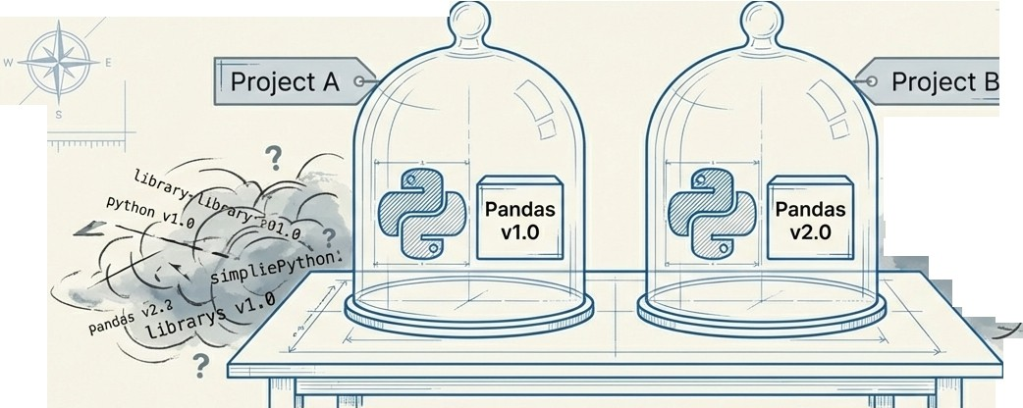


The Quarantine: Python Virtual Environments
-+
t
.
\
N
t.
Global Environment
/"" (Dependency Hell)
/
�
�
lbraryr•�1.�0�• �\
.....--..,_
,d.,-eC""�
l'I�0 �
--
\
,
)
-�
l • � J //))I
91obal y v₂.�\ •
2
ibrary
-(_�
Vl.0 -y--
../�V2.e
?
•
i
The Problem:
Different projects need different library versions.
Installing globally creates conflicts.
The Solution:
'venv'.
Aself-contained sandbox sandbox for each project.
^{r}ThCrietical Step: ACTIVATION. ^{il}
��rce venv/bin/activateI
�'il-
- �
inside the jar, not outside. * I
l_ Tells the terminal to look
.-----.
IE11 1 1 II;,\ NotebookLM

Slide 7




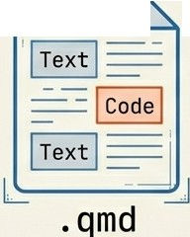





The Publisher: What is Quarto?
The Universal Document Converter r
N
□••• ₋
E
Quarto + Python Engine
/ 7
��
YAML Front Matter (Settings)
HTML
s
.A"O
h-,-,-l,11�1•1•�1111�11••�•"' �
--
7
IYAML
,--
�=-------�
•••••••••••
'==.-
r
L --�
executing...
Presentation
(Slides)
Quarto takes raw text and code, executes the logic, captures the results, and weaves them into professional documents.
YAML: The control panel at the top of your file that defines the output style.
,iE, ,
1 II;,\ NotebookLM

Slide 8

,I ,,
''
The Artist: Data Visualization as Code
r.
I
import matplotlib.pyplot as plt import matplotlib.pyplot as plt
Growth
30
= [1, 2,
3, �]
X
25
/
y = [10, 20, 25, 30]
plt.plot(x, y) plt.title('Growth') plt.show()
•••••
·V₋,
•
r
••
Rendered �
by Quarto
^{X}<(
20
�
>-
•
•••••
15
10
1
2
3
4
X-Axis
I
Matplotlib gives you granular control over every pixel. Unlike Excel, the chart is generated programmatically, making it reproducible instantly with new data.
I11111 111 111d11, I I
I
I
I
Is,\ NoteoookLM
111111111 111d1111 111111111
1 1d1n 11111 1 111

Slide 9
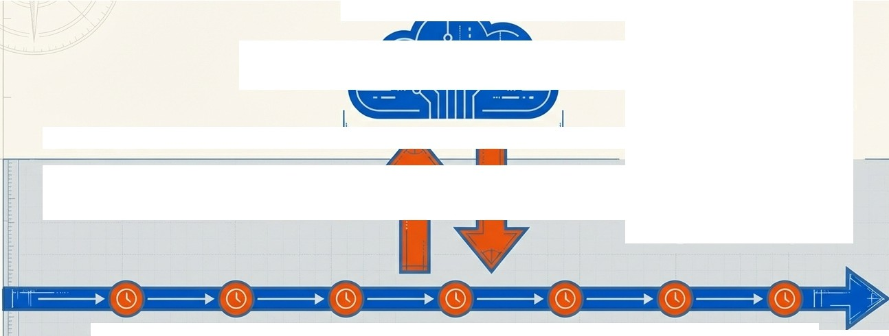


-- t ----
l -
-
-
The Time Machine: Git & GitHub
r
GitHub
(Remote)
7
Git: The tool that tracks changes and creates save points.
GitHub: The platform that hosts the backup and enables collaboration.
Commit: Saving a snapshot locally.
The Cloud
Lott layer
Push
(Sync/Upload)
Clone
(Download)
Commit
Commit
Commit Commit Commit
Git Database (Local)
Commit
Commit
i<
,1 1 • I'S\ NotebookLM

Slide 10





The Cycle of Development
l
l
Activate venv
Repeat for every insight.
Commit & Push
to GitHub
Write Code in .qmd
( • d
Preview HTML output
l
t
1
In,d 111 111d11 I
I 11 11111
I
I
I
lsll NotebookLM
111111111 111,I 111
11 di 111111111 111

Slide 11
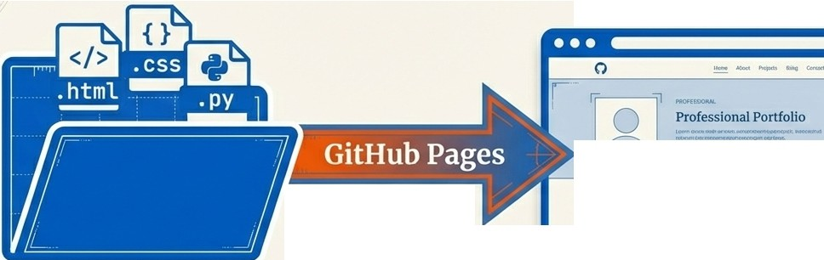





-
- --
J.
The Product: GitHub Pages
., ._=.I
041·8 < o.-.., )
J
Hosting
Project Showcase
A repository is just code. GitHub Pages turns that code into a live website.
Value: Instant credibility. A live URL is a product; a file attachment is just homework.
Configuration: Settings
> Pages > Source: Deploy from Main Branch / Root.
1
t
1
�
1,,,,1,,,I,, ,1,,, l1111l,,,,1,,,.1,,,I,, 1,,,,1,,
,1,,.,f,:,�t��kLM

Slide 12


1
Troubleshooting Checklist: When Things Break
o,
1····· ·····7
: D Error: ''Module not found''
1
Fix: Did you activate the venv? Is your IDE interpreter set
to .\venv\Scripts\python.exe?
D Error: ''Quarto command not found''
.
Fix: Is Quarto in your PATH variable? Restart the terminal.
D Error: ''Script disabled'' (PowerShell)
Fix: Run Set-ExecutionPolicy RemoteSigned.
: D Error: ''Changes not visible online''
: ,
Fix: Did you Commit AND Push? (Committing is local only). : ..
� L ....The setup is the hardest part. Errors are part of the process.... _j
.
t
1

Slide 13
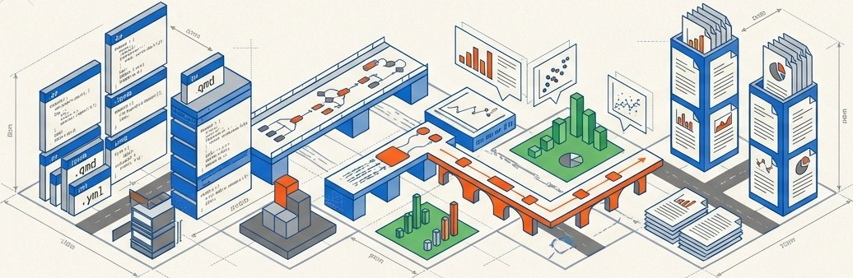

150
100
₋-
₋-
1111111111
You Are Now an Architect
You haven't just installed software. You have built a professional analytics infrastructure.
The Inventory
Repository Management (GitHub)
Isolated Environments (Venv)
Automated Reporting (Quarto)
Programmatic Visualization (Matplotlib)
Trust the process. The infrastructure is built. Now, go build the analysis.
II I I I
j IHI 111111 I
Isl\ NotebookLM
120
50

