Slide 1
Is Toronto a reasonable place to open a coffee shop?
Capstone Project

Slide 2

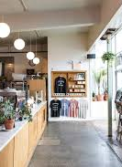
Introduction
Need to determine if Toronto is a reasonable candidate for a new coffee shop location
To do this:
Need to compare it to other cities as well as to look at the current location and distribution of current coffee businesses.
Number and density of coffee shops in the city were assessed in addition to making comparisons to other cities.

Slide 3
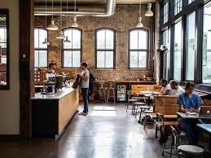
Data
Used the FourSquare API to collect data about locations of coffee stores in 5 major cities:
Toronto, ON,
New York, NY,
San Francisco, CA,
Boston, MA and
Portland, OR.
These are some of the most populated cities and each have a strong “coffee culture.”

Slide 4
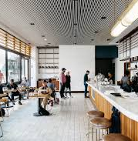
methodology
My main target here is to assess which city would have the highest coffee shop density.
Density calculated by looking at mean distances from mean location of all shops within a city

Slide 5
Results
For our initial visual inspection we see that they all have multiple coffee shops and often more than Foursquare would like to supply us. The following geoplots were generated with folium(only top 3 shown here)…

Slide 6
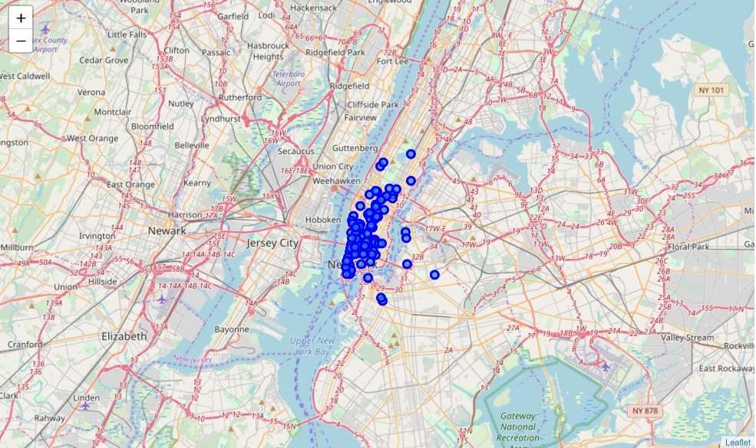
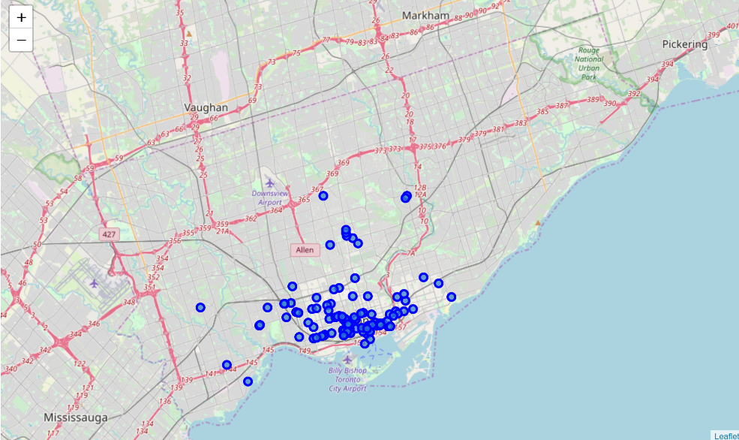
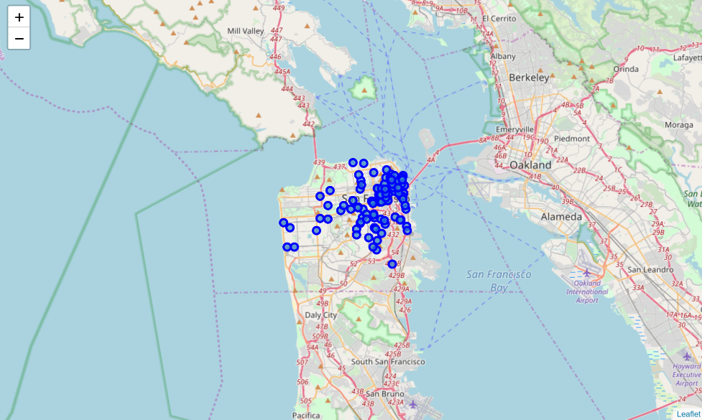
NY ->Toronto ->SF

Slide 7
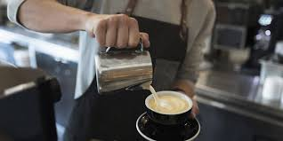
Results
Most dense to least dense (in terms of coffee shops in each city) ranking:
New York
San Francisco
Boston
Toronto
Portland

Slide 8
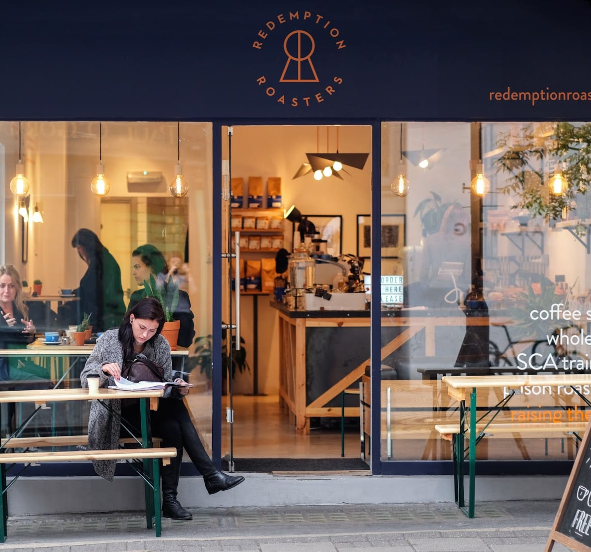
discussion
Since some cities had what appeared to be outliers (shops far away from the core densities)
Outliers needed to be removed to assess influence
When 10% of the furthest shops were removed from the calculations, Portland moved from #5 to #3.

Slide 9
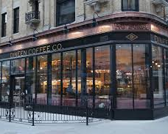
conclusion
It appears that with more research, Toronto could be a reasonable location for a new coffee shop. With lower densities than similar cities, there is likely a place that could serve as a niche for a new shop.

