Slide 1
Text Processing and Pipelines
LESSON 08
Introduction to Linux
Concepts, demonstrations, and guided practice
Linux Introduction / Lesson 8
1
Notes:
Source: lesson-08-text-processing-pipelines.md
Linux commands often report useful information as lines of text. Text-processing tools can select relevant lines, choose fields, normalize values, count repeats, and summarize results. This lesson builds on the streams and pipeline basics from Lesson 2 and applies them to small, predictable data files. Students will construct a report in short, inspectable stages rather than rely on a long command they cannot explain.

Slide 2
Learning goals
01
Explain how standard input, standard output, and standard error flow through redirection and pipelines
02
Filter lines with grep and select fields with cut or introductory awk
03
Sort and count values with sort and uniq
04
Count lines with wc and transform characters with tr
Linux Introduction / Lesson 8
2
Notes:
Source: lesson-08-text-processing-pipelines.md
By the end of the lesson, students will be able to:
- explain how standard input, standard output, and standard error flow through redirection and pipelines;
- filter lines with `grep` and select fields with `cut` or introductory `awk`;
- sort and count values with `sort` and `uniq`;
- count lines with `wc` and transform characters with `tr`;
- make simple, non-destructive substitutions with `sed`;
- build and explain a short pipeline one stage at a time;
- redirect results to a new lab report without overwriting source data; and
- recognize when simple text tools are unsuitable for fully quoted CSV.

Slide 3
Learning goals continued
01
Make simple, non-destructive substitutions with sed
02
Build and explain a short pipeline one stage at a time
03
Redirect results to a new lab report without overwriting source data
04
Recognize when simple text tools are unsuitable for fully quoted CSV.
Linux Introduction / Lesson 8
3
Notes:
Source: lesson-08-text-processing-pipelines.md
By the end of the lesson, students will be able to:
- explain how standard input, standard output, and standard error flow through redirection and pipelines;
- filter lines with `grep` and select fields with `cut` or introductory `awk`;
- sort and count values with `sort` and `uniq`;
- count lines with `wc` and transform characters with `tr`;
- make simple, non-destructive substitutions with `sed`;
- build and explain a short pipeline one stage at a time;
- redirect results to a new lab report without overwriting source data; and
- recognize when simple text tools are unsuitable for fully quoted CSV.

Slide 4
Practice boundaries
01
Use only the course workspace, approved VM, or prepared examples.
02
Stay within this lesson’s stated targets and permitted actions.
03
Pause when output or the intended effect is unclear.
Linux Introduction / Lesson 8
4
Notes:
Source: lesson-08-text-processing-pipelines.md
Work only in `~/lesson8-lab` or the instructor-provided practice directory. Use a small sample file with simple comma-delimited fields and no embedded commas. Do not use `sudo`, edit system logs, alter source data in place, or run a pipeline against large or sensitive files. Use a new output filename for every redirected result. Remember that `>` replaces an existing destination.

Slide 5
Text streams and files
01
A pipe passes stdout to the next command’s stdin.
02
Standard error stays separate unless redirected.
03
Preserve the source and choose a new report filename.
Linux Introduction / Lesson 8
5
Notes:
Source: lesson-08-text-processing-pipelines.md
## 1. Text streams are a useful interface
Many Linux commands communicate with readable text. A command can receive text through **standard input**, print normal results to **standard output**, and print diagnostic messages to **standard error**. Lesson 2 introduced these streams and the shell operators that connect them. Here, we use those connections to answer questions about logs and small delimited files.
A **pipeline** connects one command's standard output to the next command's standard input with `|`. Each command should do one understandable task. When a result is surprising, run the stages separately and inspect intermediate output. Pipelines are easier to troubleshoot when they are short, fields are understood, and results are checked before being saved.

Slide 6
Line selection with grep
01
grep selects matching lines. -i ignores case.
02
-n adds line numbers. -v selects nonmatching lines.
03
No matches can be expected and produce a nonzero status.
Linux Introduction / Lesson 8
6
Notes:
Source: lesson-08-text-processing-pipelines.md
## 2. Redirect input and output carefully
The shell reads input from a file with `<`, replaces a file's contents with `>`, and appends to a file with `>>`. Standard error can be redirected with `2>`. Lesson 2 introduced these forms; this lesson uses them to feed known data to tools and create a report.
```bash
wc -l < service-log.csv
grep -i 'error' service-log.csv > errors.txt
printf 'Reviewed service log\n' >> summary.txt
```
`>` replaces the destination's existing contents. Choose a new, disposable output filename and confirm that it is the intended target before using it. `>>` appends and can grow a file each time it runs. Keep original lab data separate from generated results. Redirection does not make a command safe; understand the command first.

Slide 7
Sorting and counting
01
sort groups equal lines. sort -n compares numeric values.
02
uniq -c counts adjacent repeated lines.
03
Headers also count unless handled deliberately.
Linux Introduction / Lesson 8
7
Notes:
Source: lesson-08-text-processing-pipelines.md
## 3. Select lines with `grep`
`grep` prints lines that match a search pattern. A basic literal search can find a status or message in a log:
```bash
grep 'ERROR' service-log.csv
```
Use `-i` to ignore letter case, `-n` to display line numbers, and `-v` to select lines that do not match. For example, `grep -in 'error' service-log.csv` finds case-insensitive matches and includes line numbers. `grep -v 'INFO' service-log.csv` shows lines that do not contain that text.
By default, `grep` patterns use basic regular-expression rules, so some punctuation has special meaning. For a beginner exercise, choose simple words without regular-expression punctuation. A result with no matching lines is not automatically a system error: `grep` returns a nonzero status when there are no matches. Check the pattern and data before changing the command.

Slide 8
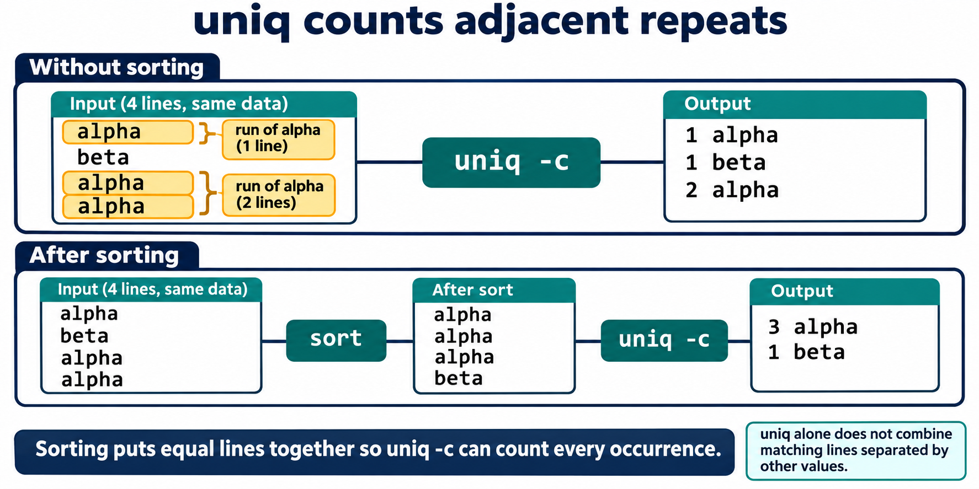
Lesson 8 / Figure 8.1
8
Notes:
Source: lesson-08-text-processing-pipelines.md
Image: graphics\lesson-08\01-sort-before-uniq.png
Figure 8.1. uniq -c counts runs of adjacent equal lines. Sorting groups all equal lines together, allowing one count for each distinct value. This four-line example is separate from the service log.
# Lesson 8 graphics
[Course graphics index](../README.md) · [Source chapter](../../lesson-08-text-processing-pipelines.md)
Production: AI-generated illustrations using the built-in image_gen tool, continuing the course's navy, teal, and amber style. All figures are drafts for instructional review.
## Figure 8.1 — uniq counts adjacent repeats
![For alpha, beta, alpha, alpha, uniq -c reports separate runs: one alpha, one beta, and two alpha. Sorting first produces alpha, alpha, alpha, beta, allowing uniq -c to report three alpha and one beta.](01-sort-before-uniq.png)
- **Placement:** Section 4, after the explanation of sorting before counting and handling the header.
- **Learning purpose:** Make adjacency visible and explain why separated duplicates remain separate without sorting.
- **Caption:** **Figure 8.1.** `uniq -c` counts runs of adjacent equal lines. Sorting groups all equal lines together, allowing one count for each distinct value. This four-line example is separate from the service log.
- **Alt text:** For alpha, beta, alpha, alpha, uniq -c reports separate runs: one alpha, one beta, and two alpha. Sorting first produces alpha, alpha, alpha, beta, allowing uniq -c to report three alpha and one beta.
- **Prompt:** [01-generation-prompt.txt](01-generation-prompt.txt).
- **Review note:** Sorting changes input order and follows the current locale. For these simple lowercase values, the shown ordering is expected. Counts omit uniq's display padding. Both branches must begin with identical data and preserve all four occurrences.
## Figure 8.2 — Know the fields before selecting them
![A simple log row has fields timestamp, service, status, and message. cut -d, -f2 and awk -F, with print $2 both select search from this row. A quoted CSV message containing a comma illustrates why splitting at every comma is not complete CSV parsing.](02-fields-and-csv-limits.png)
- **Placement:** Section 5, after the explanation of cut and quoted CSV limitations.
- **Learning purpose:** Connect field numbers and delimiters to the sample record and distinguish simple field splitting from CSV parsing.
- **Caption:** **Figure 8.2.** Number fields from one and identify the delimiter before selecting data. Both examples select the service field from this simple row. Quoted CSV can contain commas inside a single field, so `cut` and basic `awk -F,` are not general CSV parsers.
- **Alt text:** A simple log row has fields timestamp, service, status, and message. cut -d, -f2 and awk -F, with print $2 both select search from this row. A quoted CSV message containing a comma illustrates why splitting at every comma is not complete CSV parsing.
- **Prompt:** [02-generation-prompt.txt](02-generation-prompt.txt).
- **Review note:** Output shown is for the single example row, not the complete lab file. The full commands also process the header. The quoted-comma caution demonstrates record-parsing limitations; it does not imply that selecting field 2 fails for that particular record. The chapter introduces awk syntax in Section 8; this preview connects its shared field-selection role.
## Figure 8.3 — Build the error report one stage at a time
![grep -i selects the three error rows in the lab service log. cut extracts search, search, storage; sort keeps these grouped; uniq -c produces two search and one storage. Each stage's output becomes the next stage's input.](03-error-report-pipeline.png)
- **Placement:** Section 9, after the explanation of the focused error-service pipeline and before the warning about obscured errors.
- **Learning purpose:** Trace actual intermediate text and verify the sample's error counts.
- **Caption:** **Figure 8.3.** Filter matching rows, select service names, group equal values, then count them. The lab data contains three case-insensitive error matches: two for `search` and one for `storage`. Inspect intermediate output before saving a report.
- **Alt text:** grep -i selects the three error rows in the lab service log. cut extracts search, search, storage; sort keeps these grouped; uniq -c produces two search and one storage. Each stage's output becomes the next stage's input.
- **Prompt:** [03-generation-prompt.txt](03-generation-prompt.txt).
- **Review note:** The pattern matches error anywhere in a row, not a specific numeric status or field. The header is excluded here because it does not match. The selected service names already happen to be sorted; keep sort to ensure reliable adjacency for other input orders. Standard error is separate from a normal pipe, and output alone does not prove every command succeeded.

Slide 9
Simple field selection
01
cut -d, -f2 selects field 2 using comma as delimiter.
02
awk -F, can select fields with a small action.
03
Basic delimiter splitting does not interpret quoted CSV commas.
Linux Introduction / Lesson 8
9
Notes:
Source: lesson-08-text-processing-pipelines.md
## 4. Sort values and count repeated lines
`sort` arranges input lines. By default it sorts text according to the current locale; `sort -n` sorts numeric values and `sort -r` reverses the order. For example, `sort -nr` displays numeric values from largest to smallest.
`uniq` identifies adjacent repeated lines. To count repeated values throughout a file, sort the values first, then use `uniq -c`:
```bash
cut -d, -f3 service-log.csv | sort | uniq -c
```
This selects the third comma-delimited field, sorts those values so equal statuses are adjacent, then prints each distinct line with its count. The header is a value too, so the output may include `status`; remove or handle the header deliberately if it should not be counted. `sort -u` can produce unique sorted lines, but `uniq -c` is needed when counts matter.
![For alpha, beta, alpha, alpha, uniq -c reports separate runs: one alpha, one beta, and two alpha. Sorting first produces alpha, alpha, alpha, beta, allowing uniq -c to report three alpha and one beta.](graphics/lesson-08/01-sort-before-uniq.png)
**Figure 8.1.** `uniq -c` counts runs of adjacent equal lines. Sorting groups all equal lines together, allowing one count for each distinct value. This four-line example is separate from the service log.

Slide 10
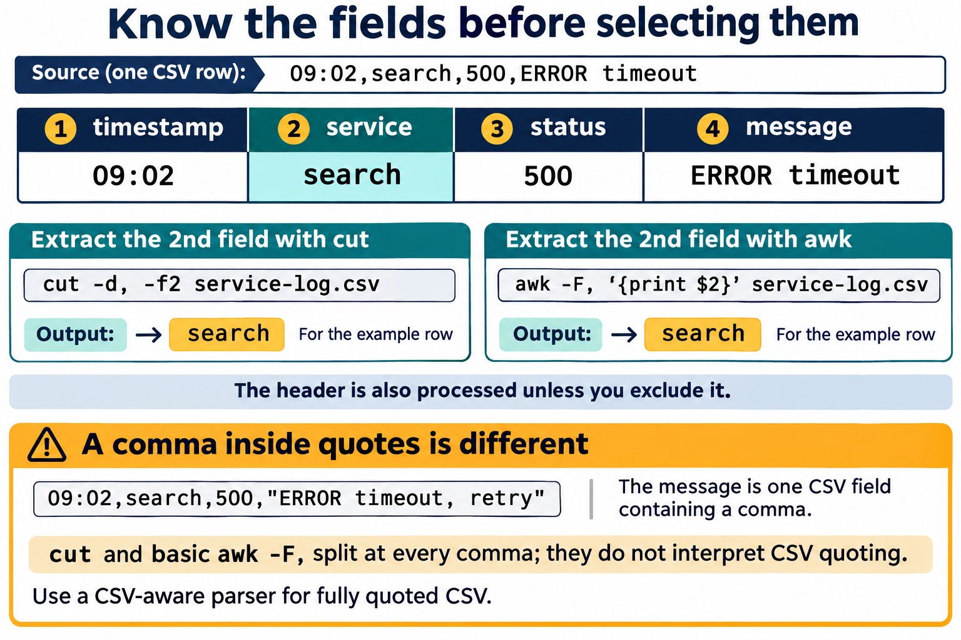
Lesson 8 / Figure 8.2
10
Notes:
Source: lesson-08-text-processing-pipelines.md
Image: graphics\lesson-08\02-fields-and-csv-limits.png
Figure 8.2. Number fields from one and identify the delimiter before selecting data. Both examples select the service field from this simple row. Quoted CSV can contain commas inside a single field, so cut and basic awk -F, are not general CSV parsers.
# Lesson 8 graphics
[Course graphics index](../README.md) · [Source chapter](../../lesson-08-text-processing-pipelines.md)
Production: AI-generated illustrations using the built-in image_gen tool, continuing the course's navy, teal, and amber style. All figures are drafts for instructional review.
## Figure 8.1 — uniq counts adjacent repeats
![For alpha, beta, alpha, alpha, uniq -c reports separate runs: one alpha, one beta, and two alpha. Sorting first produces alpha, alpha, alpha, beta, allowing uniq -c to report three alpha and one beta.](01-sort-before-uniq.png)
- **Placement:** Section 4, after the explanation of sorting before counting and handling the header.
- **Learning purpose:** Make adjacency visible and explain why separated duplicates remain separate without sorting.
- **Caption:** **Figure 8.1.** `uniq -c` counts runs of adjacent equal lines. Sorting groups all equal lines together, allowing one count for each distinct value. This four-line example is separate from the service log.
- **Alt text:** For alpha, beta, alpha, alpha, uniq -c reports separate runs: one alpha, one beta, and two alpha. Sorting first produces alpha, alpha, alpha, beta, allowing uniq -c to report three alpha and one beta.
- **Prompt:** [01-generation-prompt.txt](01-generation-prompt.txt).
- **Review note:** Sorting changes input order and follows the current locale. For these simple lowercase values, the shown ordering is expected. Counts omit uniq's display padding. Both branches must begin with identical data and preserve all four occurrences.
## Figure 8.2 — Know the fields before selecting them
![A simple log row has fields timestamp, service, status, and message. cut -d, -f2 and awk -F, with print $2 both select search from this row. A quoted CSV message containing a comma illustrates why splitting at every comma is not complete CSV parsing.](02-fields-and-csv-limits.png)
- **Placement:** Section 5, after the explanation of cut and quoted CSV limitations.
- **Learning purpose:** Connect field numbers and delimiters to the sample record and distinguish simple field splitting from CSV parsing.
- **Caption:** **Figure 8.2.** Number fields from one and identify the delimiter before selecting data. Both examples select the service field from this simple row. Quoted CSV can contain commas inside a single field, so `cut` and basic `awk -F,` are not general CSV parsers.
- **Alt text:** A simple log row has fields timestamp, service, status, and message. cut -d, -f2 and awk -F, with print $2 both select search from this row. A quoted CSV message containing a comma illustrates why splitting at every comma is not complete CSV parsing.
- **Prompt:** [02-generation-prompt.txt](02-generation-prompt.txt).
- **Review note:** Output shown is for the single example row, not the complete lab file. The full commands also process the header. The quoted-comma caution demonstrates record-parsing limitations; it does not imply that selecting field 2 fails for that particular record. The chapter introduces awk syntax in Section 8; this preview connects its shared field-selection role.
## Figure 8.3 — Build the error report one stage at a time
![grep -i selects the three error rows in the lab service log. cut extracts search, search, storage; sort keeps these grouped; uniq -c produces two search and one storage. Each stage's output becomes the next stage's input.](03-error-report-pipeline.png)
- **Placement:** Section 9, after the explanation of the focused error-service pipeline and before the warning about obscured errors.
- **Learning purpose:** Trace actual intermediate text and verify the sample's error counts.
- **Caption:** **Figure 8.3.** Filter matching rows, select service names, group equal values, then count them. The lab data contains three case-insensitive error matches: two for `search` and one for `storage`. Inspect intermediate output before saving a report.
- **Alt text:** grep -i selects the three error rows in the lab service log. cut extracts search, search, storage; sort keeps these grouped; uniq -c produces two search and one storage. Each stage's output becomes the next stage's input.
- **Prompt:** [03-generation-prompt.txt](03-generation-prompt.txt).
- **Review note:** The pattern matches error anywhere in a row, not a specific numeric status or field. The header is excluded here because it does not match. The selected service names already happen to be sorted; keep sort to ensure reliable adjacency for other input orders. Standard error is separate from a normal pipe, and output alone does not prove every command succeeded.

Slide 11
Character and text transformations
01
tr transforms individual characters from standard input.
02
sed substitutes text in displayed output.
03
The lab avoids in-place editing and checks transformed copies.
Linux Introduction / Lesson 8
11
Notes:
Source: lesson-08-text-processing-pipelines.md
## 5. Count lines and select simple fields
`wc` counts lines, words, and bytes. Its options select a count: `wc -l` for lines, `wc -w` for words, and `wc -c` for bytes. With input redirection, `wc -l < service-log.csv` prints only the line count rather than repeating the filename. A header is included in the total.
`cut` selects columns or character positions from each line. For a simple comma-delimited file, `cut -d, -f2` selects the second field. `-d` names the delimiter and `-f` names the field number. `cut` does not parse general CSV quoting rules: if a value contains a quoted comma, use a CSV-aware tool instead of assuming every comma separates a field.
![A simple log row has fields timestamp, service, status, and message. cut -d, -f2 and awk -F, with print $2 both select search from this row. A quoted CSV message containing a comma illustrates why splitting at every comma is not complete CSV parsing.](graphics/lesson-08/02-fields-and-csv-limits.png)
**Figure 8.2.** Number fields from one and identify the delimiter before selecting data. Both examples select the service field from this simple row. Quoted CSV can contain commas inside a single field, so `cut` and basic `awk -F,` are not general CSV parsers.

Slide 12
A report pipeline
01
Filter relevant rows before extracting the service field.
02
Sort service names, then count their adjacent repeats.
03
Compare intermediate outputs and final counts with the sample data.
Linux Introduction / Lesson 8
12
Notes:
Source: lesson-08-text-processing-pipelines.md
## 6. Transform characters with `tr`
`tr` translates or deletes individual characters from standard input. For example:
```bash
tr '[:lower:]' '[:upper:]' < labels.txt
```
This prints an uppercase version without modifying `labels.txt`. `tr` works on characters, not words or fields. First display a transformation and confirm it before redirecting its result to a new file.

Slide 13
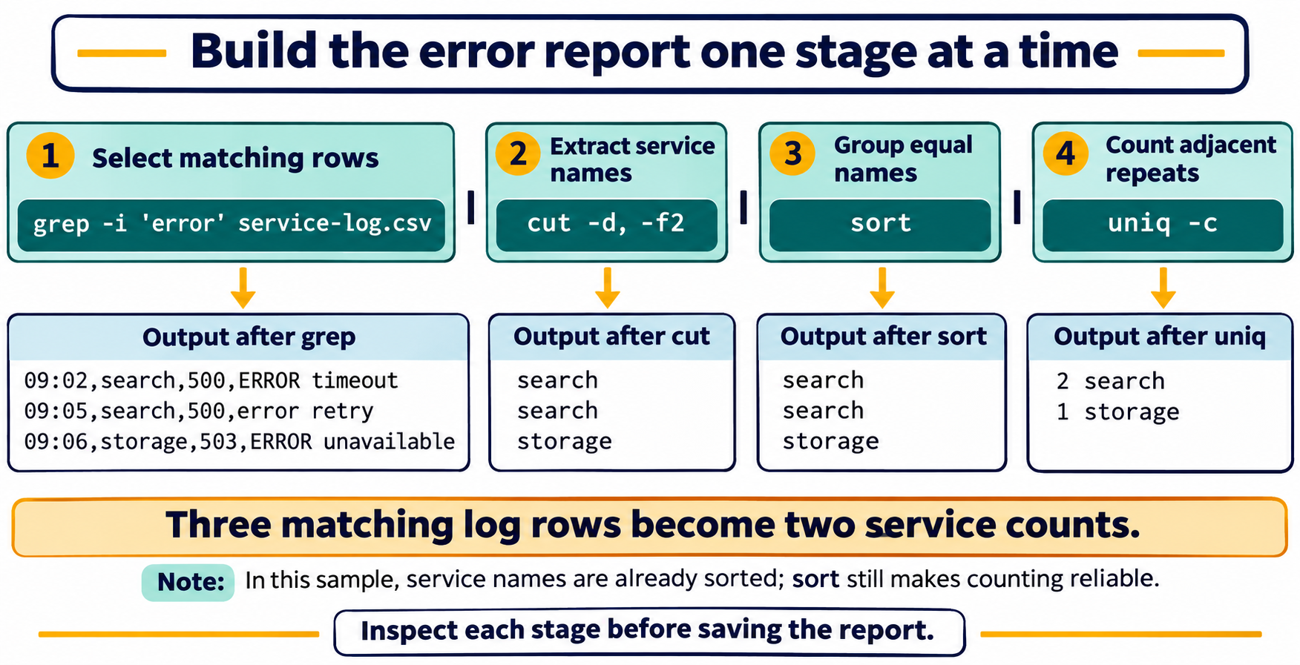
Lesson 8 / Figure 8.3
13
Notes:
Source: lesson-08-text-processing-pipelines.md
Image: graphics\lesson-08\03-error-report-pipeline.png
Figure 8.3. Filter matching rows, select service names, group equal values, then count them. The lab data contains three case-insensitive error matches: two for search and one for storage. Inspect intermediate output before saving a report.
# Lesson 8 graphics
[Course graphics index](../README.md) · [Source chapter](../../lesson-08-text-processing-pipelines.md)
Production: AI-generated illustrations using the built-in image_gen tool, continuing the course's navy, teal, and amber style. All figures are drafts for instructional review.
## Figure 8.1 — uniq counts adjacent repeats
![For alpha, beta, alpha, alpha, uniq -c reports separate runs: one alpha, one beta, and two alpha. Sorting first produces alpha, alpha, alpha, beta, allowing uniq -c to report three alpha and one beta.](01-sort-before-uniq.png)
- **Placement:** Section 4, after the explanation of sorting before counting and handling the header.
- **Learning purpose:** Make adjacency visible and explain why separated duplicates remain separate without sorting.
- **Caption:** **Figure 8.1.** `uniq -c` counts runs of adjacent equal lines. Sorting groups all equal lines together, allowing one count for each distinct value. This four-line example is separate from the service log.
- **Alt text:** For alpha, beta, alpha, alpha, uniq -c reports separate runs: one alpha, one beta, and two alpha. Sorting first produces alpha, alpha, alpha, beta, allowing uniq -c to report three alpha and one beta.
- **Prompt:** [01-generation-prompt.txt](01-generation-prompt.txt).
- **Review note:** Sorting changes input order and follows the current locale. For these simple lowercase values, the shown ordering is expected. Counts omit uniq's display padding. Both branches must begin with identical data and preserve all four occurrences.
## Figure 8.2 — Know the fields before selecting them
![A simple log row has fields timestamp, service, status, and message. cut -d, -f2 and awk -F, with print $2 both select search from this row. A quoted CSV message containing a comma illustrates why splitting at every comma is not complete CSV parsing.](02-fields-and-csv-limits.png)
- **Placement:** Section 5, after the explanation of cut and quoted CSV limitations.
- **Learning purpose:** Connect field numbers and delimiters to the sample record and distinguish simple field splitting from CSV parsing.
- **Caption:** **Figure 8.2.** Number fields from one and identify the delimiter before selecting data. Both examples select the service field from this simple row. Quoted CSV can contain commas inside a single field, so `cut` and basic `awk -F,` are not general CSV parsers.
- **Alt text:** A simple log row has fields timestamp, service, status, and message. cut -d, -f2 and awk -F, with print $2 both select search from this row. A quoted CSV message containing a comma illustrates why splitting at every comma is not complete CSV parsing.
- **Prompt:** [02-generation-prompt.txt](02-generation-prompt.txt).
- **Review note:** Output shown is for the single example row, not the complete lab file. The full commands also process the header. The quoted-comma caution demonstrates record-parsing limitations; it does not imply that selecting field 2 fails for that particular record. The chapter introduces awk syntax in Section 8; this preview connects its shared field-selection role.
## Figure 8.3 — Build the error report one stage at a time
![grep -i selects the three error rows in the lab service log. cut extracts search, search, storage; sort keeps these grouped; uniq -c produces two search and one storage. Each stage's output becomes the next stage's input.](03-error-report-pipeline.png)
- **Placement:** Section 9, after the explanation of the focused error-service pipeline and before the warning about obscured errors.
- **Learning purpose:** Trace actual intermediate text and verify the sample's error counts.
- **Caption:** **Figure 8.3.** Filter matching rows, select service names, group equal values, then count them. The lab data contains three case-insensitive error matches: two for `search` and one for `storage`. Inspect intermediate output before saving a report.
- **Alt text:** grep -i selects the three error rows in the lab service log. cut extracts search, search, storage; sort keeps these grouped; uniq -c produces two search and one storage. Each stage's output becomes the next stage's input.
- **Prompt:** [03-generation-prompt.txt](03-generation-prompt.txt).
- **Review note:** The pattern matches error anywhere in a row, not a specific numeric status or field. The header is excluded here because it does not match. The selected service names already happen to be sorted; keep sort to ensure reliable adjacency for other input orders. Standard error is separate from a normal pipe, and output alone does not prove every command succeeded.

Slide 14
Demonstration 1
Before running: explain the target, effect, and permitted scope
grep -in 'error' service-log.csv
grep -v 'INFO' service-log.csv
Predict the result, inspect the output, and explain what it establishes
Linux Introduction / Lesson 8
14
Notes:
Source: lesson-08-text-processing-pipelines.md
## Demonstration 1: Inspect the sample file
Create or open the prepared `service-log.csv` and inspect its header and rows with `cat` or `less`. Confirm that it has four comma-separated fields and no values containing commas. Ask students which field identifies the service and status before using a command.
## Demonstration 2: Find matching and nonmatching lines
```bash
grep -in 'error' service-log.csv
grep -v 'INFO' service-log.csv
```
Compare selected lines with the source. Explain `-i`, `-n`, and `-v`. Try a pattern that is absent and discuss the empty result and nonzero exit status.
## Demonstration 3: Count status values step by step
Run each stage separately, then connect them:
```bash
cut -d, -f3 service-log.csv
cut -d, -f3 service-log.csv | sort
cut -d, -f3 service-log.csv | sort | uniq -c
cut -d, -f3 service-log.csv | sort | uniq -c | sort -nr
```
Ask what the header contributes to the count. Have students predict the final order before running the last command.
## Demonstration 4: Compare simple field tools
```bash
cut -d, -f2 service-log.csv
awk -F, '{print $2}' service-log.csv
```
Both examples select the second field in this simple file. Explain that `awk` can add conditions and calculations, but more complex is not automatically better for one-field selection. Neither example is a complete CSV parser.
## Demonstration 5: Transform output without editing the source
```bash
tr '[:lower:]' '[:upper:]' < service-log.csv
sed 's/ERROR/ISSUE/g' service-log.csv
```
Confirm that displayed transformations leave the original file unchanged. If saving a result, use a fresh filename in the lab directory.

Slide 15
Demonstration 2
Before running: explain the target, effect, and permitted scope
cut -d, -f3 service-log.csv
cut -d, -f3 service-log.csv | sort
cut -d, -f3 service-log.csv | sort | uniq -c
cut -d, -f3 service-log.csv | sort | uniq -c | sort -nr
Predict the result, inspect the output, and explain what it establishes
Linux Introduction / Lesson 8
15
Notes:
Source: lesson-08-text-processing-pipelines.md
## Demonstration 1: Inspect the sample file
Create or open the prepared `service-log.csv` and inspect its header and rows with `cat` or `less`. Confirm that it has four comma-separated fields and no values containing commas. Ask students which field identifies the service and status before using a command.
## Demonstration 2: Find matching and nonmatching lines
```bash
grep -in 'error' service-log.csv
grep -v 'INFO' service-log.csv
```
Compare selected lines with the source. Explain `-i`, `-n`, and `-v`. Try a pattern that is absent and discuss the empty result and nonzero exit status.
## Demonstration 3: Count status values step by step
Run each stage separately, then connect them:
```bash
cut -d, -f3 service-log.csv
cut -d, -f3 service-log.csv | sort
cut -d, -f3 service-log.csv | sort | uniq -c
cut -d, -f3 service-log.csv | sort | uniq -c | sort -nr
```
Ask what the header contributes to the count. Have students predict the final order before running the last command.
## Demonstration 4: Compare simple field tools
```bash
cut -d, -f2 service-log.csv
awk -F, '{print $2}' service-log.csv
```
Both examples select the second field in this simple file. Explain that `awk` can add conditions and calculations, but more complex is not automatically better for one-field selection. Neither example is a complete CSV parser.
## Demonstration 5: Transform output without editing the source
```bash
tr '[:lower:]' '[:upper:]' < service-log.csv
sed 's/ERROR/ISSUE/g' service-log.csv
```
Confirm that displayed transformations leave the original file unchanged. If saving a result, use a fresh filename in the lab directory.

Slide 16
Guided lab
01
Create and inspect the supplied service-log.csv data.
02
Run each filtering and counting stage separately.
03
Save a fresh report and confirm counts against the original rows.
Linux Introduction / Lesson 8
16
Notes:
Source: lesson-08-text-processing-pipelines.md
# Student lab: Lesson 8 — Text Processing and Pipelines
## Safety and scope
Work only in `~/lesson8-lab` or the instructor-provided practice directory. Use a small sample file with simple comma-delimited fields and no embedded commas. Do not use `sudo`, edit system logs, alter source data in place, or run a pipeline against large or sensitive files. Use a new output filename for every redirected result. Remember that `>` replaces an existing destination.
## Part A: Create and inspect sample data
Create `service-log.csv` in the practice directory with a text editor:
```text
timestamp,service,status,message
09:00,portal,200,request complete
09:02,search,500,ERROR timeout
09:03,portal,200,request complete
09:05,search,500,error retry
09:06,storage,503,ERROR unavailable
09:08,portal,404,missing page
09:10,storage,200,recovered
```
Inspect the file. Count its rows, including the header, and identify the field number for service, status, and message.
## Part B: Filter and count
Find the error rows with a case-insensitive search. Select the service field and count how many error rows belong to each service:
```bash
grep -i 'error' service-log.csv
grep -i 'error' service-log.csv | cut -d, -f2
grep -i 'error' service-log.csv | cut -d, -f2 | sort | uniq -c
```
Run each line separately. Record the number of selected rows and service counts. Explain why the pipeline starts with `grep` and ends with `uniq -c`.
## Part C: Summarize status values
Select field 3, sort the values, count duplicates, then sort the counts from highest to lowest:
```bash
cut -d, -f3 service-log.csv | sort | uniq -c | sort -nr
```
The header contributes the word `status` to the output. Add `grep -v '^status$'` to exclude that exact line and compare the result. Describe what each stage contributes.
## Part D: Count and transform
Compare total rows, including the header, with the number of matching error lines:
```bash
wc -l < service-log.csv
grep -i 'error' service-log.csv | wc -l
```
Print the file in uppercase and make a non-destructive substitution in displayed output:
```bash
tr '[:lower:]' '[:upper:]' < service-log.csv
sed 's/ERROR/ISSUE/g' service-log.csv
```
The original sample should remain unchanged. Explain how you can tell.
## Part E: Select fields with `awk`
Print service and status fields from each row:
```bash
awk -F, '{print $2, $3}' service-log.csv
```
The header is printed too. Modify the command so the action only runs when `NR > 1`. Explain that `NR` is the current input record number.
## Part F: Save a concise report
Use one new report file inside the practice directory. First save a heading, then append the error service counts:
```bash
printf 'Error counts by service\n' > error-summary.txt
grep -i 'error' service-log.csv | cut -d, -f2 | sort | uniq -c >> error-summary.txt
```
Read the report and verify that the counts match Part B. Explain why the first command uses `>` and the second uses `>>`. If the destination exists and contains work you need, choose another new filename.
## Part G: Explain and reflect
Write a short explanation of your report pipeline. Name each stage, its input, and its output. Then answer:
1. Why must values be sorted before `uniq -c` can reliably count all repeats?
2. Why does `cut -d, -f2` have limitations with fully quoted CSV?
3. What happens if a report command uses `>` on an existing file?
4. What should you do if a pipeline result is unexpected?
5. How can an early-stage error be obscured by later stages in a pipeline?
## Lab success criteria
- The student identifies the sample file's fields and header.
- The student finds error lines without changing source data.
- The student explains each stage of a multi-command pipeline.
- The student obtains correct status and service counts and accounts for the header.
- The student uses `wc`, `tr`, `sed`, and `awk` for their taught purposes.
- The student saves and verifies a report in the practice directory.
- The student explains the limits of simple comma-delimited field extraction.

Slide 17
Evidence to record
01
The student identifies the sample file's fields and header.
02
The student finds error lines without changing source data.
03
The student explains each stage of a multi-command pipeline.
04
The student obtains correct status and service counts and accounts for the header.
Linux Introduction / Lesson 8
17
Notes:
Source: lesson-08-text-processing-pipelines.md
# Student lab: Lesson 8 — Text Processing and Pipelines
## Safety and scope
Work only in `~/lesson8-lab` or the instructor-provided practice directory. Use a small sample file with simple comma-delimited fields and no embedded commas. Do not use `sudo`, edit system logs, alter source data in place, or run a pipeline against large or sensitive files. Use a new output filename for every redirected result. Remember that `>` replaces an existing destination.
## Part A: Create and inspect sample data
Create `service-log.csv` in the practice directory with a text editor:
```text
timestamp,service,status,message
09:00,portal,200,request complete
09:02,search,500,ERROR timeout
09:03,portal,200,request complete
09:05,search,500,error retry
09:06,storage,503,ERROR unavailable
09:08,portal,404,missing page
09:10,storage,200,recovered
```
Inspect the file. Count its rows, including the header, and identify the field number for service, status, and message.
## Part B: Filter and count
Find the error rows with a case-insensitive search. Select the service field and count how many error rows belong to each service:
```bash
grep -i 'error' service-log.csv
grep -i 'error' service-log.csv | cut -d, -f2
grep -i 'error' service-log.csv | cut -d, -f2 | sort | uniq -c
```
Run each line separately. Record the number of selected rows and service counts. Explain why the pipeline starts with `grep` and ends with `uniq -c`.
## Part C: Summarize status values
Select field 3, sort the values, count duplicates, then sort the counts from highest to lowest:
```bash
cut -d, -f3 service-log.csv | sort | uniq -c | sort -nr
```
The header contributes the word `status` to the output. Add `grep -v '^status$'` to exclude that exact line and compare the result. Describe what each stage contributes.
## Part D: Count and transform
Compare total rows, including the header, with the number of matching error lines:
```bash
wc -l < service-log.csv
grep -i 'error' service-log.csv | wc -l
```
Print the file in uppercase and make a non-destructive substitution in displayed output:
```bash
tr '[:lower:]' '[:upper:]' < service-log.csv
sed 's/ERROR/ISSUE/g' service-log.csv
```
The original sample should remain unchanged. Explain how you can tell.
## Part E: Select fields with `awk`
Print service and status fields from each row:
```bash
awk -F, '{print $2, $3}' service-log.csv
```
The header is printed too. Modify the command so the action only runs when `NR > 1`. Explain that `NR` is the current input record number.
## Part F: Save a concise report
Use one new report file inside the practice directory. First save a heading, then append the error service counts:
```bash
printf 'Error counts by service\n' > error-summary.txt
grep -i 'error' service-log.csv | cut -d, -f2 | sort | uniq -c >> error-summary.txt
```
Read the report and verify that the counts match Part B. Explain why the first command uses `>` and the second uses `>>`. If the destination exists and contains work you need, choose another new filename.
## Part G: Explain and reflect
Write a short explanation of your report pipeline. Name each stage, its input, and its output. Then answer:
1. Why must values be sorted before `uniq -c` can reliably count all repeats?
2. Why does `cut -d, -f2` have limitations with fully quoted CSV?
3. What happens if a report command uses `>` on an existing file?
4. What should you do if a pipeline result is unexpected?
5. How can an early-stage error be obscured by later stages in a pipeline?
## Lab success criteria
- The student identifies the sample file's fields and header.
- The student finds error lines without changing source data.
- The student explains each stage of a multi-command pipeline.
- The student obtains correct status and service counts and accounts for the header.
- The student uses `wc`, `tr`, `sed`, and `awk` for their taught purposes.
- The student saves and verifies a report in the practice directory.
- The student explains the limits of simple comma-delimited field extraction.
# Knowledge check
1. What are standard input, standard output, and standard error?
2. What does the pipe operator `|` connect?
3. What is the difference between `>` and `>>`?
4. What does `grep -i` change about a search?
5. What does `grep -v` select?
6. Why might `grep` return a nonzero status even when it ran correctly?
7. What does `sort -n` do?
8. Why should values usually be sorted before using `uniq -c`?
9. What does `wc -l` count?
10. What do `cut -d, -f2` options specify?
11. Why is `cut` not a complete parser for every CSV file?
12. What does `tr '[:lower:]' '[:upper:]'` do to input text?
13. What does `sed 's/ERROR/ISSUE/'` do by default in this lesson?
14. What does the `g` flag add to a `sed` substitution?
15. In `awk -F, '{print $2, $3}'`, what does `-F,` set?
16. In an `awk` action, what does `$2` refer to?
17. Why should a pipeline be built and inspected one stage at a time?
18. Why is redirecting transformed output to a new file safer than editing the original in place?
19. What should a student check if expected output is missing?
20. How can a header row affect a field-count summary?
21. In what order does `grep -i 'error' file | cut -d, -f2 | sort | uniq -c` work?
22. Why can an early command's error be missed when reading only the final pipeline output?
## Answer key
1. Standard input supplies command input, standard output carries normal results, and standard error carries diagnostic messages.
2. The left command's standard output to the right command's standard input.
3. `>` replaces destination contents; `>>` appends.
4. It makes matching case-insensitive.
5. Lines that do not match the pattern.
6. `grep` returns nonzero when there are no matches; that can be expected.
7. It sorts values numerically rather than lexicographically as text.
8. `uniq` counts adjacent duplicates, so sorting groups equal values.
9. Input lines.
10. `-d,` sets comma as delimiter; `-f2` selects field two.
11. Quoted values may contain commas that are data, and simple `cut` does not interpret CSV quoting.
12. It translates lowercase characters to uppercase in output.
13. It replaces the first `ERROR` on each line in displayed output without editing the source.
14. It replaces every matching occurrence on each line.
15. The comma field separator.
16. The second field in the current input record.
17. Intermediate inspection helps locate incorrect assumptions or stages.
18. The original remains available for comparison and recovery if the transformation is wrong.
19. Check the pattern, input file, field number, delimiter, intermediate output, and whether no matches are expected.
20. It is processed as another row and can be counted unless excluded deliberately.
21. Filter matching lines, extract field 2, sort values, then count adjacent repeats.
22. Later commands may still produce output; output alone does not prove earlier stages succeeded.
## Exit ticket
Describe one pipeline you built today and explain what one stage contributes.
# Chapter glossary
**Delimited text:** Text in which a consistent character separates fields or values.
**Field:** One value or column within a delimited record or input line.
**Filter:** A tool or operation that selects some input lines or values and leaves others out.
**Pipeline:** A connection in which one command's standard output becomes another command's standard input.
**Redirection:** A shell operation connecting command input or output to a file or another destination.
**Standard error:** The stream commonly used for diagnostic messages.
**Standard input:** The stream from which a command reads input.
**Standard output:** The stream commonly used for normal results.
**Text transformation:** A change to text values or characters, often written to a new output rather than altering the source.
# Instructor materials
## Instructor notes
- Remind learners that Lesson 2 introduced stream redirection and pipes, plus `sort`, `uniq`, `wc`, and `tr`; Lesson 8 develops their use with new examples.
- Use small files with known results. Have students identify delimiters and headers before selecting fields.
- Model each pipeline stage independently. Ask learners what data each stage receives and produces.
- Show that `uniq` counts adjacent equal lines, which is why sorting often comes first.
- Explain that a no-match `grep` status differs from a failure such as a missing file.
- Keep sample data simple. `cut` and simple `awk -F,` do not parse all CSV formats.
- Show `sed` output without in-place editing and save to new filenames when redirecting.
- Do not use authentication logs, personal data, or large system logs in the student lab.
- Have students inspect each generated report and compare it with the source.
## Suggested slide outline
1. Review: streams, redirection, and pipelines
2. Search and filter lines with `grep`
3. Sort values and count duplicates
4. Count and select fields with `wc` and `cut`
5. Transform characters and text with `tr` and `sed`
6. Select fields with introductory `awk`
7. Build, inspect, and save a readable report pipeline
8. Limits, errors, and safe handling of source files
## Commands introduced or developed
`grep`, `sort`, `uniq`, `wc`, `cut`, `tr`, `sed`, and `awk`. Lesson 2 introduced `sort`, `uniq`, `wc`, and `tr`; this lesson reviews and extends those tools. It also develops the previously introduced `cat`, `printf`, pipes, input/output/error redirection, and quoting. The symbols `|`, `<`, `>`, `>>`, and `2>` are shell operators, not commands.

Slide 18
Review questions
01
What are standard input, standard output, and standard error?
02
What does the pipe operator | connect?
03
What is the difference between > and >>?
Linux Introduction / Lesson 8
18
Notes:
Source: lesson-08-text-processing-pipelines.md
1. What are standard input, standard output, and standard error?
2. What does the pipe operator `|` connect?
3. What is the difference between `>` and `>>`?
4. What does `grep -i` change about a search?
5. What does `grep -v` select?
6. Why might `grep` return a nonzero status even when it ran correctly?
7. What does `sort -n` do?
8. Why should values usually be sorted before using `uniq -c`?
9. What does `wc -l` count?
10. What do `cut -d, -f2` options specify?
11. Why is `cut` not a complete parser for every CSV file?
12. What does `tr '[:lower:]' '[:upper:]'` do to input text?
13. What does `sed 's/ERROR/ISSUE/'` do by default in this lesson?
14. What does the `g` flag add to a `sed` substitution?
15. In `awk -F, '{print $2, $3}'`, what does `-F,` set?
16. In an `awk` action, what does `$2` refer to?
17. Why should a pipeline be built and inspected one stage at a time?
18. Why is redirecting transformed output to a new file safer than editing the original in place?
19. What should a student check if expected output is missing?
20. How can a header row affect a field-count summary?
21. In what order does `grep -i 'error' file | cut -d, -f2 | sort | uniq -c` work?
22. Why can an early command's error be missed when reading only the final pipeline output?
## Answer key
1. Standard input supplies command input, standard output carries normal results, and standard error carries diagnostic messages.
2. The left command's standard output to the right command's standard input.
3. `>` replaces destination contents; `>>` appends.
4. It makes matching case-insensitive.
5. Lines that do not match the pattern.
6. `grep` returns nonzero when there are no matches; that can be expected.
7. It sorts values numerically rather than lexicographically as text.
8. `uniq` counts adjacent duplicates, so sorting groups equal values.
9. Input lines.
10. `-d,` sets comma as delimiter; `-f2` selects field two.
11. Quoted values may contain commas that are data, and simple `cut` does not interpret CSV quoting.
12. It translates lowercase characters to uppercase in output.
13. It replaces the first `ERROR` on each line in displayed output without editing the source.
14. It replaces every matching occurrence on each line.
15. The comma field separator.
16. The second field in the current input record.
17. Intermediate inspection helps locate incorrect assumptions or stages.
18. The original remains available for comparison and recovery if the transformation is wrong.
19. Check the pattern, input file, field number, delimiter, intermediate output, and whether no matches are expected.
20. It is processed as another row and can be counted unless excluded deliberately.
21. Filter matching lines, extract field 2, sort values, then count adjacent repeats.
22. Later commands may still produce output; output alone does not prove earlier stages succeeded.
## Exit ticket
Describe one pipeline you built today and explain what one stage contributes.

Slide 19
Reflection and next step
01
Which concept changed how you approached the lab?
02
Explain one result using evidence from Lesson 8.
03
State one limitation of your evidence or one check you would make next.
Linux Introduction / Lesson 8
19
Notes:
Source: lesson-08-text-processing-pipelines.md
Describe one pipeline you built today and explain what one stage contributes.

