Slide 1
Integration Capstone
LESSON 14
Introduction to Linux
Concepts, demonstrations, and guided practice
Linux Introduction / Lesson 14
1
Notes:
Source: lesson-14-integration-capstone.md
The capstone brings the course together in a small, reviewable project. Students create a Bash workflow that gathers a limited system report, archives instructor-created practice data, checks the archive contents, and demonstrates a restore. They apply least privilege, safe file handling, evidence-based troubleshooting, and clear documentation. The project runs in a personal course directory and makes no system-wide changes.

Slide 2
Learning goals
01
Plan a small Linux task by connecting relevant course concepts and tools
02
Write and run a readable Bash script in a bounded practice directory
03
Gather system information without changing system configuration
04
Create, inspect, restore, and compare a backup of synthetic practice data
Linux Introduction / Lesson 14
2
Notes:
Source: lesson-14-integration-capstone.md
By the end of the capstone, students will be able to:
- plan a small Linux task by connecting relevant course concepts and tools;
- write and run a readable Bash script in a bounded practice directory;
- gather system information without changing system configuration;
- create, inspect, restore, and compare a backup of synthetic practice data;
- explain the permissions, privacy, and trust boundaries of the project;
- verify the result against stated acceptance criteria; and
- submit a concise setup guide, evidence, and troubleshooting record.

Slide 3
Learning goals continued
01
Explain the permissions, privacy, and trust boundaries of the project
02
Verify the result against stated acceptance criteria
03
Submit a concise setup guide, evidence, and troubleshooting record.
Linux Introduction / Lesson 14
3
Notes:
Source: lesson-14-integration-capstone.md
By the end of the capstone, students will be able to:
- plan a small Linux task by connecting relevant course concepts and tools;
- write and run a readable Bash script in a bounded practice directory;
- gather system information without changing system configuration;
- create, inspect, restore, and compare a backup of synthetic practice data;
- explain the permissions, privacy, and trust boundaries of the project;
- verify the result against stated acceptance criteria; and
- submit a concise setup guide, evidence, and troubleshooting record.

Slide 4
Practice boundaries
01
Keep all project writes inside ~/linux-capstone.
02
Archive only synthetic demo-data and use a fresh restore directory.
03
Use ordinary user authority and review shared reports for identifying details.
Linux Introduction / Lesson 14
4
Notes:
Source: lesson-14-integration-capstone.md
Work only under `~/linux-capstone/` in an approved VM or local practice environment. Use invented sample text, not personal documents or course records. Do not use `sudo`, schedule the script, install software, change system settings, start a network listener, or archive `/`, the whole home directory, or removable media. Review paths before running commands that create, archive, or extract files.

Slide 5
Capstone purpose and scope
01
Combine scripting, inspection, archiving, and evidence in one small project.
02
Keep writes inside ~/linux-capstone and archive synthetic demo-data only.
03
The project makes no system-wide changes or scheduled tasks.
Linux Introduction / Lesson 14
5
Notes:
Source: lesson-14-integration-capstone.md
## 1. A capstone is an integration exercise
An integration project uses skills together to complete a bounded goal. A good beginner project is small enough to understand, but complete enough to require planning, implementation, verification, and documentation. This capstone uses ideas from several lessons:
| Course area | How the project uses it |
|---|---|
| Command line and paths | Keep all project files under one known directory |
| Files, permissions, and text tools | Create a script and readable report safely |
| Shell scripting | Repeat the report and archive steps consistently |
| Storage and backups | Archive synthetic data and restore a copy |
| Networking and services | Understand which system details a report might reveal; no network service is started |
| Security | Use least privilege and avoid collecting secrets or personal data |
| Troubleshooting | Compare expected results with observed output and record evidence |
The deliverable is a useful workflow, not a production backup system. It does not encrypt data, copy it to a separate device, schedule itself, or manage a live service. Those would require additional design and operational controls.

Slide 6
Project inputs and outputs
01
Selected system facts become a timestamped report.
02
Synthetic data becomes an archive and a separate listing.
03
A project-local restored copy supports comparison with the source.
Linux Introduction / Lesson 14
6
Notes:
Source: lesson-14-integration-capstone.md
## 2. Define scope before writing commands
Write the project boundary first. This project uses `~/linux-capstone/` and only instructor-created, non-sensitive files in its `demo-data/` subdirectory. The script writes a report and compressed archive into subdirectories under that project. It must not read `/etc/shadow`, collect passwords or tokens, sweep the whole home directory, change system configuration, install packages, alter firewall or SSH settings, or stop processes.
A clear boundary protects both the user and the result. A path such as `~/linux-capstone/demo-data` communicates what will be included. A vague target such as “back up my files” does not specify which files, whether they are safe to copy, or where the result will go. Always inspect a script and understand its target paths before running it.

Slide 7
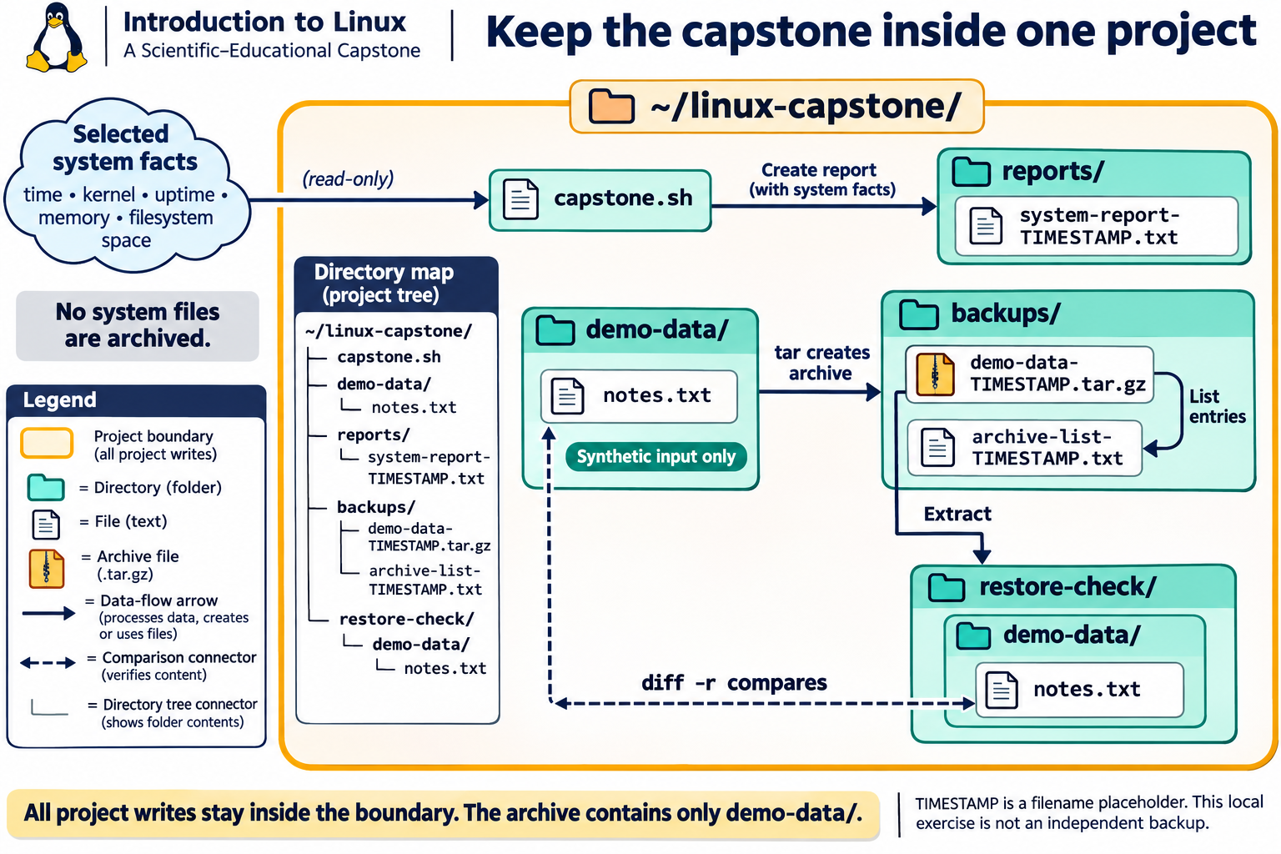
Lesson 14 / Figure 14.1
7
Notes:
Source: lesson-14-integration-capstone.md
Image: graphics\lesson-14\01-project-boundary-data-flow.png
Figure 14.1. Keep reports, archives, listings, and restore tests inside ~/linux-capstone/. The archive includes only synthetic demo-data/; selected system facts go to the report instead. Compare the restored data with the original, and review report details before sharing.
# Lesson 14 graphics
[Course graphics index](../README.md) · [Source chapter](../../lesson-14-integration-capstone.md)
Production: AI-generated illustrations using the built-in image_gen tool, continuing the course's navy, teal, and amber style. All figures are drafts for instructional review. The diagrams describe the bounded capstone, not a production backup system.
## Figure 14.1 — Keep the capstone inside one project
![Within linux-capstone, capstone.sh reads selected system facts into a report and archives only demo-data. The backups folder contains the archive and listing. The archive extracts into restore-check/demo-data, whose contents are compared with the original synthetic input.](01-project-boundary-data-flow.png)
- **Placement:** Section 3, after the explanation of report and archive contents.
- **Learning purpose:** Connect project paths to data flow and distinguish the archive input from other project artifacts.
- **Caption:** **Figure 14.1.** Keep reports, archives, listings, and restore tests inside `~/linux-capstone/`. The archive includes only synthetic `demo-data/`; selected system facts go to the report instead. Compare the restored data with the original, and review report details before sharing.
- **Alt text:** Within linux-capstone, capstone.sh reads selected system facts into a report and archives only demo-data. The backups folder contains the archive and listing. The archive extracts into restore-check/demo-data, whose contents are compared with the original synthetic input.
- **Prompt:** [01-generation-prompt.txt](01-generation-prompt.txt).
- **Review note:** TIMESTAMP stands for the script's time-based filename component, not literal text. The archive listing is a separate text file, not data implicitly included in the archive. The restore directory should be new and empty; mkdir -p alone does not establish emptiness. Paths are conceptual examples, not generated project artifacts. Timestamp names have seconds precision, so repeated or concurrent runs in one second can collide; inspect destinations rather than assuming uniqueness. No capstone script was run to create this illustration.
## Figure 14.2 — Verification answers different questions
![A syntax check establishes parsing, archive listing shows readable entries, extraction tests unpacking into a fresh directory, and diff recursively compares restored and source contents. No output plus diff exit status zero indicates no differences; these checks do not establish a separate failure domain or complete metadata equivalence.](02-verification-checks.png)
- **Placement:** Section 6, after the explanation of local restore-test limits.
- **Learning purpose:** Distinguish parsing, listing, restoration, content comparison, and independent-backup protection.
- **Caption:** **Figure 14.2.** Each check answers a different question. Syntax acceptance does not prove correct behavior; archive listing does not replace extraction; extraction does not replace comparison. Check both `diff -r` output and its status, and separately inspect report contents. A local restore test does not provide independent backup storage.
- **Alt text:** A syntax check establishes parsing, archive listing shows readable entries, extraction tests unpacking into a fresh directory, and diff recursively compares restored and source contents. No output plus diff exit status zero indicates no differences; these checks do not establish a separate failure domain or complete metadata equivalence.
- **Prompt:** [02-generation-prompt.txt](02-generation-prompt.txt).
- **Review note:** ARCHIVE, SOURCE, and RESTORE are placeholders for reviewed project paths. GNU diff returns 0 for no differences, 1 for differences, and 2 for trouble. Content comparison does not verify every permission, ownership, ACL, extended attribute, or recovery condition. The sample script checks archive operations but does not comprehensively check every report command; inspect the report and document failures. Use only a trusted archive and a fresh, empty restore directory.
## Figure 14.3 — Connect deliverables to evidence
![Six submission components map to the evidence they provide: script, redacted report and archive listing, restore comparison result, setup guide, security and troubleshooting notes, and reflection. A final review removes identifying details and confirms synthetic data.](03-deliverables-evidence.png)
- **Placement:** Student lab, after the deliverables and privacy guidance and before the knowledge check.
- **Learning purpose:** Link the submitted artifacts to observable acceptance criteria without treating a successful run as a complete project.
- **Caption:** **Figure 14.3.** Submit the script, redacted report and listing, restore-verification evidence, setup guide, security and troubleshooting notes, and reflection. Explain what each artifact demonstrates and what remains limited. Review all shared material for identifying information and non-synthetic data.
- **Alt text:** Six submission components map to the evidence they provide: script, redacted report and archive listing, restore comparison result, setup guide, security and troubleshooting notes, and reflection. A final review removes identifying details and confirms synthetic data.
- **Prompt:** [03-generation-prompt.txt](03-generation-prompt.txt).
- **Review note:** The chapter does not require an archive upload. Do not share an archive containing real data or raw host-specific reports. A missing or hypothetical troubleshooting issue must be labeled honestly; no repair or root cause should be invented. Evidence should describe the actual comparison result, not just that a command was attempted. Redact shared copies while preserving appropriate original project evidence locally.

Slide 8
Script structure
01
Quoted variables name the project and output paths.
02
A grouped block writes the selected report sections.
03
Conditional tar operations check archive creation and listing status.
Linux Introduction / Lesson 14
8
Notes:
Source: lesson-14-integration-capstone.md
## 3. Plan the data flow
The project has four kinds of output:
```text
synthetic practice files ──tar──> compressed archive
│ │
│ └──list and restore──> restore-check copy
│
current system facts ──script──> timestamped text report
```
The archive contains only the synthetic practice directory. The report contains a small set of system facts useful for basic context: the time it was generated, kernel/release summary, uptime, memory summary, and free space for the user's home filesystem. Even basic system details can reveal information about a device, so reports should be reviewed and redacted before sharing.
![Within linux-capstone, capstone.sh reads selected system facts into a report and archives only demo-data. The backups folder contains the archive and listing. The archive extracts into restore-check/demo-data, whose contents are compared with the original synthetic input.](graphics/lesson-14/01-project-boundary-data-flow.png)
**Figure 14.1.** Keep reports, archives, listings, and restore tests inside `~/linux-capstone/`. The archive includes only synthetic `demo-data/`; selected system facts go to the report instead. Compare the restored data with the original, and review report details before sharing.

Slide 9
Review and execution
01
Inspect paths and syntax-check with bash -n before running.
02
Use a new output name and check possible destination collisions.
03
A successful parse does not establish correct logic or complete output.
Linux Introduction / Lesson 14
9
Notes:
Source: lesson-14-integration-capstone.md
## 4. Build a readable script
Lesson 7 introduced Bash scripts, quoted variables, redirection, and exit status. The following example shows the intended size and structure. Review it line by line before running it:
```bash
#!/usr/bin/env bash
project_dir="$HOME/linux-capstone"
report_dir="$project_dir/reports"
backup_dir="$project_dir/backups"
mkdir -p "$report_dir" "$backup_dir"
timestamp="$(date +%Y%m%d-%H%M%S)"
report="$report_dir/system-report-$timestamp.txt"
archive="$backup_dir/demo-data-$timestamp.tar.gz"
archive_list="$backup_dir/archive-list-$timestamp.txt"
{
printf 'Linux Course Capstone System Report\n'
printf 'Generated: '
date --iso-8601=seconds
printf '\nKernel and release:\n'
uname -srm
printf '\nUptime and load:\n'
uptime
printf '\nMemory summary:\n'
free -h
printf '\nHome filesystem usage:\n'
df -h "$HOME"
} > "$report"
if tar -czf "$archive" -C "$project_dir" demo-data; then
if tar -tzf "$archive" > "$archive_list"; then
printf 'Report: %s\n' "$report"
printf 'Archive: %s\n' "$archive"
printf 'Archive listing: %s\n' "$archive_list"
else
printf 'Archive was created, but listing verification failed.\n' >&2
exit 1
fi
else
printf 'Archive creation failed.\n' >&2
exit 1
fi
```
The script uses quoted paths so spaces remain part of a single argument. `mkdir -p` creates the report and backup directories if needed and does not fail merely because they already exist. A timestamp gives each run a distinct output name. The braces group report commands so one redirection writes their combined output to the report file. The `if` statements check the exit status of archive creation and archive listing; they do not prove that the archived files are identical to the originals. A separate restore-and-compare step will provide stronger verification.
`tar -C "$project_dir" demo-data` changes the directory used as the archive base and includes only the named synthetic-data directory. This keeps the archive paths tidy and avoids accidentally including the whole project or home directory. Do not replace `demo-data` with `/`, `~`, or an unreviewed broad path.

Slide 10
Restore verification
01
Extract your trusted archive into a fresh empty project-local directory.
02
Compare source and restored trees using diff -r.
03
Check both output and status, and separately inspect the report sections.
Linux Introduction / Lesson 14
10
Notes:
Source: lesson-14-integration-capstone.md
## 5. Test and run within the project boundary
Before execution, inspect the script and confirm the values of `project_dir`, `demo_dir`, `report_dir`, and `backup_dir`. Syntax-check it with `bash -n` and then run it with Bash:
```bash
bash -n "$HOME/linux-capstone/capstone.sh"
bash "$HOME/linux-capstone/capstone.sh"
```
`bash -n` asks Bash to parse the script without executing it. A successful syntax check does not prove that the script's logic is correct, that its paths are appropriate, or that its output is accurate. Running it with `bash` does not require changing its executable bit. If students choose to launch it directly, they may use `chmod u+x` on the script in the project directory and then execute that specific file. Do not use `sudo`.
The script is intended to read selected system state and write report, archive, and listing files inside the project directory. It does not configure the system. It still creates files and consumes storage; the student should inspect the output and remove only their own project artifacts when the instructor says the work is complete.

Slide 11
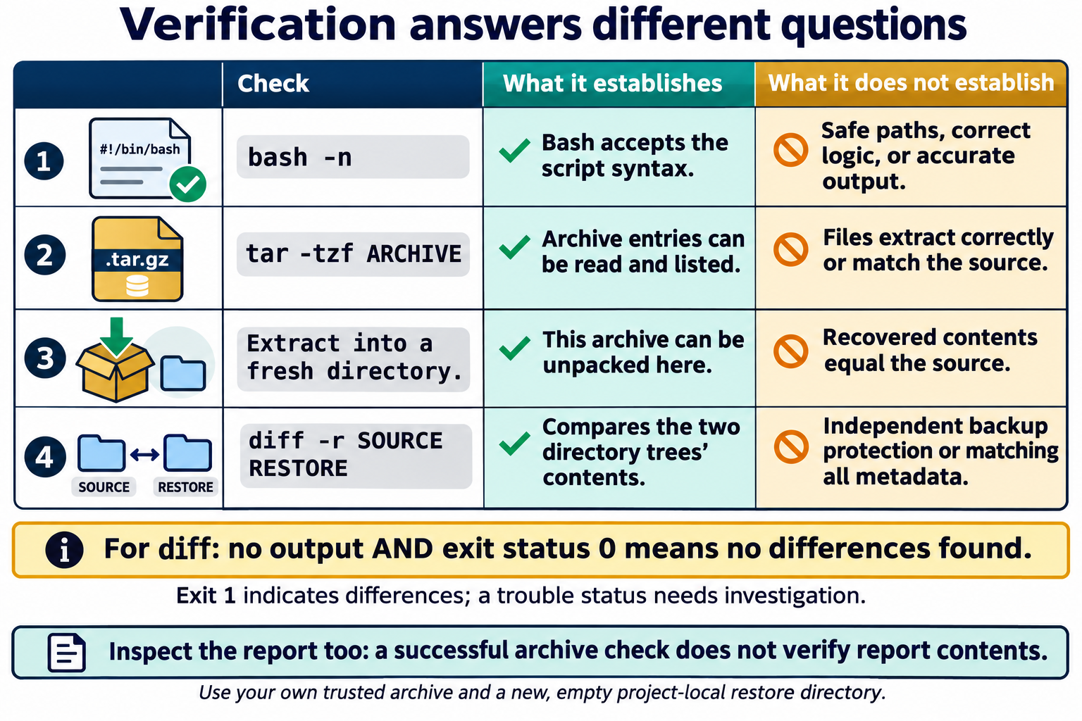
Lesson 14 / Figure 14.2
11
Notes:
Source: lesson-14-integration-capstone.md
Image: graphics\lesson-14\02-verification-checks.png
Figure 14.2. Each check answers a different question. Syntax acceptance does not prove correct behavior; archive listing does not replace extraction; extraction does not replace comparison. Check both diff -r output and its status, and separately inspect report contents. A local restore test does not provide independent backup storage.
# Lesson 14 graphics
[Course graphics index](../README.md) · [Source chapter](../../lesson-14-integration-capstone.md)
Production: AI-generated illustrations using the built-in image_gen tool, continuing the course's navy, teal, and amber style. All figures are drafts for instructional review. The diagrams describe the bounded capstone, not a production backup system.
## Figure 14.1 — Keep the capstone inside one project
![Within linux-capstone, capstone.sh reads selected system facts into a report and archives only demo-data. The backups folder contains the archive and listing. The archive extracts into restore-check/demo-data, whose contents are compared with the original synthetic input.](01-project-boundary-data-flow.png)
- **Placement:** Section 3, after the explanation of report and archive contents.
- **Learning purpose:** Connect project paths to data flow and distinguish the archive input from other project artifacts.
- **Caption:** **Figure 14.1.** Keep reports, archives, listings, and restore tests inside `~/linux-capstone/`. The archive includes only synthetic `demo-data/`; selected system facts go to the report instead. Compare the restored data with the original, and review report details before sharing.
- **Alt text:** Within linux-capstone, capstone.sh reads selected system facts into a report and archives only demo-data. The backups folder contains the archive and listing. The archive extracts into restore-check/demo-data, whose contents are compared with the original synthetic input.
- **Prompt:** [01-generation-prompt.txt](01-generation-prompt.txt).
- **Review note:** TIMESTAMP stands for the script's time-based filename component, not literal text. The archive listing is a separate text file, not data implicitly included in the archive. The restore directory should be new and empty; mkdir -p alone does not establish emptiness. Paths are conceptual examples, not generated project artifacts. Timestamp names have seconds precision, so repeated or concurrent runs in one second can collide; inspect destinations rather than assuming uniqueness. No capstone script was run to create this illustration.
## Figure 14.2 — Verification answers different questions
![A syntax check establishes parsing, archive listing shows readable entries, extraction tests unpacking into a fresh directory, and diff recursively compares restored and source contents. No output plus diff exit status zero indicates no differences; these checks do not establish a separate failure domain or complete metadata equivalence.](02-verification-checks.png)
- **Placement:** Section 6, after the explanation of local restore-test limits.
- **Learning purpose:** Distinguish parsing, listing, restoration, content comparison, and independent-backup protection.
- **Caption:** **Figure 14.2.** Each check answers a different question. Syntax acceptance does not prove correct behavior; archive listing does not replace extraction; extraction does not replace comparison. Check both `diff -r` output and its status, and separately inspect report contents. A local restore test does not provide independent backup storage.
- **Alt text:** A syntax check establishes parsing, archive listing shows readable entries, extraction tests unpacking into a fresh directory, and diff recursively compares restored and source contents. No output plus diff exit status zero indicates no differences; these checks do not establish a separate failure domain or complete metadata equivalence.
- **Prompt:** [02-generation-prompt.txt](02-generation-prompt.txt).
- **Review note:** ARCHIVE, SOURCE, and RESTORE are placeholders for reviewed project paths. GNU diff returns 0 for no differences, 1 for differences, and 2 for trouble. Content comparison does not verify every permission, ownership, ACL, extended attribute, or recovery condition. The sample script checks archive operations but does not comprehensively check every report command; inspect the report and document failures. Use only a trusted archive and a fresh, empty restore directory.
## Figure 14.3 — Connect deliverables to evidence
![Six submission components map to the evidence they provide: script, redacted report and archive listing, restore comparison result, setup guide, security and troubleshooting notes, and reflection. A final review removes identifying details and confirms synthetic data.](03-deliverables-evidence.png)
- **Placement:** Student lab, after the deliverables and privacy guidance and before the knowledge check.
- **Learning purpose:** Link the submitted artifacts to observable acceptance criteria without treating a successful run as a complete project.
- **Caption:** **Figure 14.3.** Submit the script, redacted report and listing, restore-verification evidence, setup guide, security and troubleshooting notes, and reflection. Explain what each artifact demonstrates and what remains limited. Review all shared material for identifying information and non-synthetic data.
- **Alt text:** Six submission components map to the evidence they provide: script, redacted report and archive listing, restore comparison result, setup guide, security and troubleshooting notes, and reflection. A final review removes identifying details and confirms synthetic data.
- **Prompt:** [03-generation-prompt.txt](03-generation-prompt.txt).
- **Review note:** The chapter does not require an archive upload. Do not share an archive containing real data or raw host-specific reports. A missing or hypothetical troubleshooting issue must be labeled honestly; no repair or root cause should be invented. Evidence should describe the actual comparison result, not just that a command was attempted. Redact shared copies while preserving appropriate original project evidence locally.

Slide 12
Limits and troubleshooting
01
A same-disk restore exercise does not provide independent backup storage.
02
A report is selected evidence at one time, not a health diagnosis.
03
Investigate an error’s narrow cause without broadening permissions or adding sudo.
Linux Introduction / Lesson 14
12
Notes:
Source: lesson-14-integration-capstone.md
## 6. Verify the archive with a restore
An archive listing confirms that the archive contains named entries; it does not confirm that extraction succeeds or that the restored content matches the source. Use an empty, project-local restore directory and compare it with the source:
```bash
mkdir -p "$HOME/linux-capstone/restore-check"
tar -xzf "$HOME/linux-capstone/backups/ARCHIVE_NAME.tar.gz" \
-C "$HOME/linux-capstone/restore-check"
diff -r "$HOME/linux-capstone/demo-data" \
"$HOME/linux-capstone/restore-check/demo-data"
```
Replace `ARCHIVE_NAME` with the archive path printed by the script. `tar -xzf` extracts the gzip-compressed archive into the specified restore directory. Extraction writes files, so use only the approved project-local directory and a known archive. `diff -r` compares directory trees recursively; no output and a successful exit status indicate that the compared contents match. A difference should be investigated rather than ignored. Do not extract an unknown archive into a real home directory or system path.
The restore check verifies a small local archive but not a complete backup strategy. A real backup plan needs a separate failure domain, appropriate access control, retention, and periodic restore tests. A second directory on the same disk is convenient for this exercise but would not protect against disk failure.
![A syntax check establishes parsing, archive listing shows readable entries, extraction tests unpacking into a fresh directory, and diff recursively compares restored and source contents. No output plus diff exit status zero indicates no differences; these checks do not establish a separate failure domain or complete metadata equivalence.](graphics/lesson-14/02-verification-checks.png)
**Figure 14.2.** Each check answers a different question. Syntax acceptance does not prove correct behavior; archive listing does not replace extraction; extraction does not replace comparison. Check both `diff -r` output and its status, and separately inspect report contents. A local restore test does not provide independent backup storage.

Slide 13
Acceptance and handoff
01
Demonstrate the data boundary and synthetic archive contents.
02
Provide a restore result, redacted report, setup guide, and security note.
03
Document evidence, uncertainty, and one possible future improvement.
Linux Introduction / Lesson 14
13
Notes:
Source: lesson-14-integration-capstone.md
## 7. Verify the report and explain its limits
Open the generated report with a text viewer such as `less` or `cat`, introduced earlier. Check that its timestamp, system summary, memory summary, and home filesystem line are present and readable. Compare those sections with direct command output if needed. Command output may vary by distribution and system state.
The report is a snapshot. It does not diagnose a problem, prove the machine is healthy, or capture every relevant fact. It omits logs, network addresses, process lists, credentials, and personal files by design. If an instructor-approved project needs another field, students must state why it is useful, whether it is sensitive, and how it will be protected before adding it.

Slide 14
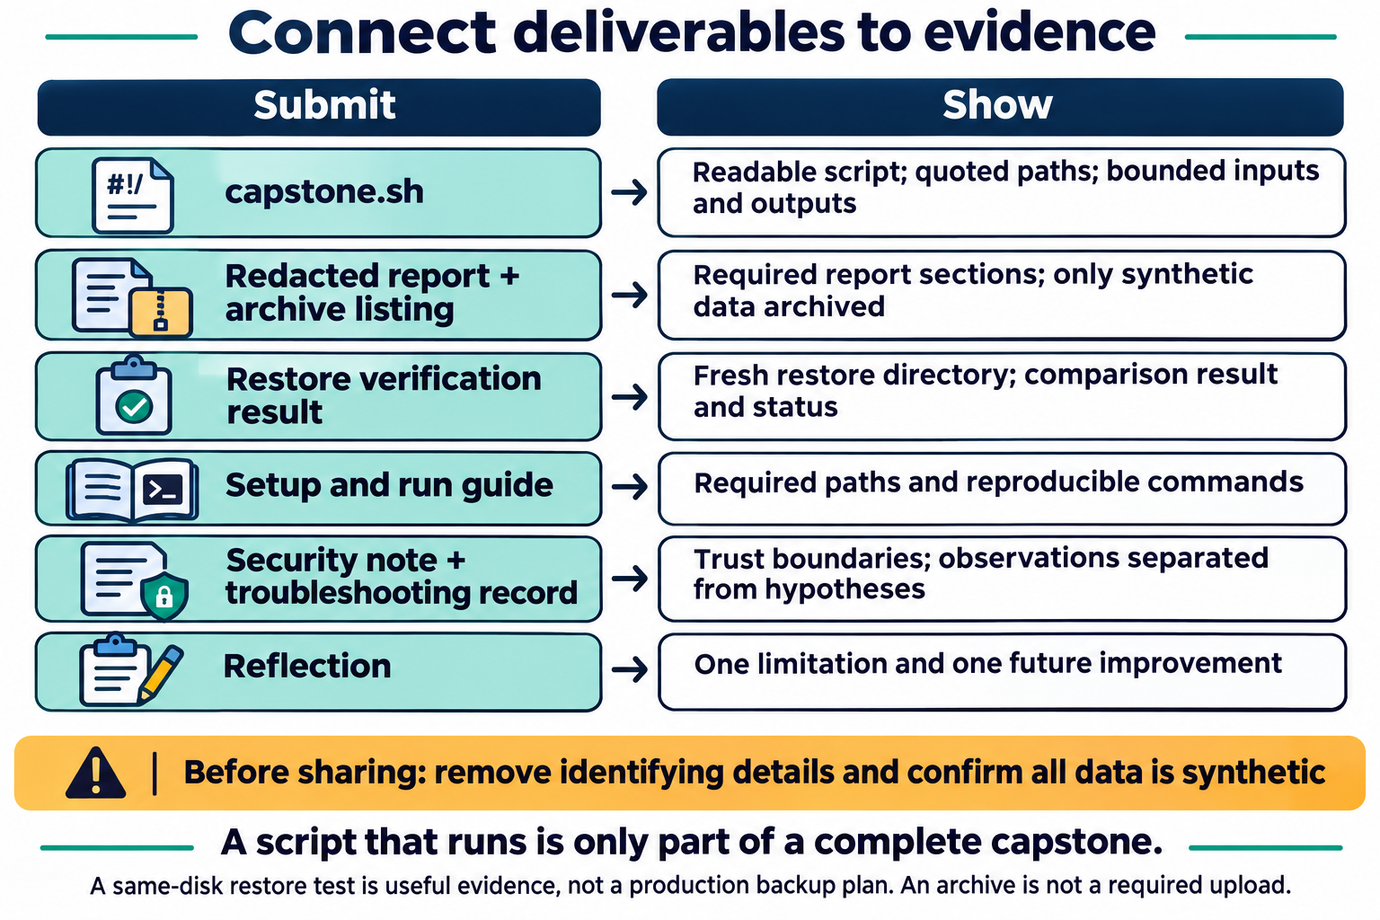
Lesson 14 / Figure 14.3
14
Notes:
Source: lesson-14-integration-capstone.md
Image: graphics\lesson-14\03-deliverables-evidence.png
Figure 14.3. Submit the script, redacted report and listing, restore-verification evidence, setup guide, security and troubleshooting notes, and reflection. Explain what each artifact demonstrates and what remains limited. Review all shared material for identifying information and non-synthetic data.
# Lesson 14 graphics
[Course graphics index](../README.md) · [Source chapter](../../lesson-14-integration-capstone.md)
Production: AI-generated illustrations using the built-in image_gen tool, continuing the course's navy, teal, and amber style. All figures are drafts for instructional review. The diagrams describe the bounded capstone, not a production backup system.
## Figure 14.1 — Keep the capstone inside one project
![Within linux-capstone, capstone.sh reads selected system facts into a report and archives only demo-data. The backups folder contains the archive and listing. The archive extracts into restore-check/demo-data, whose contents are compared with the original synthetic input.](01-project-boundary-data-flow.png)
- **Placement:** Section 3, after the explanation of report and archive contents.
- **Learning purpose:** Connect project paths to data flow and distinguish the archive input from other project artifacts.
- **Caption:** **Figure 14.1.** Keep reports, archives, listings, and restore tests inside `~/linux-capstone/`. The archive includes only synthetic `demo-data/`; selected system facts go to the report instead. Compare the restored data with the original, and review report details before sharing.
- **Alt text:** Within linux-capstone, capstone.sh reads selected system facts into a report and archives only demo-data. The backups folder contains the archive and listing. The archive extracts into restore-check/demo-data, whose contents are compared with the original synthetic input.
- **Prompt:** [01-generation-prompt.txt](01-generation-prompt.txt).
- **Review note:** TIMESTAMP stands for the script's time-based filename component, not literal text. The archive listing is a separate text file, not data implicitly included in the archive. The restore directory should be new and empty; mkdir -p alone does not establish emptiness. Paths are conceptual examples, not generated project artifacts. Timestamp names have seconds precision, so repeated or concurrent runs in one second can collide; inspect destinations rather than assuming uniqueness. No capstone script was run to create this illustration.
## Figure 14.2 — Verification answers different questions
![A syntax check establishes parsing, archive listing shows readable entries, extraction tests unpacking into a fresh directory, and diff recursively compares restored and source contents. No output plus diff exit status zero indicates no differences; these checks do not establish a separate failure domain or complete metadata equivalence.](02-verification-checks.png)
- **Placement:** Section 6, after the explanation of local restore-test limits.
- **Learning purpose:** Distinguish parsing, listing, restoration, content comparison, and independent-backup protection.
- **Caption:** **Figure 14.2.** Each check answers a different question. Syntax acceptance does not prove correct behavior; archive listing does not replace extraction; extraction does not replace comparison. Check both `diff -r` output and its status, and separately inspect report contents. A local restore test does not provide independent backup storage.
- **Alt text:** A syntax check establishes parsing, archive listing shows readable entries, extraction tests unpacking into a fresh directory, and diff recursively compares restored and source contents. No output plus diff exit status zero indicates no differences; these checks do not establish a separate failure domain or complete metadata equivalence.
- **Prompt:** [02-generation-prompt.txt](02-generation-prompt.txt).
- **Review note:** ARCHIVE, SOURCE, and RESTORE are placeholders for reviewed project paths. GNU diff returns 0 for no differences, 1 for differences, and 2 for trouble. Content comparison does not verify every permission, ownership, ACL, extended attribute, or recovery condition. The sample script checks archive operations but does not comprehensively check every report command; inspect the report and document failures. Use only a trusted archive and a fresh, empty restore directory.
## Figure 14.3 — Connect deliverables to evidence
![Six submission components map to the evidence they provide: script, redacted report and archive listing, restore comparison result, setup guide, security and troubleshooting notes, and reflection. A final review removes identifying details and confirms synthetic data.](03-deliverables-evidence.png)
- **Placement:** Student lab, after the deliverables and privacy guidance and before the knowledge check.
- **Learning purpose:** Link the submitted artifacts to observable acceptance criteria without treating a successful run as a complete project.
- **Caption:** **Figure 14.3.** Submit the script, redacted report and listing, restore-verification evidence, setup guide, security and troubleshooting notes, and reflection. Explain what each artifact demonstrates and what remains limited. Review all shared material for identifying information and non-synthetic data.
- **Alt text:** Six submission components map to the evidence they provide: script, redacted report and archive listing, restore comparison result, setup guide, security and troubleshooting notes, and reflection. A final review removes identifying details and confirms synthetic data.
- **Prompt:** [03-generation-prompt.txt](03-generation-prompt.txt).
- **Review note:** The chapter does not require an archive upload. Do not share an archive containing real data or raw host-specific reports. A missing or hypothetical troubleshooting issue must be labeled honestly; no repair or root cause should be invented. Evidence should describe the actual comparison result, not just that a command was attempted. Redact shared copies while preserving appropriate original project evidence locally.

Slide 15
Guided lab
01
Create synthetic demo-data under ~/linux-capstone.
02
Run the reviewed script and inspect report and archive listing.
03
Restore and compare, then submit the guide, evidence, and reflection.
Linux Introduction / Lesson 14
15
Notes:
Source: lesson-14-integration-capstone.md
# Student lab — Build, restore, and document
## Safety boundaries
Work only under `~/linux-capstone/` in an approved VM or local practice environment. Use invented sample text, not personal documents or course records. Do not use `sudo`, schedule the script, install software, change system settings, start a network listener, or archive `/`, the whole home directory, or removable media. Review paths before running commands that create, archive, or extract files.
## Part A: Create the project and synthetic input
Create a small project tree and a sample file:
```bash
mkdir -p "$HOME/linux-capstone/demo-data"
printf 'Synthetic course practice data.\n' > \
"$HOME/linux-capstone/demo-data/notes.txt"
```
Create `~/linux-capstone/capstone.sh` in a text editor and enter the example script from the textbook. Read it carefully. Confirm that it includes only `demo-data/` as archive input and writes all outputs under the project directory.
## Part B: Syntax-check and run
Run:
```bash
bash -n "$HOME/linux-capstone/capstone.sh"
bash "$HOME/linux-capstone/capstone.sh"
```
If the script reports a syntax error or cannot write an output, record the message and inspect the relevant lines and paths. Do not add `sudo`. After it succeeds, record the report path, archive path, archive-list path, and the script's exit status.
## Part C: Review and verify outputs
Open the report and archive listing. Confirm the report has the required sections and that the listing contains the `demo-data/` path and its sample file. Create an empty restore directory and extract the archive there:
```bash
mkdir -p "$HOME/linux-capstone/restore-check"
tar -xzf "$HOME/linux-capstone/backups/ARCHIVE_NAME.tar.gz" \
-C "$HOME/linux-capstone/restore-check"
diff -r "$HOME/linux-capstone/demo-data" \
"$HOME/linux-capstone/restore-check/demo-data"
```
Replace the archive placeholder with the name printed by the script. Record whether `diff -r` produced output. If there are differences, identify the paths and investigate without overwriting the source.
## Part D: Security and troubleshooting review
Write a short note answering:
1. Which directory does the script archive, and how did you verify that boundary?
2. What information in the report might be sensitive if shared publicly?
3. Why does a successful archive listing not replace a restore test?
4. What would you check first if the script says permission denied?
5. Which changes would require an instructor or administrator's approval?
Then make a troubleshooting record for one issue you encountered, or for a hypothetical issue supplied by the instructor. Include the symptom, relevant evidence, hypothesis, test, result, and next step. Do not claim a root cause unless the test supports it.
## Deliverables
Submit:
- `capstone.sh`;
- one redacted generated report and its archive listing;
- a restore verification result (for example, a note that `diff -r` returned no differences);
- a short setup/run guide with required paths and commands;
- the security note and troubleshooting record; and
- a brief reflection describing one limitation and one possible future improvement.
Do not submit the archive if it contains anything beyond synthetic practice data. Remove hostnames, usernames, addresses, and other identifying details from screenshots or output included in the submission.
![Six submission components map to the evidence they provide: script, redacted report and archive listing, restore comparison result, setup guide, security and troubleshooting notes, and reflection. A final review removes identifying details and confirms synthetic data.](graphics/lesson-14/03-deliverables-evidence.png)
**Figure 14.3.** Submit the script, redacted report and listing, restore-verification evidence, setup guide, security and troubleshooting notes, and reflection. Explain what each artifact demonstrates and what remains limited. Review all shared material for identifying information and non-synthetic data.

Slide 16
Evidence to record
01
The script is readable and remains inside the linux-capstone project boundary
02
The report contains the selected system summary and a timestamp
03
The archive contains only the synthetic demo-data/ content
04
The archive can be listed and extracted into a project-local restore directory
Linux Introduction / Lesson 14
16
Notes:
Source: lesson-14-integration-capstone.md
# Student lab — Build, restore, and document
## Safety boundaries
Work only under `~/linux-capstone/` in an approved VM or local practice environment. Use invented sample text, not personal documents or course records. Do not use `sudo`, schedule the script, install software, change system settings, start a network listener, or archive `/`, the whole home directory, or removable media. Review paths before running commands that create, archive, or extract files.
## Part A: Create the project and synthetic input
Create a small project tree and a sample file:
```bash
mkdir -p "$HOME/linux-capstone/demo-data"
printf 'Synthetic course practice data.\n' > \
"$HOME/linux-capstone/demo-data/notes.txt"
```
Create `~/linux-capstone/capstone.sh` in a text editor and enter the example script from the textbook. Read it carefully. Confirm that it includes only `demo-data/` as archive input and writes all outputs under the project directory.
## Part B: Syntax-check and run
Run:
```bash
bash -n "$HOME/linux-capstone/capstone.sh"
bash "$HOME/linux-capstone/capstone.sh"
```
If the script reports a syntax error or cannot write an output, record the message and inspect the relevant lines and paths. Do not add `sudo`. After it succeeds, record the report path, archive path, archive-list path, and the script's exit status.
## Part C: Review and verify outputs
Open the report and archive listing. Confirm the report has the required sections and that the listing contains the `demo-data/` path and its sample file. Create an empty restore directory and extract the archive there:
```bash
mkdir -p "$HOME/linux-capstone/restore-check"
tar -xzf "$HOME/linux-capstone/backups/ARCHIVE_NAME.tar.gz" \
-C "$HOME/linux-capstone/restore-check"
diff -r "$HOME/linux-capstone/demo-data" \
"$HOME/linux-capstone/restore-check/demo-data"
```
Replace the archive placeholder with the name printed by the script. Record whether `diff -r` produced output. If there are differences, identify the paths and investigate without overwriting the source.
## Part D: Security and troubleshooting review
Write a short note answering:
1. Which directory does the script archive, and how did you verify that boundary?
2. What information in the report might be sensitive if shared publicly?
3. Why does a successful archive listing not replace a restore test?
4. What would you check first if the script says permission denied?
5. Which changes would require an instructor or administrator's approval?
Then make a troubleshooting record for one issue you encountered, or for a hypothetical issue supplied by the instructor. Include the symptom, relevant evidence, hypothesis, test, result, and next step. Do not claim a root cause unless the test supports it.
## Deliverables
Submit:
- `capstone.sh`;
- one redacted generated report and its archive listing;
- a restore verification result (for example, a note that `diff -r` returned no differences);
- a short setup/run guide with required paths and commands;
- the security note and troubleshooting record; and
- a brief reflection describing one limitation and one possible future improvement.
Do not submit the archive if it contains anything beyond synthetic practice data. Remove hostnames, usernames, addresses, and other identifying details from screenshots or output included in the submission.
![Six submission components map to the evidence they provide: script, redacted report and archive listing, restore comparison result, setup guide, security and troubleshooting notes, and reflection. A final review removes identifying details and confirms synthetic data.](graphics/lesson-14/03-deliverables-evidence.png)
**Figure 14.3.** Submit the script, redacted report and listing, restore-verification evidence, setup guide, security and troubleshooting notes, and reflection. Explain what each artifact demonstrates and what remains limited. Review all shared material for identifying information and non-synthetic data.
# Knowledge check and answer key
1. **What makes a capstone project appropriately bounded?** It has a clear purpose, known inputs and outputs, an explicit directory/safety boundary, and acceptance criteria.
2. **Why does the project use synthetic practice data?** It avoids exposing or accidentally archiving personal or sensitive information.
3. **What is the purpose of `mkdir -p "$report_dir" "$backup_dir"` in the script?** Create the required output directories, including when they already exist.
4. **Why quote path variables in Bash?** Quoting preserves spaces and prevents unintended word splitting and wildcard expansion.
5. **What does `date +%Y%m%d-%H%M%S` provide in the script?** A timestamp suitable for distinguishing output filenames from separate runs.
6. **What does `date --iso-8601=seconds` provide in the report?** A readable, standardized timestamp with seconds precision.
7. **What does `uname -srm` summarize?** Kernel name, release, and machine hardware name/architecture information.
8. **What does `uptime` contribute to the report?** System uptime and load averages at the time of collection.
9. **What does `free -h` summarize?** Memory and swap information in human-readable units.
10. **What does `df -h "$HOME"` report?** Human-readable capacity/usage for the filesystem containing the user's home path.
11. **Why is the script's report only a snapshot?** It records selected information at one time and does not prove overall health or explain every later problem.
12. **Why does the example use `tar -C "$project_dir" demo-data`?** It archives only the named synthetic directory using a project-relative path.
13. **What does `tar -czf ARCHIVE -C DIR INPUT` do?** Creates a gzip-compressed tar archive from the named input relative to the selected directory.
14. **What does `tar -tzf ARCHIVE` do?** Lists entries in a gzip-compressed tar archive without extracting them.
15. **What does `tar -xzf ARCHIVE -C DESTINATION` do?** Extracts a gzip-compressed tar archive into the specified destination directory.
16. **Why extract only into a known project-local directory?** Extraction writes files; a bounded destination reduces the risk of overwriting unrelated data.
17. **What does `diff -r SOURCE RESTORE` check?** Recursively compares the contents of the two directory trees.
18. **What does no output from a successful `diff -r` usually indicate?** No content differences were found between the compared directory trees.
19. **Does a successful `tar -tzf` prove a backup can be restored?** No. It lists archive entries; an extraction and comparison test gives stronger evidence.
20. **Why is a second directory on the same disk not an independent backup?** A disk failure or other shared event can affect both copies.
21. **What does `bash -n SCRIPT` do?** Parses the Bash script for syntax without executing its commands.
22. **Does a successful syntax check prove the script is safe and logically correct?** No. Review paths, logic, permissions, and output, then test in the bounded lab.
23. **Why should students not fix a permission error by adding `sudo`?** It expands authority and may hide an incorrect path or ownership assumption; the cause should be inspected first.
24. **What should a useful troubleshooting record distinguish?** Direct observations from hypotheses and conclusions.
25. **Why redact a generated system report before sharing?** It may disclose details about the device, operating system, storage, or user environment.
26. **What is a suitable improvement for a future version of this project?** Examples include stronger error handling, a restore test built into a separate safe mode, a retention plan, or a separately stored backup, with appropriate review.
# Chapter glossary
- **Acceptance criteria:** Observable conditions used to decide whether a project meets its requirements.
- **Archive:** A file that combines selected files and directory structure, optionally compressed.
- **Capstone:** A culminating project that integrates knowledge and skills from a course.
- **Data boundary:** A stated limit on what a project is allowed to read, change, or include.
- **Exit status:** A numeric result returned by a command or script; zero conventionally indicates success.
- **Integration:** Combining multiple concepts or tools to complete one coherent task.
- **Restore test:** Extracting or recovering a backup and checking that the recovered data is usable.
- **Synthetic data:** Invented practice data that does not contain real personal or sensitive information.
- **Verification:** A check that compares the result with expected behavior or acceptance criteria.
# Instructor materials
## Facilitation notes
- Assess the process and evidence, not only whether the script ran successfully on the first attempt.
- Ask students to trace every read path and write path. The archive must contain only the designated synthetic directory.
- Do not require students to upload host-specific reports or archives to a public repository.
- Accept equivalent editors and minor report formatting differences if the safety boundary and required content remain clear.
- Treat a sensible limitation statement as evidence of understanding; the workflow is not a production backup product.
## Assessment rubric (20 points)
| Criterion | Points |
|---|---:|
| Script is readable, quoted, and stays within the project directory | 4 |
| Report contains selected system facts and a timestamp | 3 |
| Archive is limited to synthetic data and its contents are inspected | 3 |
| Restore is performed in a bounded location and compared with source | 4 |
| Setup/run guide and safety note are clear and accurate | 2 |
| Troubleshooting record separates evidence from inference | 2 |
| Submission is redacted and identifies limitations/future improvement | 2 |
## Course reflection prompts
- Which earlier lesson contributed the most useful tool to your project, and why?
- Which assumption did you need to verify rather than accept?
- What would need to change before this workflow could be used for important organizational data?
## References
- [GNU Bash manual](https://www.gnu.org/software/bash/manual/bash.html)
- [GNU tar manual](https://www.gnu.org/software/tar/manual/)
- [Ubuntu `diff` manual](https://manpages.ubuntu.com/manpages/noble/man1/diff.1.html)

Slide 17
Review questions
01
What makes a capstone project appropriately bounded?
02
Why does the project use synthetic practice data?
03
What is the purpose of mkdir -p "$report_dir" "$backup_dir" in the script?
Linux Introduction / Lesson 14
17
Notes:
Source: lesson-14-integration-capstone.md
and answer key
1. **What makes a capstone project appropriately bounded?** It has a clear purpose, known inputs and outputs, an explicit directory/safety boundary, and acceptance criteria.
2. **Why does the project use synthetic practice data?** It avoids exposing or accidentally archiving personal or sensitive information.
3. **What is the purpose of `mkdir -p "$report_dir" "$backup_dir"` in the script?** Create the required output directories, including when they already exist.
4. **Why quote path variables in Bash?** Quoting preserves spaces and prevents unintended word splitting and wildcard expansion.
5. **What does `date +%Y%m%d-%H%M%S` provide in the script?** A timestamp suitable for distinguishing output filenames from separate runs.
6. **What does `date --iso-8601=seconds` provide in the report?** A readable, standardized timestamp with seconds precision.
7. **What does `uname -srm` summarize?** Kernel name, release, and machine hardware name/architecture information.
8. **What does `uptime` contribute to the report?** System uptime and load averages at the time of collection.
9. **What does `free -h` summarize?** Memory and swap information in human-readable units.
10. **What does `df -h "$HOME"` report?** Human-readable capacity/usage for the filesystem containing the user's home path.
11. **Why is the script's report only a snapshot?** It records selected information at one time and does not prove overall health or explain every later problem.
12. **Why does the example use `tar -C "$project_dir" demo-data`?** It archives only the named synthetic directory using a project-relative path.
13. **What does `tar -czf ARCHIVE -C DIR INPUT` do?** Creates a gzip-compressed tar archive from the named input relative to the selected directory.
14. **What does `tar -tzf ARCHIVE` do?** Lists entries in a gzip-compressed tar archive without extracting them.
15. **What does `tar -xzf ARCHIVE -C DESTINATION` do?** Extracts a gzip-compressed tar archive into the specified destination directory.
16. **Why extract only into a known project-local directory?** Extraction writes files; a bounded destination reduces the risk of overwriting unrelated data.
17. **What does `diff -r SOURCE RESTORE` check?** Recursively compares the contents of the two directory trees.
18. **What does no output from a successful `diff -r` usually indicate?** No content differences were found between the compared directory trees.
19. **Does a successful `tar -tzf` prove a backup can be restored?** No. It lists archive entries; an extraction and comparison test gives stronger evidence.
20. **Why is a second directory on the same disk not an independent backup?** A disk failure or other shared event can affect both copies.
21. **What does `bash -n SCRIPT` do?** Parses the Bash script for syntax without executing its commands.
22. **Does a successful syntax check prove the script is safe and logically correct?** No. Review paths, logic, permissions, and output, then test in the bounded lab.
23. **Why should students not fix a permission error by adding `sudo`?** It expands authority and may hide an incorrect path or ownership assumption; the cause should be inspected first.
24. **What should a useful troubleshooting record distinguish?** Direct observations from hypotheses and conclusions.
25. **Why redact a generated system report before sharing?** It may disclose details about the device, operating system, storage, or user environment.
26. **What is a suitable improvement for a future version of this project?** Examples include stronger error handling, a restore test built into a separate safe mode, a retention plan, or a separately stored backup, with appropriate review.

Slide 18
Reflection and next step
01
Which concept changed how you approached the lab?
02
Explain one result using evidence from Lesson 14.
03
State one limitation of your evidence or one check you would make next.
Linux Introduction / Lesson 14
18
Notes:
Source: lesson-14-integration-capstone.md

