Slide 1
Comparison Philips Interview Web Project
Huijuan (Ann) Huang
02/19/2016

Slide 2
Outline
Introduction
Description
Assumption
Strategy
Architecture
Workflow & Algorithm
Implementation
Environment Configuration
Project Code Hierarchy
Demo
Summary
Techniques/Tools Involved
Future Plan

Slide 3
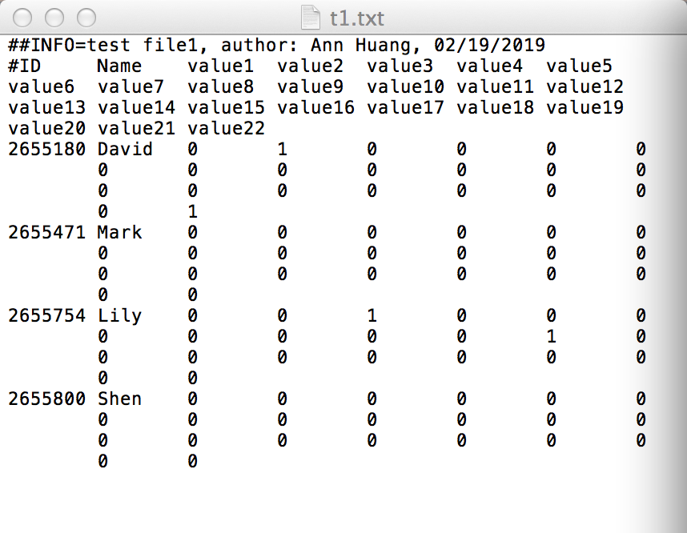

Introduction
Project Goal: Create web project to find out unique records of 2 uploaded files
Project Assumption: Assume the records format of uploaded files is ID, Name and Values.
e.g. test file 1: t1.txt

Slide 4
Strategy – MVC Architecture
model
2
3
controller
1
4
browser
view
5
Client
Server

Slide 5
Strategy – MVC Architecture
MVC: Models, Views, Controller
Models: represent data
Java class/object
Views: Render the display to clients
HTML (CSS, JavaScript), JSP
Controller: Implement actions
Handle input, access/process data, implement logic, pass data to views
Java (Servlet)
Notes:
Java code embedded in HTML documents

Slide 6
Strategy – Workflow & Algorithm
url request
response
view:
entry page
response
browser
controller
entry page
response
result page
view:
result page
response
request
controller
browser
unique records
read files
compare records
using hashing
upload files
process records
HashMap records
models
Notes:
Java code embedded in HTML documents

Slide 7
Implementation – Environment Configuration
Java
Download and install
1.7 version JDK
Tomcat server
Download and install
Add the JSP Standard Tag Library (JSTL).to the lib folder under the Tomcat directory:
Eclipse
Download Eclipse IDE for Java EE
Run Web App with eclipse using Eclipse build in Tomcat
More details : README.txt

Slide 8
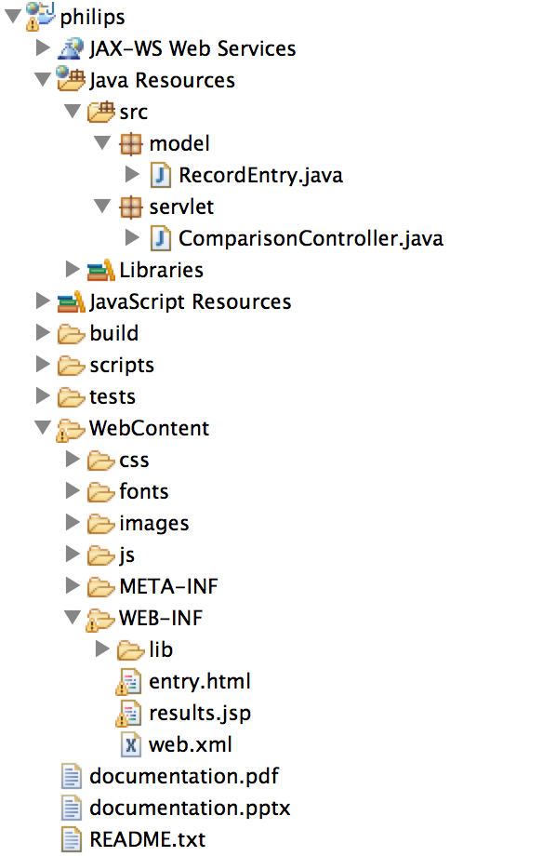
Implementation – Project Hierarchy
Project name
Back end model, Java
Back end controller, Java
Front end views
Views styling, CSS…
Views source, html…

Slide 9
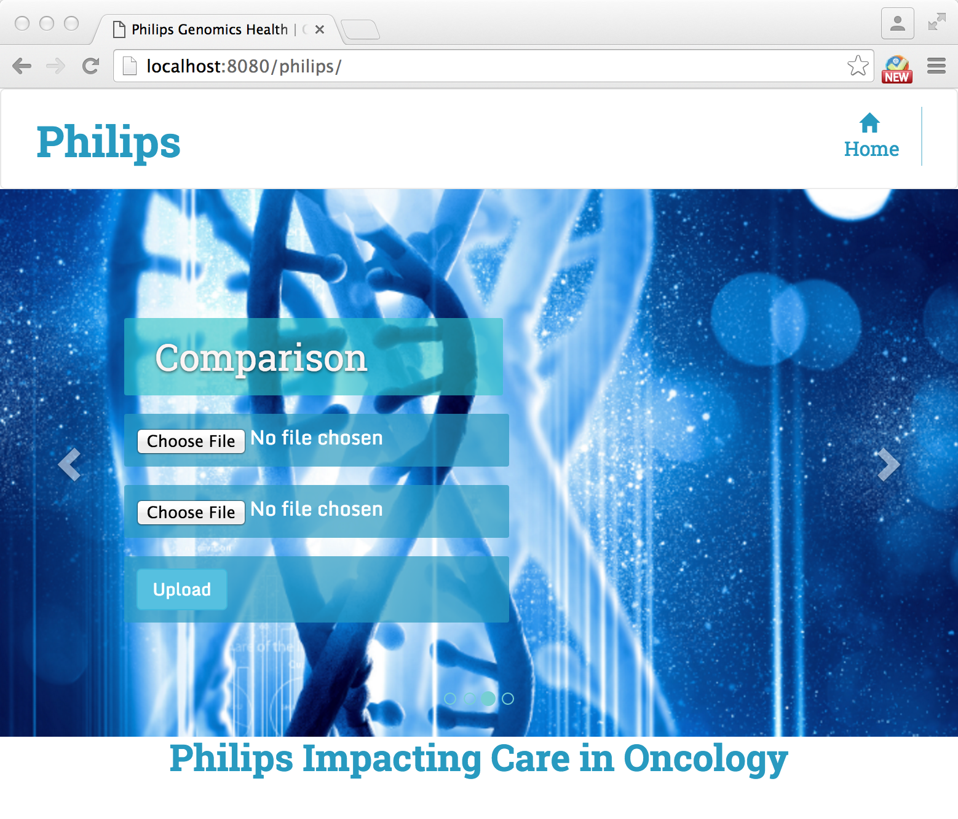
Implementation – Demo
Please refer to demo.mp4 file
https://goo.gl/2Nr4Ns

Slide 10

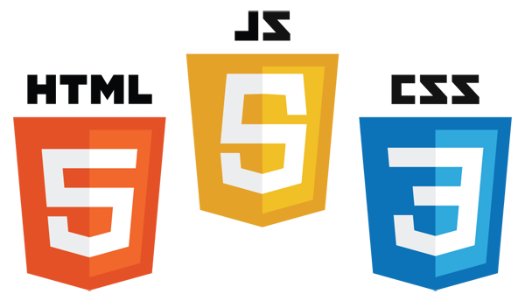
Summary – Technique/Tools Involved
Architecture: MVC
Back end: Java (Servlet)
Front end: HTML, CSS, JavaScript, JSP, JSTL, bootstrap(JS CSS framework)
Version Control: GitHub

Slide 11
Summary – Future Plan
Modify model class based input file format (record format)
Back end model use MySQL, the database creation and two tables comparison scripts are already in the source code
MySQL
Persistent
Data
Store
controller
model
browser
view
client
Application code

Slide 12
Thank you

