Slide 1
Node.js with Express
Notes:
This is the introduction of express for node.js that can help get start to use express

Slide 2
What is Express
Node.js web application framework
inspired by Sinatra
Newly-released Express 4.0.0
Notes:
Like other mvc web framework, Express is Node.js framework,
a light-weight web application framework to help organize your web app into MVC architecture on the server side.
It is the most popular node.js framework right now, it is so popular that when people are talking about node.js, they mean express
(You can use a variety of choices for your templating language (like ejs, jade, dustjs).
You can then use a database like mongodb with mongoose (for modeling) to provide a backend for your node.js app. Express basically helps you manage everything, from routes, to handling requests and views.
)
Lightweight: no ORM （Object Relation Model，）。它只是一个轻量级的 Web 框架，多数功能只是对 HTTP 协议中常用操作的封装，更多的功能需要插件或者整合其他模块来完成。

Slide 3
What Express do
Parses argument s and headers
Routing
Views
Sessions
….
Notes:
Basically what Express does is that is enables you to easily create web applications by providing a slightly simpler interface for creating your request endpoints, handling cookies, etc. than vanilla Node. You could drop it out of the equation, but then you'd have to do a lot more work in whipping up your web-application. Node itself could do everything express is doing (d'uh, express is done with node), but express just wraps it in a nicer package.
t provides functions for pretty much everything you need to do to build a web server. If you were to write the same functionality with vanilla Node.js, you would have to write significantly more code.

Slide 4
Installation
Node.js & NPM
http://nodejs.org/
Install Express
local: c:\> npm install express
global: c:\> npm install – g express
Notes:
We assume that you already have node.js and npm installed in your computer

Slide 5


Get started
Create a project
Install dependencies
Run project

Slide 6
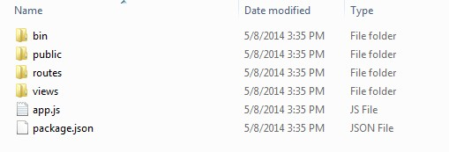
Express Project Archetype
Image, css, js static content
Directory for routing content
Views documents
The main entry point for the Express application
Tells Node and NPM what packages are required
Notes:
app.js：启动文件，或者说入口文件 package.json：存储着工程的信息及模块依赖，当在 dependencies中添加依赖的模块时，运行 npm install，npm会检查当前目录下的 package.json，并自动安装所有指定的模块 node_modules：存放 package.json中安装的模块，当你在 package.json添加依赖的模块并安装后，存放在这个文件夹下 public：存放 image、css、js等文件 routes：存放路由文件 views：存放视图文件或者说模版文件

Slide 7
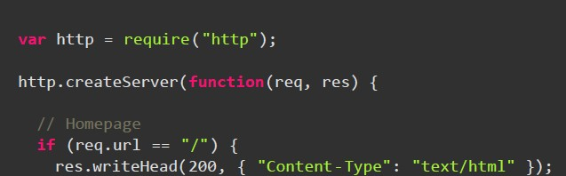
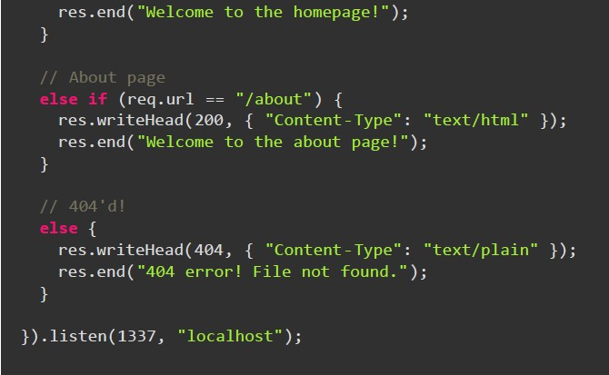
Example-Routing without express
Notes:
Routing is a way to map different requests to specific handlers.

Slide 8
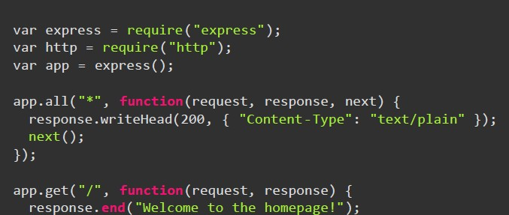
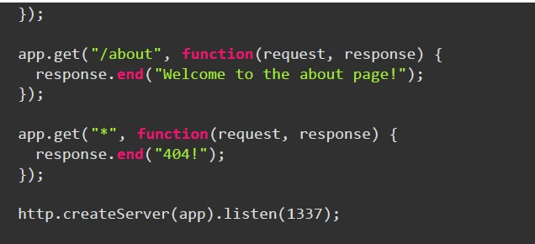
Example-Routing with express

Slide 9
Useful link
Official Web sits
http://expressjs.com/
http://expressjs.com/guide.html
http://expressjs.com/api.html
Concepts
http://code.tutsplus.com/tutorials/introduction-to-express--net-33367
http://evanhahn.com/understanding-express/
Video Tutorial
https://www.youtube.com/watch?v=ndKRjmA6WNA
Notes:
Helps you to structure app, less code and easy to maintain

Slide 10
Back up

Slide 11
What express can do
Routing
Middleware
Logger
Body Parser
Method Override
Cookie Paser
Session
Templating Engine
Static Content

Slide 12
Web Application
Client-side: HTML, CSS, JavaScript, Java Applet
Rich Internet Application (RIA) technologies
-- Adobe Flex and Flash
-- Microsoft Silverlight
Server-side: PHP, ASP.NET, Java, ColdFusion, Perl, Ruby, Python,

Slide 13
Web Application
Client-side: JavaScript
Server-side: JavaScript --- Node.js

