Slide 1
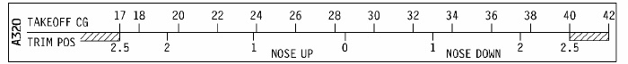
17 18 20 22 24 26 28 30 32 34 36 38 40 42
A320
TAKEOFF CG
TRIM POS
2.5 2 1 0 1 2 2.5
NOSE UP
NOSE DOWN

