Slide 1
Optim cloud event system architecture/features discussion

Slide 2
Topics
Project overview
Architecture design
Protobuf decode oc-events-mqtt topic’s payload.
Auto ingestion with kafka-connect-tdengine and kafka-connect-mongodb
Event/metrics/update schema design
Supporting new event type/existing event type’s changes
Optim event control config support

Slide 3
Project Overview
The Optim Cloud Event System is designed to collect, store, and analyze a wide range of events from home network devices, including gateways and extenders. These events are used for:
Monitoring network health
Detecting and diagnosing anomalies
Supporting AI-based analytics
Enabling customer support and remote troubleshooting

Slide 4
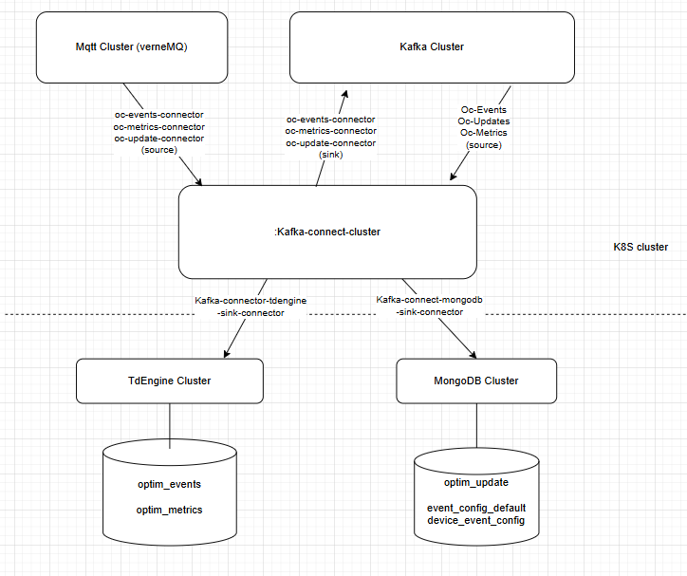
Optim Event System Architecture (backend)

Slide 5
Optim Event MQTT message
Topic:
oc_events_mqtt/{serial_number}
Mqtt message payload schema:
event_report_type: can have value of:
EVENTS
METRIC
UPDATE
event_data: json object
Mqtt topic: oc_events_mqtt
Message:
{ "event_report_type": "EVENTS", "event_data": { "ts": 1720732800000, // the time event triggered. "EQP-BOOT:cause": "RemoteReboot", "EQP-BOOT:reason": "watchdog", "event_id": "EQP-BOOT", "network_id": "net-001", "serial_number": "GW12345678", "object_id": "", "equip_type": "gateway", "fw_version": "3.2.0-build100", "isp": “testis-01" } }

Slide 6
Optim event auto ingestion flow
New Kafka connector to:
Read data from mqtt’s oc-events-mqtt topic
Protobuf decode the mqtt message payload in kafka-connect-mqtt connector.
Publish to Kafka cluster:
Topic: oc-events or oc_metrics based on the report_event_type in the mqtt message.
Message data: the event_data from mqtt message.
2. Kafka-connect-tdengine to:
Read data from oc-events,
Insert to oc_events table with proper mapping.
3. Kafaka-connect-tdengine to
Read data from oc_metrics
Insert to oc_metrics with proper mapping.
4. Kafka-connect-mongodb to:
Read data from oc_update topic,
insert to mongodb’s oc_update_events collection with properly mapping.

Slide 7
oc_events schema
Event Schema Design Strategy:
Use one generic oc_events supertable
Use TAGS for:
event_id, network_id, serial_number, object_id, equip_type, fw_version, isp
Use columns for:
Timestamp ts
The oc_event table will the union of all event’s properties:
`EQP-BOOT:cause` BINARY(32) DEFAULT NULL,
`EQP-BOOT:reason` BINARY(32) DEFAULT NULL,
`EQP-CRASH-DUMP` BINARY(32) DEFAULT NULL, `
EQP-FLASH-AGING:current_wear_level` BINARY(32) DEFAULT NULL,
`EQP-FLASH-AGING:previous_wear_level` BINARY(32) DEFAULT NULL,

Slide 8
Support adding new event type
ALTER STABLE oc_events ADD COLUMN ... for each new attribute.
Update the TDengine connector’s template so that the new JSON fields mapped to the right columns.
Test on beta, include:
ingestion E2E test
Verify on Grafana/SQL dashboards.

Slide 9
Modifying an existing event’s properties
Adding more attributes to an existing event
Follow the similar approach as adding a new event type.
Renaming, changing type, or dropping an attribute
This type change is incompatible change that should be avoided unless necessary.
Make the changes in two stages:
add a new column for renaming/change type
Change the ingestion mapping to route the data to new column
Mark the column as deprecated with comment
(optional ) Wait for at one data retention period ( 7 days), drop the deprecated columns ( only if no one uses the old column ).

Slide 10
oc_metrics table schema
Event Schema Design Strategy:
Use one generic oc_metrics supertable
Use TAGS for:
event_id, network_id, serial_number, object_id, equip_type, fw_version, isp
Use columns for:
Timestamp ts
The oc_metrics table will the union of all metrics’s properties:
`wan:duration` BIGINT,
`wan:physical_interface_name` BINARY(64),
`wan:last_change` BIGINT,
`wan:max_bitrate_dl` BIGINT,
`wan:max_bitrate_ul` BIGINT,
`wan:current_bitrate_dl` BIGINT,
`wan:current_bitrate_ul` BIGINT,
`wan:current_duplex_mode` BINARY(16),
`wan:current_flow_control_mode` BINARY(16),

Slide 11
Optim event control config schema design
1. event_config_global Collection {
"ProfileName": “optim",
"EventDefaults": {
"Detect": true,
"ReportToOptim": true,
"CountAndReportMetric": true,
"CountingInterval": 1,
"ReportRateControl15min": 10,
"ReportRateControl60min": 30,
"ReportRateControl24hours": 100,
"MetricFixedIntervalSec": 900,
"UpdateFixedIntervalMin": 1440
},
"LastUpdated": ISODate("2025-07-10T01:00:00Z")
}
2. device_event_config Collection {
"SerialNumber": "GW12345678",
“UseProfile": “optim",
"EventOverrides": {
"EQP-BOOT": {
"Detect": false
},
"METRIC-WIFI": {
"MetricFixedIntervalSec": 60
}
},
"LastUpdated": ISODate("2025-07-10T01:00:00Z")
}
For each device, the backend will:
Load default event configs from event_config_global using useProfile.
Apply overrides from EventOverrides.
Support different global config by adding different profiles
Records in device_event_config will be added only when there is a change to overwrite the defaults, or to use a different defaultprofile.

Slide 12
MQTT-Based Config Sync via CTRL/REPLY Topic
Optim Cloud ➝ Device
Publish to CTRL/<SerialNumber> with RPC payload: {
"type": "SET_EVENT_CONFIG",
"payload": {
"EventConfig": { ... }
}
}
B. Device ➝ Optim Cloud
Reply on REPLY/<SerialNumber> confirming configuration update:
{
"type": "SET_EVENT_CONFIG_ACK",
"payload": {
"status": "ok",
"applied": true
}
}

Slide 13
How to verify optim event control via TDSM sql?
Check Metric Report Frequency
SELECT COUNT(*) AS reports_per_day
FROM oc_wan_metrics
WHERE SerialNumber = 'GW12345678'
AND EventType = 'METRIC'
AND ts > now - 1d;
Check Event Rate Control Enforcement
SELECT event_id, COUNT(*) AS reported_events
FROM oc_events
WHERE SerialNumber = 'GW12345678'
AND ts > now - 15m
GROUP BY event_id;

