Slide 1
Git and GitHub
A very basic, fairly non-technical introduction to what they are, why you should be using them, and how to do just that

Slide 2
What is Git?
Git is a tool for version control. It can be used to keep track of changes when one or more people are working on a folder.
You can use Git from the command line, but there are lots of GUI tools to make the basics easier. GitHub Desktop is one of these.
It can be used for any kind of file, but it works best with text files, and is commonly used for code.

Slide 3
What is GitHub?
GitHub is an online hosting service for Git repositories (more on these later). It is the main service we use in this group for sharing and collaborating on code.
Besides storing and working with code (or anything else you put in a repository), it includes tools for documentation, issue tracking, collaborating, etc.
GitHub also makes a GUI tool called GitHub Desktop. It doesn’t have all the bells and whistles of some other Git GUIs, but it’s easy to use and is particularly designed for repositories hosted on GitHub, so it’s probably a good choice if you’re just getting started with Git. I’ll be showing you how to use some of its features in this presentation.

Slide 4
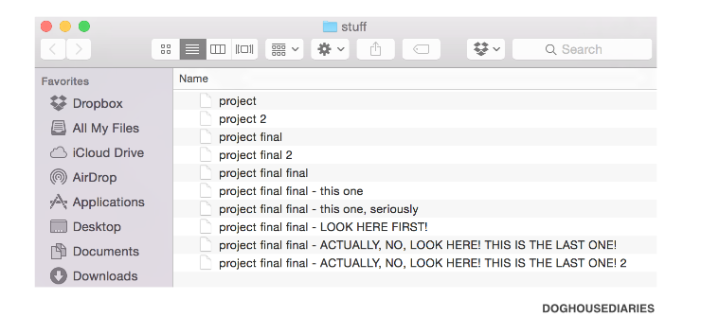
Why you should use Git

Slide 5
Why you should use Git
Just like you’d keep a notebook for doing experiments in a wet lab, it’s important to keep track of changes to your code when you’re using it for analysis, sampling, etc.
It makes coding easier - you can see what you’ve tried that didn’t work, keep track of why you’ve made changes, etc., without having to clutter up your code with huge comment blocks or save many copies of each file. You can also undo mistakes, work on multiple copies of something at the same time, and jump between versions.
You can collaborate with other people easily while keeping track of everyone’s contributions.
When combined with GitHub (or another hosting service), it’s a good way to back up your work

Slide 6
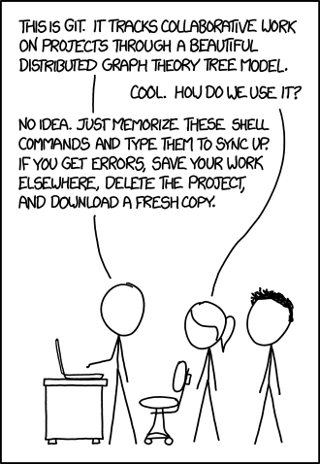
How to use Git
xkcd.com

Slide 7
How to use Git
Git has a reputation for being unintuitive and difficult to learn (not entirely without reason), but the basics are pretty simple. If you use a GUI, it’s even easier.
The most important concepts to understand are repositories, commits, pushing/pulling, and branches.

Slide 8
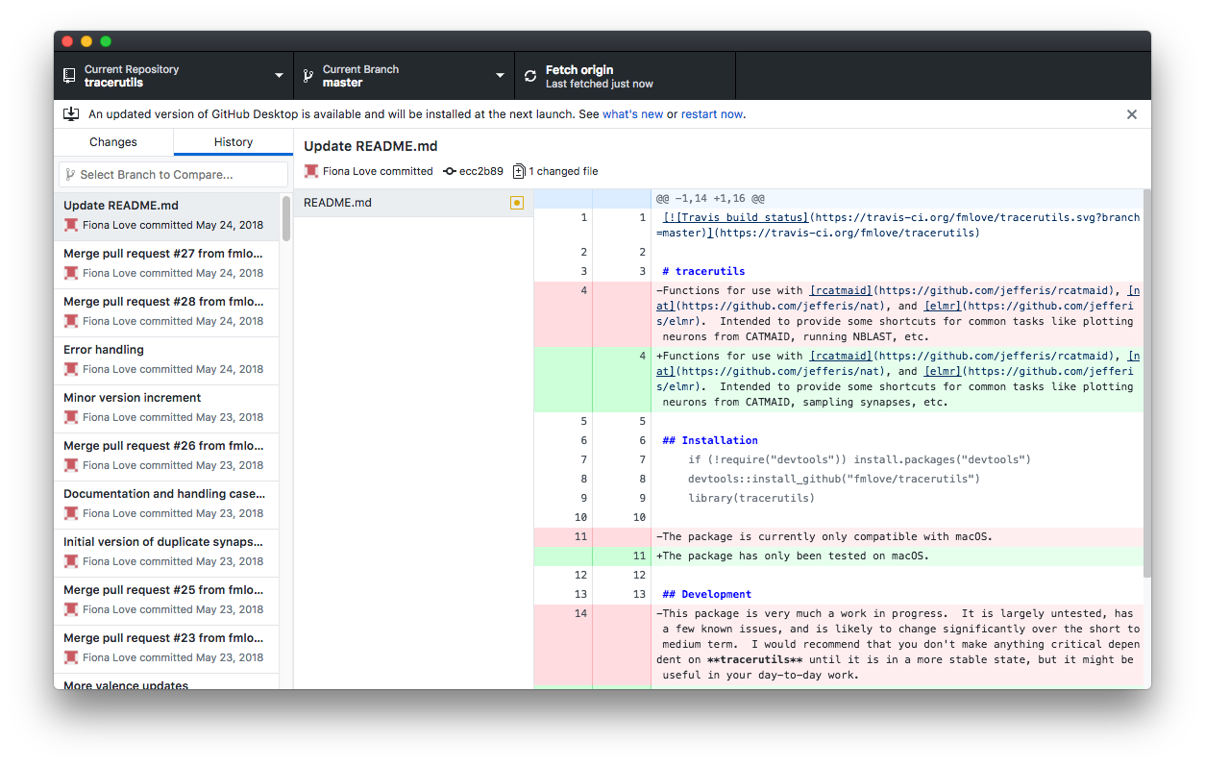
How to use Git - GitHub Desktop

Slide 9
Repositories
A repository (or repo) is basically just a folder that you’ve told Git to track.
You can make one online with GitHub, through GitHub Desktop, or just by picking a folder on your computer, navigating to it in the terminal, and typing git init.
Once you’ve created a repository (or downloaded one from e.g. GitHub, called cloning), you can use Git to keep track of anything you add, remove, or change in the folder.

Slide 10
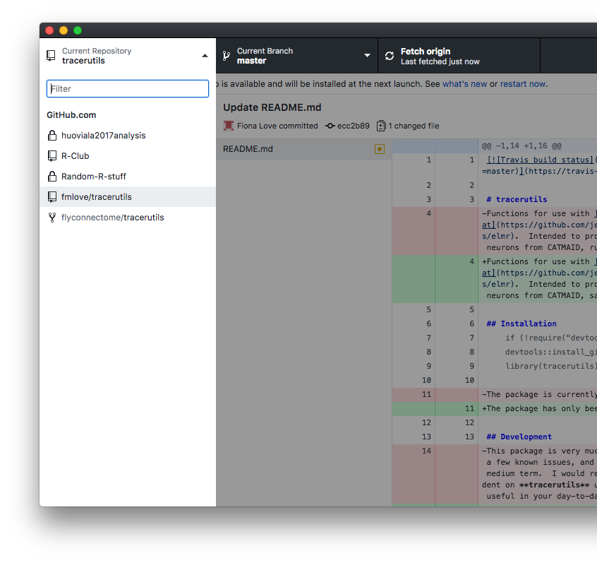
Repositories in GitHub Desktop
This is the repository you’ve selected
This is a list of all the repositories you’ve added to GitHub Desktop. They will be organised into ‘GitHub’ and ‘Other’ sections, for repositories that you have hosted on GitHub and everything else (e.g. local repositories on your computer)

Slide 11
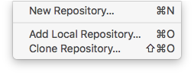
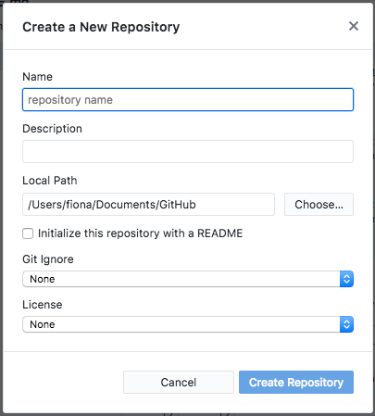
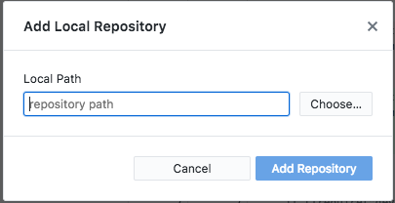
Repositories in GitHub Desktop
Creating or adding repositories
By selecting ‘Add Local’ or ‘New’ here, you can either add an existing repository on your computer (e.g. one you created by running git init in the terminal) to GitHub Desktop, or create a new one by selecting the folder you want Git to track.
After you’ve created or added a repository this way, you’ll have the option to publish it to GitHub if you want it hosted on the web. By default, this will make your repository visible to anyone on the internet, so make sure you don’t have any sensitive information (e.g. hard coded passwords) in it first.

Slide 12
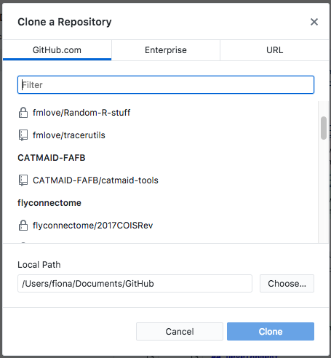
Repositories in GitHub Desktop
Cloning repositories
You can also clone, or download a copy of repositories you have stored in GitHub. These can be your own repositories, or ones belonging to a GitHub organisation you’re a part of, like flyconnectome. You can also use a URL to clone repos from other sources, e.g. BitBucket.
Once you’ve cloned a repository, or published a repository to GitHub, you’ll be able to synchronise changes between your computer and the cloud, and access them from other computers. We’ll get to how this is done in a few more slides.

Slide 13
Commits
Once you’ve changed (or added or deleted) something, you need to tell Git about it so it can save a snapshot of your work.
You do this by staging, or selecting the files you want Git to snapshot, and then creating a commit. The commit will include the changes to the files you selected, as well as information like the date and time. If you’re using GitHub Desktop, it will also include who is making the commit.
Commits can also include messages, which are an important part of why Git is so useful. They let you record why you are making each change, which can be very helpful when looking back through your commit history, or trying to figure out what a bit of code does.

Slide 14
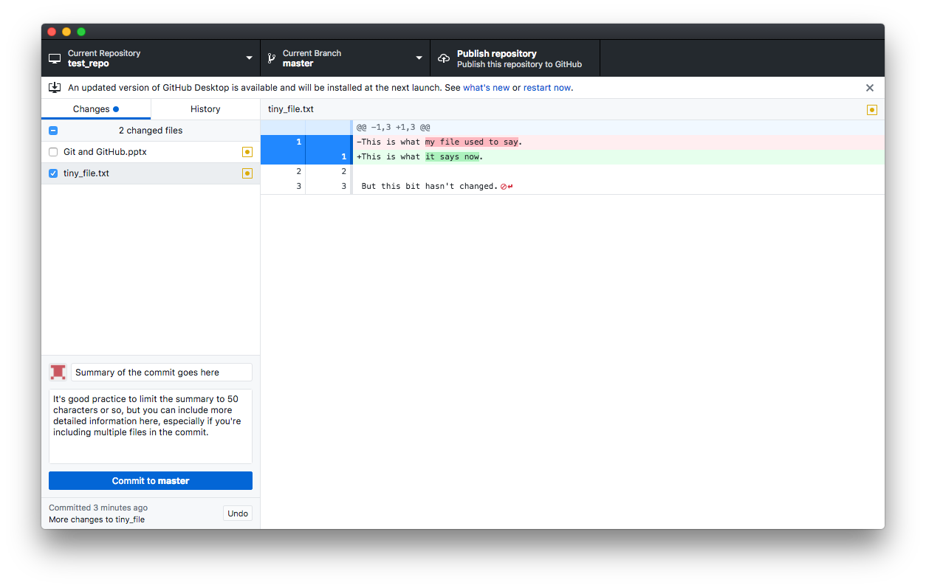
Commits in GitHub Desktop
This indicates that you’re viewing current changes, rather than either your repository history or a previous commit
Check the box next to each file to stage it for the commit. Be careful not to include things you don’t want to commit, as this can be a bit fiddly to undo.
If you’ve made changes to text files (.txt, .R, .py, etc.), this panel will show a line-by line breakdown of anything removed (highlighted in red) or added (in green).
Click this when you’re ready to save the commit.

Slide 15
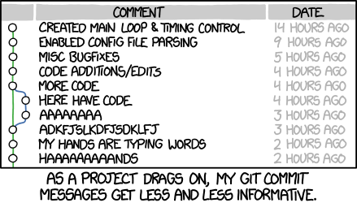
A note on commit messages
xkcd.com
The more descriptive the message, the more useful it will be (both to anyone else viewing your repository and to future you trying to figure out why you made some stupid change). GitHub Desktop encourages you to include a summary and description for each of your commits, which is a good habit to get into.

Slide 16
Reverting commits
Another advantage of using Git is that mistakes are very easy to undo. If you realise you’ve made a mistake in a commit, you can revert that commit to remove those specific changes.
Rather than deleting anything, this actually creates another commit with the opposite changes, essentially undoing everything in the commit you’ve chosen to revert. This way, you can fix the mistake, but all your changes are still on the record.
When you revert a commit, Git will also check for conflicts, i.e. if another commit depends on something you’re trying to undo. This isn’t completely foolproof, but it makes it a bit less likely that you’ll unexpectedly break your code by deleting something it needs.

Slide 17
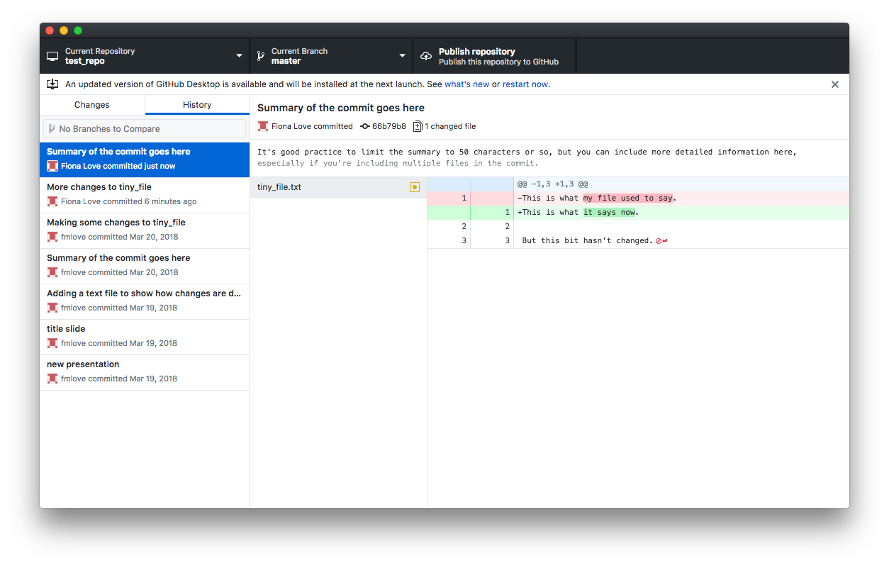
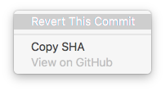
Reverting commits in GitHub Desktop

Slide 18
Pushing and pulling (and fetching)
If you’re collaborating with someone else on a project, or just trying to keep your own code backed up to the cloud, it’s important to make sure everything stays in sync.
Git handles this as two different steps. Pushing will take any changes to your local copy of the repository and apply them to a remote (i.e. the copy saved on GitHub), and pulling will take any changes from the remote and apply them to your local copy.
Fetching is like pulling, but instead of applying the changes to your local copy, it just checks if there are any differences between your version and the remote. If there are differences, you can decide if you need to push, pull, or do something a bit more complicated.

Slide 19
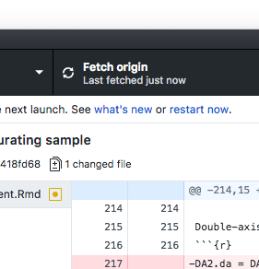
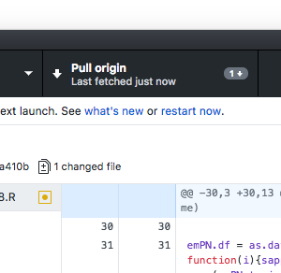
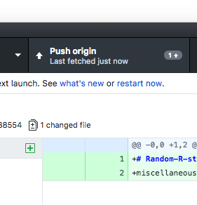
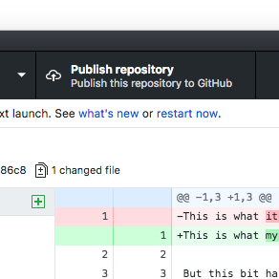
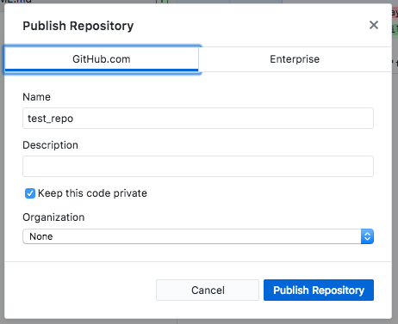
Fetching, pushing, and pulling in GitHub Desktop
GitHub Desktop will give you different options in this panel based on the differences between your local copy of the repository and the remote. It should fetch automatically every 5-10 minutes or so, but it’s a good idea to do this manually before you commit, so you can make sure you don’t accidentally undo someone else’s changes. You should also pull/push changes whenever they’re flagged up here, to be sure you (and anyone you’re collaborating with) have the most recent version.
If you’re working on a local repo, instead of fetch/push/pull, you’ll see a button to publish the repository to GitHub. If you do this, be careful that there is no sensitive information (e.g. passwords) in your repo (even if you delete them - they’re still in the history!). GitHub repos are publicly visible by default, although you can set them to private.

Slide 20
Branches
If you’re just using Git to back up and keep track of your own code, you can probably get away without using branches. However, they’re a great feature, particularly on more complicated projects, so it’s definitely worth knowing the basics.
Branches are essentially different versions of a repository. They let you do things like make changes to your code while keeping a working version handy, or allow multiple people to work on the same project without overwriting each other’s changes.
There are two basic processes involved in using branches - branching and merging. Branching is just telling Git that you want to start working on a new version of your repository. Merging is combining the changes you’ve made on two different branches – it’s a lot like pulling changes from a remote copy of the repository, but instead you’re pulling changes from one version to another.

Slide 21
Branching and merging
A
A - You create a new repository!
B - You make some pretty cool changes.
C - You have an idea, but you’re not sure if it will work, and
you don’t want to break the stuff you already have.
You make a new branch to work on it.
D - You make some fixes to the original code.
E - You do more work on that cool idea you had.
F - It works! You have a really cool new feature.
G - You merge together your branches. Now you have
your cool original code, plus your cool new feature,
because you’re awesome at using Git.
B
C
D
E
F
G

Slide 22
Branching and merging
A
A
In your Git history, these two patterns are essentially the same. Using branches means that you can work on multiple tasks or features at the same time, with less risk of accidentally undoing your own (or other people’s) changes, and keep all the commits relating to a feature neatly grouped together.
B
B
D
C
D
C
E
E
F
F
G
G

Slide 23
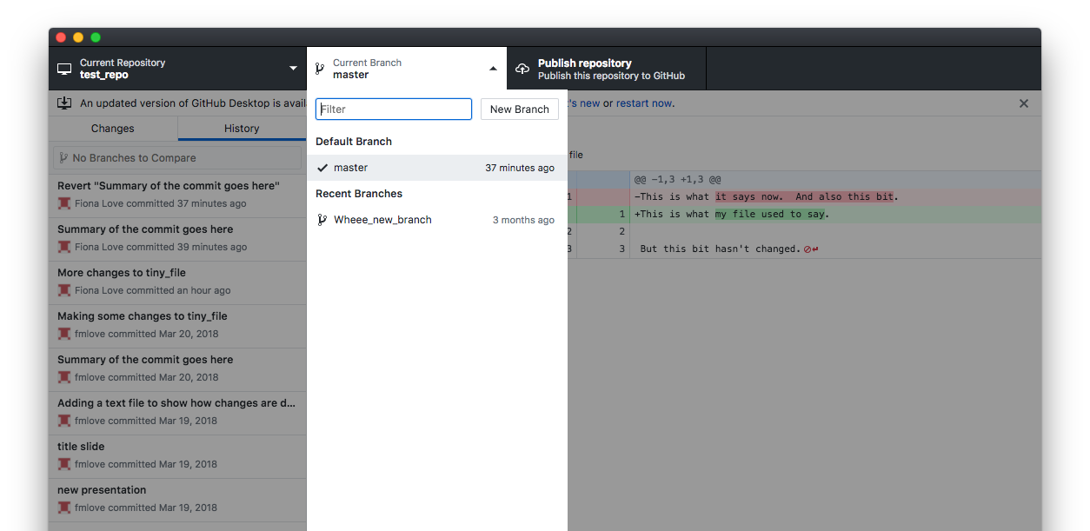
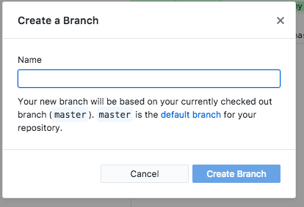
Branching in GitHub Desktop
The branch you’re currently on. You can use the drop down to switch between branches.

Slide 24
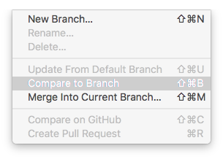
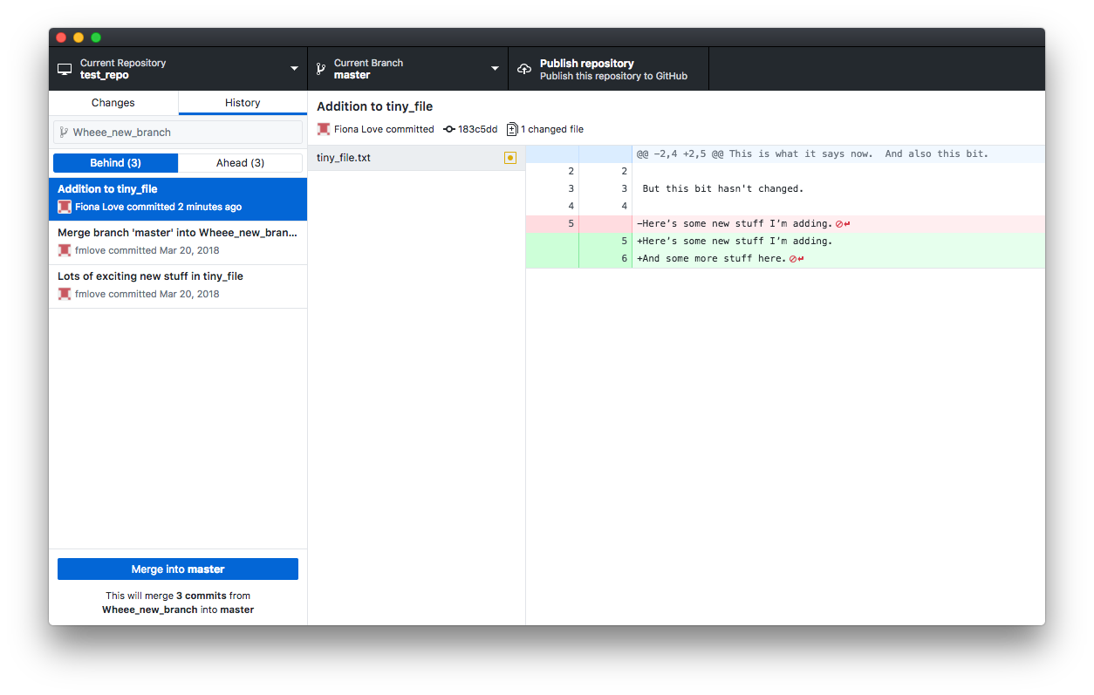
Merging in GitHub Desktop
‘Behind’ shows the changes that will be merged into your current branch
Make sure you’re merging in the right direction!

Slide 25
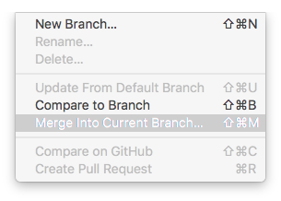
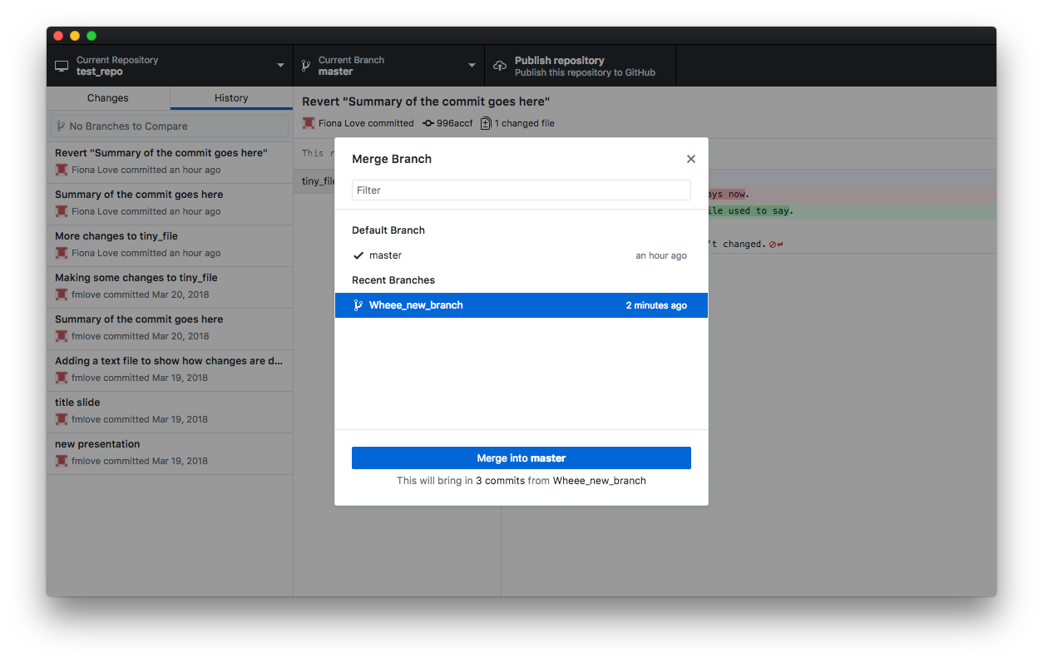
Merging in GitHub Desktop

Slide 26
Pull requests
If you’re working in a shared repository, you should generally use pull requests instead of merging directly, particularly when adding things to a ‘master’ branch. This ensures that everyone knows about the changes you’re about to make, and has the chance to review them and ask questions/make suggestions if necessary.
Once you’ve submitted a pull request, you (and others) can view it on GitHub, add comments, etc., before accepting. Once you’ve accepted a pull request , GitHub will create a merge commit for you.

Slide 27
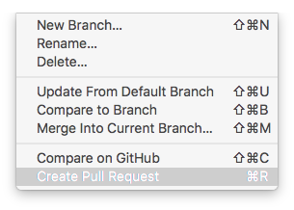
Pull requests in GitHub Desktop (kind of)
With the new version of GitHub Desktop, the pull request is actually created in the browser, so this menu option is only available if your repository and branch are published on GitHub.

Slide 28
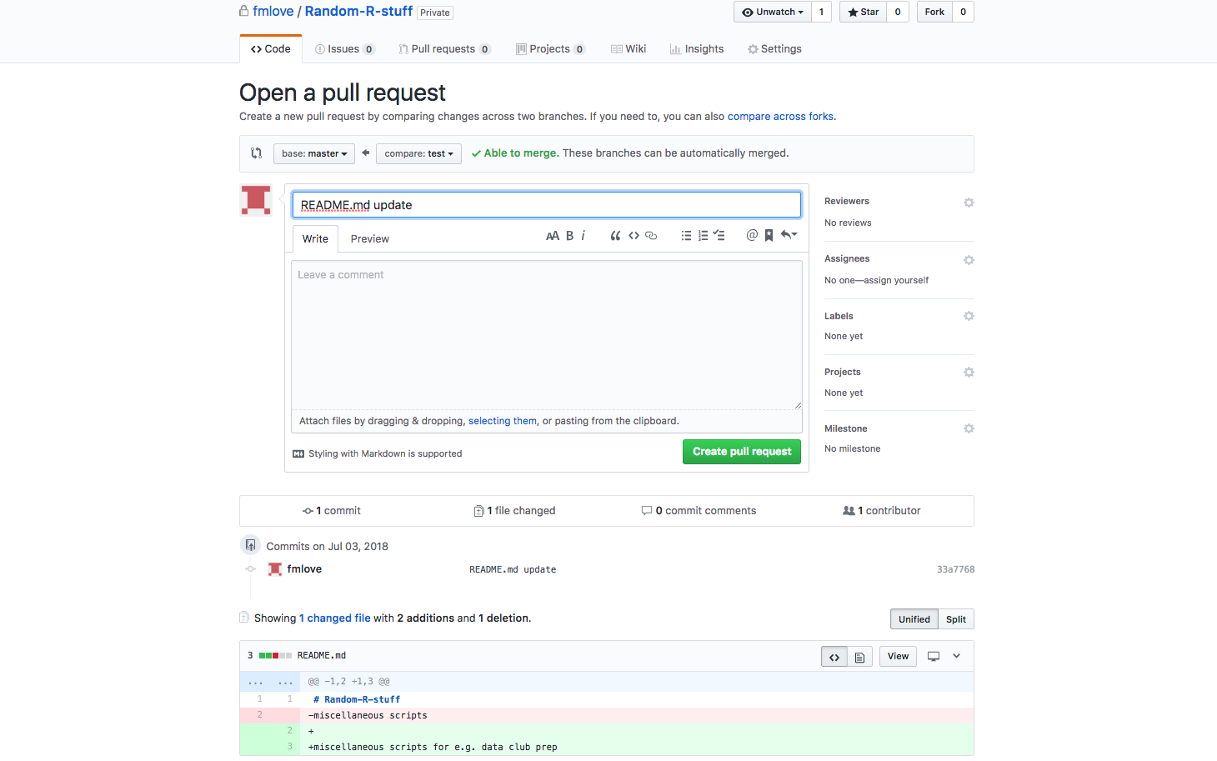
Pull requests in GitHub

Slide 29
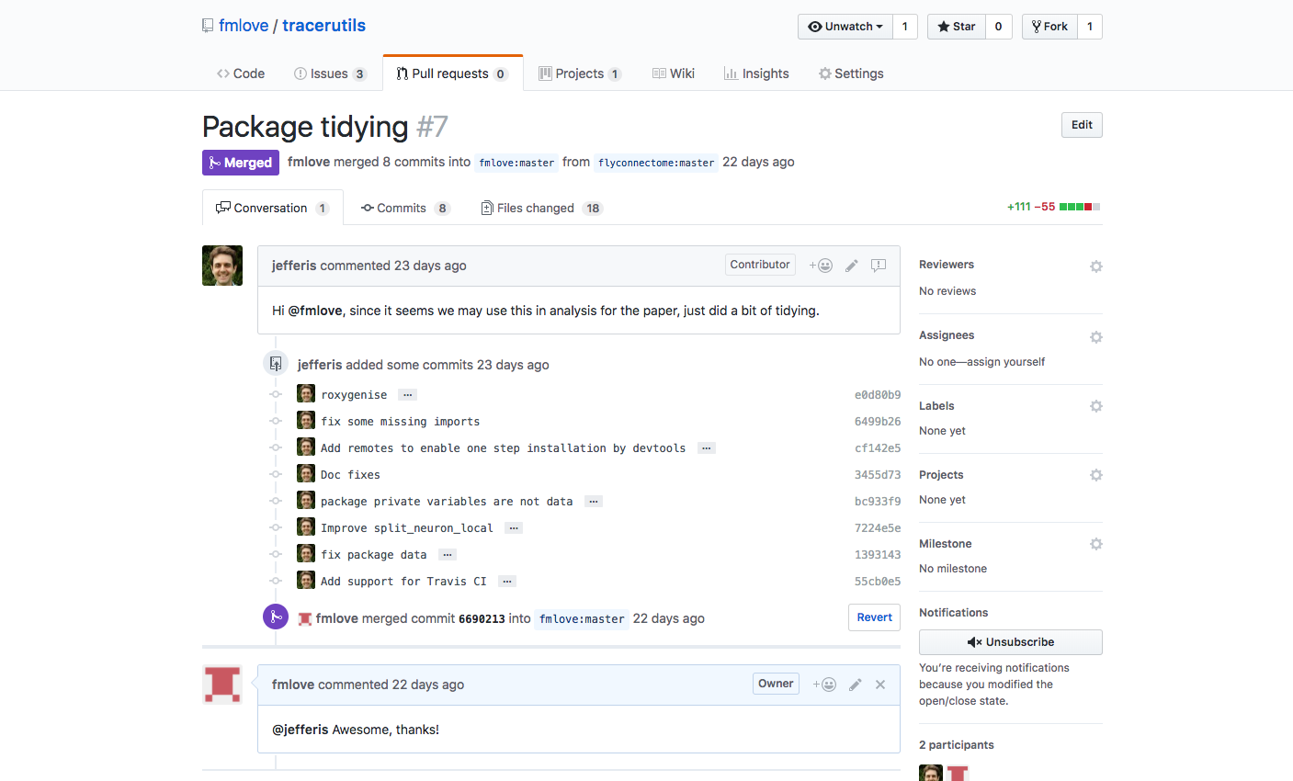
Pull requests in GitHub

Slide 30
Learning Resources
https://guides.github.com/
In particular, https://guides.github.com/introduction/git-handbook/ and https://guides.github.com/activities/hello-world/ are a good place to start
https://www.codecademy.com/learn/learn-git
https://www.codeschool.com/courses/try-git
https://www.atlassian.com/git
This one is from the company behind Bitbucket – a popular alternative to GitHub – so some of the information is geared towards their software, but the basic lessons are still pretty good.

Slide 31
Free private repos!
https://help.github.com/articles/applying-for-an-academic-research-discount/
As an academic researcher, you are entitled to a free Developer account, which gives you unlimited private repos. If you have an @cam or other academic email account, this should only take a few minutes.
It’s still a good idea to share your code wherever possible, so don’t just put everything in private repos, but these can be useful for backing up repos that might include publishable data on neurons or connectivity.
If you’re still a student, you can get that plus a bunch of other cool free stuff!
https://education.github.com/pack

