Slide 1
Real-time Voxelization for Complex Models
Zhao Dong, Wei Chen, Hujun Bao, Hongxin Zhang, Qunsheng Peng
State Key Lab of CAD&CG
Zhejiang University, P.R.China

Slide 2
Outline
Introduction
New voxelization algorithm
Hardware implementation
Results and applications
Future work

Slide 3
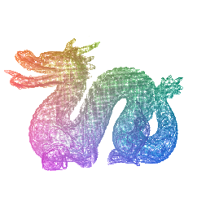
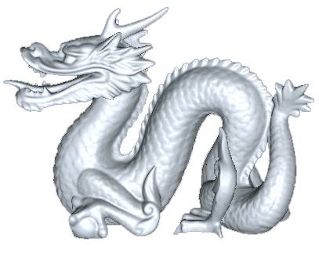
Introduction
Surface Graphics: Geometric rendering of Continuous Spatial Models (CSM)
Volume Graphics: Volumetric Model (VM)
Voxelization
CSM
VM
Notes:
Voxelization of a CSM, manipulation, and volume rendering of

Slide 4

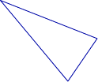
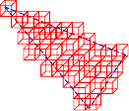
Introduction
Voxelization: A process of approximating a continuous geometric primitive in the 3D discrete space.
The result of this process:
  Binary voxelization ( )
  Non-binary voxelization (densities, color, etc.)

Slide 5
Introduction
Voxelization Algorithm
  Quality-oriented algorithm
    Aliasing Filtering Design [Wang 93, Wang 94]
  Performance-oriented algorithm
    Depth Buffer Based Voxelization [Aggeliki 99]
    Slice-based Voxelization [Fang 99, Fang 00]

Slide 6
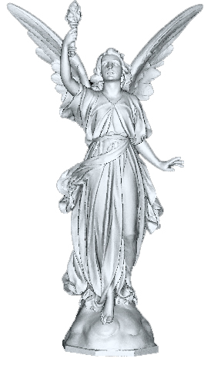
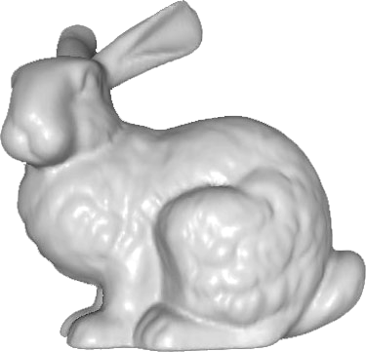
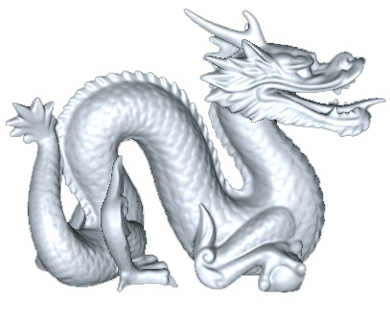
Introduction
The size and complexity of the models are becoming even larger
69,451 triangles
1,132,830 triangles
28,055,742 triangles
Performance has become the main challenge, we focus on it!
Notes:
换bunny

Slide 7
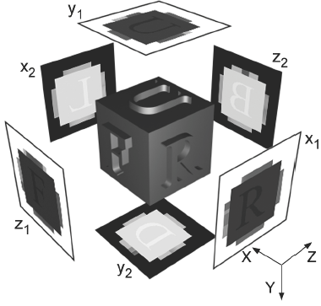
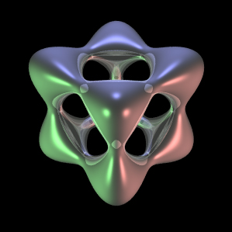
Introduction
Depth Buffer Based Voxelization [Aggeliki 99]
Convexity
requirement

Slide 8
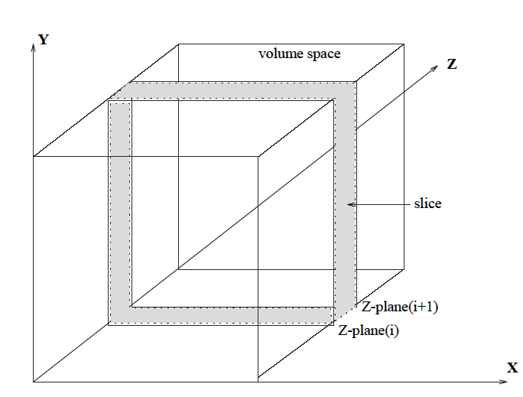
Introduction
Slice-based Voxelization [Fang 99, Fang 00]
Original Model
If i < N
(N=Z-resolution)
Render Model
Z-plane(i+1)
Set Clipping Plane
Z-plane(i)
Get ith Slice
Write to ith 3D texture
else
Final Volume dataset

Slide 9
Introduction
  Slice-based Voxelization algorithm
    One slice each time, render model N times
      Scene complexity↑, volume resolution↑, performance ↓
    High video memory cost
      For binary voxeliztion, One voxel → One byte
    Special hardware requirement
      Write slice to 3D texture memory

Slide 10
Introduction
Our Challenge
  More slices each time, render model at times as less as possible
  Lower video memory cost
    For binary voxelization, one voxel → one bit
  GPU on PC platform to support real-time voxelization

Slide 11
New Voxelization Algorithm
Original Model
CPU work
Sorting geometry by surface normal
Z-oriented
Y-oriented
X-oriented
GPU work
Slab
voxelization
Slab
voxelization
Slab
voxelization
Texture
encoding
Texture
encoding
Texture
encoding
Composite three intermediate textures
Final Volume Dataset
Illustration of new voxelization algorithm stages

Slide 12
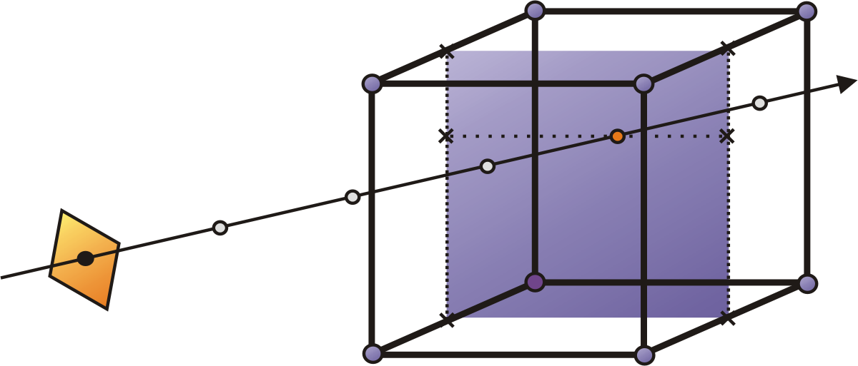
New Voxelization Algorithm
A problem of rasterization by graphics hardware
Projection plane
Volume information will be lost
So we need sort geometry according to
surface orientation

Slide 13
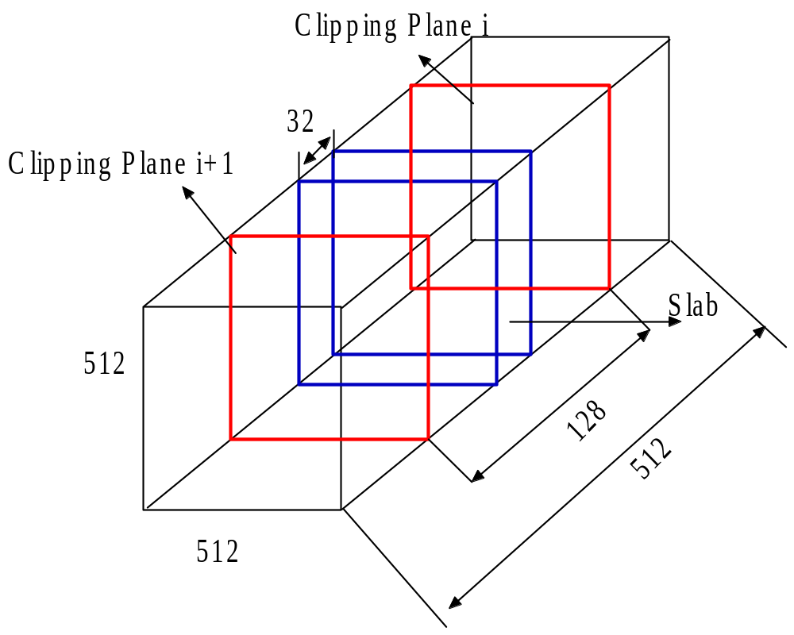
New Voxelization Algorithm
Slab voxelization
An example of binary voxelization at volume resolution 512³
  One bit(0 or 1) to represent One voxel
  Use 512x512 32bits 2D texture to
  record a slab
  If one bit ←→ one voxel then
  512x512x512 = 512x512x32x16
  GPU support 4 Render targets simultaneously☺
  So we need render models only 4 times
Notes:
Flake → slab
In order to make it clear, we shall illustrate

Slide 14
New Voxelization Algorithm
Texture encoding
  After slab voxelization, we get 16 slabs(512x512 2D textures).
  Encode them into a single 2048x2048 2D textures
Clipping Plane i+1
Clipping Plane i
Clipping Plane i+1
Slab11
Slab3
Slab7
Slab15
Clipping Plane i+1
Clipping Plane i
12 | 13 | 14 | 15
8 | 9 | 10 | 11
4 | 5 | 6 | 7
0 | 1 | 2 | 3
Clipping Plane i+1
Clipping Plane i
Slab2
Slab6
Slab10
Slab14
Clipping Plane i
Slab1
Slab5
Slab9
Slab13
2048x2048 intermediate texture
‘0’ represents Z-nearest
‘15’ represents Z-furthest
Slab0
Slab4
Slab8
Slab12

Slide 15
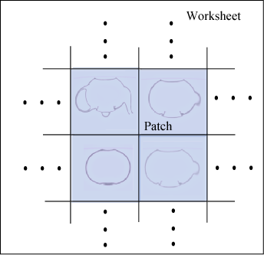
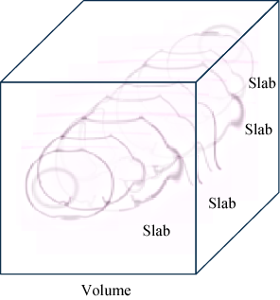
New Voxelization Algorithm
Teapot Example
Slab voxelization
Texture encoding

Slide 16
New Voxelization Algorithm
Composite three parts into one
z
y
x
(x2,y2,z2)
(x1,y1,z1)
(x3,y3,z3)
x
y2 = x1
z2 = y1
x2 = z1
z
x1 = z3
y1 = x3
z1 = y3
y
O
y
O
x
O
z
3D coordinates
for Y-oriented patches
3D coordinates
for Z-oriented patches
3D coordinates
for X-oriented patches
(All are left-hand coordinates)
We integrate the voxelization results of Y-oriented and X-oriented
patches into that of Z-oriented patches

Slide 17
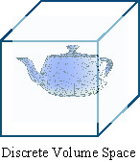
New Voxelization Algorithm
Composition of three intermediate textures
Y-oriented patches
Patches1 in
z-oriented space
Original z-oriented
patches
Coordinates
Transform
Patches0 in
z-oriented space
X-oriented patches
Patches2 in
z-oriented space
Notes:
4个→ 3个
改框图

Slide 18
Hardware Implementation
Related Techniques
  Maximum Texture Size
  Dynamic vertex and index buffers
  Multiple render targets
  Dependent texture fetching
  Lookup Textures
    Fetching one bit
    Storing one bit
    Intermediate textures composition
Efficient bit operation in pixel shader
Notes:
2048x2048
AGP memory
4 render targets

Slide 19
Hardware Implementation
Use of the Resultant Volume
  Deferred video memory
  Read back to main memory
    But AGP is an asymmetric bus, read back from video memory will reduce the efficiency
    PCI-express may offer potential solution

Slide 20
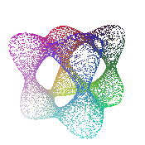
Applications of Algorithm
Voxelization of Surface of Other Forms
  Implicit Surface
  Parametric Surface
  CSG Models
Implicit Surface:
volume resolution is 128³

Slide 21
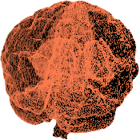
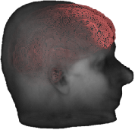
Applications of Algorithm
Transparent Illustration
Interactive hybrid volume rendering

Slide 22
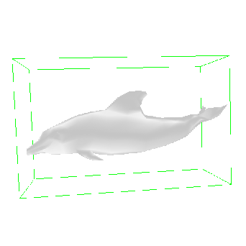
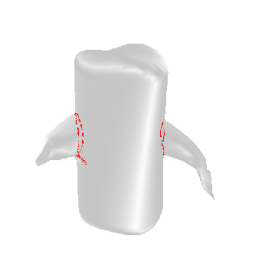
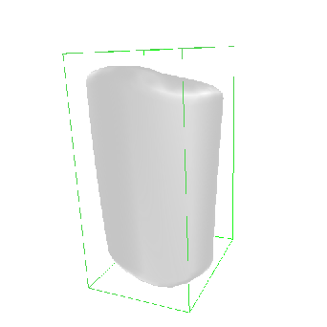
Applications of Algorithm
Collision Detection

Slide 23

Applications of Algorithm
Solid Voxelization
  3D scan-filling similar to 2D scanning
Surface Voxelization
Solid Voxelization

Slide 24
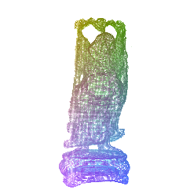
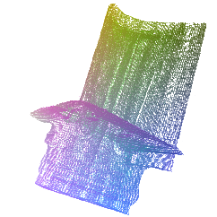
Results
Performance
Dragon
871,326 Triangles
439,370 Vertices
Resolution 256³
Voxelization 57ms
Buddha
1,087,514 Triangles
550,868 Vertices
Resolution 256³
Voxelization 64.8ms
Blade
1,765,388 Triangles
898,796 Vertices
Resolution 256³
Voxelization 95ms
Notes:
加VOXEL数目，分辨率 ，时间

Slide 25
Results
Model | #Triangles | #Vertices | Slab Voxelization | Texture encoding | Composition | Total Time
Buck | 1,254 | 947 | 9.0ms | 8.0ms | 10ms | 27ms
Bugo | 16,928 | 8,634 | 9.7ms | 8.3ms | 10ms | 28ms
Bunny | 69,451 | 34,834 | 12.0ms | 8.0ms | 11ms | 31ms
Dragon | 871,326 | 439,370 | 38.0ms | 8.0ms | 11ms | 57ms
Buddha | 1,087,514 | 550,868 | 47.0ms | 7.8ms | 10ms | 64.8ms
Blade | 1,765,388 | 898,796 | 75.0ms | 8.0ms | 12ms | 95ms
Table 1. Voxelization timings for different model sizes.
Volume resolution: 256³, bit-depth: 8.
Notes:
调整SORTING 位置

Slide 26
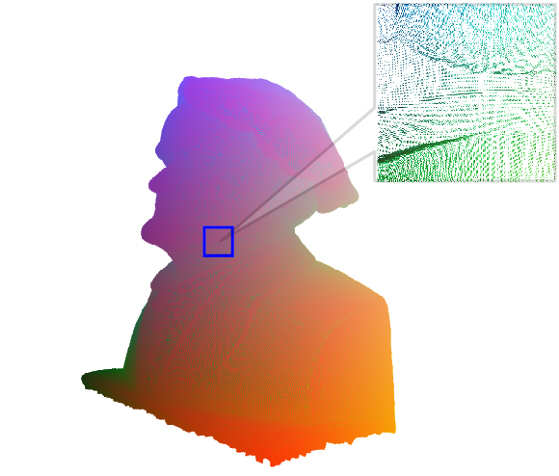
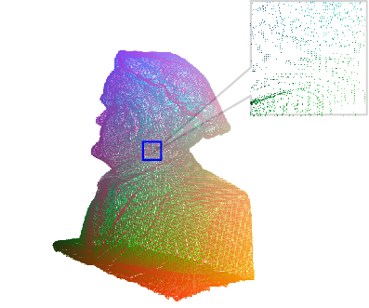
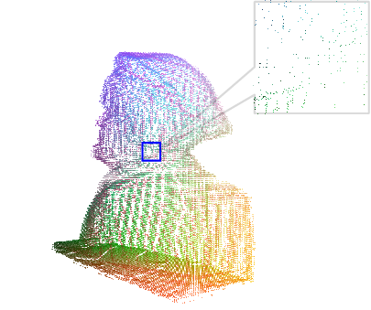
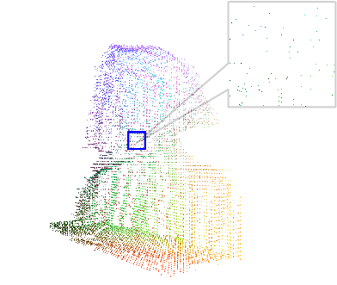
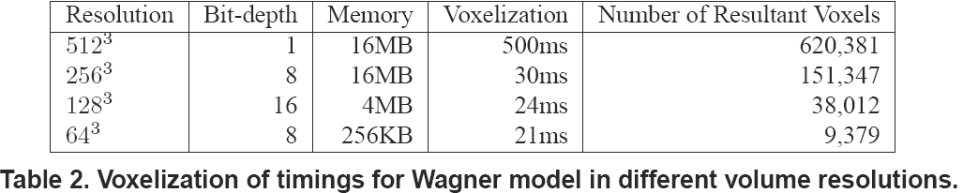
Results
Notes:
改图，清晰

Slide 27
Results
Comparisons
  Two algorithms were implemented on the same hardware platform
    CPU: Intel P4 2.4GHz
    Memory: 512M
    GPU: ATI Radeon 9800Pro with 256M video memory
Model | #Triangles | #Vertices | Slice-based Method | Our Method
Wagner | 60,246 | 30,215 | 320ms | 30ms
Bunny | 69,451 | 34,843 | 336ms | 31ms
Dragon | 871,326 | 439,370 | 3,751ms | 57ms
Buddha | 1,087,514 | 550,868 | 5,263ms | 65ms
Table 3. Comparisons between Slice-based method
and our method

Slide 28
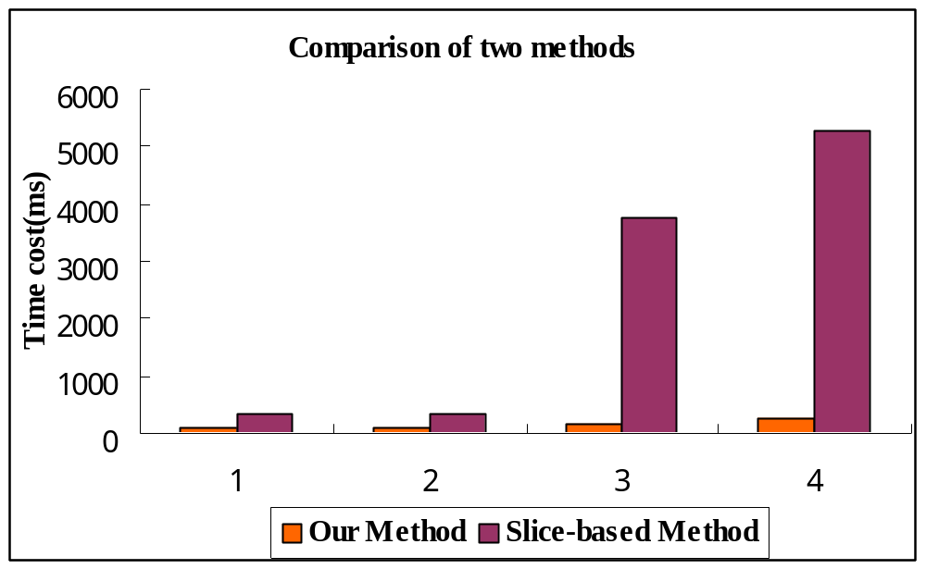
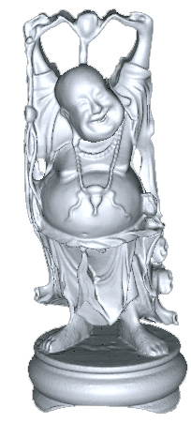
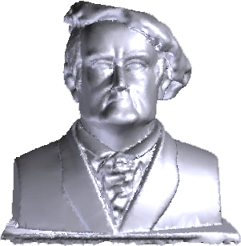
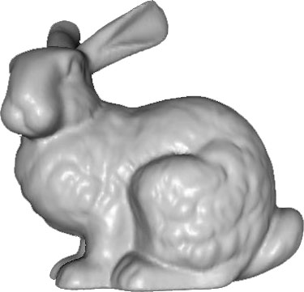
Results
Wagner
Bunny
Dragon
Buddha
Notes:
改表格

Slide 29
Future work
Improvement of the voxelization quality
Video cards that support the blending operation for floating point textures.
  Now Nvidia Geforce 6800 has supported the blending operation for16bit floating point textures
Shade Mode 3.0 has been supported. We can use dynamic judgement in shader program, so sorting geometry can also be finished in GPU
Integration of the voxelization engine → mature software product for market

Slide 30
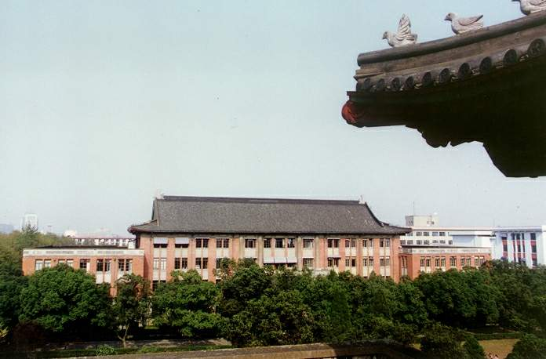
Questions and Answers
Thanks a lot for your attention ☺
Notes:
Thx
Question?

