Slide 1

Recurrent Neural Networks
Notation
deeplearning.ai

Slide 2
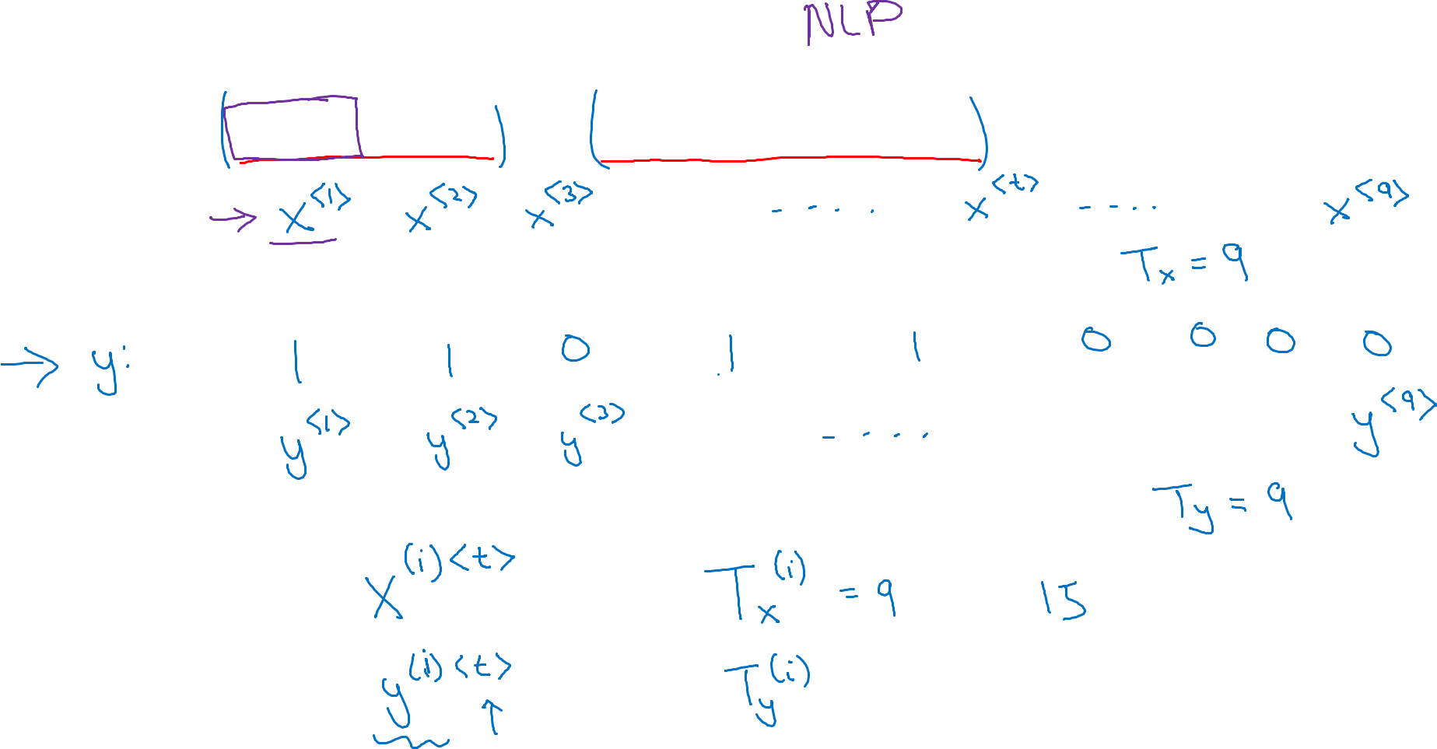
Motivating example
The purpose is to label people’s name
x:
Harry Potter and Hermione Granger invented a new spell.
Total word count for input
i^{th} training example, the t^{th} word
Total word count for input
= 9

Slide 3
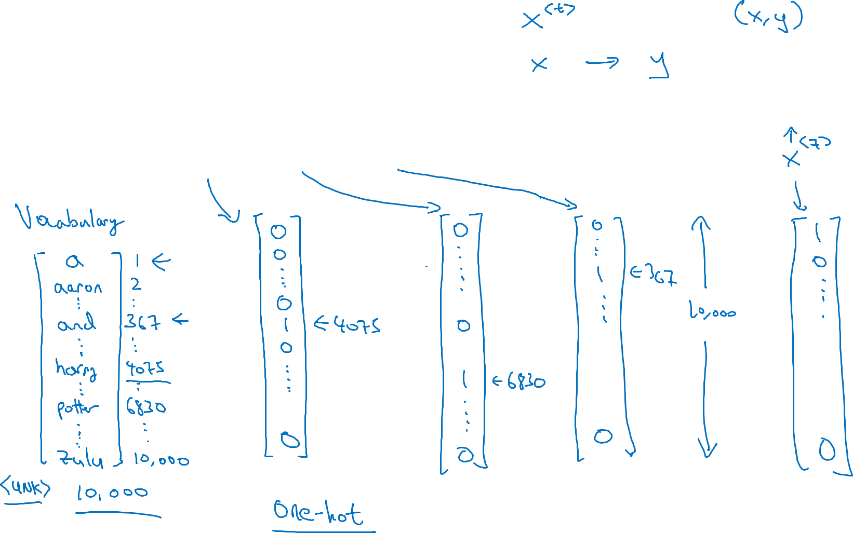





Representing words
x:
Harry Potter and Hermione Granger invented a new spell.
$$x^{<1>}$$
$$x^{<2>}$$
$$x^{<3>}$$
$$⋯$$
$$x^{<9>}$$
Here the vocalulary sample is 10k, for commercial, it could go up to million

Slide 4
Representing words
x:
Harry Potter and Hermione Granger invented a new spell.
$$x^{<1>}$$
$$x^{<2>}$$
$$x^{<3>}$$
$$⋯$$
$$x^{<9>}$$
And = 367
Invented = 4700
A = 1
New = 5976
Spell = 8376
Harry = 4075
Potter = 6830
Hermione = 4200
Gran… = 4000

