Slide 1

NLP and Word Embeddings
Debiasing word embeddings
deeplearning.ai

Slide 2

The problem of bias in word embeddings
Man:Woman as King:Queen
Man:Computer_Programmer as Woman:
Homemaker
Father:Doctor as Mother:
Nurse
Word embeddings can reflect gender, ethnicity, age, sexual orientation, and other biases of the text used to train the model.
[Bolukbasi et. al., 2016. Man is to computer programmer as woman is to homemaker? Debiasing word embeddings]

Slide 3
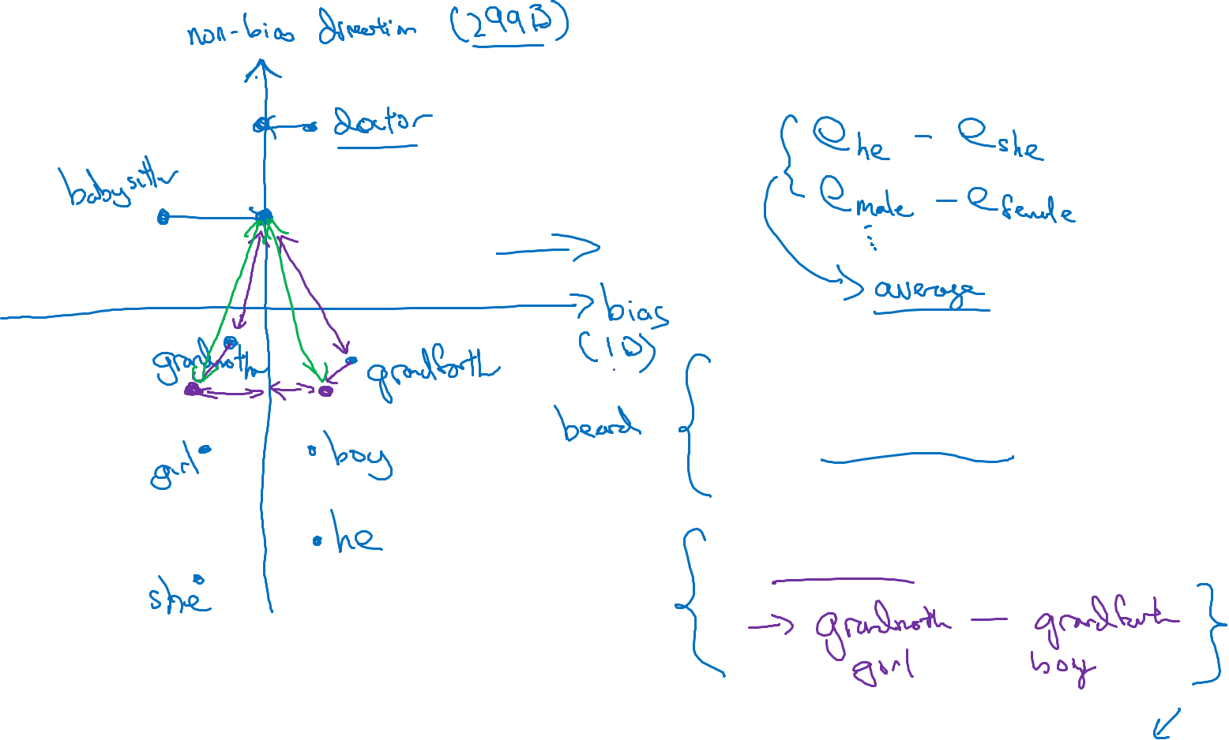
Addressing bias in word embeddings
1. Identify bias direction.
Ex: Word like doctor and babysitter, that do not have legitimate gender component like grandmother or grandfather.
2. Neutralize: For every word that is not definitional, project to get rid of bias.
3. Equalize pairs.
[Bolukbasi et. al., 2016. Man is to computer programmer as woman is to homemaker? Debiasing word embeddings]

