Slide 1

NLP and Word Embeddings
GloVe word vectors
deeplearning.ai

Slide 2
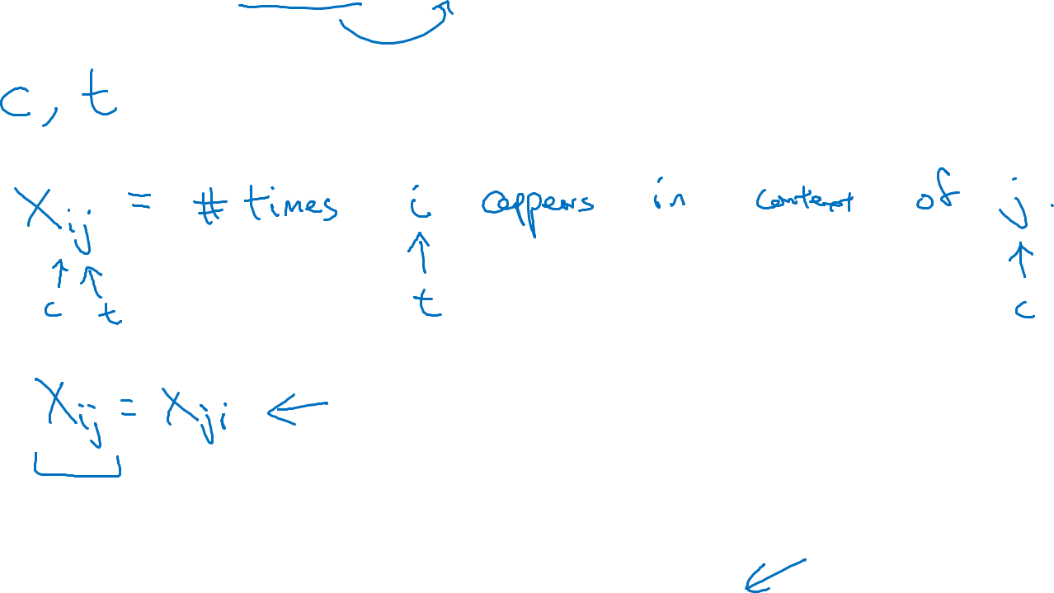
GloVe (global vectors for word representation)
I want a glass of orange juice to go along with my cereal.
j
i
[Pennington et. al., 2014. GloVe: Global vectors for word representation]

Slide 3
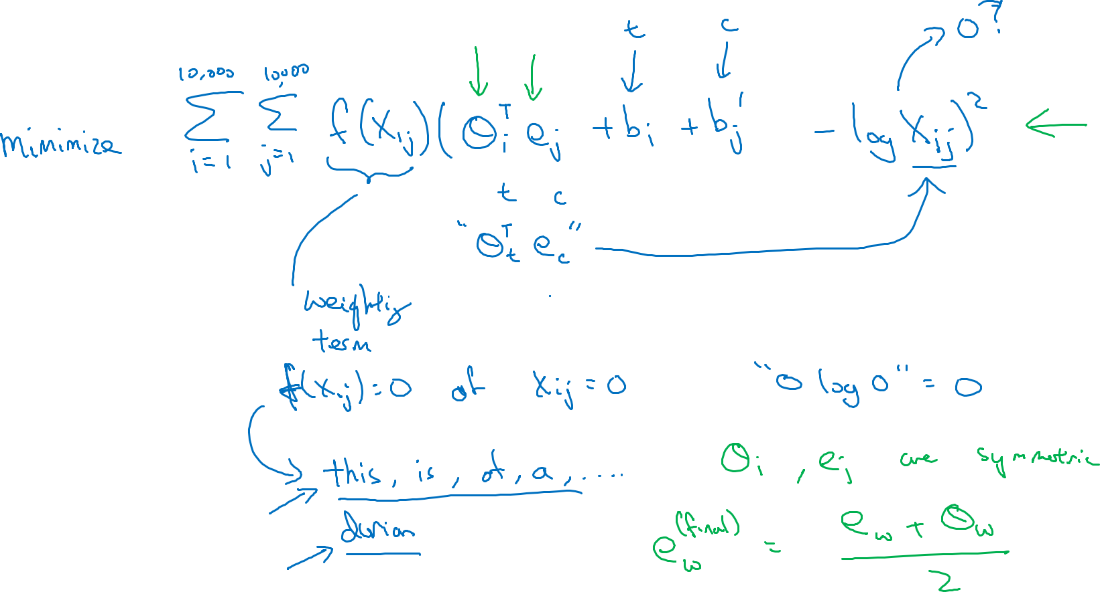
Model

Slide 4





A note on the featurization view of word embeddings
Man
(5391)
Woman
(9853)
King
(4914)
Queen
(7157)
Gender
$$−1$$
1
-0.95
$$0.97$$
Royal
$$0.01$$
0.02
0.93
$$0.95$$
Age
0.03
0.02
0.70
0.69
Food
0.09
0.01
0.02
0.01
When we are using the algorithm to learn word embedding( the feature associated with each word), The feature might not be interpretable. This is because, there is no guarantee that the first axis of the embedding vector is aligned with the axis that has a meaning such as gender, royal and etc. In reality, the first and second vector might be like e_{w1} and e_{w2} They might not even orthogonal.
m$inimize \sum_{i=1}^{10,000}{\sum_{j=1}^{10,000}{f\left(X_{ij}\right){\left(θ_{i}^{T}e_{j}+b_{i}−b_{j}^{′}−\log{X_{ij}}\right)}^{2}}}$
+
Here is the explaination, if we multiply a A to the two vector, we can rotate them but the result remians the same..

