Slide 1

NLP and Word Embeddings
Negative sampling
deeplearning.ai

Slide 2
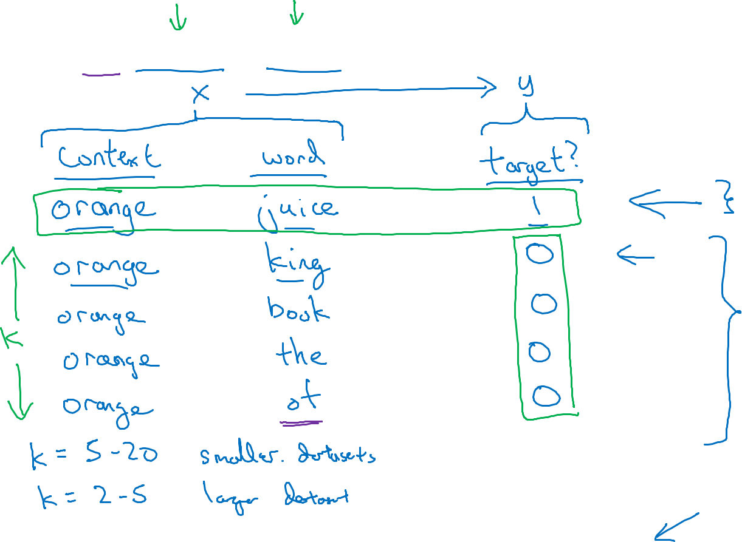
Defining a new learning problem
I want a glass of orange juice to go along with my cereal.
Then this becomes a supervised learning problem
Target = 1 ( positive example), means context and word are the right pair.
Then we will generate K negative example ( Target = 0)
It is okay to have a word that is within the fixed window size of the target word.
[Mikolov et. al., 2013. Distributed representation of words and phrases and their compositionality]

Slide 3
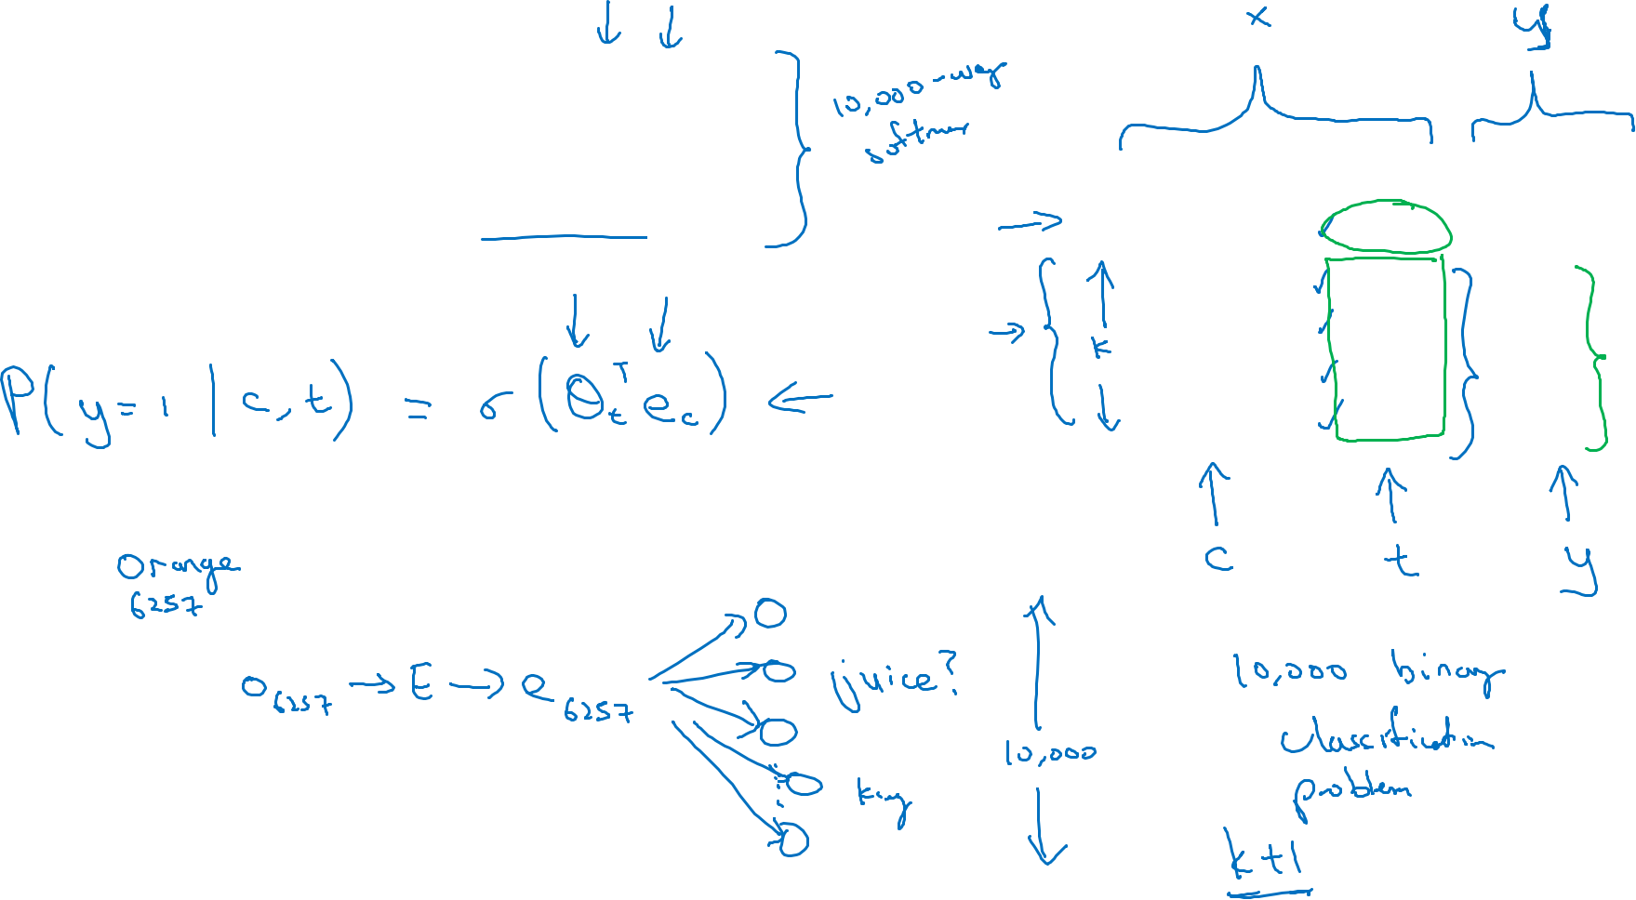



Model
This is the softmax function which is computational intensive
$$p\left(t | c\right)=\frac{e^{θ_{t}^{T}e_{c}}}{\sum_{j=1}^{10,000}{e^{θ_{j}^{T}e_{c}}}}$$
Softmax:
context
word
target?
We have K : 1 ratio between positve and negative training samples
orange
juice
$$1$$
orange
king
$$0$$
orange
book
$$0$$
orange
the
$$0$$
orange
of
$$0$$
There will be 10, 000 logistic regression, but instead of traning 10,000 logistic regression( binary classification), we will train K + 1 samles per iteration. ( in this case 4 negative and 1 postive case)
Content
Target
Onehot of input word
Embedding Matrix
Embedding
Vector

Slide 4
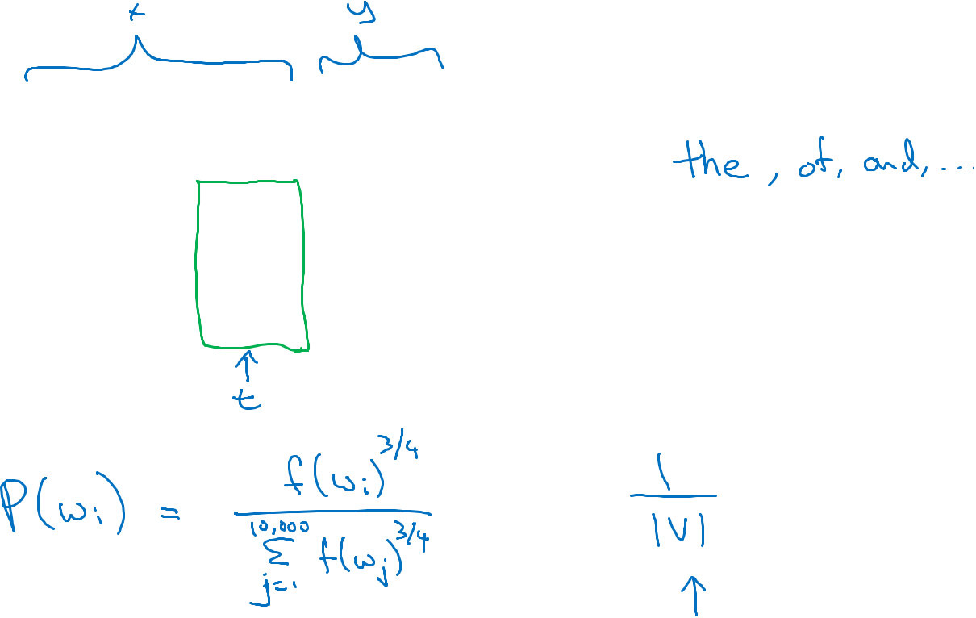
Selecting negative examples
context
word
target?
If you sample based on emperical frequency, you will get these useless words:
orange
juice
$$1$$
orange
king
$$0$$
orange
book
$$0$$
orange
the
$$0$$
orange
of
$$0$$
f(w_{i})is the observed frequency a particular word w_{i} in English or in the training set corpus.

