Slide 1

NLP and Word Embeddings
Sentiment classification
deeplearning.ai

Slide 2
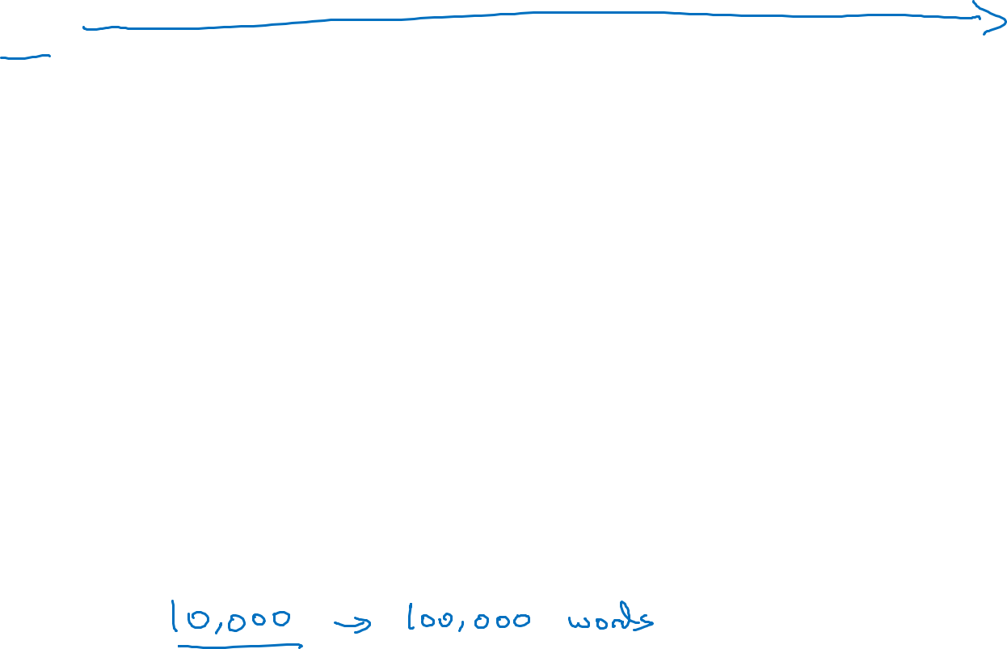


Sentiment classification problem
$$x$$
$$y$$
The dessert is excellent.
Service was quite slow.
Good for a quick meal, but nothing special.
Completely lacking in good taste, good service, and good ambience.
The common dataset varies from 10, 000 to 100,000 words

Slide 3








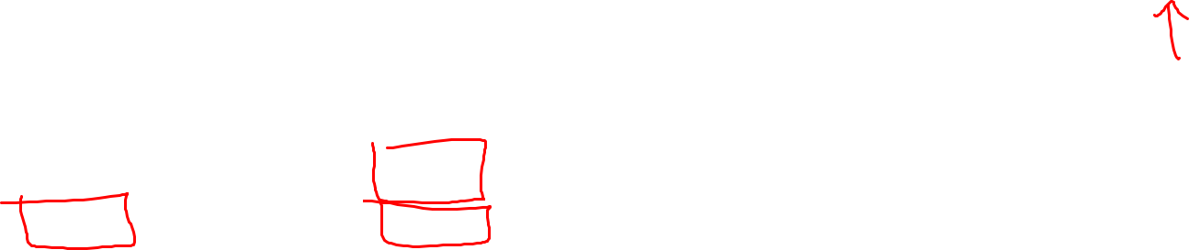
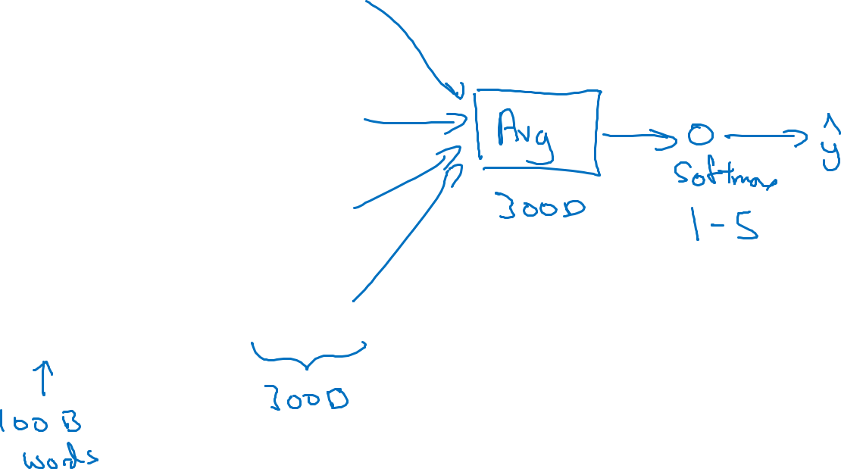





Simple sentiment classification model
The dessert is excellent
$$8928$$
$$2468$$
$$4694$$
$$3180$$
The embedding matrix may have been trained for 100 billion words
The
$$o_{8928}$$
$$E$$
$$e_{8928}$$
Sum / average
desert
$$o_{2468}$$
$$E$$
$$e_{2468}$$
is
$$o_{4694}$$
$$E$$
$$e_{4694}$$
Softmax to output 1 start to 5 star
excellent
$$o_{3180}$$
$$E$$
$$e_{3180}$$
“Completely lacking in good taste, good service, and good ambience.”
The problem of the algorithm is it ignoiring the order. Such as the sentence on the left. It should be a very negative review but could be classified as a positive one.

Slide 4













RNN for sentiment classification
$$\hat{y}$$
softmax
$$a^{<0>}$$
$$a^{<1>}$$
$$a^{<2>}$$
$$a^{<3>}$$
$$a^{<4>}$$
$$⋯$$
$$a^{<10>}$$
$$e_{1852}$$
$$e_{4966}$$
$$e_{4427}$$
$$e_{3882}$$
$$e_{330}$$
$$E$$
$$E$$
$$E$$
$$E$$
$$E$$
Completely lacking in good …. ambience
This is the many-to-oneRNN architecutre

