Slide 1

Sequence to sequence models
Attention model
deeplearning.ai

Slide 2
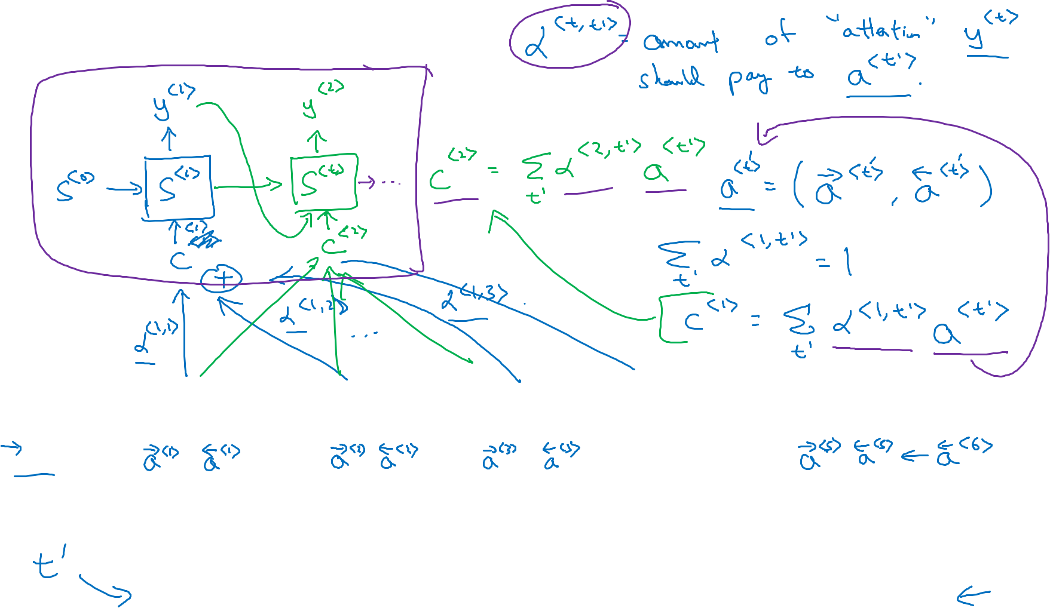






Attention model
$$a^{<0>}$$
$$x^{<1>}$$
$$x^{<2>}$$
$$x^{<3>}$$
$$x^{<4>}$$
$$x^{<5>}$$
jane
visite
l’Afrique
en
septembre
[Bahdanau et. al., 2014. Neural machine translation by jointly learning to align and translate]

Slide 3






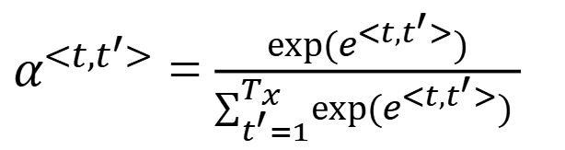
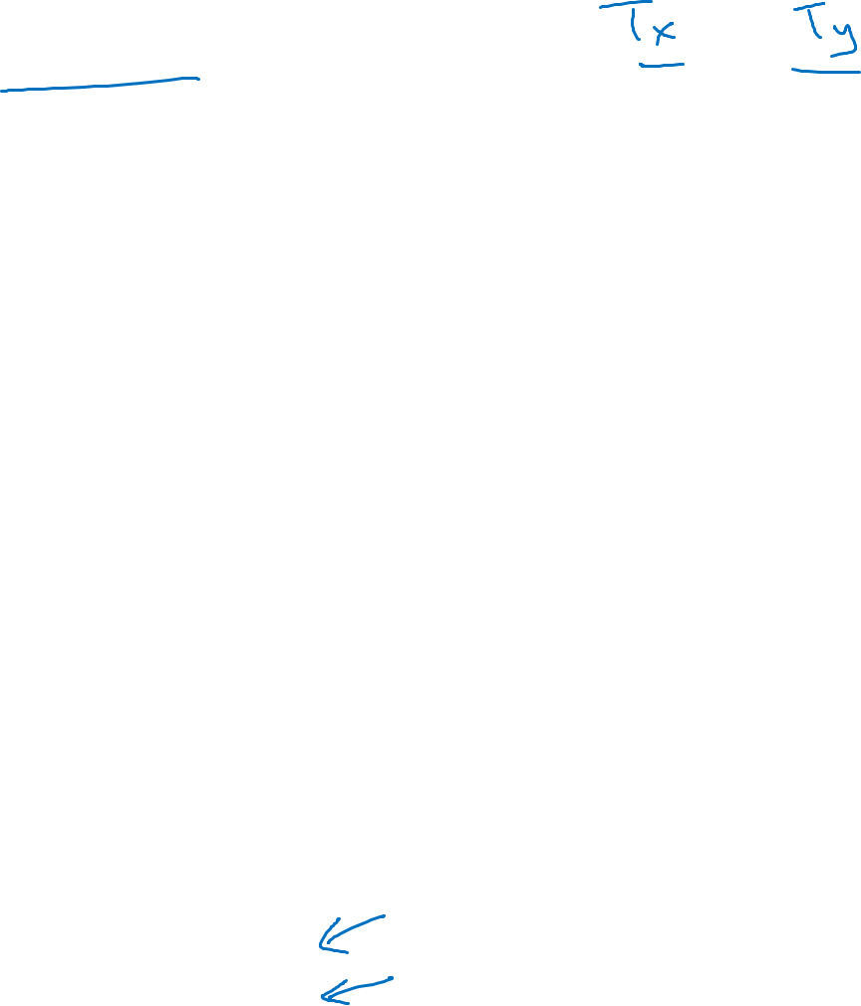









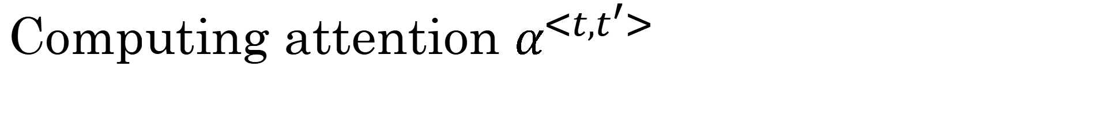
Computing attention $α^{<t,t^{′}>}$
$α^{<t,t^{′}>}$ = amount of attention $y^{<t >}$ should pay to $a^{<t^{′}>}$
$${\hat{y}}^{<t−1>}$$
$${\hat{y}}^{<t>}$$
$α^{<t,t^{′}>}$ = $\frac{exp⁡(e^{<t,t^{′}>})}{∑_{t^{′}=1}^{T_{x}}exp⁡(e^{<t,t^{′}>}) }$
$$s^{<t−1>}$$
$$s^{<t>}$$
$$+$$
$$s^{<t−1>}$$
$$e^{<t,t^{′}>}$$
$$a^{<t^{′}>}$$
$$a^{<0>}$$
$$⋯$$
$$x^{<1>}$$
$$x^{<2>}$$
$$x^{<T_{x}−1>}$$
$$x^{<T_{x}>}$$
[Bahdanau et. al., 2014. Neural machine translation by jointly learning to align and translate]
[Xu et. al., 2015. Show, attend and tell: Neural image caption generation with visual attention]

Slide 4
Computing attention $α^{<t,t^{′}>}$
$α^{<t,t^{′}>}$ = amount of attention $y^{<t >}$ should pay to $a^{<t^{′}>}$
For ever fixed t, the sumation equals to 1, like a softmax.
$${\hat{y}}^{<t−1>}$$
$${\hat{y}}^{<t>}$$
$α^{<t,t^{′}>}$ = $\frac{exp⁡(e^{<t,t^{′}>})}{∑_{t^{′}=1}^{T_{x}}exp⁡(e^{<t,t^{′}>}) }$
$$s^{<t−1>}$$
$$s^{<t>}$$
We will use a small NN to calculate e^{<t,t’>} , typically one hidden layer NN
$$+$$
a^{<t’>}
$$s^{<t−1>}$$
$$e^{<t,t^{′}>}$$
$$a^{<0>}$$
$$⋯$$
$$a^{<t^{′}>}$$
$$x^{<1>}$$
$$x^{<2>}$$
$$x^{<T_{x}−1>}$$
$$x^{<T_{x}>}$$
S^{<t-1>} is the hidden state from previous time step that is fed into S^{<t>}
a^{<t’>} is the feature from time t’
[Bahdanau et. al., 2014. Neural machine translation by jointly learning to align and translate]
[Xu et. al., 2015. Show, attend and tell: Neural image caption generation with visual attention]

Slide 5
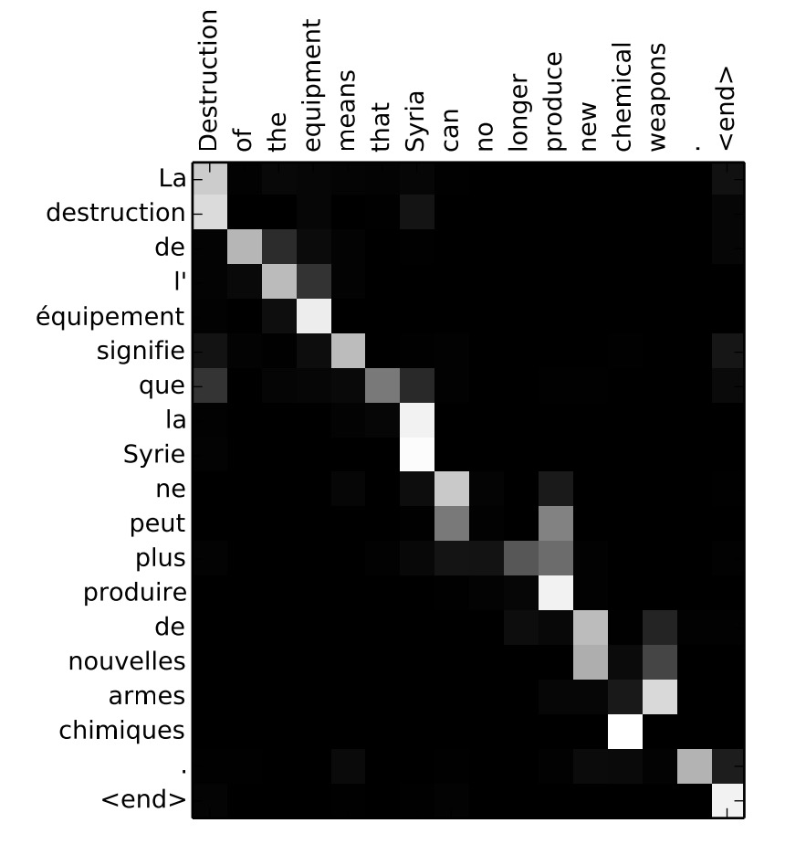
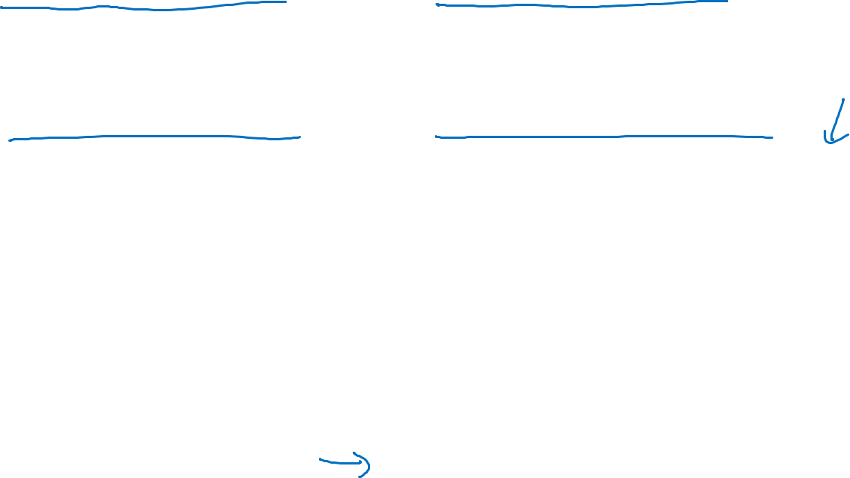




Attention examples
July 20th 1969
$1969−07−20$
This is one application, where you can normalize the date in specific format
${23}^{ }$April, $1564$
$1564−04−23$
here's a machine translation example and here were plotted in different colors. the magnitude of the different attention waitsThe corresponding input and output words you find that the attention waits will tend to be high.
Visualization of $α^{<t,t^{′}>}$:

