Slide 1

Sequence to sequence models
Attention model intuition
deeplearning.ai

Slide 2
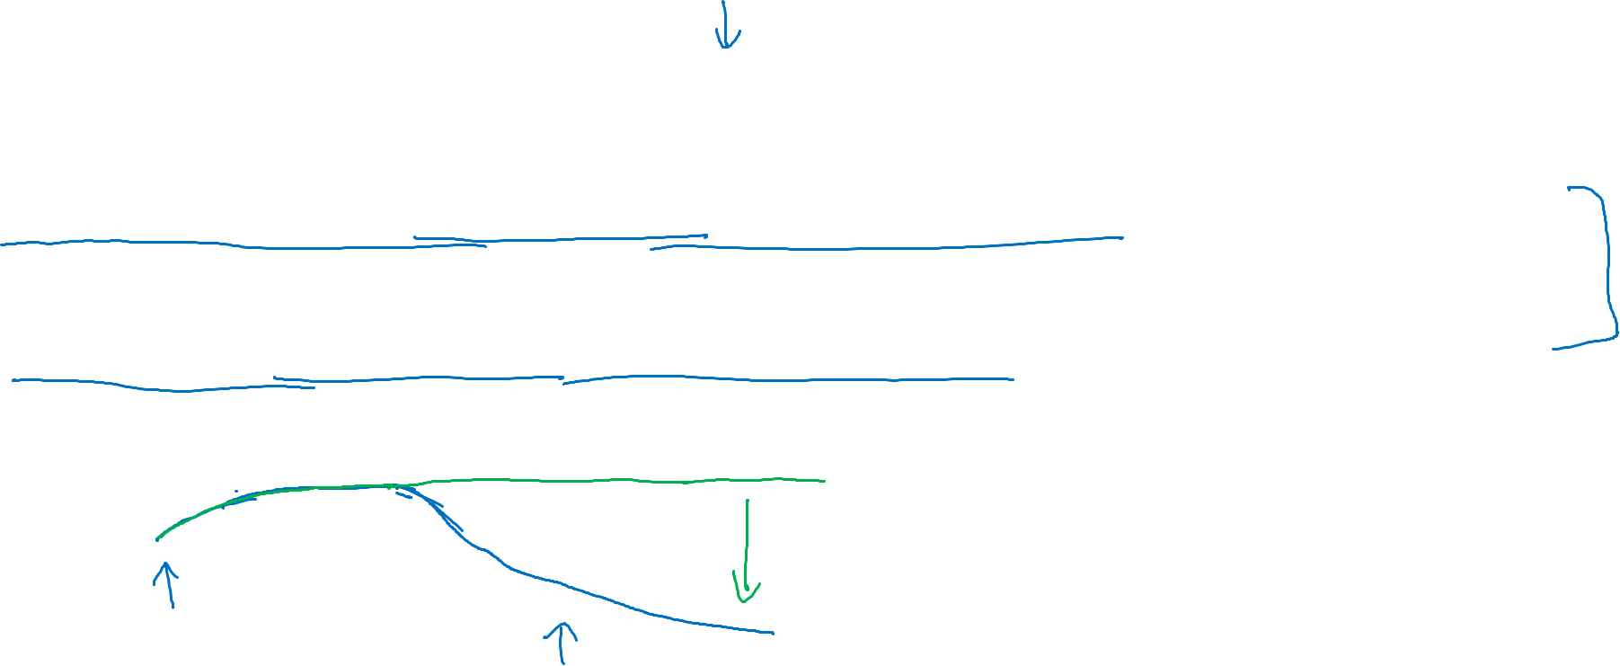







The problem of long sequences
The Green Encoder will read the whole sentence and memorize and store it in the activation conveyed here.
$${{\hat{y}}^{<1>}}^{ }$$
$${{\hat{y}}^{<T_{y}>}}^{ }$$
$$a^{<0>}$$
$$⋯$$
$$⋯$$
$$x^{<1>}$$
$$x^{<T_{x}>}$$
Jane s'est rendue en Afrique en septembre dernier, a apprécié la culture et a rencontré beaucoup de gens merveilleux; elle est revenue en parlant comment son voyage était merveilleux, et elle me tente d'y aller aussi.
Jane went to Africa last September, and enjoyed the culture and met many wonderful people; she came back raving about how wonderful her trip was, and is tempting me to go too.
Bleu
score
The Green Encoder will read the whole sentence and memorize and store it in the activation conveyed here.
10
20
30
40
50
Sentence length

Slide 3








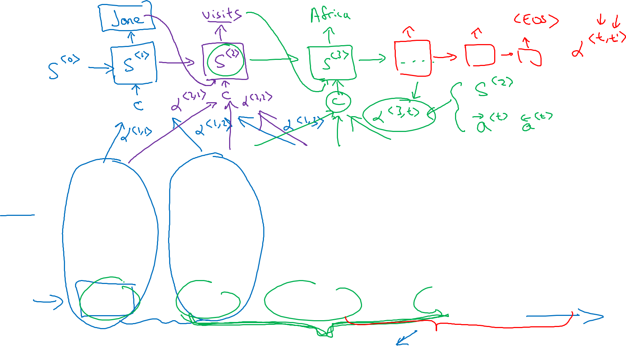



Attention model intuition
$${\hat{y}}^{<1> }$$
$${\hat{y}}^{<2> }$$
$${\hat{y}}^{<3> }$$
$${\hat{y}}^{<4> }$$
$${\hat{y}}^{<5> }$$
$$a^{<0>}$$
$$x^{<1>}$$
$$x^{<2>}$$
$$x^{<3>}$$
$$x^{<4>}$$
$$x^{<5>}$$
jane
visite
l’Afrique
en
septembre
[Bahdanau et. al., 2014. Neural machine translation by jointly learning to align and translate]

