Slide 1

Sequence to sequence models
Bleu score
(optional)
deeplearning.ai

Slide 2
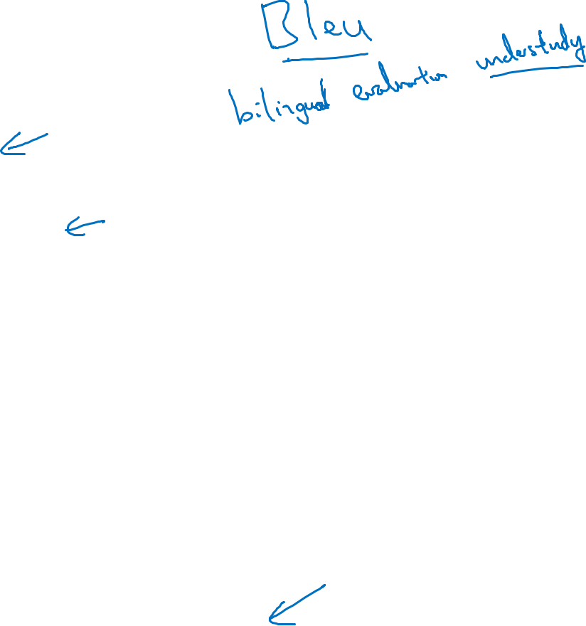
Evaluating machine translation
French: Le chat est sur le tapis.
Reference 1: The cat is on the mat.
Reference 2: There is a cat on the mat.
MT output: the the the the the the the.
MT: Machine Translation
Precision:
Modified precision:
This is also called unigrams
Basically to check whether the word predicted by MT output appears in Reference 1 or 2.
Apparently, the precision = 7/7, which seems like a good translation but actually is terrible.
Weare looking for the reference with the maximum number of a particular word and set the maximum appearing of this word to this number.
Ex: “ The “ appears once and twice on Ref 1 and Ref 2. So se set it to be 2. Then the Modified Precision is 2/7. The numerator is Countclip from Ref,
The demominator is Cout from MT.
[Papineni et. al., 2002. Bleu: A method for automatic evaluation of machine translation]

Slide 3
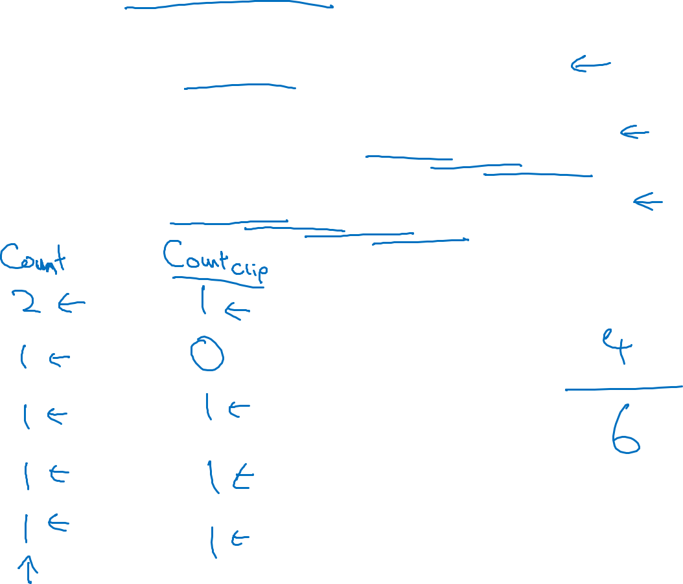
Bleu score on bigrams
so far, we've been looking at words in isolation. In the BLEU score, you don't want to just look at isolated words. You maybe want to look at pairs of words as well.Bigrams means a pair of word appeard next to each other.
Example:
Reference 1: The cat is on the mat.
Reference 2: There is a cat on the mat.
MT output: The cat the cat on the mat.
Bigrams of MT output
Clip the Count to the max number that appears in Ref1 or Ref 2
the cat
cat the
On Ref 1 or Ref 2
Modifed Precision on the bigrams:
cat on
On MT
on the
the mat
[Papineni et. al., 2002. Bleu: A method for automatic evaluation of machine translation]

Slide 4
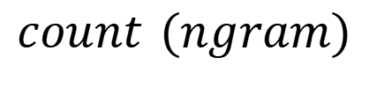
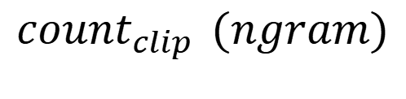
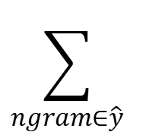
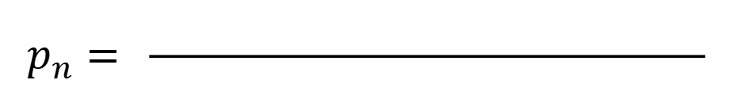
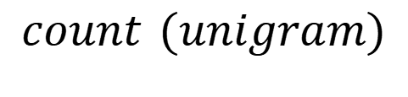
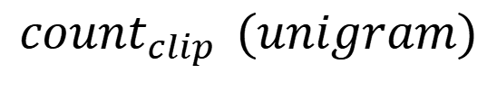

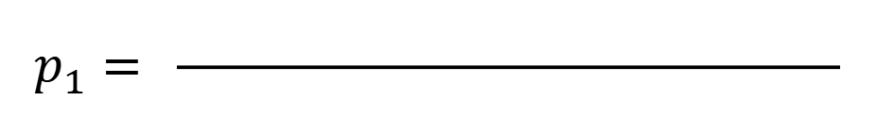
Bleu score on unigrams
Example:
Reference 1: The cat is on the mat.
Reference 2: There is a cat on the mat.
MT output: The cat the cat on the mat.
$$\sum_{unigram∈\hat{y}}^{ }{ }$$
$$\underset{ }{count_{clip}}{(unigram)}$$
$$\sum_{ngram∈\hat{y}}^{ }{ }$$
$$\underset{ }{count_{clip}}{(ngram)}$$
$$p_{1}= \frac{ }{ }$$
$$p_{n}= \frac{ }{ }$$
$$\sum_{unigram∈\hat{y}}^{ }{ }$$
$$\underset{ }{count_{ }}{(unigram)}$$
$$\sum_{ngram∈\hat{y}}^{ }{ }$$
$$\underset{ }{count_{ }}{(ngram)}$$
[Papineni et. al., 2002. Bleu: A method for automatic evaluation of machine translation]

Slide 5
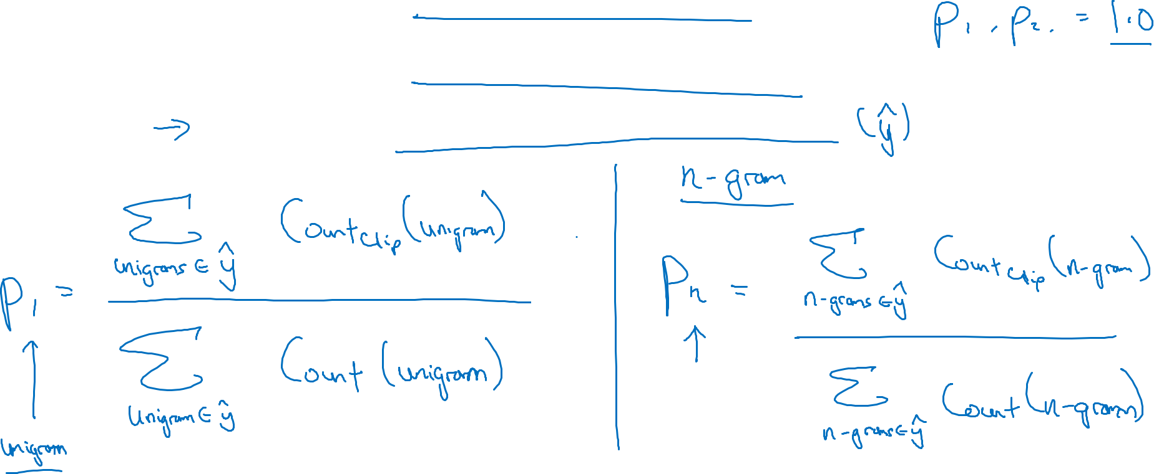
Bleu score on unigrams
If the MT is the same as Ref1 or Ref 2, then P1 and P2 will all be 1.
Example:
Reference 1: The cat is on the mat.
Reference 2: There is a cat on the mat.
MT output: The cat the cat on the mat.
We have introduced bigrams, N=2
[Papineni et. al., 2002. Bleu: A method for automatic evaluation of machine translation]

Slide 6
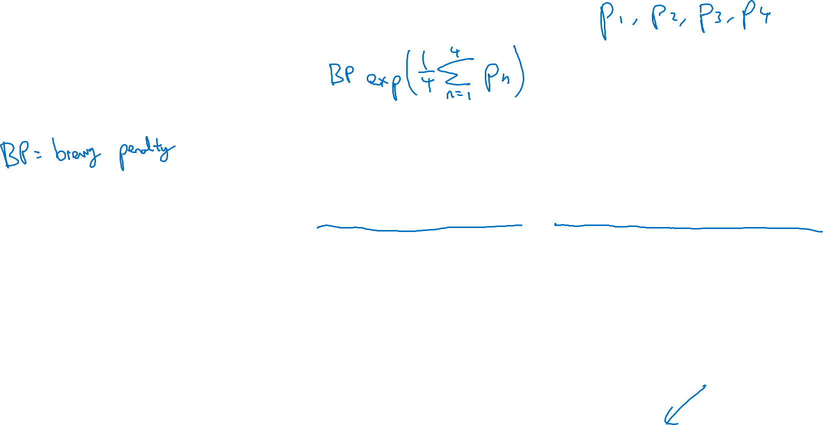
Bleu details
$p_{n}=$ Bleu score on n-grams only
Combined Bleu score:
If we just use n = 4
BP: Brevity penalty
We adjust this score with BP. If the output is very short translation, it is easier to get high precision. So BP is the penalize if the output translation is too short.
$1$ if MT_output_length > reference_output_length
BP =
$exp⁡(1−reference_output_length/MT_output_length$) otherwise
[Papineni et. al., 2002. Bleu: A method for automatic evaluation of machine translation]

