Slide 1

Sequence to sequence models
Error analysis on beam search
deeplearning.ai

Slide 2





Example
Jane visite l’Afrique en septembre.
Human: Jane visits Africa in September.
Algorithm: Jane visited Africa last September.
In this way you can tell whether the error coming from RNN or Beam Search
$$a^{<0>}$$
$$⋯$$
$$x^{<1>}$$
$$x^{<T_{x}>}$$

Slide 3
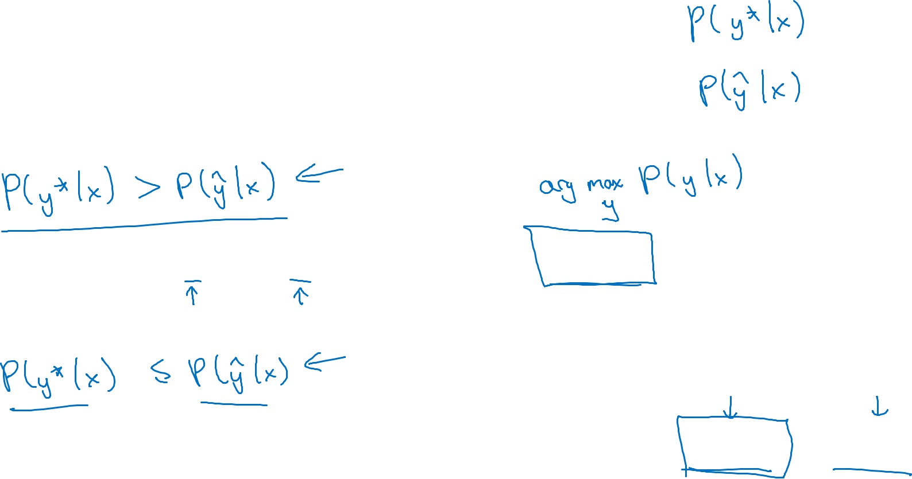
Error analysis on beam search
Human: Jane visits Africa in September. ${(y}^{∗})$
Algorithm: Jane visited Africa last September. $(\hat{y})$
Case 1:
Beam search chose $\hat{y}$. But $y^{∗}$ attains higher $P\left(y | x\right).$
Conclusion: Beam search is at fault.
Case 2:
One detail is that if you use length normalization, then you should use normailize the length here when comparing this probability
$y^{∗}$is a better translation than $\hat{y}.$ But RNN predicted $P\left(y^{∗} | x\right)<P\left(\hat{y} | x\right).$
Conclusion: RNN model is at fault.

Slide 4
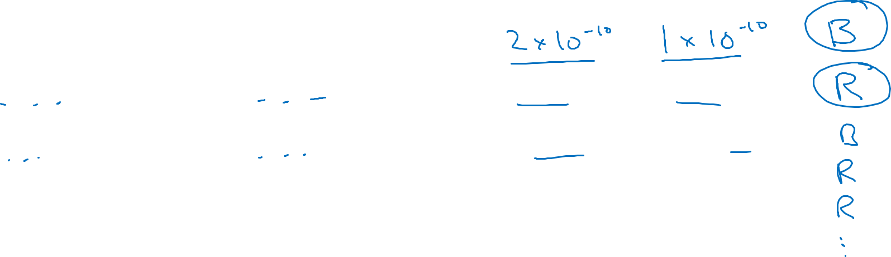


Error analysis process
Human
Algorithm
$$P\left(y^{∗} | x\right)$$
$$P\left(\hat{y} | x\right)$$
At fault?
Jane visits Africa in September.
Jane visited Africa last September.
Figures out what faction of errors are “due to” beam search vs. RNN model

