Slide 1

Sequence to sequence models
Refinements to beam search
deeplearning.ai

Slide 2
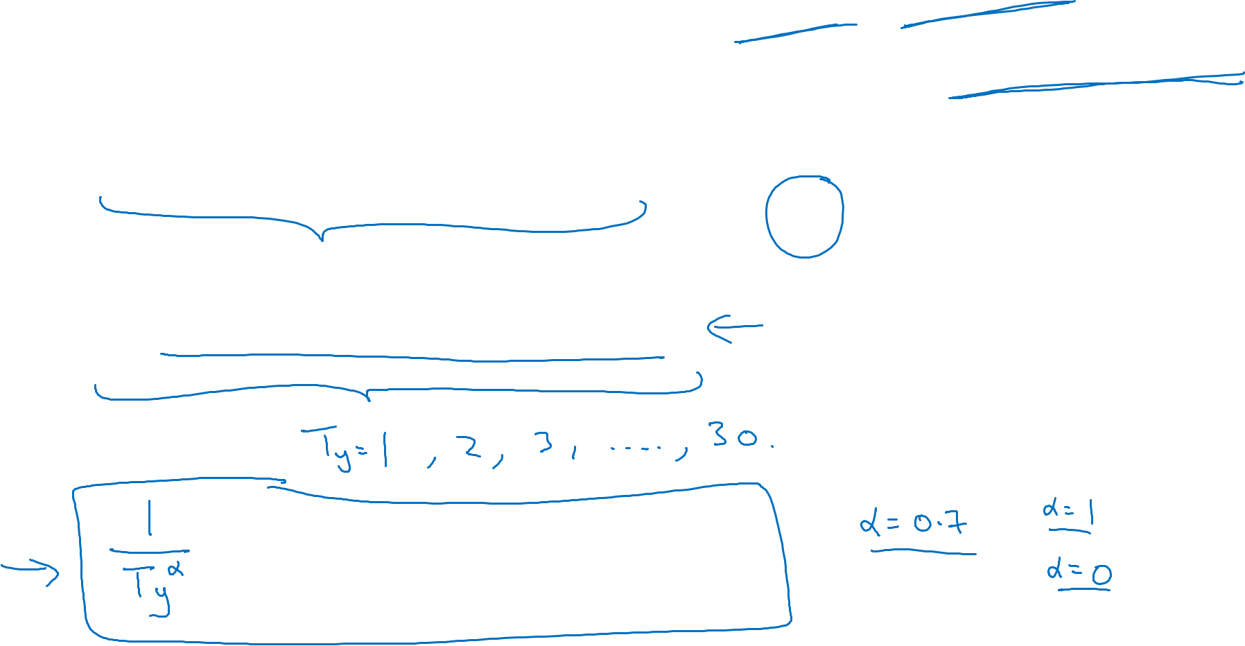
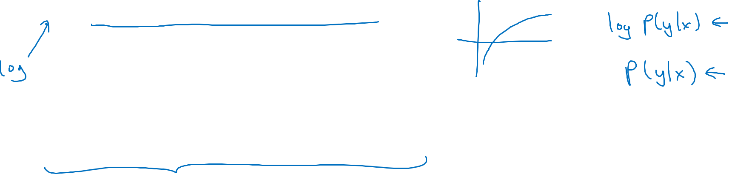
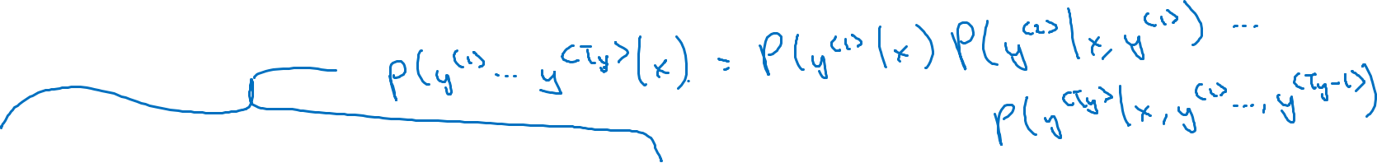
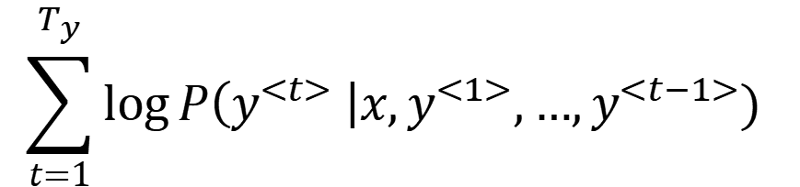
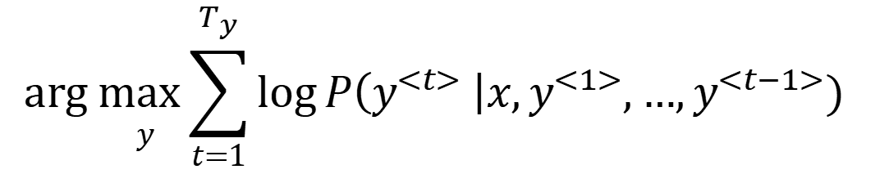
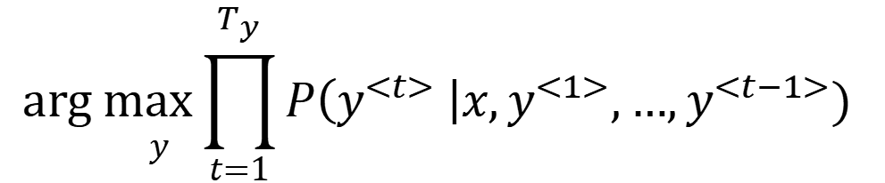
Length normalization
$${\underset{ y}{arg max}{\prod_{t=1}^{T_{y}}{P\left(y^{<t>} \right|x,y^{<1>},…,y^{<t−1>})}}}_{ }$$
The Probability are very small number, which will lead to numerical underflow.
To overcome this, we take log
①
②
$${\underset{ y}{arg max}{\sum_{t=1}^{T_{y}}{\log{P\left(y^{<t>} \right|x,y^{<1>},…,y^{<t−1>}) }}}}_{ }^{ }$$
if we have a long senstence, the probability will be low. The longer the sentence, the lower the probability. In that sense, the alg will always recommend shorter senstence. The same as you take log, the longer the sentence, the more negative the logTo overcome this, we normalized to the length of the sentence.
$$\sum_{t=1}^{T_{y}}{\log{P\left(y^{<t>} \right|x,y^{<1>},…,y^{<t−1>}) }}$$
③
In practice, we will normalize to Ty to the α, which is a hyperparamter. The rule of thumb is 0.7
(4)
Given Bean Search width =3,you will be keeping track of the top three possibilities for each of these possible sentence lengths, 1, 2, 3, 4 and so on, up to 30. Then look at all the output sentences against this score. Then pick the one with highest score.

Slide 3
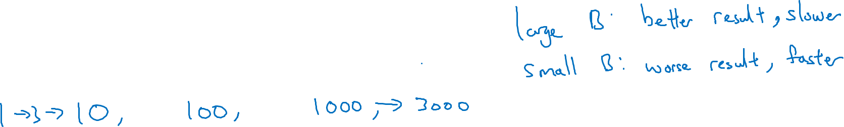
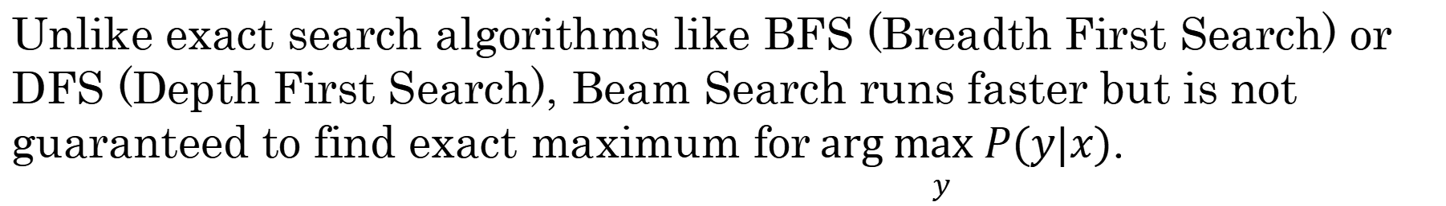
Beam search discussion
Beam width B?
These are more realistic number for production. B = 100 would consider a very large number for production.
Sometime, we will see these numbers used in reseach field.
We will see huge gain when choosing B from 1 to 10 but not that much from 1000 to 2000.
Unlike exact search algorithms like BFS (Breadth First Search) or DFS (Depth First Search), Beam Search runs faster but is not guaranteed to find exact maximum for$\underset{ y}{arg max} P(y|x)$.

