Slide 1
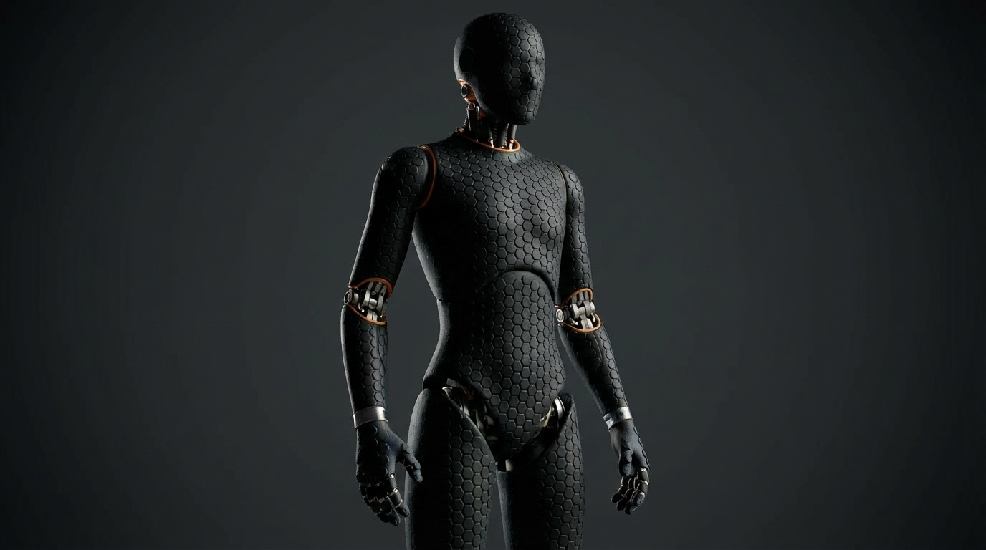
TACTOSKIN
The Missing Modality
Exploring the next frontier of robot-world interaction through touch
TACTOSKIN
01/08

Slide 2

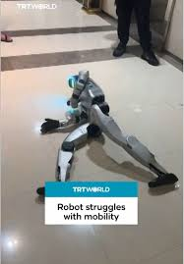

WHY DO ROBOTS STILL FALL?
80%
of robot behavior can be learned from video
The remaining 20% requires physical interaction with the real world.
Falling. Dropping fragile objects. Failing delicate tasks.
These failures share one root cause — robots cannot feel.
TACTOSKIN
02/08
Touch data is the missing dimension. That's what we're building.

Slide 3


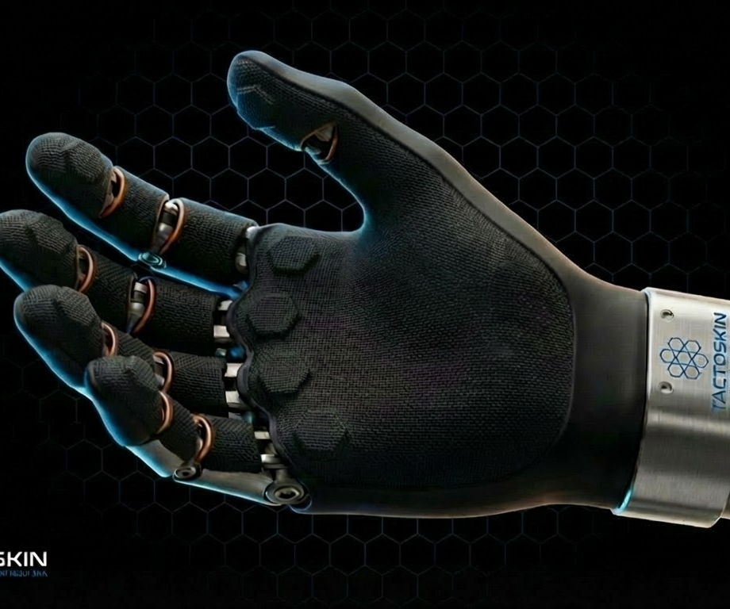
TactoSkin · Modular Tactile Intelligence
Snap-on hex modules · 5s swap
55,000–72,000 sensels full-body
One interface standard · scales to any robot
5-Layer Architecture
Protective
Impact
Thermal
Tactile Array
FPC
TACTOSKIN
03/08

Slide 4


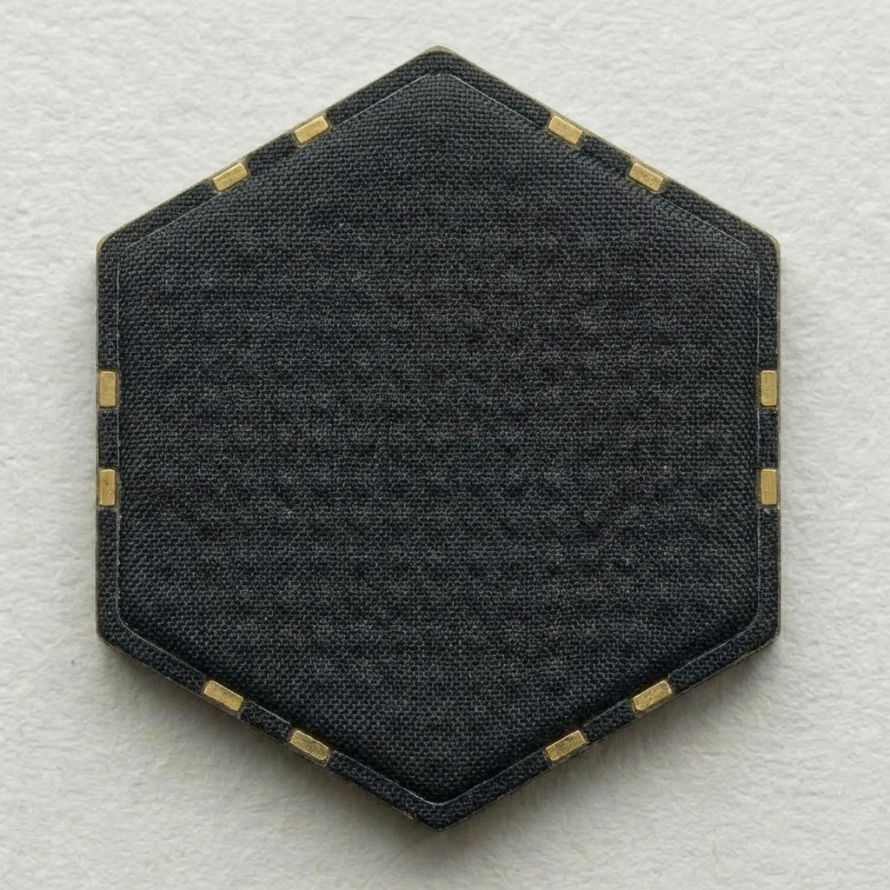
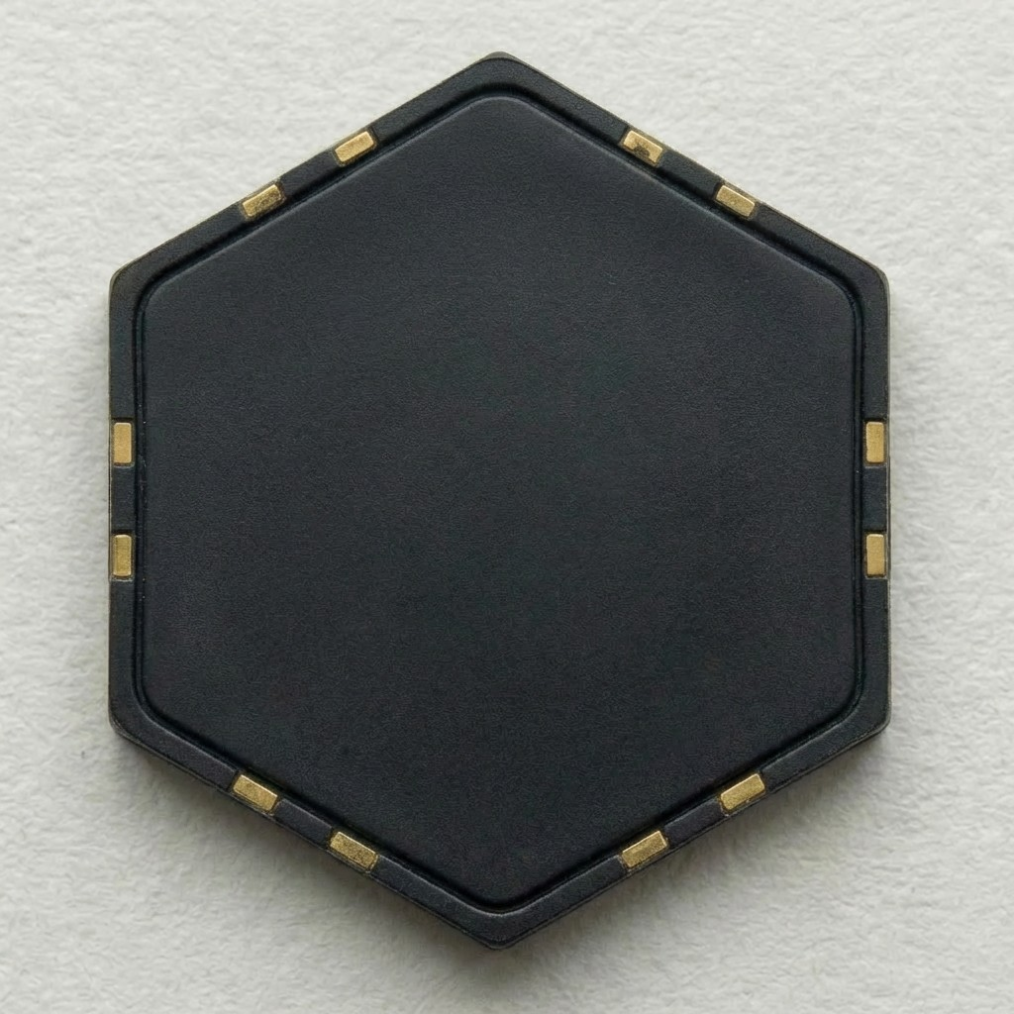
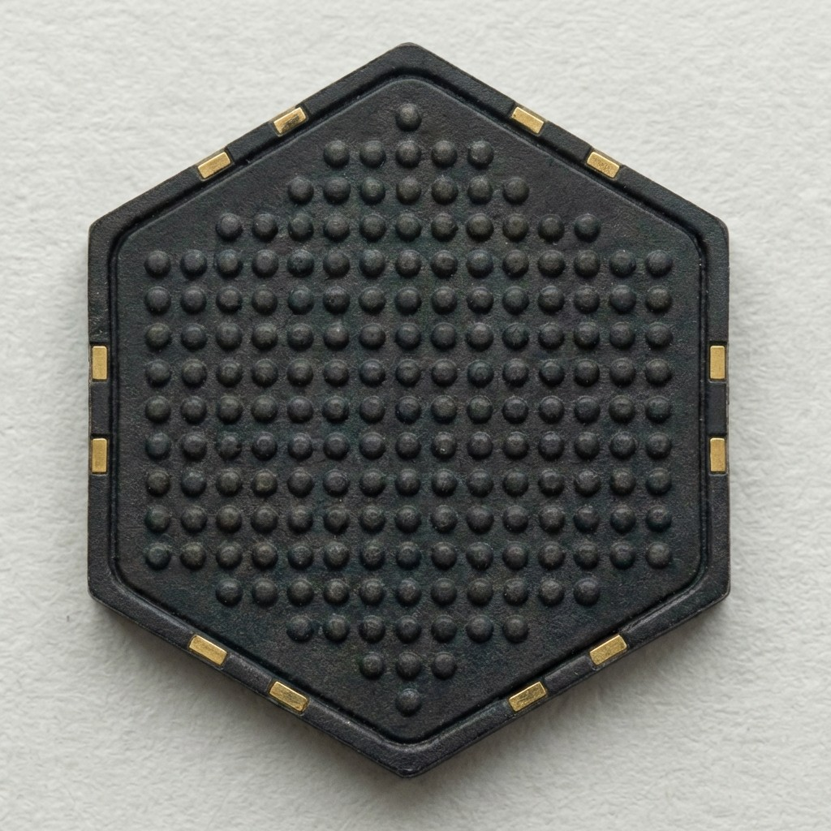

HEX MODULE SERIES
One Standard · Three Variants
H-Series
HAND
B-Series
BODY
F-Series
FOOT
361 sensels/cm²
0.1g sensitivity
500–1000Hz sampling
4–50 sensels/cm²
Standard coverage
Matte silicone finish
Reinforced TPU
200k+ cycles durability
Heavy-duty build
Force
Textile
Slip Detection
Force Detection
Force
Slip Detection
TACTOSKIN
04/08
All modules feature unified magnetic connector + I2C interface

Slide 5

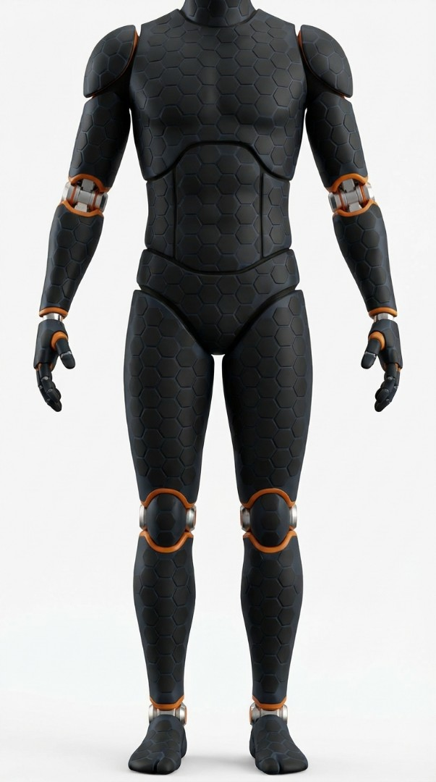


Full Coverage · Accessible Cost
< $3,000
Projected Full-Body Coverage Cost
B-Series body modules (torso + limbs)
~$1,800
H-Series hand modules (×2 gloves)
~$800
F-Series foot modules (×2)
~$400
Total Target
< $3,000 / unit
Designed for volume manufacturing from day one.
TACTOSKIN
05/08

Slide 6
Touch Data: The Next Training Frontier
"
Video gave robots eyes.
Touch will give robots judgment.
🤲
📊
🤖
Human-Generated
Training Data
Standardized
Touch Format
Robot Capability
Leap
DATA
Humans wear the glove to perform real tasks, generating labeled tactile datasets for robot learning.
Touch Pixel — the atomic unit of tactile data that enables seamless cross-platform AI model training.
With tactile data, robots learn to handle eggs, thread needles, and detect surface textures — tasks video alone cannot teach.
No standardized touch data format exists today. Why can’t we do one.
TACTOSKIN
06/08

Slide 7




Seed Round · $1.5M
Key Milestones
$1.5M
2025 Q3
Working Prototype Complete
2025 Q4
First OEM Pilot Deployed
2027 Q4
60%
25%
15%
Break-even Point Reached
Team
Prototype
IP & Legal
Core Engineering + BD
MVP Hardware Dev
Patent Filing
tactoskin.com
TACTOSKIN
07/08

Slide 8
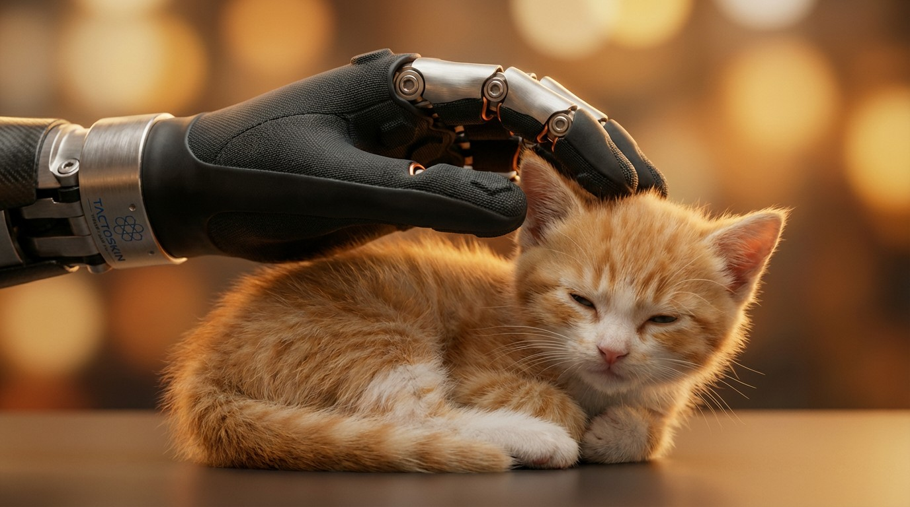

Precision Beyond Vision
Delicate enough to feel what cameras cannot see
TACTOSKIN
Let's build the sense of touch, together.
08/08

